Slide 1


Disrupting the online shopping landscape
SimplyRetain
SimplyRetain
Fabrikam, Inc.
A new way to engage with customers from across the globe.

Slide 2


Attrition: The Problem
$11B
Cost
Invaluable
Loss
Cost of attrition is twice the cost of retention
Most precious assets of the company
As per McKinsey 2016 report

Slide 3
Research Reports’ Statistics
Millennials turnover due to engagement $30,5 billion cost US economy
Source: Gallop report
Staffing: 352%(Source: American Staffing Association)
Hotels: 60-300% (Source: CHA International)
Supermarkets: 100%(Source: Small Business Chronicle)
Retail: 59% (Source: Small Business Chronicle)
Total employee turnover in 2016 across industries was close to 18%.
Average 11 Billion loss
Source: Altura Consulting Group, 2017
Source: Mc Kinsey Report

Slide 4
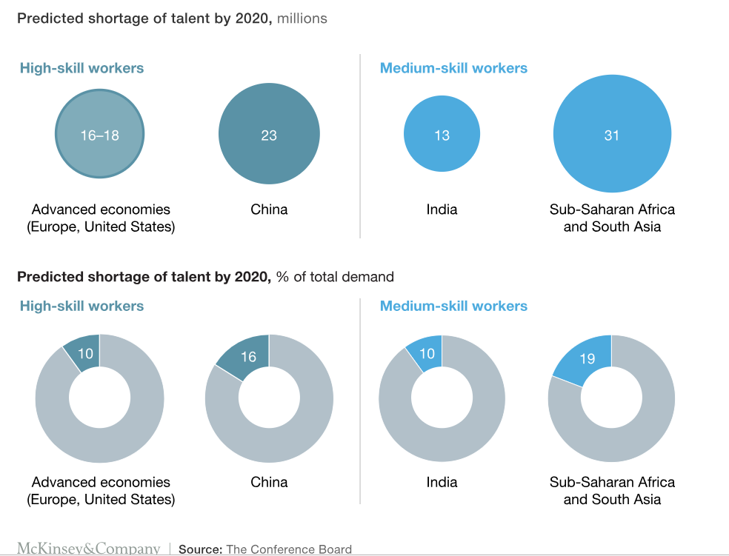
Almost one 3rd of Senior leaders feel talent as major challenge

Slide 5
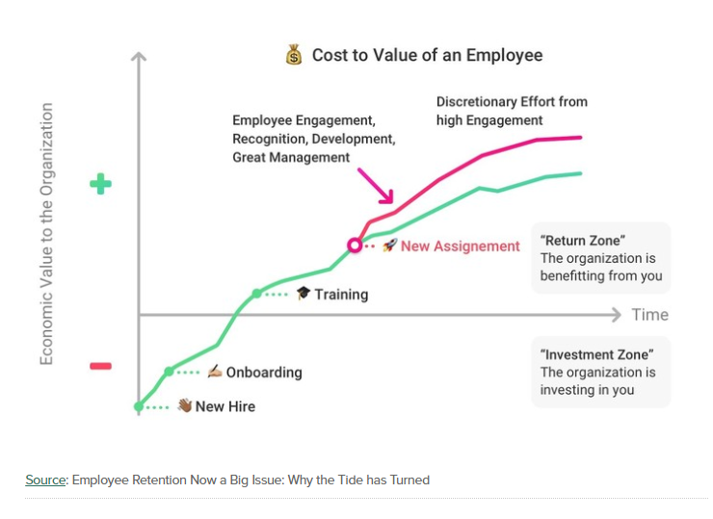
Cost of Attrition
Separation and Dismissal Costs
Absorption cost
Job advertisement
Time and effort for interviews
Employee not joining
Joining bonus
Relocation cost
Training costs
Lower production initially
Administrative costs
Departure interviews
Severance payments
Exemption costs
Costs for loss of performance
Increased absenteeism
Scrap production
Work delay

Slide 6
Reasons for Attrition – Community/Market level
Birth rate/Life Expectancy:
Low birth rate: 550,000 newborns/year by 2060
Increased life expectancy:
Men: from 78 to 87
Women: from 83 to 90
Persons of working age from
20 to 64: from 49.2 (2013) to
38 million (2060)
Analytics skill gap:
USA
Lack of 140,000 to 190,000 employees with advanced
analytical skills and 1.5 million managers + analysts with the knowledge how to use advanced analytics to make effective decisions
Germany
Loss of €30bn due to shortage of
440,000 skilled workers
INDIA:
$1.97 trillion dollar GDP growth is at risk over next decade due to lack of right talent
Source: McKinsey Global Institute, 2011, S.10
Source: Accenture report
Notes:
Euroupe
Poaching from competitor due to lack of right talent

Slide 7
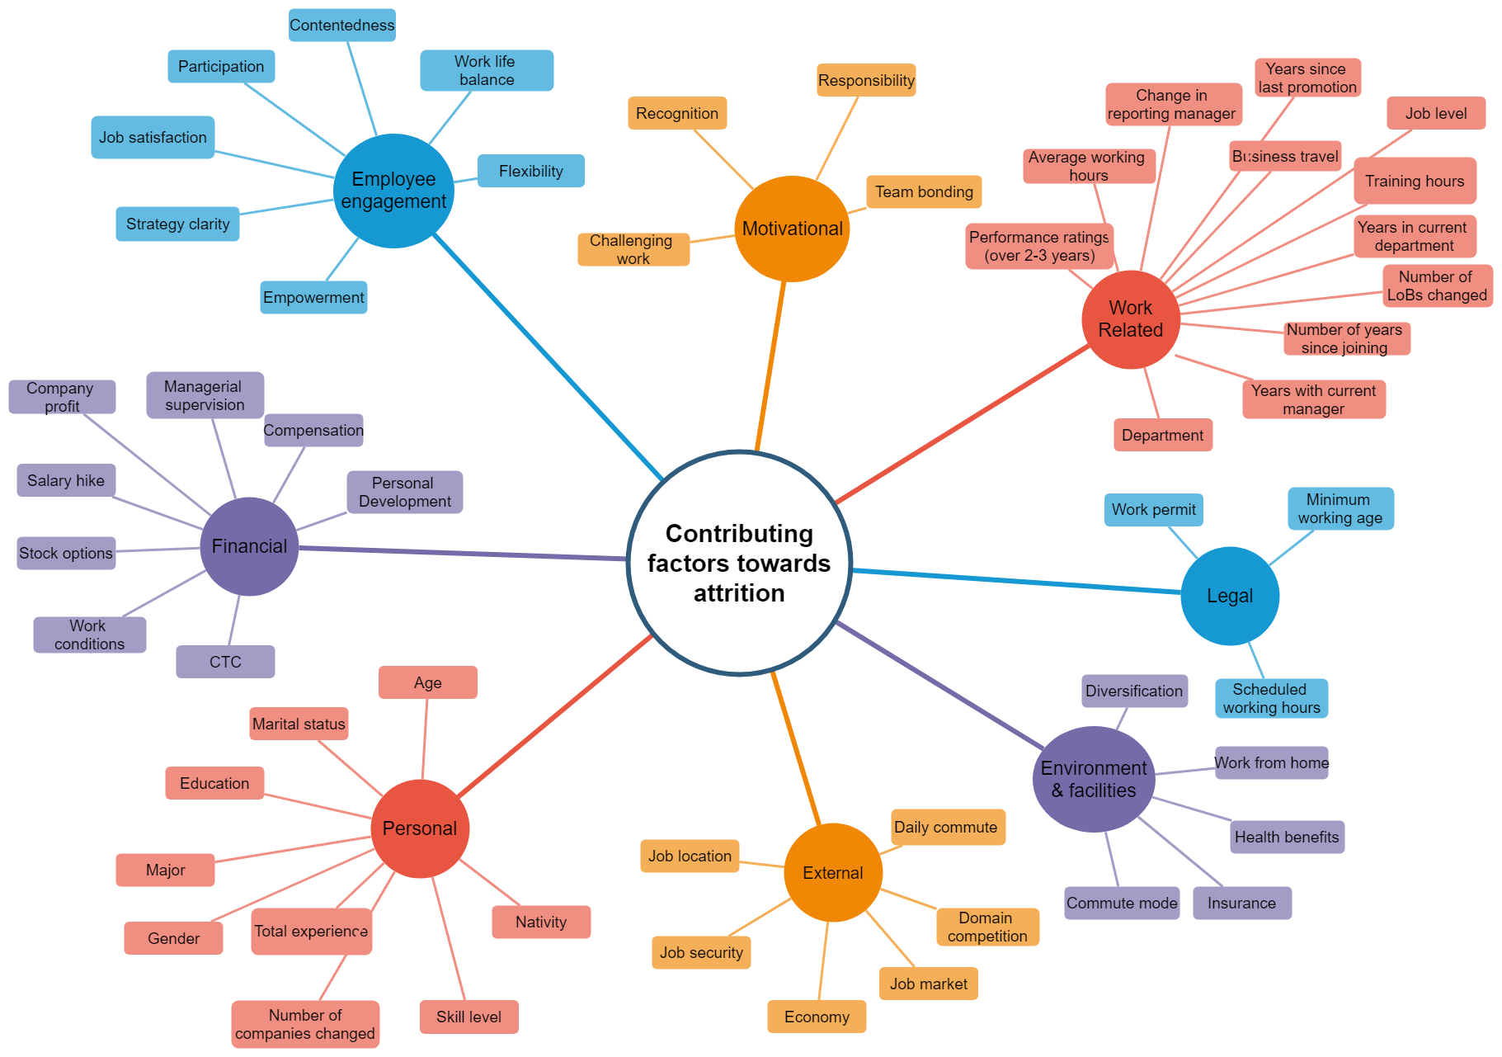
Reasons for Attrition – Individual level
Notes:
Europe
Poaching from competitor due to lack of right talent

Slide 8




Our Solution
Identify
Recommend
Monitor
Get the early warnings that might lead to attrition
Give suggestions to prevent it
Monitor the action by the management
We identify the early signs of attrition and help overcoming them by recommending actions to the management

Slide 9
Model Flow
Feedback
loop
Data extraction from multiple sources.
Knowledge base creation of general market trends and HR policies.
Relevant features are extracted and model is trained on it.
Model identifies early signs that may lead to attrition.
Based upon the early signs and knowledge base, recommender engine suggests corresponding actions to be taken to avoid attrition.
This action may/may not be taken by the manager. In each case we monitor the decision.
Enacted employee details are again recorded in our corpus via feedback loop, thus enriching our data.
Identifying early signs (eg: GenX+multiple years in current role)
Recommend actions (eg: offer promotion)
Random forest,
decision trees, NLP
Similarity inferences, NLP, Sentiment analysis
Knowledge Base
Action upon the given recommendation
Feature engineering, data preparation, model building
Enacted employee goes into the dataset; hence enriching the data
HR policies from
research reports
Extracted data (trends, behavioral data)
Employee specific data (eg: Payroll, Employee Central, Performance Rating)
Answers to custom questions (eg: How would you rate your manager?, VoW)
General trends in industries (eg: market analysis, job market)
Sentiment (eg: #ilovemyjob, #Resume)
HR
(eg:SFSF)
Surveys
(eg:Hewiit)
Reports
(eg: HBR, McKinsey)
Social Media
(eg: LinkedIn)

Slide 10
Personas HR VP
Mary
Joe has been a HR VP for large company for almost 10 years. His main job is keep the business going with right talent and people at right jobs. He manages 5-6 teams. He has regular follow up meetings with people managers to understand team requirements and inform company policies
Ensure business runs normal
Teams are up to date with required right talent
Employee are motivated with different rewards and polices
Constant attrition
Change management
Employee engagement
Not able keep track of happening in different teams
Early signals of employee leaving
How are the different rewards and policies working ?
Planning and development of the right talent based on company strategy
Goals
Requirements
Anxieties

Slide 11
Customer Segment
HR Jobs:
Employee lifecycle
hiring,
attracting,
motivating,
retaining
Rewards and Benefits
Deriving Statutory policies
Understand the teams requirements
Gains:
Save time and spend time with meeting individuals
Bring unbiased transparency to Resource planning
Insights to Policies being rolled out
Pain Points
Talent war
Employee retention
Employee engagement

Slide 12
Value proposition
Pain relievers:
Better insight into resources & polices being implemented
Lower risk of missing commitments
Maintain brand and attract talent
One source of truth across payroll, leave management
Products and Services:
Alert management with early signal of attrition likelihood
Usage of employee benefits
Give insights who are critical to organization
Gain creators:
Retain talent
Retention management
Resource planning
Employee engagement

Slide 13
Value Proposition
As an ABC company , we have created a product Simply Retain for HR VP ‘s and People managers that results in
Help in proper Resource planning
Work on the feedback of policies
Save time to spend more time with people

Slide 14
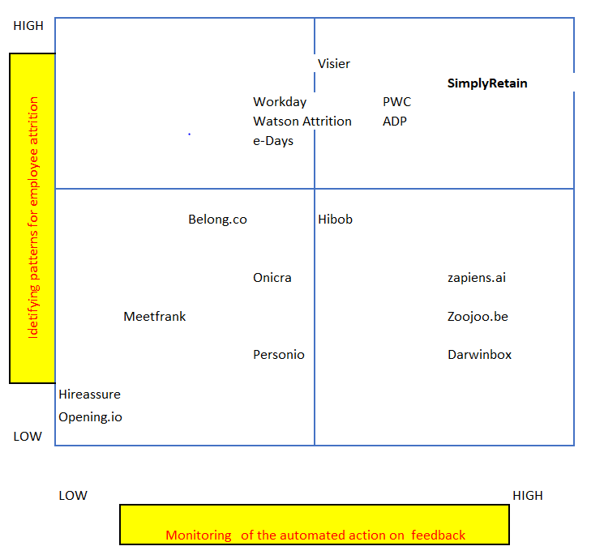
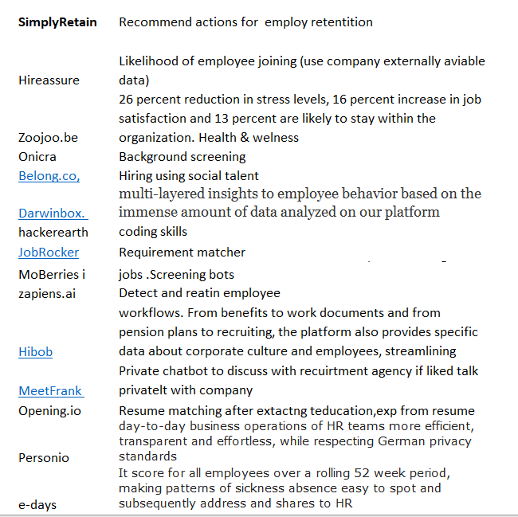
Competitive Analysis
Notes:
In short we have decided that we take most common information available today in HR and from surveys so that companies can start in fermium model when sold with SFSF or what ever HR product companies today they have. And once the companies start asking questions , we can customize to their company specific environment and accordingly improve the product to their specific needs .

Slide 15
AI in HR
Identifying at-risk talent through attrition modeling (25%)
Modeling our talent pipeline (22%)
Predicting high-performing recruits (18%)
Sourcing best-fit candidates with resume analysis (15%)
Forbes report

Slide 16
Feedback
Open Questions:
GDPR
Does only Attrition management make a Unicorn company?
Does Simply Retain help me understand rewards & company policies are working ?
Does Diversity is taken care ?
Change management
Different generations can work together.
Positives:
Would love to have this kind of product
Planning requirement
Alert on early signal help talk to individual
Talent shortage
Poaching
Cost :The only way hire somebody to take them away from somebody and raise our wages and they raise their wages .

Slide 17
Addressing GDPR
Auto pilot mode
Solution based on Anonymized data
Custom solutions for enterprise who share data

Slide 18
Scope of MVP (Auto Pilot)
Upload of Employee attrition data till 2017 in excel/csv.
Simply retain would automatically
Divide the data to train & test
Find categorical & numerical variables
Do feature Engineering based on target variable
Train & Test
Upload the latest data without employee attrition data
Simply retain would give
Insights to different people activities
Early signals of people leaving

Slide 19
Work on Feedback
Training data
Workforce trends based on population trends , diversity
Feedback to management on Employee benefits
Organization network analysis ( Slack, Microsoft teams, Jam,Email metadata)

Slide 20
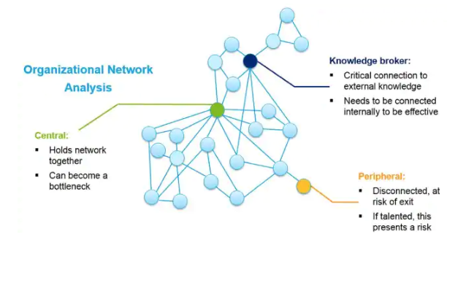
More Insights From Organization Network Data
Source:Deloitte

Slide 21
Our Team
Suresh Pasumarthi
Dr. Shiva Prasad Nayak
Aditya
Idea Owner
Product management (10+)
ML/AI Enthusiast
Worked in Analytics and Banking, Energy Industries
Love to explore future trends and likes Market research
Enjoy looking for opportunities by observing and understanding customer problem
Idea Architect/Designer
Development Architect (11+)
Data Scientist
Sun Certified Enterprise Architect (SCEA)
Java, J2EE, JavaScript, Node.js, Python Expert
Have Patents and International Publications
Worked in Analytics, BI, SCM, Warehouse_Management, Inventory_Management, Logistics and Insurance domains
Love/enjoy to architect, design and code machine learning problems and upskill myself on latest trends and technologies.
Feature engineering/ full stack development
Sound Mathematics and Data Science background
Interested in inter-diciplinary (cognition, vision, art) ML research
Enjoy problem solving, studying/building end to end business processes

