Slide 1
Evaluation of Parallel Eccentricity Estimation
Saravana Prabhu Ramasamy
Mugunthan Krishnan

Slide 2
An Evaluation of Parallel Eccentricity Estimation Algorithms on Undirected Real-World Graphs
https://dl.acm.org/doi/10.1145/2783258.2783333
Author Julian Shun

Slide 3
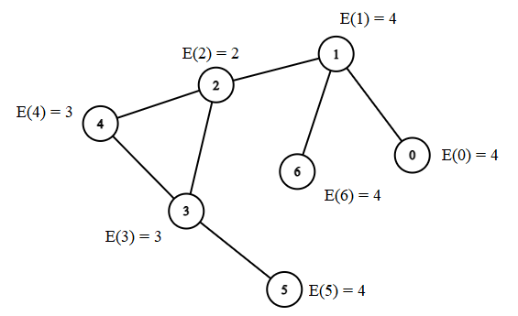
Eccentricity
The eccentricity of a vertex - the largest distance from the vertex to any other reachable vertex.
Julian Shun - Undirected, unweighted graph.
Graph connectivity, diameter, vertices locality.
Is undirected, weighted graph estimation possible?

Slide 4
Serial BFS-Naive
The distance from vertex i to every other vertex is calculated using a breadth-first search.
The eccentricity is the maximum distance of the computed distances.
Naive non-parallel BFS does not perform well for larger graphs.

Slide 5
Julian Shun’s Approach
MultipleBFS - kBFS
Multiple BFS run in parallel would not give expected results.
Use Double-Sweep
Find the furthest vertices from random vertex.
Run BFS from furthest vertices to give the most accurate result.
Ligra Framework - Lightweight graph processing system for shared memory
Provides graph generators, parallel algorithms for real world graphs.

Slide 6
Parallel k-BFS
Multiple BFS can overlap -> Identify shared work and parallelize
Visited nodes by other process can be visited by another process multiple times.
Unnecessary computation overhead
Goals:
Reduce redundant computation on a Vertex
Reduce visiting the same vertex.

Slide 7
k-BFS - steps
Algorithm has 2 major phases:
Phase-1:
Take k source vertices randomly - frontier.
Compute the distance between each source and other vertices.
The vertices that are newly visited or has maximum distance becomes the new frontier.
Phase-2:
Max eccentricity -> New source to compute the eccentricity estimates to other vertices.
The final eccentricity would be maximum distances of the two sets of eccentricities calculated.
Parallelism
Checking every vertex in the frontier and iterating its every neighbor.

Slide 8
Improving performance - Bit level updates
Each BFS execution assigns a specific bit for the vertex.
Parallel comparison is simplified.
For a 8 parallel BFS execution following would be the bit level modification for each vertex.
Process: 0 value: 1
Process: 1 value: 2
Process: 2 value: 4
Process: 6 value: 64
Process: 4 value: 16
Process: 7 value: 128
Process: 3 value: 8
Process: 5 value: 32

Slide 9
Weighted Graph Assumptions
Eccentricity of a vertex:
is the max(all shortest path distances to other vertices).
is the maximum distance possible to reach other vertices.
Integrated accumulation of weights instead of BFS level distance.
Provides comparatively accurate values for low level parallelization.
Accuracy drops while increasing k BFS(Parallel).
Factors that might result in poor accuracy
Uneven weight distribution involves multiple updates over a vertex.
Parallel BFS performs multiple visits to a visited node due to varying edge distance.

Slide 10
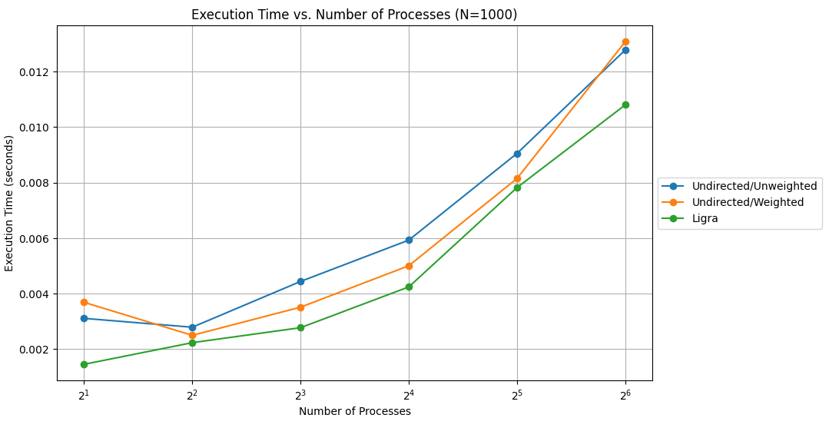
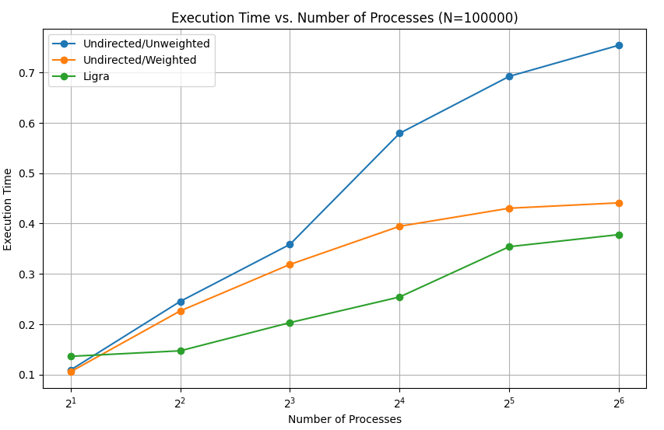
Performance

Slide 11
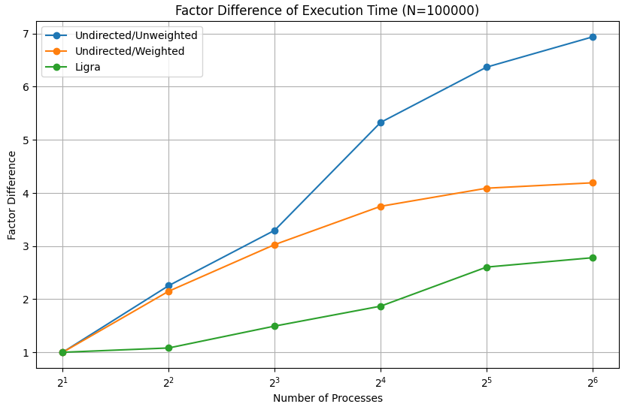
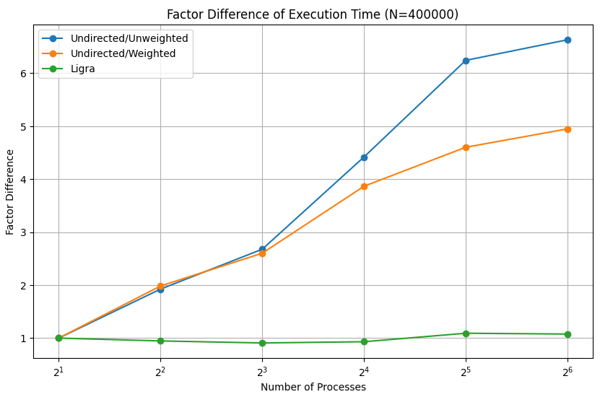
Performance

Slide 12
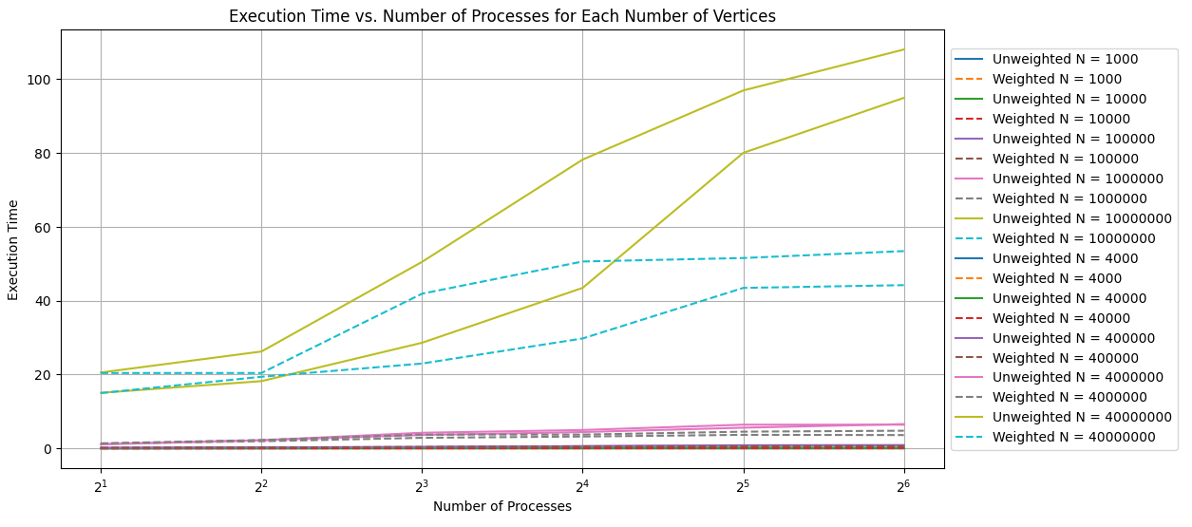
Overall Performance

Slide 13
Evaluation
Computational Intensity:
Visiting each vertex and processing the adjacent vertices.
Number of operations performed for each vertex:
Atomic OR - Assigning specific bit to a vertex for each BFS.
Compare & Swap - Compare and swap old and new values.
C.I = Sum(OR Flops, CAS Flops)/Execution Time
Vertex Skips:
Unweighted - Numerous vertices belong to same BFS level. - More vertex skips.
Weighted - The weights constantly change and needs to be updated. - Less vertex skips.

Slide 14
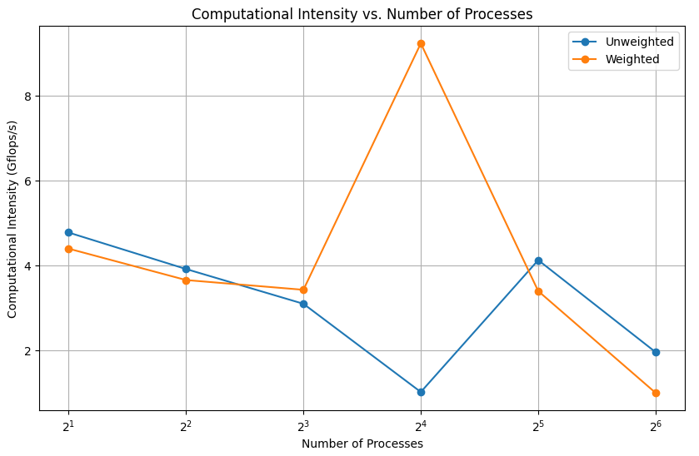
Computational Intensity

Slide 15
Down the road
Identify more sections to parallelize the eccentricity calculation.
Improve performance for weighted and unweighted graphs.
Accuracy validation for larger graphs of more than 100M vertices.

Slide 16
THANK YOU

