Slide 1



A Dataset of Scratch Programs: Scraped, Shaped and Scored
Efthimia Aivaloglou @feniaiv
Felienne Hermans @felienne
Jesús Moreno León @J_MorenoL
Gregorio Robles @gregoriorobles

Slide 2
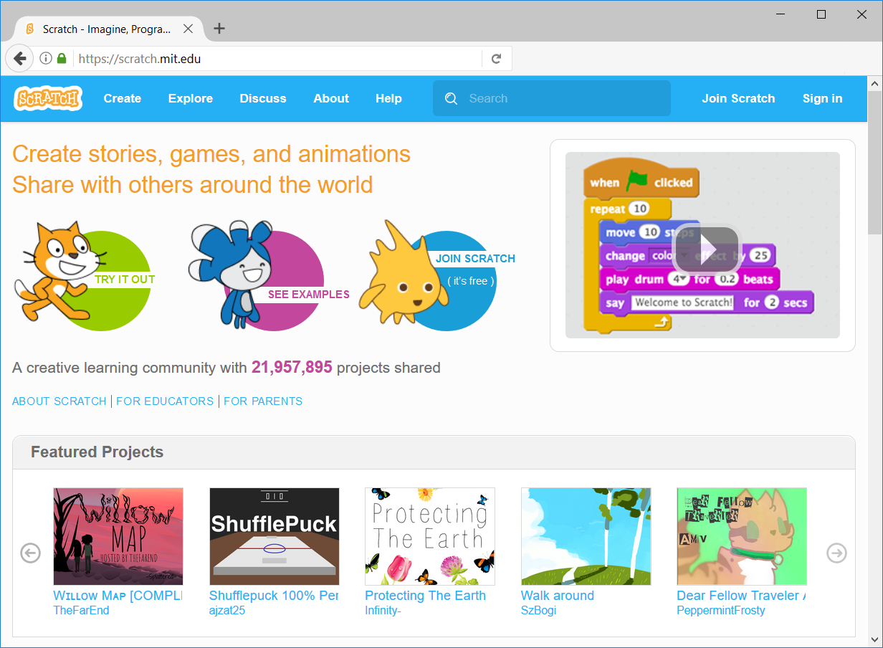

Slide 3
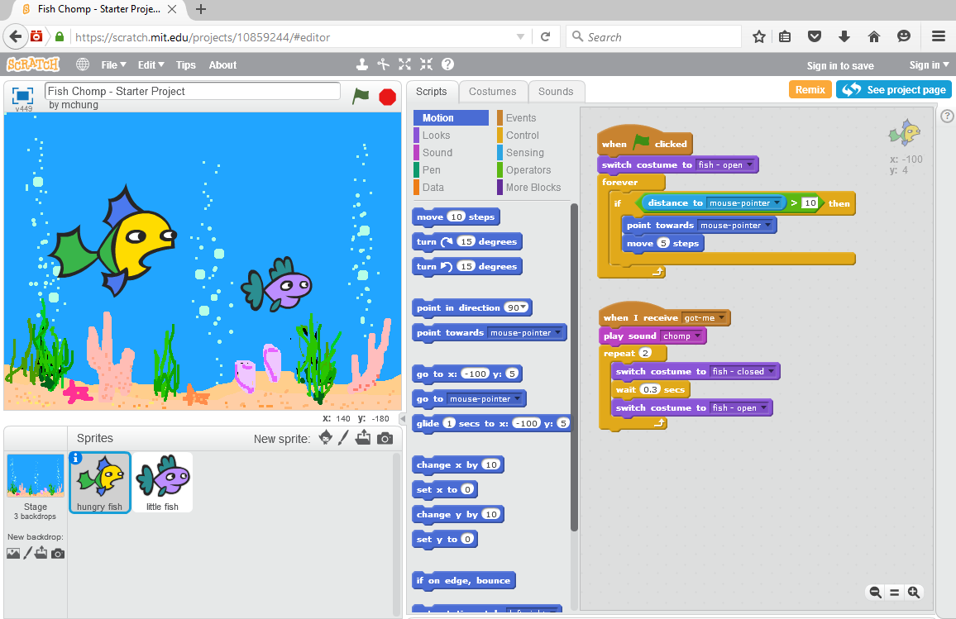
Sprites

Slide 4
Scripts

Slide 5
Categories
Blocks

Slide 6
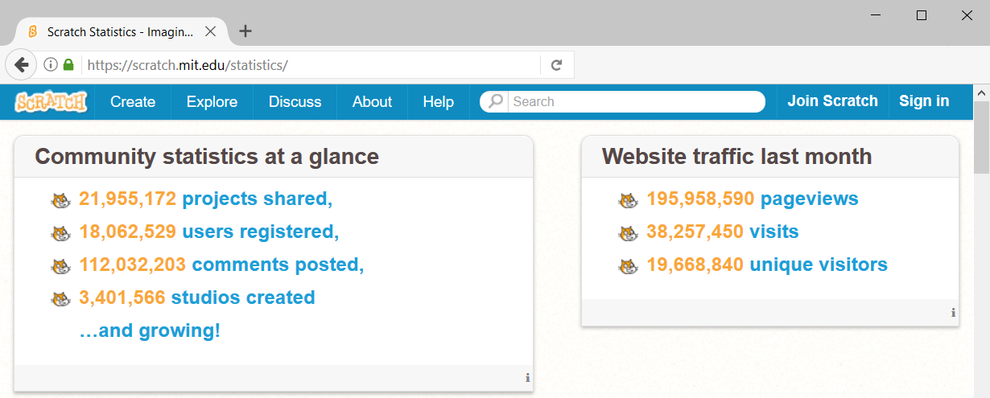

Slide 7

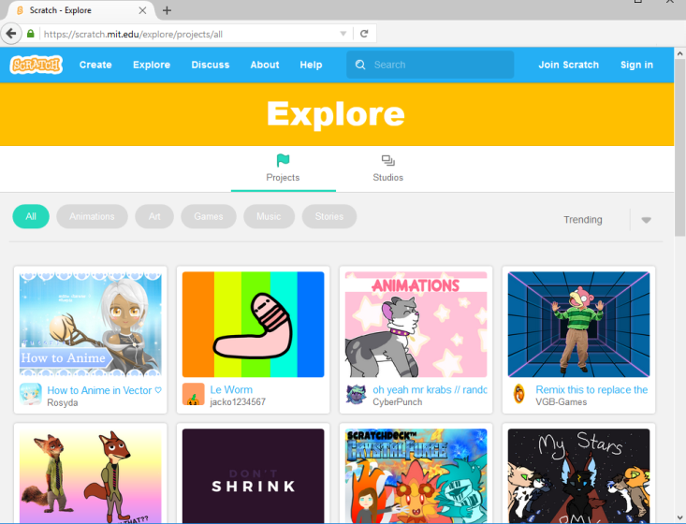
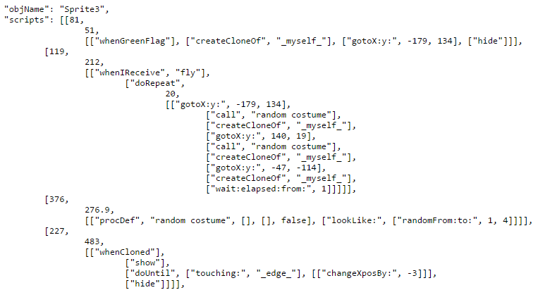
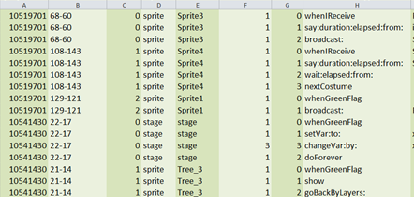
A Dataset of Scratch Programs: Scraped, Shaped and Scored
Scratch web interface
Scrape
JSON files of 250K projects
Parse
CSV files of 247K projects

Slide 8
A Dataset of Scratch Programs: Scraped, Shaped and Scored
Scratch web interface
Available for download!
Scrape
JSON files of 250K projects
Parse
CSV files of 247K projects
Available for download!

Slide 9

A Dataset of Scratch Programs: Scraped, Shaped and Scored
CSV files of 247K projects
Import
Database
Shape

Slide 10
A Dataset of Scratch Programs: Scraped, Shaped and Scored
CSV files of 247K projects
Import
Database
Shape
Available for download!

Slide 12
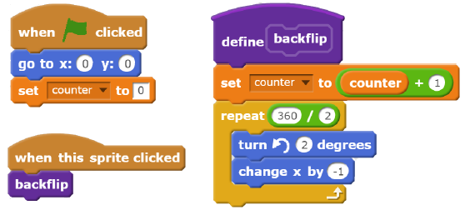
13
1
3
1

Slide 13

A Dataset of Scratch Programs: Scraped, Shaped and Scored
Analyze

Slide 14
mySQL
JSON
SQL Server
250K projects
110K users
4M scripts
204K custom blocks
36M blocks
CSV
https://github.com/TUDelftScratchLab/ScratchDataset

Slide 15
for …
assessing the programming skills that learners develop in Scratch
do they really learn? What?
quality assessment & smell detection
any bad programming habits?
examining the learning progressions of novices
does remixing/experience/xyz help?

