Slide 1


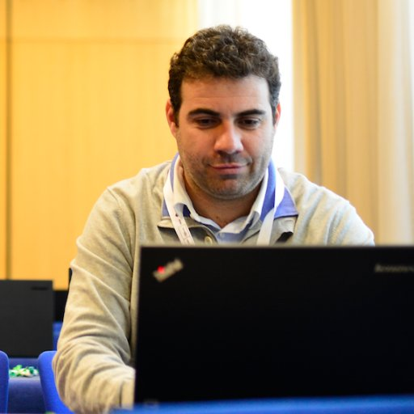




A Dataset of Scratch Programs:
Scraped, Shaped and Scored
Efthimia Aivaloglou
@feniaiv
Felienne Hermans
@felienne
Jesús Moreno León
@J_MorenoL
Gregorio Robles
@gregoriorobles

Slide 2
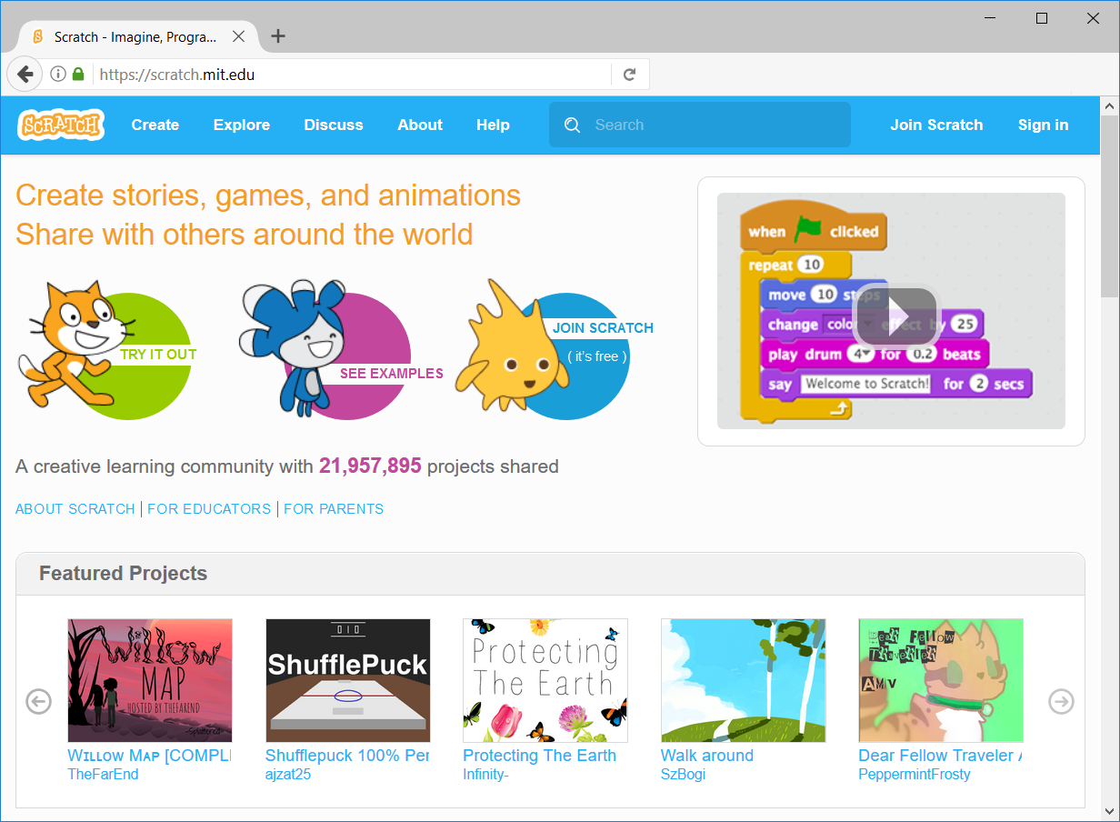
Notes:
<número>

Slide 3
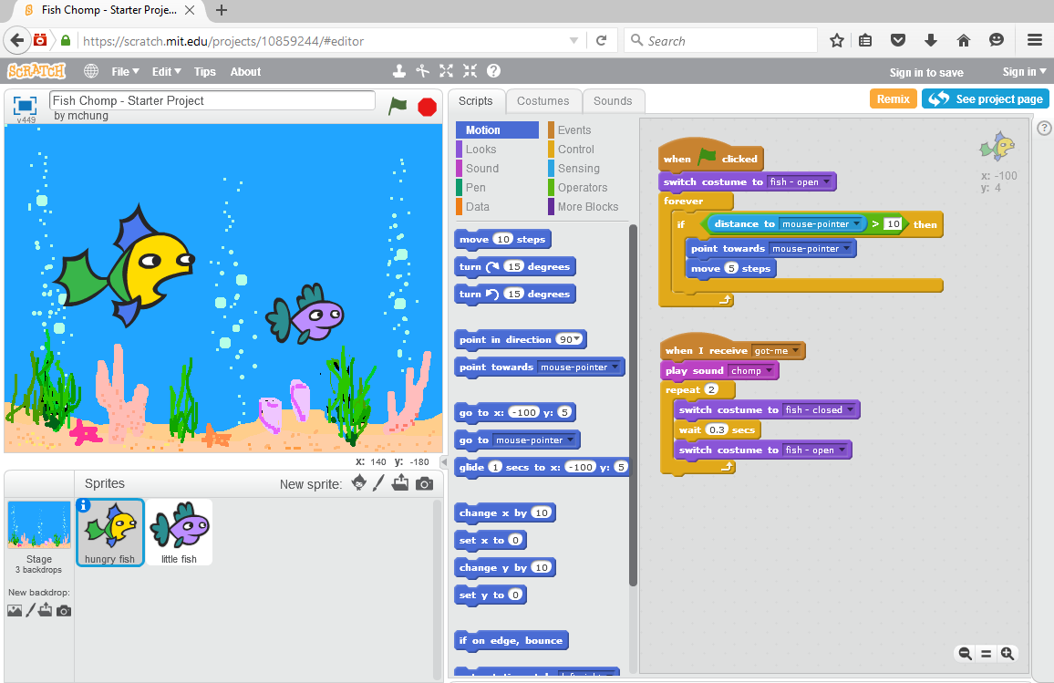
Sprites

Slide 4
Scripts

Slide 5
Categories
Blocks
Notes:
<número>

Slide 6
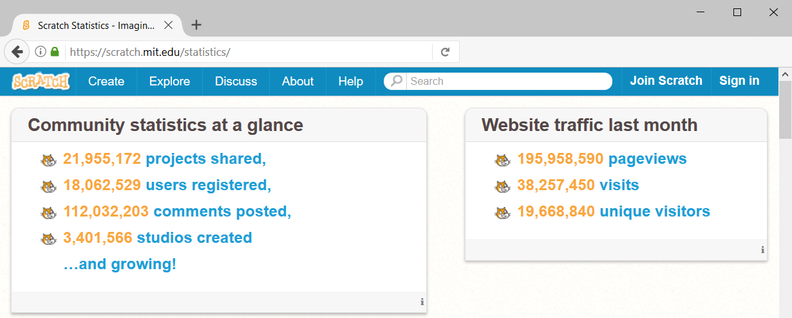

Slide 7

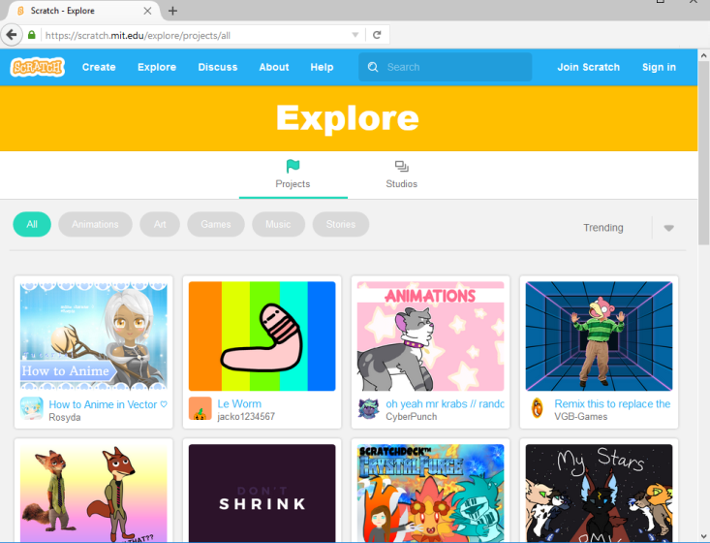
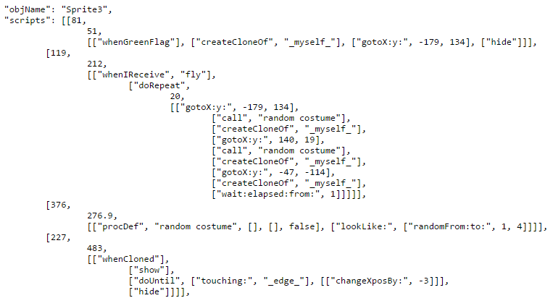
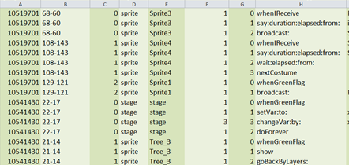
A Dataset of Scratch Programs:
Scraped, Shaped and Scored
Scratch web interface
Scrape
JSON files of 250K projects
Parse
CSV files of 247K projects
Notes:
<número>

Slide 8
A Dataset of Scratch Programs:
Scraped, Shaped and Scored
Scratch web interface
Available for download!
Scrape
JSON files of 250K projects
Parse
Available for download!
CSV files of 247K projects
Notes:
<número>

Slide 9
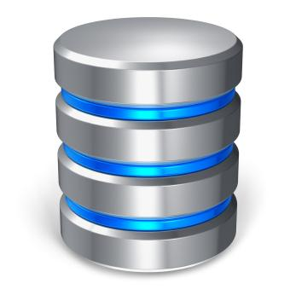
A Dataset of Scratch Programs:
Scraped, Shaped and Scored
CSV files of 247K projects
Import
Database
Shape
Notes:
<número>

Slide 10
A Dataset of Scratch Programs:
Scraped, Shaped and Scored
CSV files of 247K projects
Import
Database
Shape
Available for download!
Notes:
<número>

Slide 11
An example of what you get:
Notes:
<número>

Slide 12
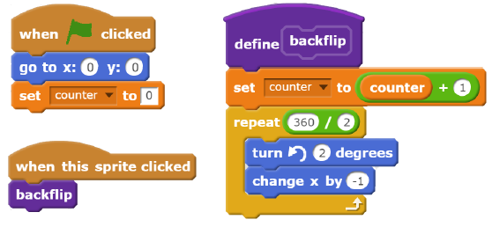
13
1
3
1
Notes:
<número>

Slide 13

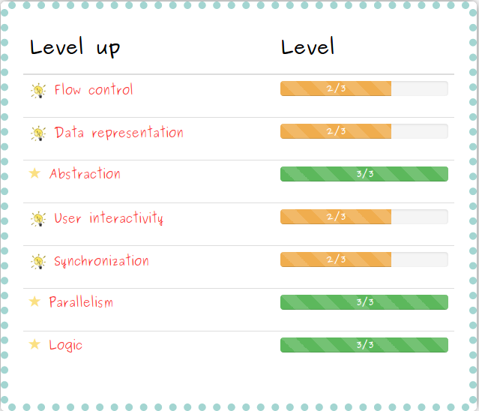
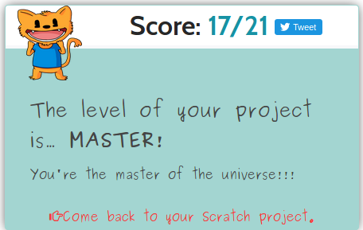
A Dataset of Scratch Programs:
Scraped, Shaped and Scored
Analyze
Notes:
<número>

Slide 14
JSON
SQL
250K projects
110K users
4M scripts
204K custom blocks
36M blocks
CSV
github.com/TUDelftScratchLab/ScratchDataset

Slide 15
Can be used for …
assessing the programming skills that learners develop in Scratch
do they really learn? What?
quality assessment & smell detection
any bad programming habits?
examining the learning progressions of novices
does remixing/experience/xyz help?

Slide 16
JSON
SQL
250K projects
110K users
4M scripts
204K custom blocks
36M blocks
CSV
github.com/TUDelftScratchLab/ScratchDataset

Slide 17
A Dataset of Scratch Programs:
Scraped, Shaped and Scored
Efthimia Aivaloglou
@feniaiv
Felienne Hermans
@felienne
Jesús Moreno León
@J_MorenoL
Gregorio Robles
@gregoriorobles

