Slide 1


A Grammar for Spreadsheet Formulas Evaluated on Two Large Datasets
Efthimia Aivaloglou (e.aivaloglou@tudelft.nl)
David Hoepelman (d.j.hoepelman@student.tudelft.nl)
Felienne Hermans (f.f.j.hermans@tudelft.nl)

Slide 2
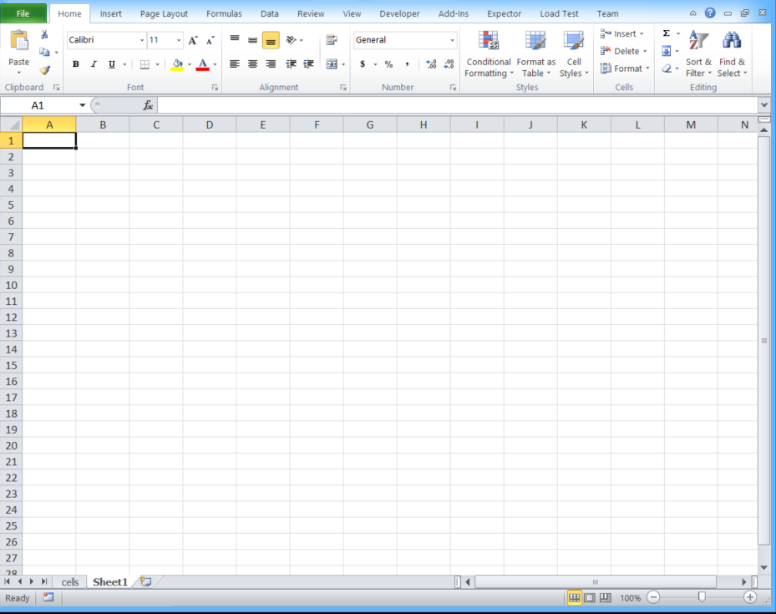
A language that all of us (think we) know
Notes:
The most widespread programming language
# of spreadsheet programmers bigger than # of software programmers

Slide 3


A language that all of us (think we) know
Notes:
The most widespread programming language
# of spreadsheet programmers bigger than # of software programmers

Slide 4
A programming language
...
A1 = SUM(F:F)
A2 = MIN(A1,B1, cells!A1)
C5 = VLOOKUP(A2,H2:K9,2)
Sheet2!A8 = A7 * Sheet1!C5
Sheet3!B2 = IF(Sheet2!A8 >A8,0,1)
…
Calculation trees
Functions
Cell references as variables
Conditional expressions
Turing complete
Notes:
Calculation trees as lines of code
Have found cells with 1000s of transitive precedents
→ Complex programs

Slide 5
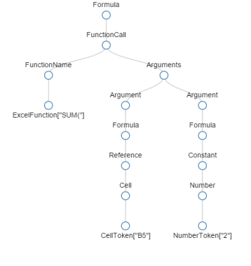
Spreadsheet research
Analysis
Metrics
cell references
functions
operations
fixed numbers
Visualization
Smells
Refactoring
Formula Parser
Formula Strings “=SUM(B5, 2) ”
References B5
Functions SUM
Numbers 2
Notes:
All research involves formula analysis
→ Formula parser to convert Strings to Parse trees

Slide 6
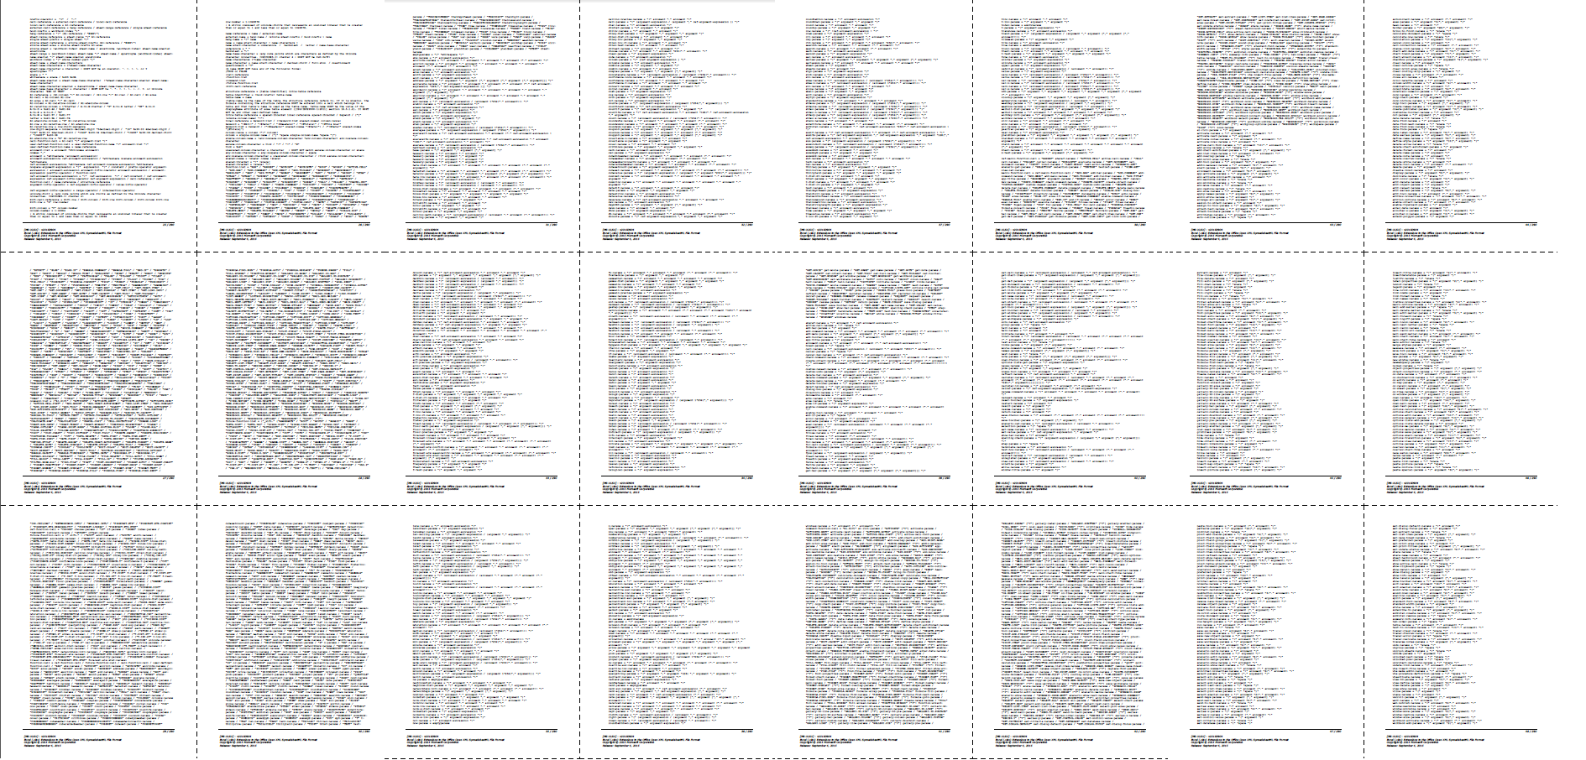
MS official grammar for Excel formulas
Notes:
Surely this grammar serves its purpose: to evaluate cells
But:
Hard to implement using a parser generator
Parse trees not suited for further manipulation and analysis

Slide 7
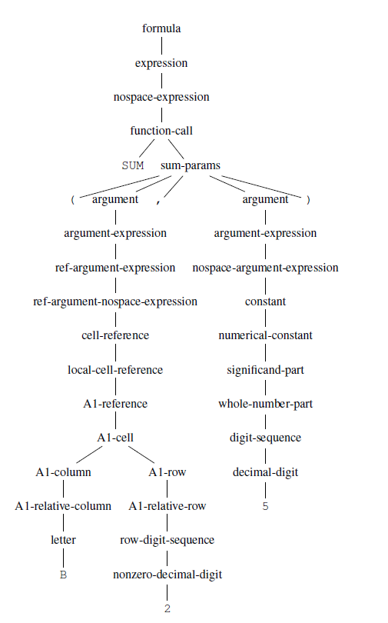
MS official grammar for Excel formulas
SUM(B2, 5)
Notes:
Surely this grammar serves its purpose: to evaluate cells
But:
Hard to implement using a parser generator
Parse trees not suited for further manipulation and analysis

Slide 8
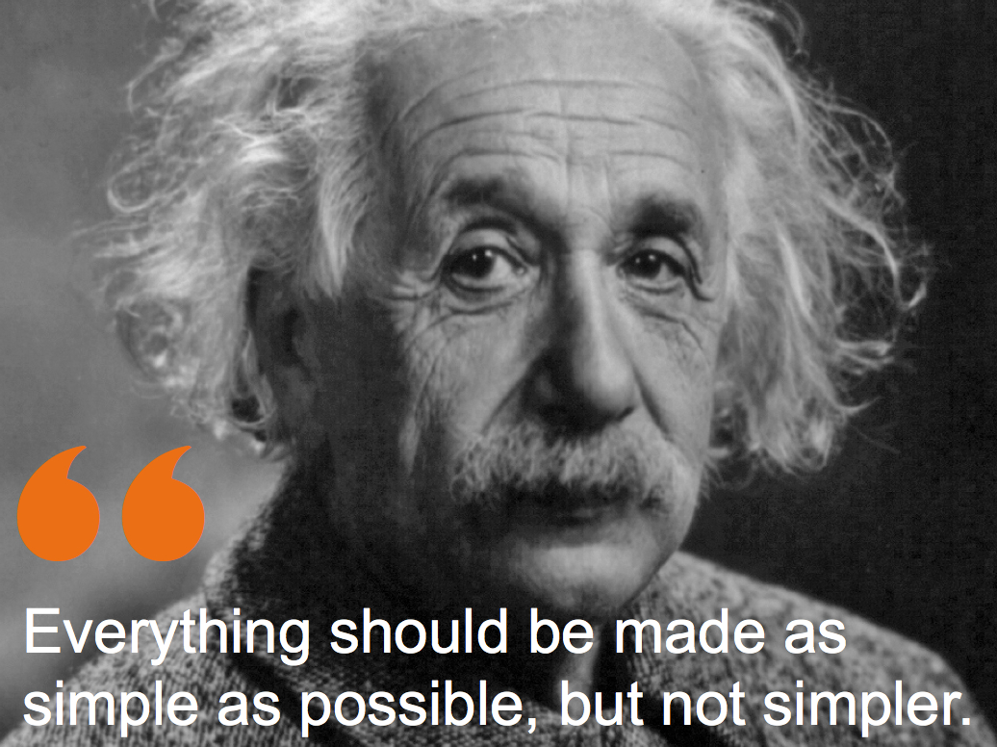

Slide 9

Compactness
Compatibility with the official language
Processable parse trees
Notes:
balance

Slide 10

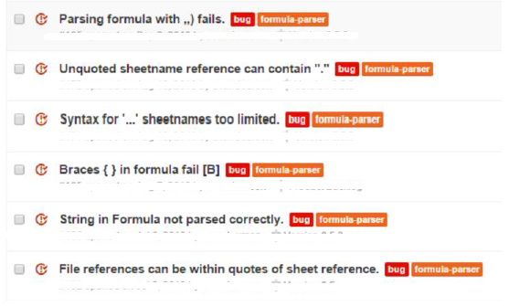
Our approach
Scan/extract formulas
Simple grammar parser
Calculate metrics
Notes:
Iterative process, trial and error
Categorize
Fix
Return
Optimize

Slide 11
Spreadsheets datasets
EUSES
2005
4.498 workbooks
Enron
2004
16.190 workbooks
Notes:
Spreadsheets not open
No spreadsheet repositories
No github for spreadsheet research

Slide 12
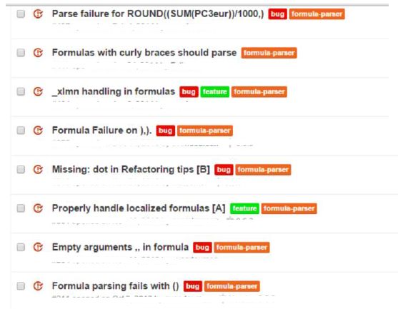
Our approach
A grammar for parsing 99,999% of 1m unique formulas
Scan/extract formulas
not-so simple grammar parser
Simple grammar parser
Calculate metrics
EUSES
Enron
~85
Notes:
Iterative process, trial and error
Categorize
Fix
Return
Optimize
20 million formulas → 1 million unique

Slide 13
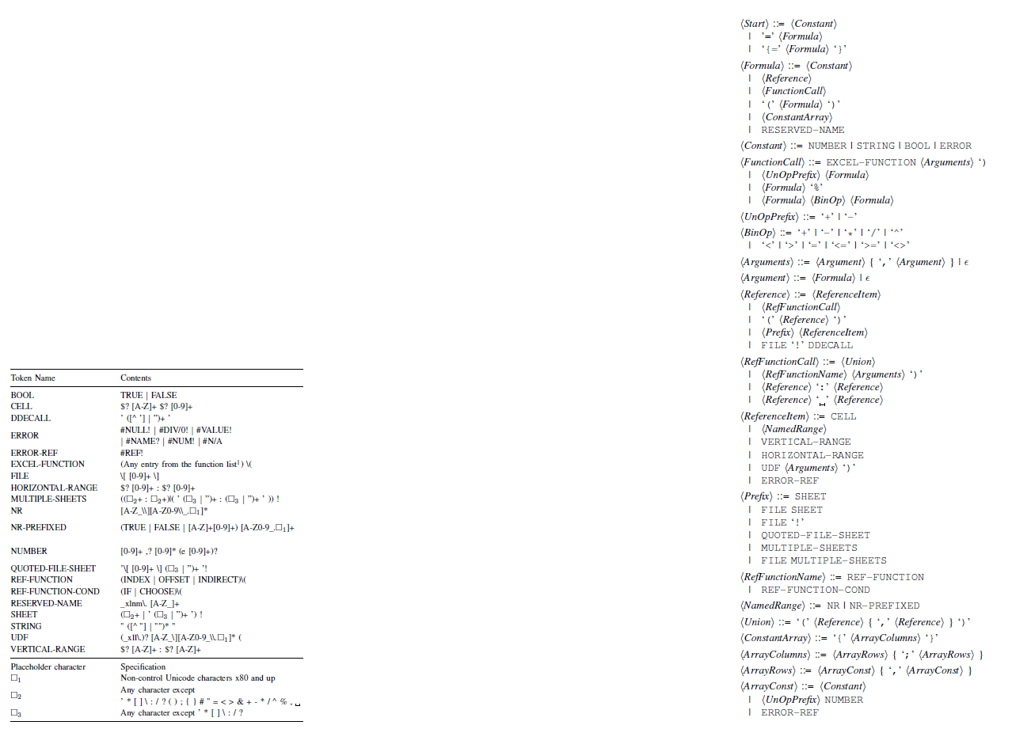
20 lexical tokens
19 production rules

Slide 14
=SUM(B2,5)
Formula
FunctionCall
Arguments
Formula
Formula
Reference
ReferenceItem
Constant
EXCEL-FUNCTION [“SUM(”]
CELL [“B5”]
NUMBER [“5”]
Notes:
Lexical analysis

Slide 15


Implementation & Testing
EUSES
Enron
Pre-processor
~ 20K workbooks
~ 22M formulas
~ 1M unique formulas
=INDEX(1,A2:AD50)
=SUM(A1:B2)
=B1+55%
XLParser
(Irony)
Notes:
preprocessor

Slide 16
99,999% success 1.035.558 parse trees
2 parse errors
=-NOX, Regi =-_SO2, Regi
Notes:
28 errors, 2 legitimate, real errors
Others due to incorrect reading of formulas or corrupt files

Slide 17
Analyzing 22M formulas
=A1
=SUM(A1:A10)
Notes:
Reference function: INDEX, OFFSET, INDIRECT

Slide 18

The rare
10 Unions
=LARGE((A1,A5),1)
15 Constant arrays
=SUM({1,2;3,4}*10)
Notes:
in addition to these constructs being rare, they also require some of the most (grammar) work to support, so that they are prime candidates to ignore

Slide 19
The rare (2)
70 Reserved names
_xlnm.Print_Area
_xlnm.Database
332 External user-defined functions
=[file]!wbname()

Slide 20
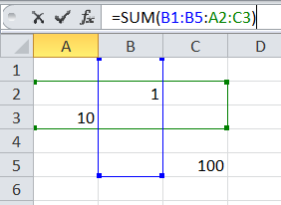

The smelly
SUM(B1:B5:A2:C3) == ?
Notes:
Error prone, lead the user to make mistakes

Slide 21
The smelly
Complex ranges, in 367
SUM(B1:B5:A2:C3) == SUM(A1:D5) (!)
Notes:
Error prone, lead the user to make mistakes

Slide 22
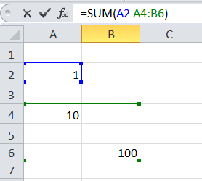

The smelly (2)
A2 A4:B6 == ?
Notes:
Error prone, lead the user to make mistakes

Slide 23
The smelly (2)
Intersection, in 304
A2 A4:B6 == #NULL!
Notes:
Error prone, lead the user to make mistakes

Slide 24
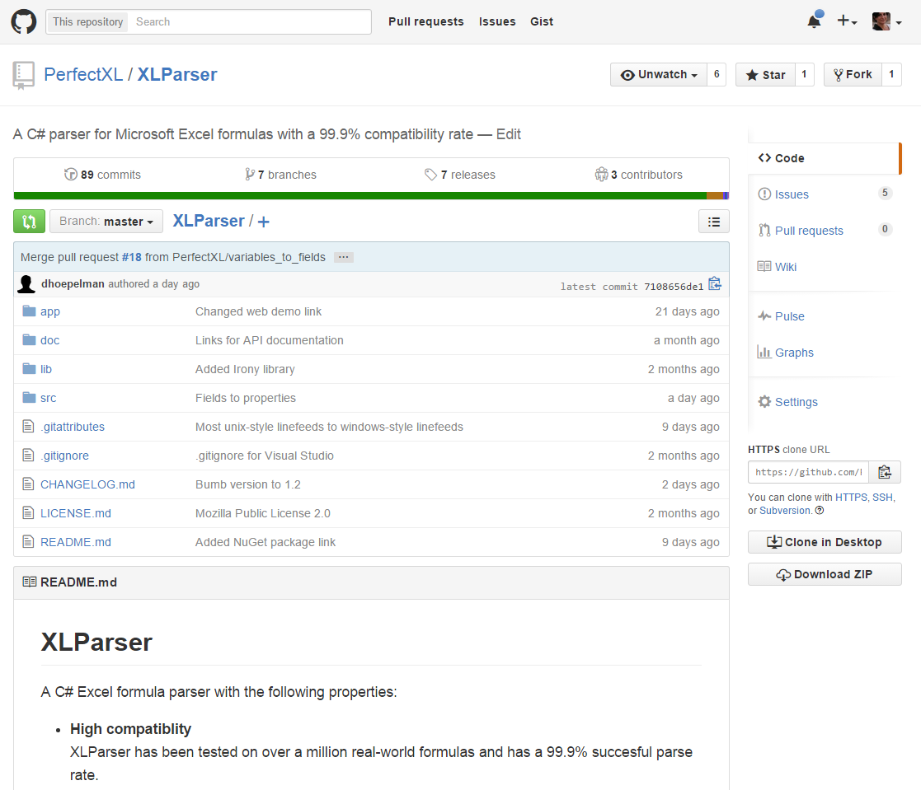
Git Repository
https://github.com/SpreadsheetLab/XLParser

Slide 25
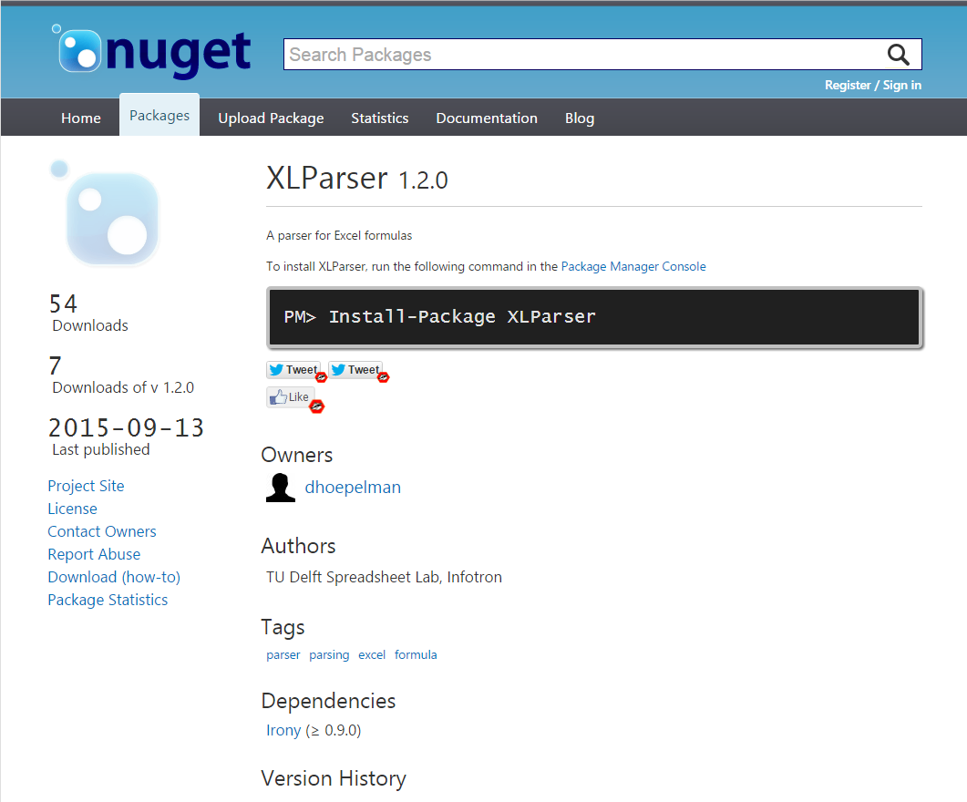
nuget package
https://www.nuget.org/packages/XLParser

Slide 26
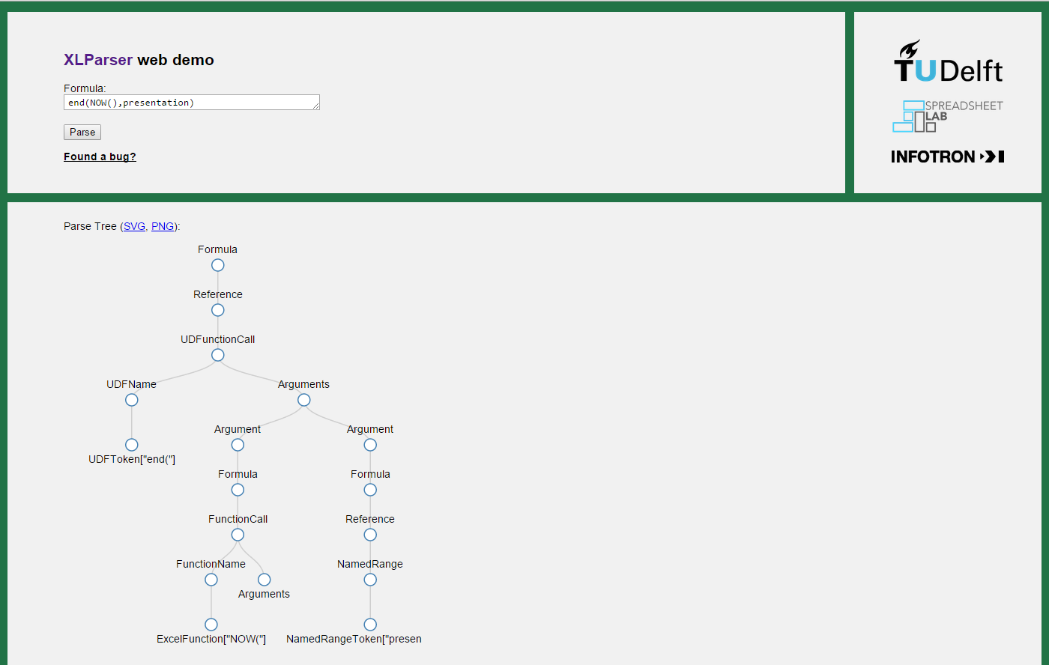
Demo
http://xlparser.perfectxl.nl/demo/

Slide 27
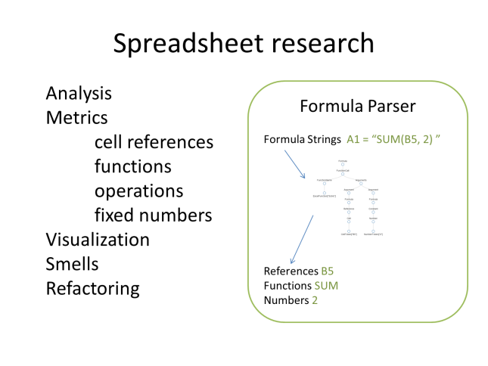
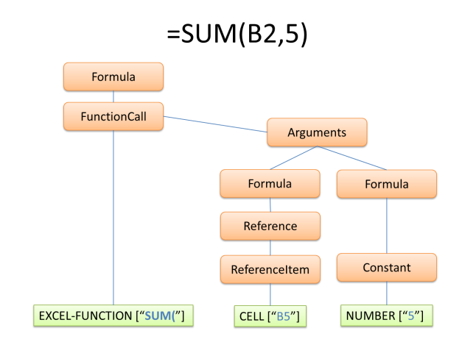
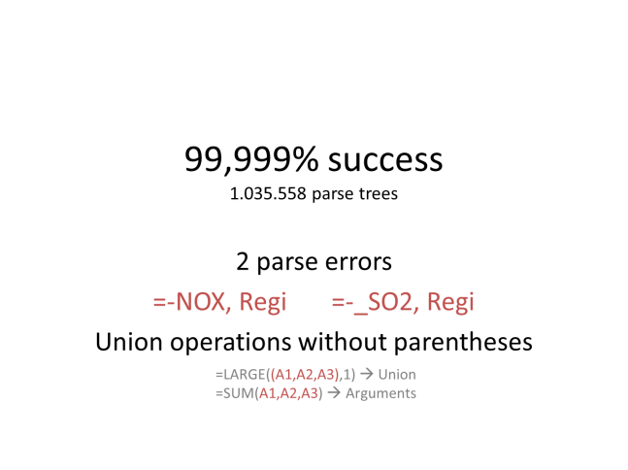
https://github.com/SpreadsheetLab/XLParser
http://xlparser.perfectxl.nl/demo/
Supported with a SCAM travel grant
Thanks to GrammaTech, of Ithaca NY and Microsoft Research, of Redmond WA
Notes:
One thing to take away:
If you want to analyze spreadsheets, there is a parser, use it.
And if there is a problem, tell us! We need feedback to improve it.

Slide 29
Lexical analysis (1)
Constants
NUMBER | 12 1.34 7.67e+24 (dates too!)
STRING | “mpla” “mp””la”
BOOL | TRUE FALSE
ERROR | #NULL! #N/A #DIV/0!
Functions
EXCEL-FUNCTION | SUM( MIN( …
REF-FUNCTION | INDEX( OFFSET( INDIRECT(
REF-FUNCTION-COND | IF( CHOOSE(
UDF | myFunction( _xll.myFunction(
Notes:
What do formulas consist of?
20 lexical tokes
In the paper, their identification patterns in the regular expression language
Along with their priorities

Slide 30
Lexical analysis (2)
References
CELL | A1 $BH12 $AZ$33
NR | myNamedRange \range.12
HORIZONTAL-RANGE | 2:3 2:$3
VERTICAL-RANGE | A:C $A:$C
ERROR-REF | #REF!
RESERVED-NAME | _xlnm.Print_Area
External References
SHEET | Sheet1! 'Sheet'' 1'!
MULTIPLE-SHEETS | Sheet1:Sheet2! 'Sheet 1:Sheet2'!A1
FILE | [1]
QUOTED-FILE-SHEET | '[2]Sheet1'!
DDECALL | Program|Topic!’Arguments’
Notes:
Dynamic data exchange link
Internal representation of external file references is numeric

Slide 31
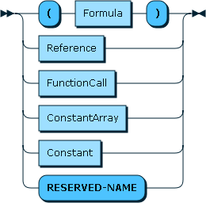
Syntactical analysis: Formula rule
=(A1 + 3)
=Sheet1!B2
=SUM(A2:B4)
={2,3;4,5}
=5
=_xlnm.Print_Area
Notes:
Next: Constant

Slide 32
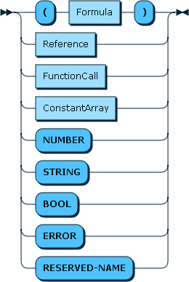
Syntactical analysis: Formula rule
=5
=“String”
=TRUE
=#DIV/0!
Notes:
Constants
Next: ConstantArray

Slide 33
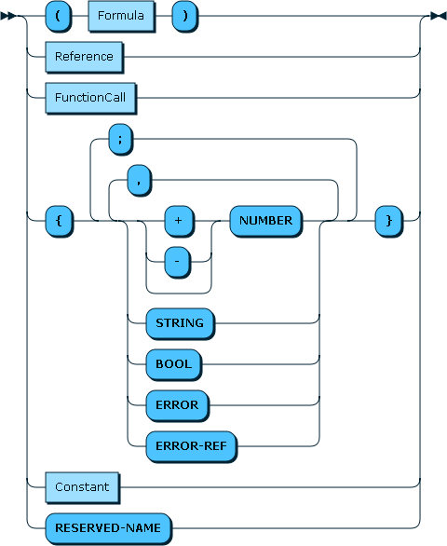
Syntactical analysis: Formula rule
={1;2;3;4;5}
=SUM({1,2,3}*10)
={“ONE”,1;”TWO”,2}
Notes:
Constants Arrays + CTRL+SHIFT+ENTER
Next: FunctionCall

Slide 34
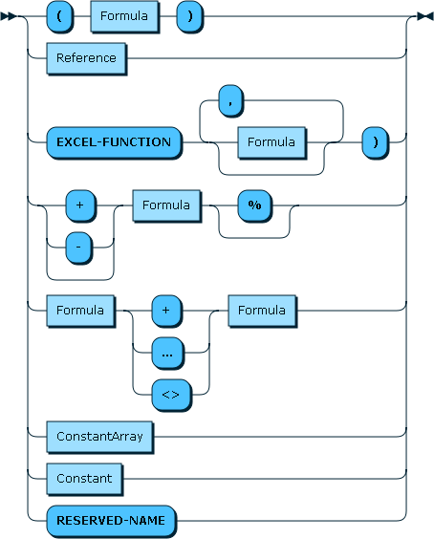
Syntactical analysis: Formula rule
=SUM(A1,A5)
=SUM(,,A2)
=5%
=5+A3
=A4>=A5
Notes:
FunctionCall
Next: Reference Rule

Slide 35
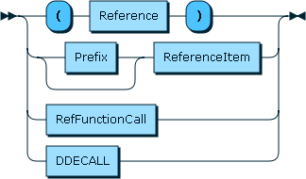
Syntactical analysis: Reference rule
=(A1)
=Sheet1!A1
=INDEX(A1:A10,5)
Program|Topic!’Arguments’
Notes:
FunctionCall
Next: Prefix and ReferenceItem

Slide 36
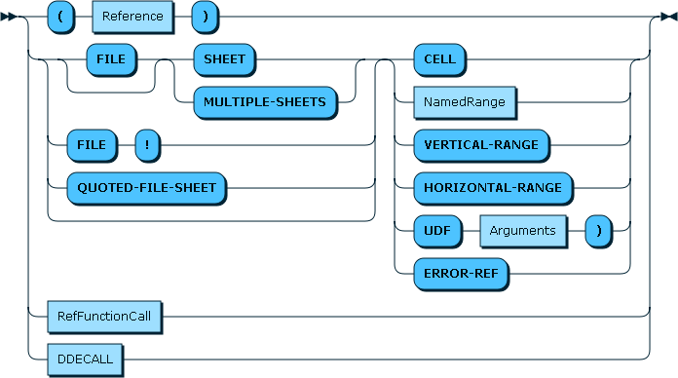
Syntactical analysis: Reference rule
=Sh1:Sh4!A3
=[1]namedRange
=C:$D
=Sheet2!3:$4
=[1]!myUdf(A3,A2)
=‘[1]my sheet’!#REF!
Notes:
Prefix + referenceItem
Next: RefFunctionCall

Slide 37
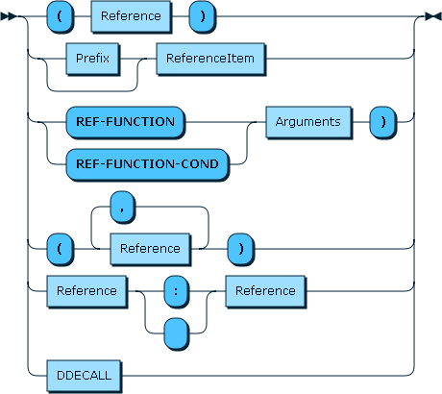
Syntactical analysis: Reference rule
=INDEX(A1:A5,2)
=SUM(IF(TRUE,B1,C1):D4)
=LARGE((A1,A2,A3),1)*
=SUM(A1:A5:B4)
=B1:B10 A5:C5
Notes:
RefFunctionCall
3 operatos for ranges:
Union, range, intersection
Unions only within parentheses: the only known compatibility breach. Without (), undisguisable from arguments, reduce reduce conflict on comma

