Slide 1

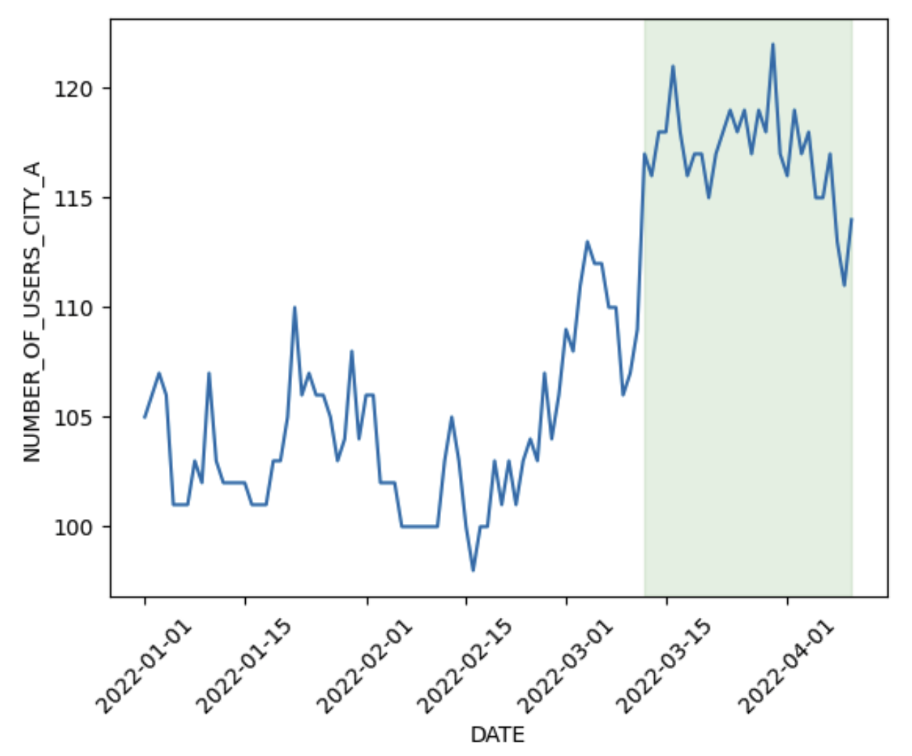
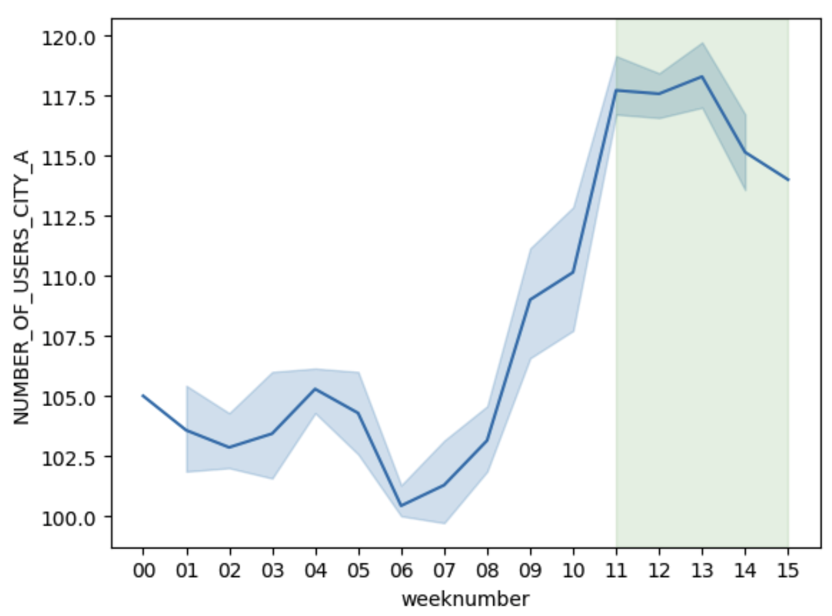
Problem 1 : How many additional users were generated by campaign?
A Brand Campaign executed in city A from Mar 12, 2022, to Apr 10,2022
Assumptions:
Product was introduce/launched both in City A & B from Jan 1st, 2022.
A ‘new’ campaign was executed in March for city A, which lead to an increase in users
Moving day averages of users in City A
Moving week averages of users in City A
Conclusion:
Overall, 12.5% increase in # of users
Avg # of users before campaign: 104
Avg # of users after campaign: 117
Avg # of increase in users after executing branding campaign: 12
Fig A: Shows the moving day average of users in City A, where green area shows the new branding campaign
Fig B: Shows the moving week average of users in City A, where green area shows the new branding campaign
Notes:
Though, Subscribers visits are least using OTT method, but the subscribers time watching (video seconds spent) is highest using OTT
Number of subscribers uses:
Desktop medium usage : 1303 numbers of subscribers
Mobile_Web usage : 1252 numbers of subscribers

Slide 2
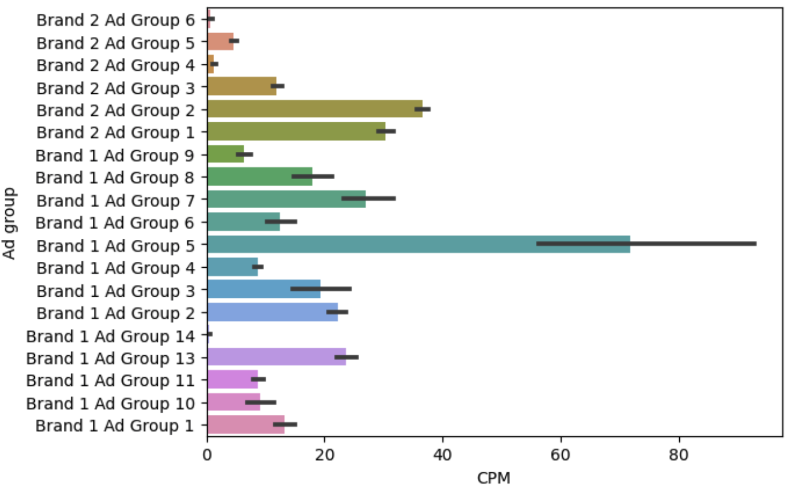
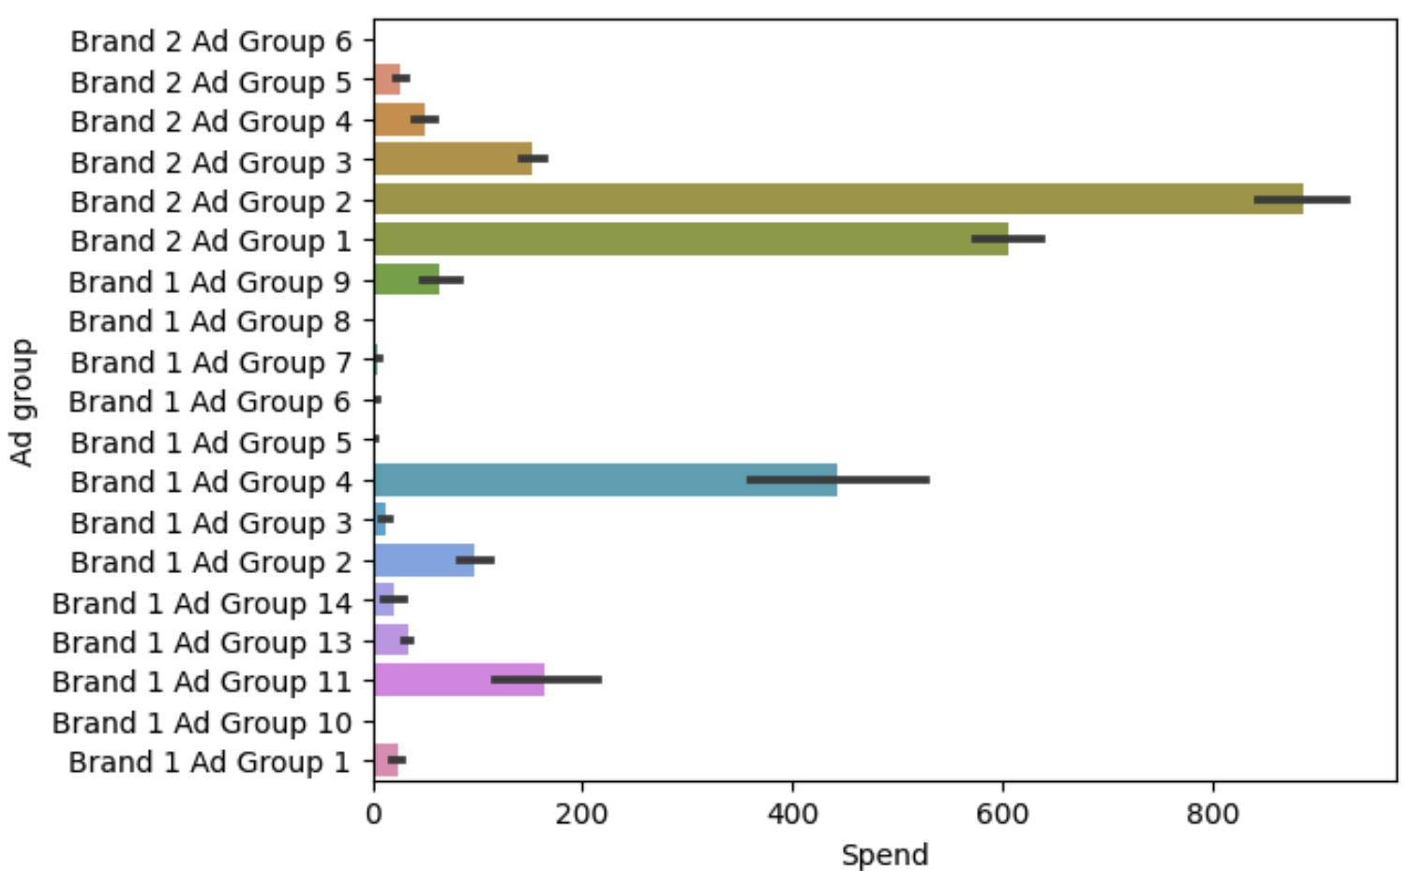
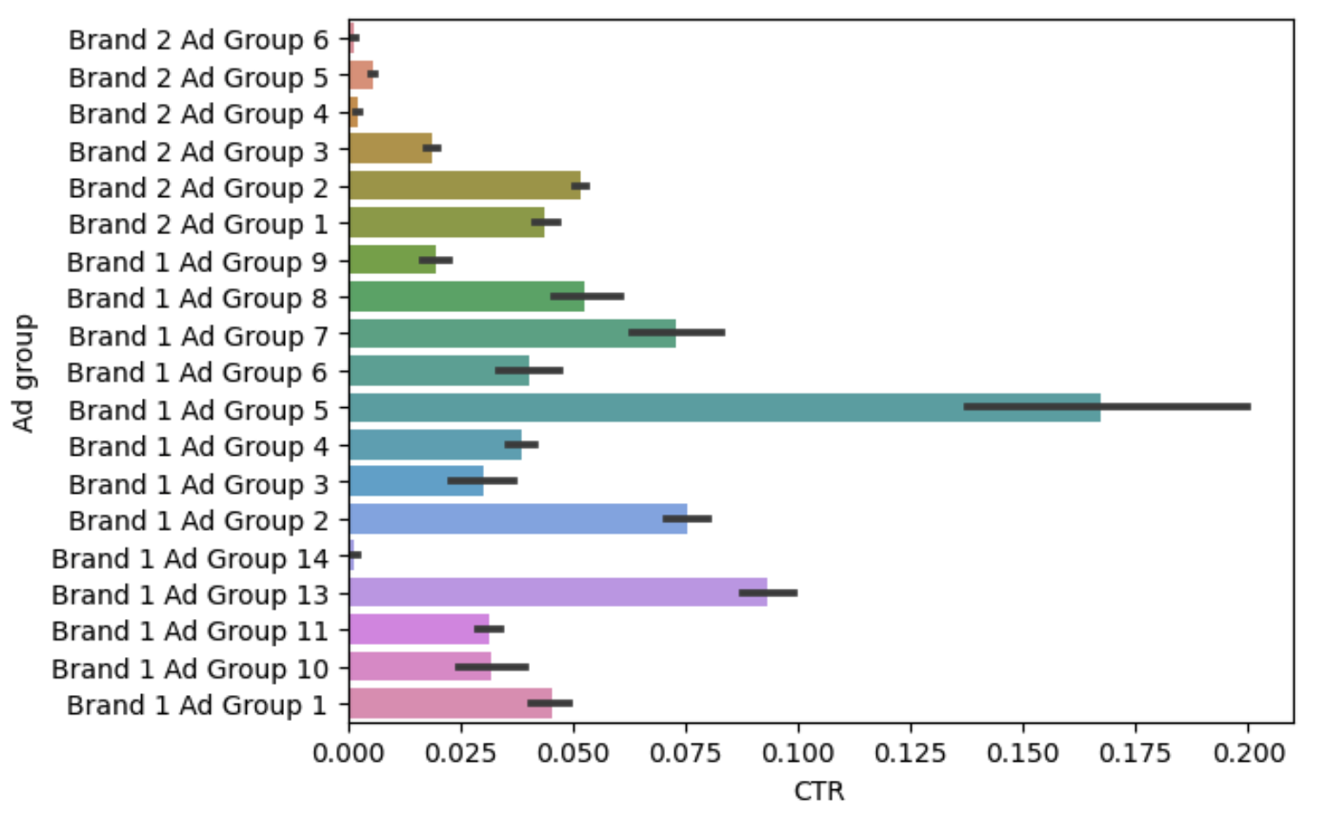
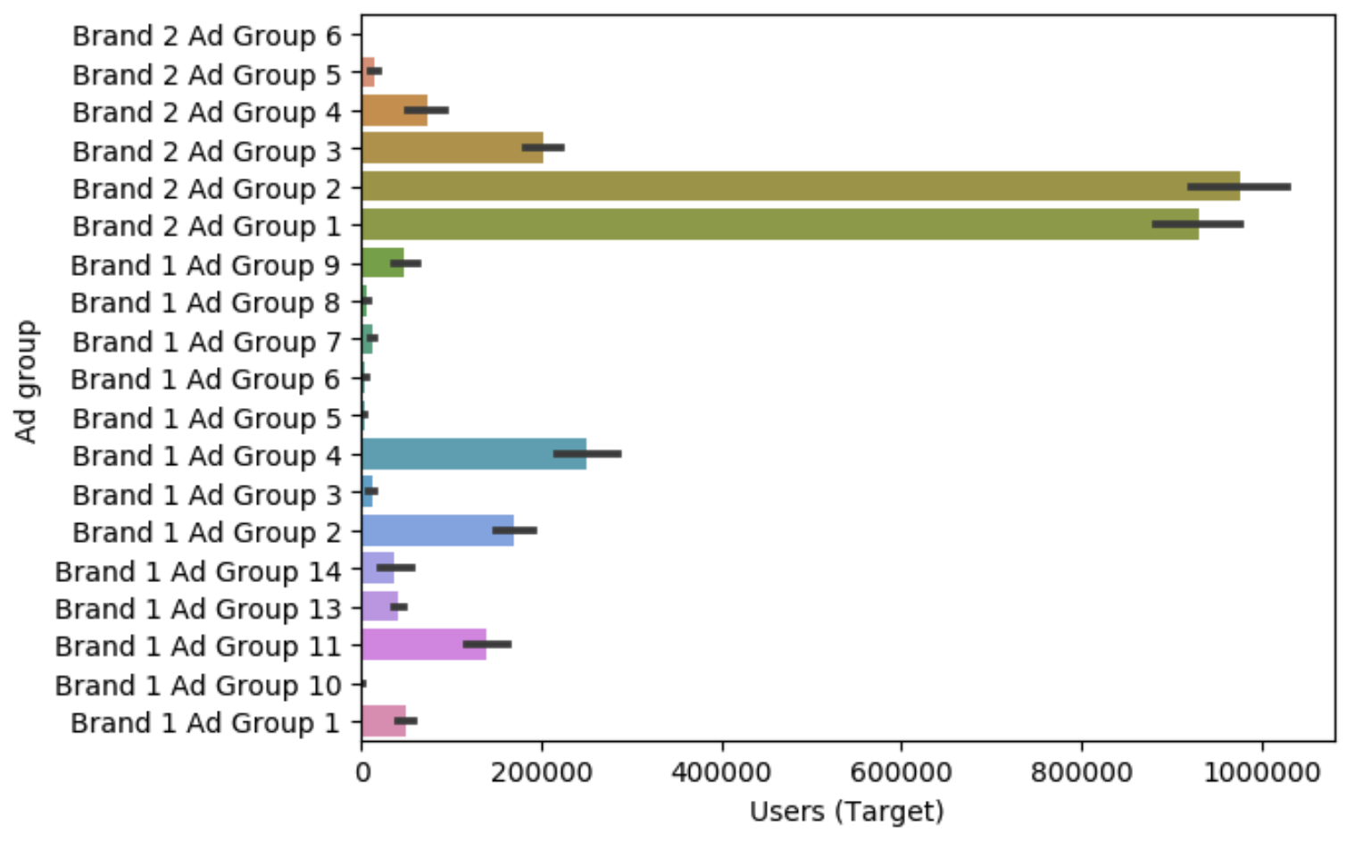
Problem 2 : Quantify effects of different Ad Groups
CPM: Cost Per Mille
Total Spend Allocated
Observations:
Brand 1 Ad group 13 have highest CTR for few thousands users with a low CPM, hence a success campaign.
Brand 1 Ad Group 2 being the 2nd most successful campaign.
Brand 2 Ad Group 1 & 2 wasn’t a success though it had a high budget and target audience
Brand 1 Ad Group 5 is having more CTR and CPM, however its not targeted well to an audience
Brand 1 Ad Group 1 & 9 are decently profitable.
CTR: Click Through Rate
Target Audience
Recommendations:
Should re-allocate some of the budget from Brand 2 Ad group 1&2 to other Ad groups like Brand 1 Ad group 13, group 6, 7, 8, etc.
Should look out for Brand 1 Ad group 5 as it has the highest CTR, needs to have more user base and budget allocated.
Low-budget Ad groups like 5,6,7,8 needs to target the right audience to be in top charts
Notes:
Though, Subscribers visits are least using OTT method, but the subscribers time watching (video seconds spent) is highest using OTT
Number of subscribers uses:
Desktop medium usage : 1303 numbers of subscribers
Mobile_Web usage : 1252 numbers of subscribers

Slide 3
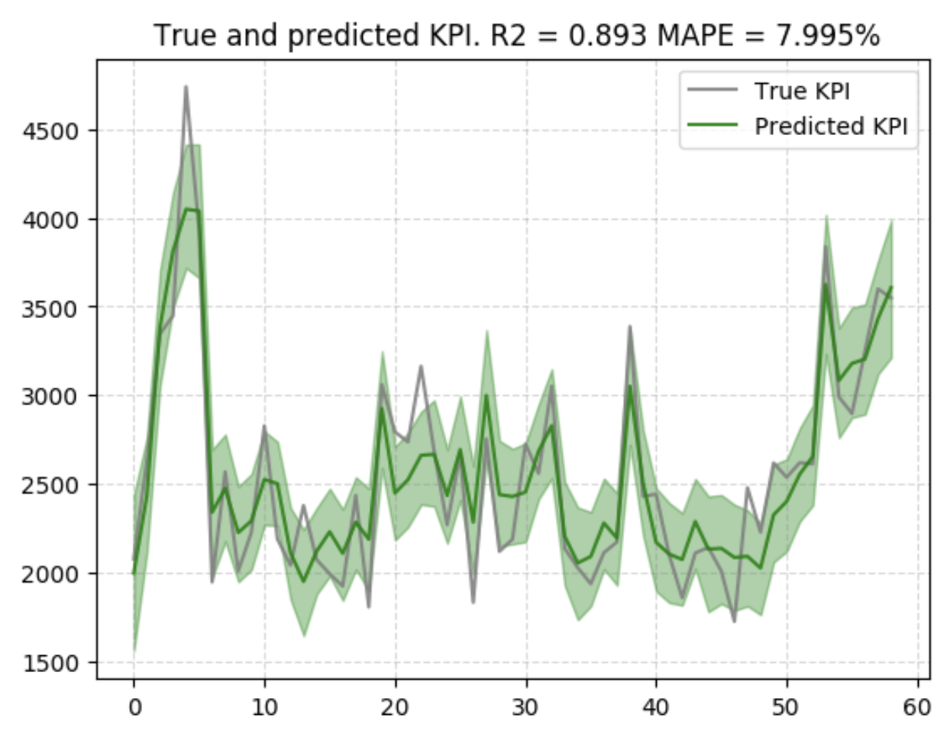
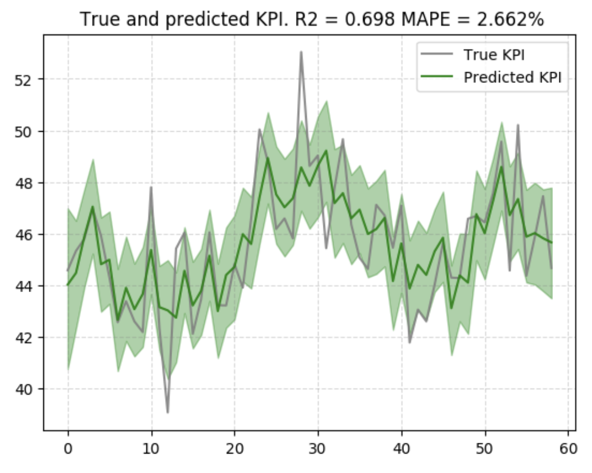
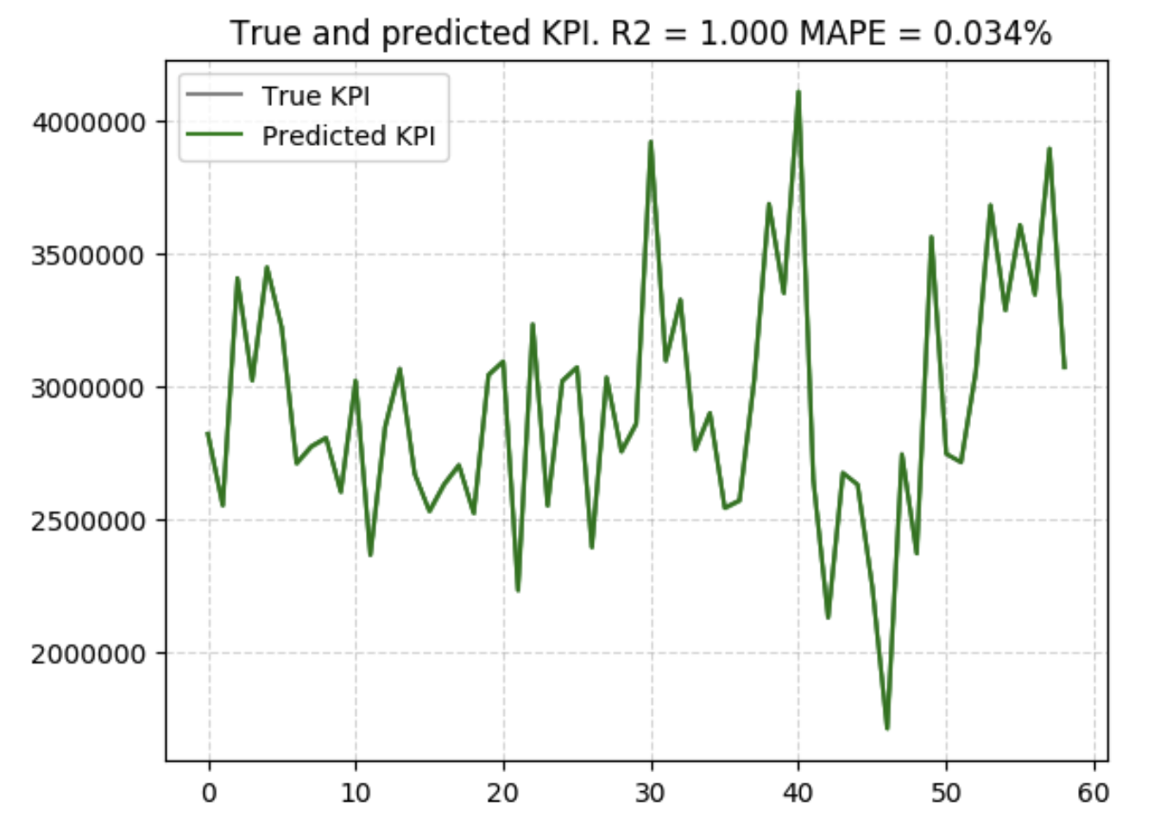
Problem 2 : Campaign Budget Optimization among different ad groups
LightweightMMM(Marketing Mix Modeling): It’s use to measure advertising effectiveness and inform budget allocation decisions across different campaigns/channels. (Bayesian MMM by Google) – Using Standard approached, KPI: Spend/Cost per time period
Approach:
Identify relationship between Users, Impressions, Clicks and Spend
Deriving new KPI’s that drives the campaign decisions
Identified the Market Mix Model that can be used to model
Identified features and hyperparameters for effective data modeling
Added organic search & social data as additional factors affecting model
Used MAPE and R2 score for model evaluation.
Model Outcomes:
1. Spend(Target) <- 7.9% MAPE score in training,
16.7% Score in testing, R2=89%(features: Impression, CPC)
2. CPC(Target) <- 2.6% MAPE score in training,
10.7% Score in testing, R2=70%(features: Impression, CPM)
3. Users(Target)<-0.04% MAPE score in training,
1.3% score in testing, R2=100 %(features: Impression, CPC)
Model Evaluation:
Model Performed well with training data, however with test data, the accuracy drops reasons:
It accounts for few months of data and validation data set
Requires more training with more data points
Outliers driving the performance as we see some extreme spikes which model is trying to learn
Model 3 is an overfitted in training set, it can be bcoz of coefficients represent the noise
Fails to form genuine relationship, as the fluctuations in the data are learned too well and it can’t be applied to new data
Model 1: Budget Optimization
Model 2: Cost per Click Optimization
Model 3: Target Audience Optimization
Model info
National level: Hill-Adstock Model (since it accounts for diminishing returns to the o/p)
Frequency Selected (Daily, considering the seasonality of the entire year)
Weekday_seasonality=true
Seasonality_frequency = 365
Feature Engineering
Impressions : Transformed per time period by Ad groups
Extra features: Based on target variable using randint created organic search and social data points
Target: Used Spend/Target Audience as KPI in model
Costs: Cost per Clicks or Cost per Mille per ad group
Criteria used to split between training and validation
Split by time (took last 28 days for validation)
Reference: https://github.com/google/lightweight_mmm
Notes:
Though, Subscribers visits are least using OTT method, but the subscribers time watching (video seconds spent) is highest using OTT
Number of subscribers uses:
Desktop medium usage : 1303 numbers of subscribers
Mobile_Web usage : 1252 numbers of subscribers

Slide 4
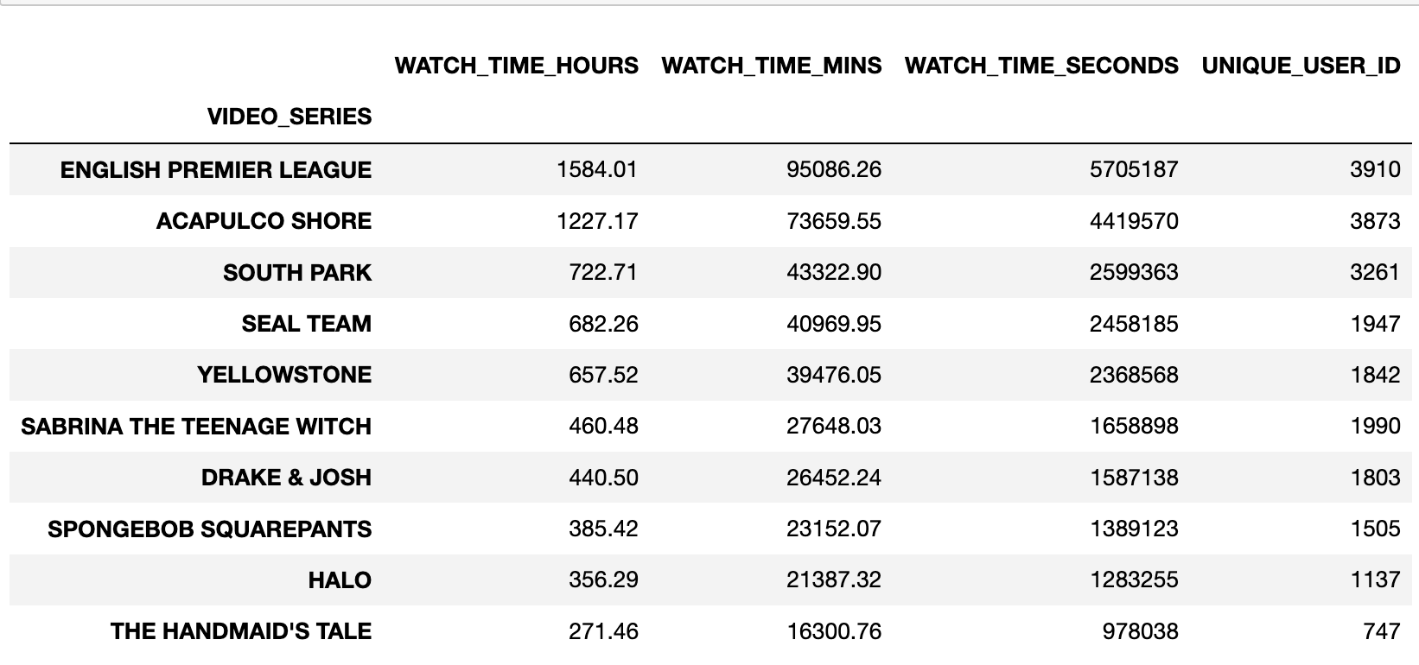
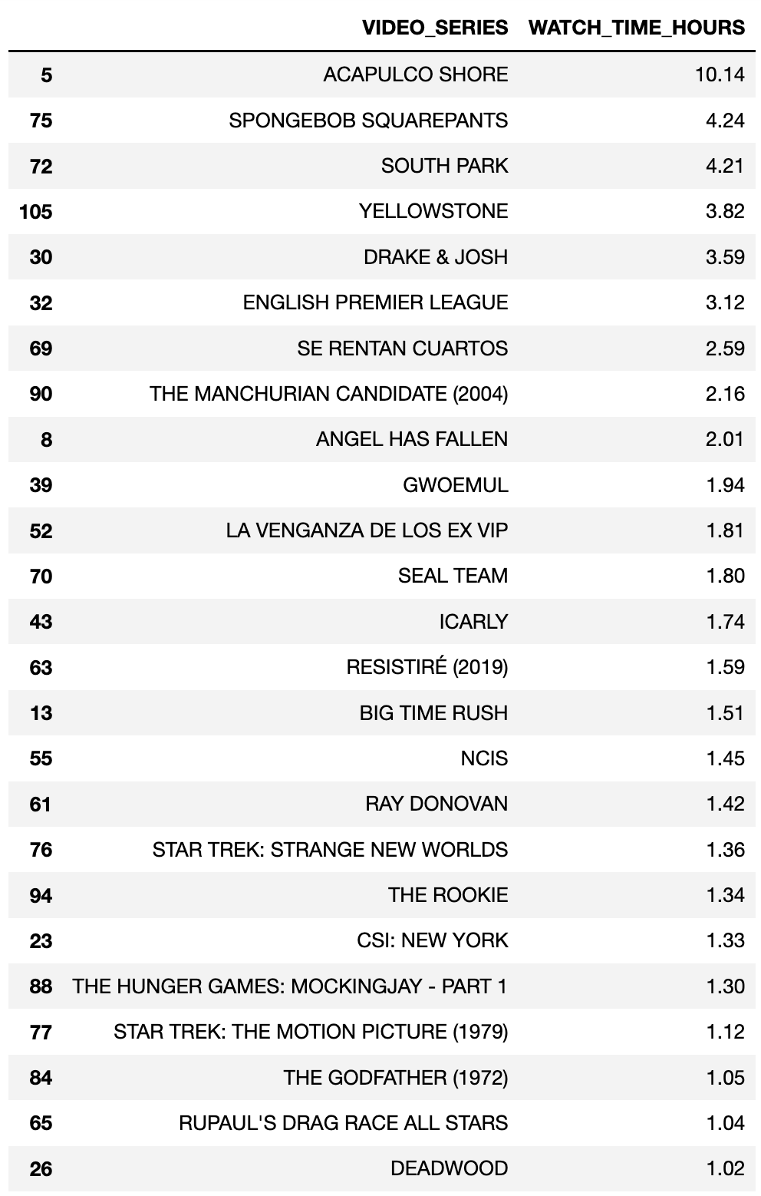
Problem 3 : Consumption Table Findings
#1: Best Performing Titles
#3: Recommendations to users who watched HALO
#2: Unique Users at risk of not Renewing
# of unique users | Screen time in mins | Screen time in sec | Risk
4278 | 576 | 34621 | Medium
1941 | 0 | 0 | High
Conclusion: Using the screen time by users who watched HALO, here are top 25 video series recommendation based on screen time clusters by time.
‘ACAPULCO SHORE’ has the highest screen time, being the closet neighbor
Conclusion: About #6219 unique users are likely at risk of not Renewing,
since the last 2 weeks avg screen time is 0-8 secs for all the users
Notes:
Though, Subscribers visits are least using OTT method, but the subscribers time watching (video seconds spent) is highest using OTT
Number of subscribers uses:
Desktop medium usage : 1303 numbers of subscribers
Mobile_Web usage : 1252 numbers of subscribers

Slide 5
Conclusions
Used averages as a metrics for Problem 1 to determine the campaign performance
Campaign Budget Optimization(CBO) is quite vital for problem 2, for which my approach was:
Identifying Market-Mix Model for the dataset
Assumptions: Target users is dependent variable ( it can be newsletters, social media, email-list, etc..)
Spend is the Cost per Mille(1000 impressions) and used to determine the budget for each ad group
Media inputs are impressions created
Screen time played a vital role in answering all questions for problem 3
Recommendations were provided based on HALO watchers screen time with other video series and identified top 25 video series
Likely users to leave based on their screen time, risk-buckets based on avg time spend by users which in this case was ranging 0-8 secs per user
Notes:
Though, Subscribers visits are least using OTT method, but the subscribers time watching (video seconds spent) is highest using OTT
Number of subscribers uses:
Desktop medium usage : 1303 numbers of subscribers
Mobile_Web usage : 1252 numbers of subscribers

