Slide 1
Version Control

Slide 2
The Plan
Why version control?
Concepts/Goals of VCS
Systems

Slide 3
The Plan
Why version control?
Concepts/Goals of VCS
Systems

Slide 4
Why Version Control?
Sanity!
Allow many people to collaboratively work
Roll back changes if they don't work out
  Encourage experimentation
“What changed?!”
“When did this break?” (blame)
Keep code elsewhere (in case of disaster)

Slide 5
The Plan
Why version control?
Concepts/Goals of VCS
Systems

Slide 6
Goals
Required:
  Keep all previous copies of code
  Give different people different places to work
    Connect these back together later
Nice:
  Credit contributors
  Mark “release” versions

Slide 7
Concepts
Versions
Branches
Tagging
Merging

Slide 8
Concepts
Versions
  Snapshot of a point in time
Branches
Tagging
Merging

Slide 9
Concepts
Versions
Branches
  Personal space to work in
Tagging
Merging

Slide 10
Concepts
Versions
Branches
Tagging
  Mark a version (ex: Release-1.0)
Merging

Slide 11
Concepts
Versions
Branches
Tagging
Merging
  Mush two branches together

Slide 12
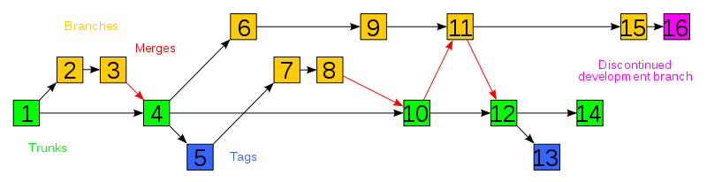
Visualization
http://engineerography.com/files/2009/08/800px-Subversion_project_visualization.svg.png

Slide 13
Systems
Terminology
Git
Subversion

Slide 14
Terminology
Repository (repo)
Centralized version control
Distributed version control

Slide 15
Terminology
Repository (repo)
Centralized version control
  All operations hit a central server
Distributed version control

Slide 16
Terminology
Repository (repo)
Centralized version control
Distributed version control
  Keep a local copy of the repository
  Operations work against this

Slide 17

Warning – Religious Wars Ahead!

Slide 18
Git – The “Stupid Content Tracker”
"I'm an egotistical bastard, and I name all my projects after myself. First 'Linux', now 'git'."
  Linus Torvalds
Decentralized VCS
Tracks by folder

Slide 19
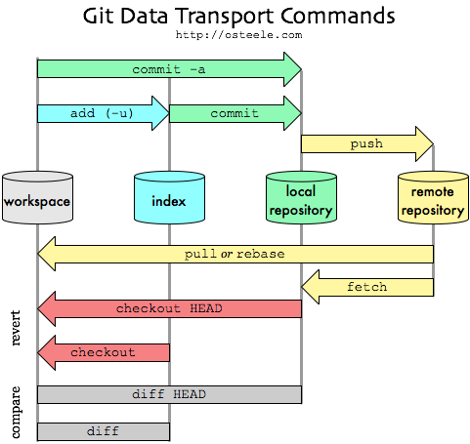

Slide 21
Subversion
Centralized VCS
Simpler (most of the time)
Tracks by file

Slide 22
Ignoring files
.gitignore
  Put in a line for each file to ignore (you can use regexps)
  https://github.com/github/gitignore
svn:ignore
  svn propset svn:ignore secret.txt .
  (this is complicated...)

Slide 23
Some Dos
Check in/commit early and often
Use descriptive commit messages

Slide 24
Some Donts
Check in binary executeables
  VCSs in general don't know how to handle it
Check in/push broken code to the master (you'll owe your team booze)
  Bad etiquette
  Exception: on your own branch
Check in passwords, local configs, keys
USE DROPBOX/EMAIL AS A VCS

Slide 25
Getting Repos
SVN: Talk to CS
Git: Run locally
Git: github.com
Both: ACM!

Slide 26
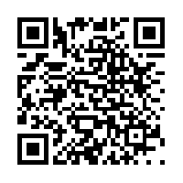
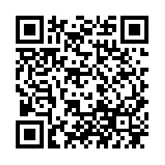
Comments/Questions/Stories?
Slides online at http://pressers.name/static/slidesets/ACMVCS-Oct12.pdf
http://pressers.name/static/slidesets/ACMVCS-Oct12.odp

