Slide 1

FISCR 16-01: How the Secret Courts Secretly Gave Away Telecommunications Privacy
(And How We Can Get it Back)
Notes:
Greeting
Hi, Steven Presser, Thaw America, that’s Mike, cofounder
Are an org dedicated to fighting the chilling effect of mass surveillance
Here to talk about FISCR 16-01, a case we’ve been working for the last year. It’s got the potential to destroy telecoms privacy, be a backdoor warrant, eliminate any expectation of privacy in online comms, etc.
If you’ve got questions, please raise your hand/ interrup tme. It’s going to be easier to deal with them as they come up

Slide 2
Background
Notes:
So first... some background
We’re going to talk a lot about FISA
FISA built as a response to Watergate. Supposed to create oversight for national security matters. Previously was dealt with via standard courts, which ended up with ad-hoc and inconsistent applications of the law
Also supposed to provide a check on presidential power

Slide 3

Courts
SCOTUS
US Court of Appeals
FISCR
(Foreign Intelligence Surveillance Court of Review)
FISC
(Foreign Intelligence Surveillance Court)
US District Court
Notes:
https://pixabay.com/en/gavel-hammer-judge-justice-court-2743897/
Let’s start with courts.
At the federal level, our courts have 3 levels:
- US district court (all federal cases start here; some cases move here from state courts)
- US Court of Appeals (second stop for all cases – mostly deals with finding technical errors or misapplications of law and ordering lower courts to re-do if found)
- Supreme Court (you all know how this works – if there’s a genuine question of law, it ends up here.
FISA Courts follow same pattern
- Everything starts in FISC
- Moves to FISCR
- Then SCOTUS (never publicly happened – may have happened w/o public notice - https://www.emptywheel.net/2017/10/20/technical-fixes-in-hjc-bill-suggest-scotus-may-have-reviewed-a-2015-fisa-application/)
One important thing to note about FISA Courts: everything is secret by default unless explicitly declassified. Until post-Snowden reforms, this meant there was an entire body of law we’re subject to but couldn’t know about. The court is still working on declassifying these decisions; the ACLU has been driving this via lawsuit

Slide 4

A Friend of the Court?
Notes:
The other critical item to know about the FISA courts is that the government is frequently unopposed. This obviously leads to something of an echo chamber and means there’s no one to poke holes in government logic.
The USA FREEDOM Act of 2015 introduced a special advocate – the amicus.
Amicus’ role is to provide opposing view/advocate on behalf of the subject of surveillance (since they obviously cannot know). Amicus has no personal stake but has always been used to stand in for someone who does but is unable to be present/represneted
Imperfect:
- Requires court to recognize that something is new/needs it
- Court can declare matters “too sensitive”
- Essentially depends on goodwill of judges to happen – current head judge has skirted this at least once already

Slide 5
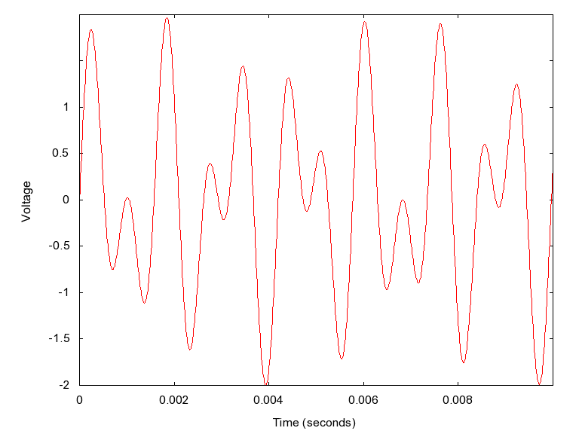
Notes:
https://upload.wikimedia.org/wikipedia/commons/0/0e/MultiTone1.png
Okay, let’s talk tech
Modern telephone dialing happens using a tech called DTMF, also known as touchtone. For each digit two tones are transmitted at the same time
- that’s what the diagram is
This happens whenever you dial a number – either during dialing or during a call
Digits dialed after a call connects are called PCTDD

Slide 6
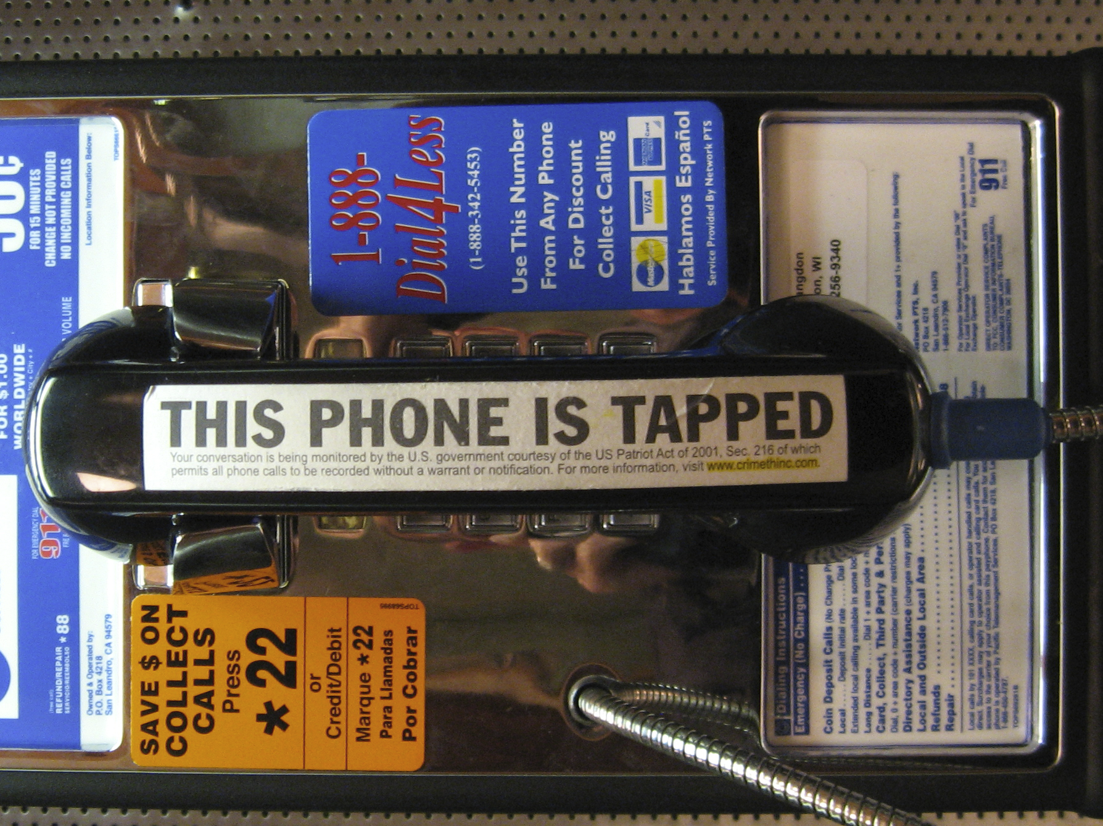
Notes:
https://upload.wikimedia.org/wikipedia/commons/e/eb/This_Phone_Is_Tapped.jpg
Let’s talk pen registers...
In the US the contents of a call are protected by 4th amdmnt
However, “Dialing Routing Addressing and Signaling” information isn’t. This is metadata, and can be collected with a pen register (who, when, how long)
Audence participation: Are PCTDD protected by 4th or are they metadata that can be captured with a pen register?
As it turns out, everyone is both right and wrong. We don’t know. This is not a settled matter of law.
Most courts don’t decide, just say that there is content pctdd and say IF there IS non-content-pctdd too risky to try to get – might get content too

Slide 7
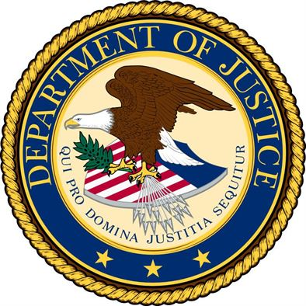

FISCR 16-01
Government’s Arguments
Notes:
The government argued that:
1. This information is REALLY important
2. This info is unprotected by 4th admdmnt
3. There’s no tech to separate content PCTDD from metadata PCTDD
4. There’s a savings clause to prevent them from using anything they get that they shouldn’t have had

Slide 8
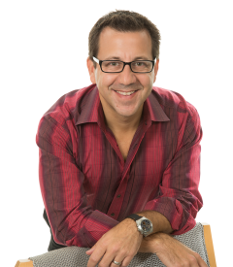
FISCR 16-01
Amicus’ Arguments
Mark Zwillinger,
Badass privacy Lawyer,
Amicus to FISCR
Notes:
This is Mark Zwillinger. He’s the amicus in this case and has a long history of privacy advocacy. I may not like FISA much, but at least when they pick an amicus, they pick the best of the best.
Unfortunately, we really don’t know what he argued – the only public document in the case is the decision. The decision tells us little about what he argued. His arguments are pretty much dismissed out of hand.
We know he argued you could stop capture after the initial 10 digits. But it’s not clear what the context of this argument was – 10 digits after call connects? - or if there were more detailed, flexible, etc arguments.
This can’t have been it, so there’s something else we don’t know about and that the court didn’t address

Slide 9

The Decision
Notes:
Pretty much wholesale adopted govt’s arguments
However, this was wrong on both legal and technical fronts:
1. 4th amendment is unconditional protection of information. There is no “piercing the veil” and getting protected info to make sure you get all unprotected info
2. Savings clause is being misinterpreted. Savings clauses (per CASE NAME) are under no circumstances permission to do something otherwise prohibited. They’re protection for the target and this is a deliberate misinterpretation on the part of the court
3. There damn well is tech to separate PCTDD types. I put together a demo of this tech – CCAD – 99% accuracy for the type of call they’d want to use it on – 98%+ for all calls

Slide 10
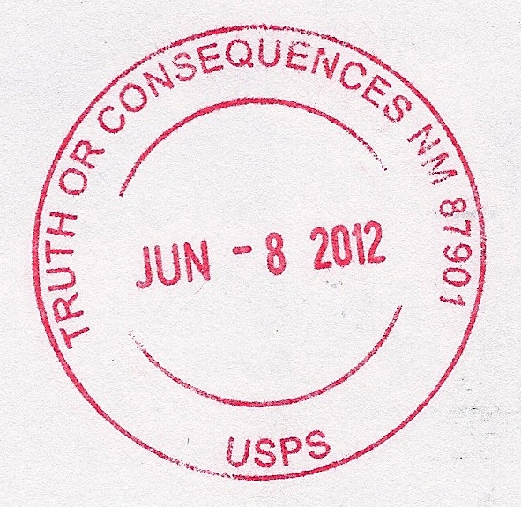
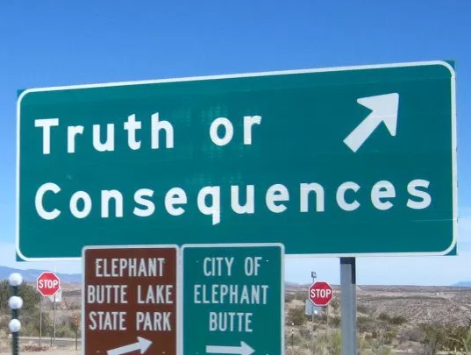
FISCR 16-01
The Consequences
Notes:
Biggest consequence: Pen registers as backdoor warrants. Could claim need to record entire call in order to make sure get all metadata, then cop listens to call
“Good faith” exception – cop could claim unaware not able to listen to call and get evidence in anyway
Also out-of-court uses of call contents – pressure (blackmail) on subjects – especially could be used to coerce confession

Slide 11
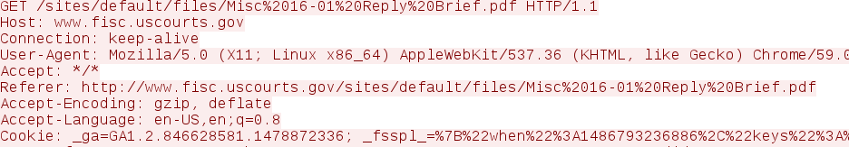
Notes:
And then there’s the internet...
As a gross charactarization, Internet Pen registers can currently be used for IP addreses and ports, email headers, but not more detailed information (and not HTTP addresses)
However, if you extend this concept of embedded routing data to the internet, it gets really dangerous.
What we’ve got here is HTTP headers – part of the protocol
See domain and document, also where I’m coming from
Unquestionably routing data
But looking at this, you now know what case I’m reading – very dangerous for atty-client privilege
(Yes, mitigated by https, but many critical places lack this... Also domain is frequently sent in the clear)

Slide 12
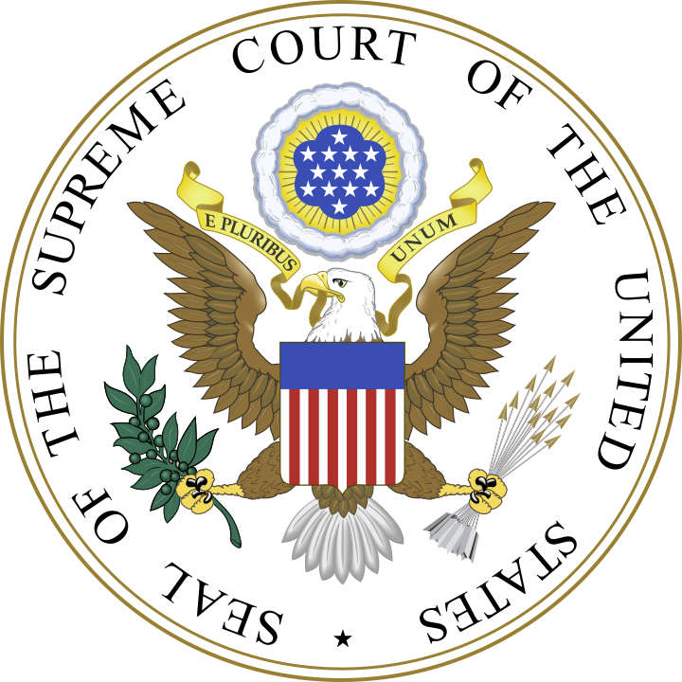
SCOTUS Appeal
Notes:
So we wrote an appeal to SCOTUS, pretty much covering:
1. legal misunderstandings: pircing the veil, savings clause misunderstanding
2. Technical misunderstanding+demo

Slide 13
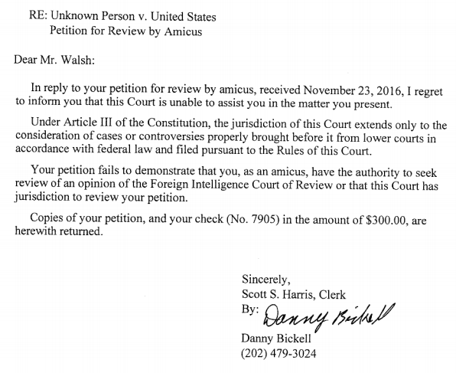
Notes:
This is what we got back. Flat denail, won;t even file it.
This is egregiously illegal and an abuse of power.
Standing is figuring out who has actually been harmed
Standing is a question of law. Clerks are paper shufflers. This clerk has declared himself to be the ultimate arbiter of law – above even the court. He’s unelected, unappointed, unaccountable and now controls whether or not cases can be heard
Note also where the clerk claims the court doesnt have jurisdiction It’s scotus – of course they have jurisdiction
Obviously this pissed us off. If this had gone up to the court and gotten turned down (either standing or insufficiently interesting – court hears only about 1.5% of cases sent to it) we’d have just gone away; found a new project
If anyone in the audience is a fed here to see what I’m talking about, I have a message for your bosses: we’d still do that. Don’t obstruct it, handle it through regular channels and if we lose, we move on to something else.

Slide 14
Motion for Reconsideration
Notes:
Course 2: present the court with the technical part of our argument and give the court a chance to reconsider their decision.
This is a highly unusual approach (though not without precedent)
We’ve sent the court several copies of the filing, first in august. So far not even acknowledgement that they’ve gotten them.
We keep working this. We’ll keep at it until they hear it, turn it down or at least ack the filing.

Slide 15

Notes:
Well, the courts are problematic. So what else can we do?
We want to find out if and how this is being used. The best way to do this is FOIA – let’s us request docs from govt
Got ~dozen requests in flight right now
We know from DIOG leak what the FBI process for using PCTDD pen registers is – but do they use them?
So we asked. No good answer yet, got wrong info back
Big one: Minization procedures. Controls when the FBI tosses info. FBI says they don’t have any (despite legal requirement to have). This is good – means the FBI is either in violation of law OR we get the uncensored version (they can’t claim another exemption later)
Also have a bunch in-flight for various legally required reports on pen register use
Also looking for copies of DBs the FBI uses to track things.

Slide 16
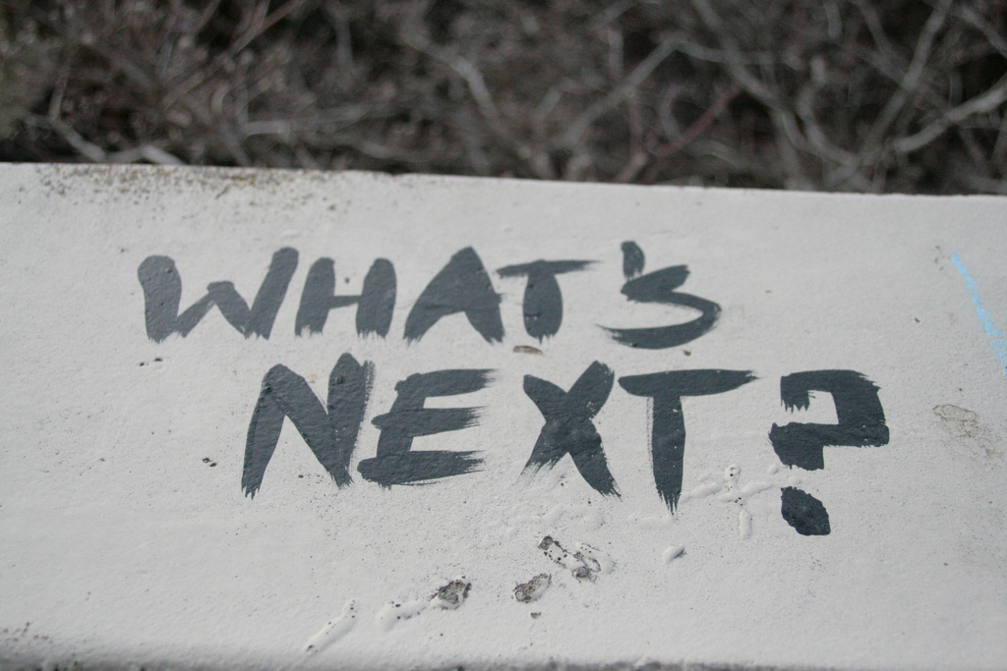
Notes:
Keep plugging on courts. Law is slow – we might still get a lucky break
Keep plugging on FOIA – there’s lots of useful info there. We’ll have an easier time once we can say certain things ARE happening, rather than might happen
Keep going out and talking about this
- We love involvement. If you want to get involved, please come talk to us. We’re very much looking for people good with publicity, design, other skills useful for advocay. The two of us are tech and law, not skilled in those areas

Slide 17
Questions?
More info at:
https://thawamerica.org/

