Slide 1
hCaptcha: Profits over People and fscking Broken
Is the CAPTCHA dead?
Steven Presser
Slides with image descriptions and notes:
pressers.name/anewhope
Notes:
Would you believe me if I told you that 15% of the internet was behind a CAPTCHA that couldn’t tell a bot from a human? And what on earth does accessibility have to do with security?
The rest of this talk should start to answer those questions.
That said, before we get into this talk, I’ve got to make a title change. I’ve presented part of this work – the part on a product called hCaptcha – before. Recently, a high-level technical manager from hCaptcha reached out to me and wanted to talk. I spoke with that person on Monday. And honestly, it changed some of my views on the company and product. I can’t stand behind the original title anymore, so I’m changing the title of this talk to “Is the CAPTCHA dead”.

Slide 2
hCaptcha: Profits over People and fscking Broken
Is the CAPTCHA dead?
Steven Presser
Slides with image descriptions and notes:
pressers.name/anewhope
Notes:
After talking with hCaptcha, I believe they believe they’re striking the best balance they can between a lot of complex requirements and a very complex environment. And I believe that I’m not in a place to evaluate brokenness, at least not completely.
However, I’m still going to talk about some work I did on the security of hCaptcha last year.

Slide 3
Agenda
Background
  Assistive Technology
  CAPTCHAs
hCaptcha
The Future
Notes:
So here’s our roadmap. I’m going to start with background, mostly on assistive technology and captchas. Next, I’ll talk about hCaptcha itself, and finish with a look at the future.

Slide 4
Assistive Technology
Notes:
Disability and assistive technology is going to play a large part in this talk. So, for those who aren’t already familiar with AT, let’s begin by looking at some. The use of assistive technologies is really common. Many of us are already using an assistive technology right now – eyeglasses and contact lenses. However, as useful as they are, they don’t have a bearing on how we interact with a computer, so I want to focus on some digital input and output devices.

Slide 5
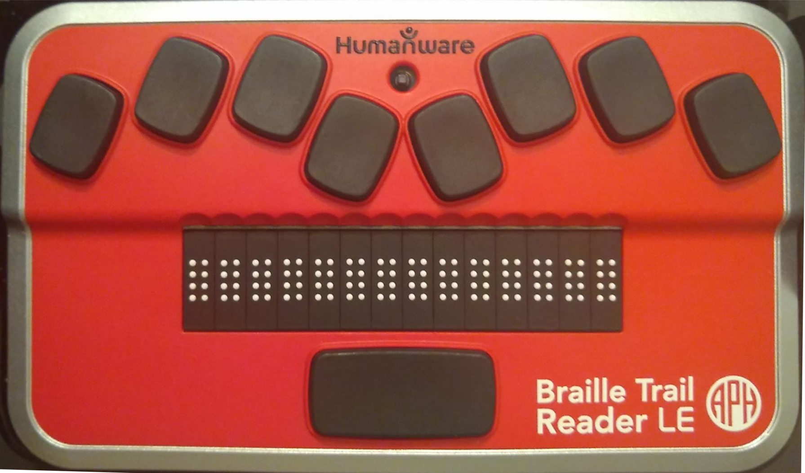
Notes:
Let’s start with this – a refreshable braille display with perkins-style brailler keyboard. This could be used by someone who is blind or visually impaired instead of or in addition to a keyboard and monitor. The paddles at the top are braille input, while the white dots along the bottom are for reading text.

Slide 6
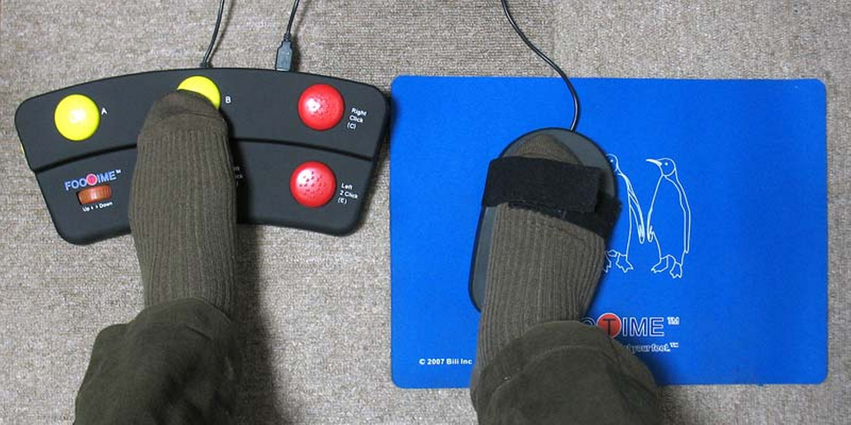
Notes:
This is a foot-operated keyboard/mouse. These could be used by anyone who has limited or no ability to use their hands to type. For example, an amputee, or who has reduced fine motor skills in their hands.

Slide 7
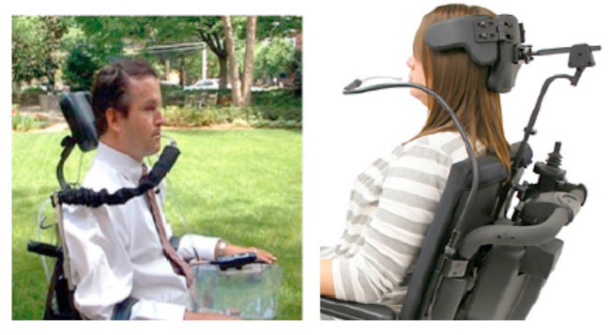
Notes:
Next up, a puff-and-sip is used by someone who typically is quadrapalegic and has no fine motor control. It can be used to replace a keyboard and mouse.

Slide 8
There is no content on this slide
Notes:
Next up, a screenreader. which is software used by people who are print-disabled (typically blind, visually impaired or severely dyslexic). It outputs on-screen text as speech and allows users to navigate with just the keyboard, if they choose to do so.
Before we go any further, I want to show you just how different using an assistive technology can be. I’m about to play for you a recording of someone using a screen reader. I’ll first play it without video, then with the video.

Slide 9
Notes:
Here’s what using NVDA is like – first without the video.
This slide shows a recording of a screen reader user. This recording displays no video, but a version of this video later in the talk will. Transcript of video audio follows.
google dash google chrome google document
search landmark
search combobox has autocomplete
editable search blank
hcaptcha
accessibility
[beep] hcaptcha accessibility dash google search document
heading level one accessibility links
link skip to main content
main landmark clickable accessibility dash hcaptcha heading level three https colon slash slash www dot hcaptcha dot com ac-
document busy blank

Slide 10
There is no content on this slide
Notes:
Before I play it with the video – anyone think they know what the user was doing there? Show of hands.

Slide 11
Notes:
Show of hands – of those of you who thought you knew what the user was doing, how many were right?
I want to emphasize that I have shown only a very small selection of the assistive technology available and many more options exist. These alternative methods have various advantages and disadvantages. For example, a screen reader is very hard to use to skim text, but typing input is fast. In contrast a puff-and-sip may allow someone to skim quickly, but might be very slow to type.
Assistive technology is really tuned to a disability and to a person, so it is as variable as disability. Which is to say – extremely. Two people with the same disability may use entirely different AT because that’s just what works for them.
This slide shows a recording of a screen reader user using google to search for "hcaptcha accessibility" and then selecting the first result, the hcaptcha help page on accessibility. Transcript and description follow, description items are prefixed with "description:" while audio transcript is prefixed with "audio:".
audio: google dash google chrome google document
description: the google.com homepage is seen. A blue box surrounds the search box.
audio: search landmark
audio: search combobox has autocomplete
audio: editable search blank
description: the user types "hcaptcha" and that text appears in the search box. Autocomplete options appear below the box.
audio: hcaptcha
description: the user types "accessibility" and that text appears in the search box. Autocomplete options appear below the box.
audio: accessibility
description: the visible page changes to the google search results page. A dashed blue box surrounds where the search box previously was. The top result is the hCaptcha accessibility page, then a box that reads, "people also ask"
audio: [beep] hcaptcha accessibility dash google search document
audio: heading level one accessibility links
description: a small yellow and slightly larger red box appear in the upper left-hand corner of the page. A small box that reads "skip to main content" briefly appears, then disappears.
audio: link skip to main content
description: a blue box appears around the title of the first result. The title reads "Accessibility - hCaptcha". A small yellow box appears above that, where the URL of the result is shown.
audio: main landmark clickable accessibility dash hcaptcha heading level three https colon slash slash www dot hcaptcha dot com ac-
description: all the colored boxes disappear and the browser begins to load the page.
audio: document busy blank
description: the hCaptcha help page on the topic of accessibility appears.

Slide 12
CAPTCHAs
Notes:
Next up are captchas.
CAPTCHAs are small puzzles that are simple for humans to solve and hard for computers (AI-hard, human-easy). They’re used to ensure that a request comes from a human, and not automation (or a bot)
Please bear with me for a little history ---
Captcha is a backronym for “Completely Automated Public Turing test to tell Computers and Humans Apart”.
Name is from “CAPTCHA: Using Hard AI problems for Security”, published in 2003, which ...

Slide 13
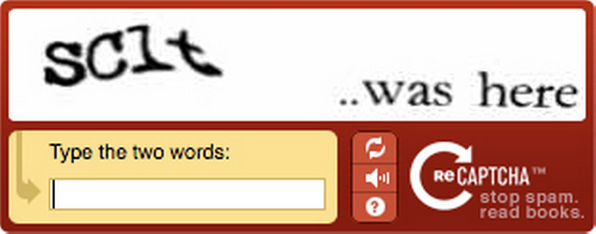
Notes:
... lead to reCAPTCHA – the first version of which you see here. Other things were CAPTCHAs first, just.. not quite called that.
ReCAPTCHA was one of the first, if not the first, to make CAPTCHAs do useful work. It got humans to label hard-to-read portions of text to train optical character recognition systems
What was brilliant about reCAPTCHA was how it aligned diverse problems – in this case, websites and users wanted to eliminate automation and authors of OCR software needed better data. ReCaptcha positioned these groups to solve each other’s problems in a mutually beneficial way.

Slide 14
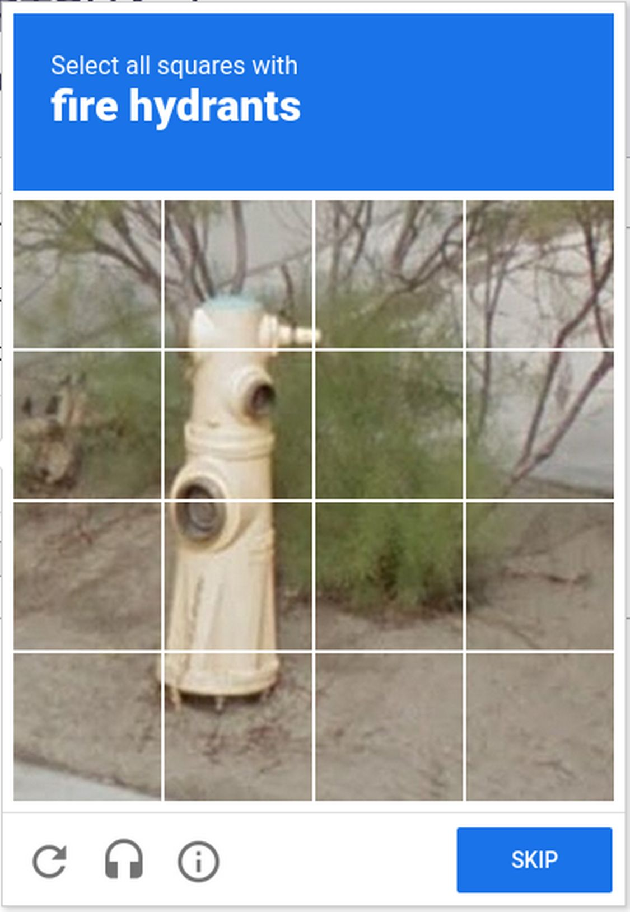
Notes:
ReCAPTCHA was bought by Google, who wanted better OCR. Eventually, however, machine OCR got to be as good or better than human, so that was no longer an AI-hard problem.
So next google looked around for another AI-hard problem, and seems to have settled on object identification in street photography, probably for their self-driving cars.

Slide 15
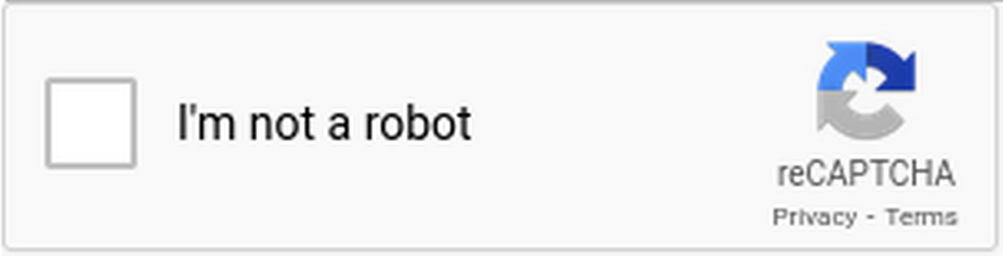
Notes:
And then they revised reCAPTCHA once again - into the now-familiar “I’m not a robot” checkbox. This tracks the user’s behavior on the page and applies machine learning to determine if the user is human or automation. The user is asked to solve a puzzle only if they look like automation.
Again, reCAPTCHA isn’t the only CAPTCHA out there, but it is the best known and has tended to be at the cutting edge of CAPTCHAs.

Slide 16
hCaptcha
Notes:
And that brings us – finally – to hCaptcha. hCaptcha is a commercial product, put out by a company called Intution Machines, Inc (IMI) and used to prevent automation on about 15% of the internet. Mostly through their largest customer, Cloudflare, who picked them up in April 2020 (which is how I heard about them)
Intuition machines is a blockchain-based data labeling and AI service company. That means is a researcher has a large set of pictures of say.. modes of transport… and wants to have them get labeled with what type of transport is in each picture, they can pay IMI to get labels attached to each picture, IMI croudsources this via hCaptcha, and website owners get paid for running hCaptcha. And somehow a blockchain is used

Slide 17
hCaptcha is...
Private
Secure
Faster/lower friction
Notes:
Intuition Machines claims on their homepage that hCaptcha is 3 things: Private, as in they don’t track or sell your data. Secure, as in keeps out automation and makes sure the user is human, and faster/lower friction – as in easy for users.

Slide 18
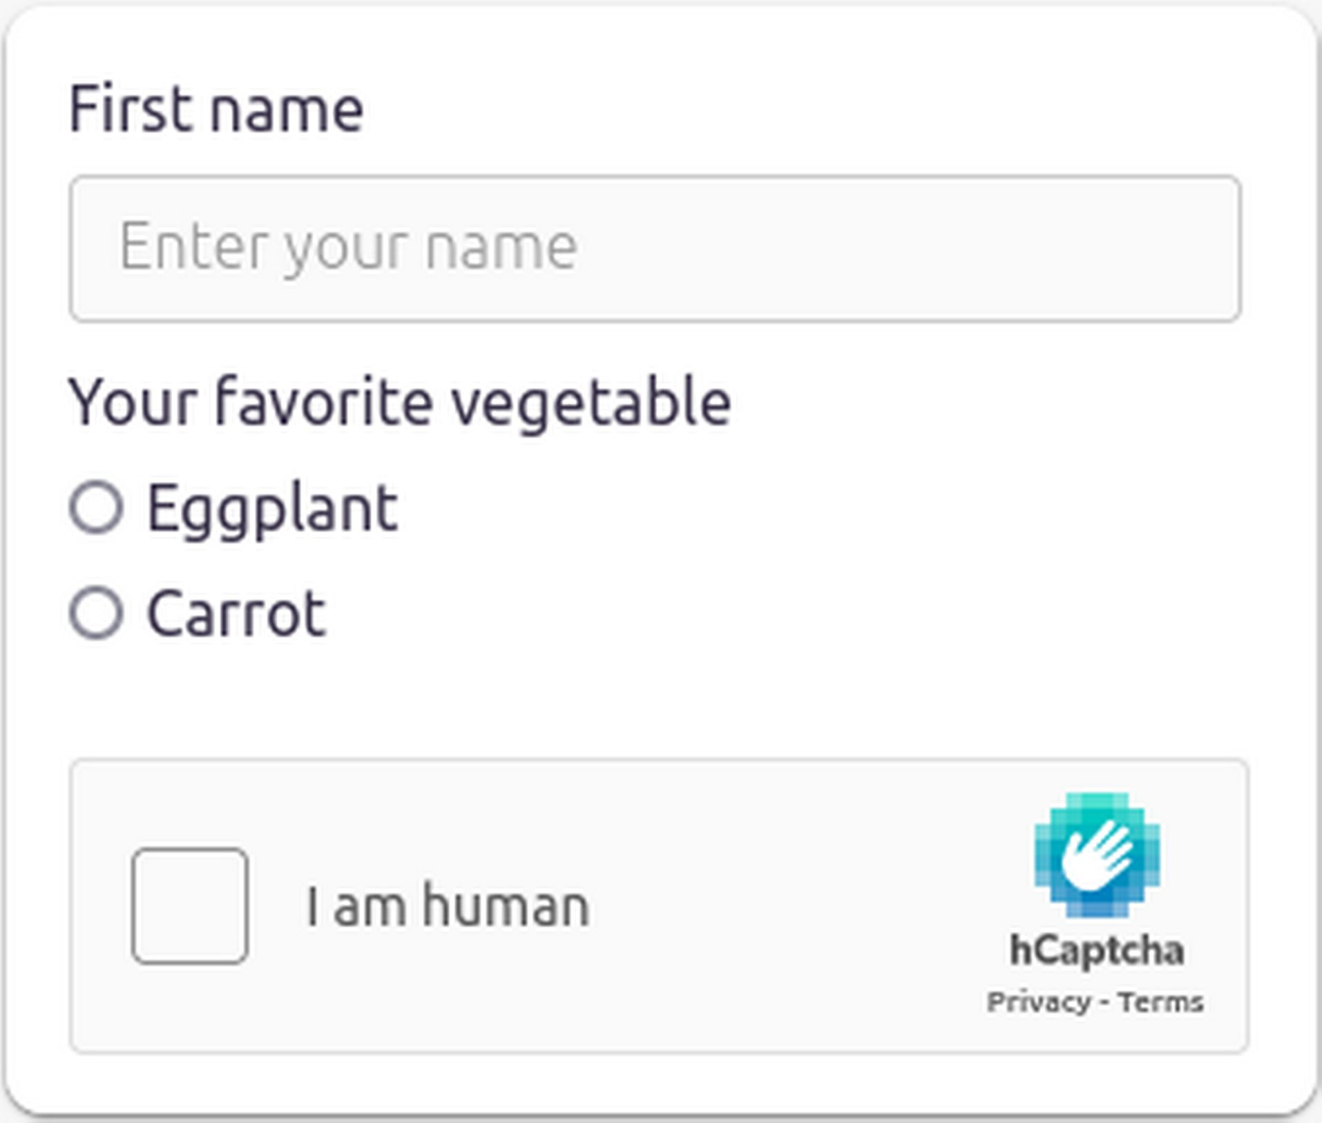
Notes:
So how does using hCaptcha work?
Let’s start by walking through their visual, timed workflow. I want to emphasize that this was as it stood a year ago, when I did this work. There are some changes through to date, that I’ll try to call out as I go.
You start by filling out a form and then checking the box labeled “I am human”. At this point, the software looks at ~criteria~ and decides if it believes you might be a bot. These criteria are an IMI secret, but might be things like IP address, if it has put cookies in your browser before, and behavior on the page. If you look odd, you get shown a challenge.
My personal experience – across their site, ebay, Cloudflare, and others, is that it always challenges. After all hCaptcha exists to get data labeled, so they’re incentivized to show as many photos as possible to as many users as possible. Or perhaps something about my profile is just suspicious.

Slide 19
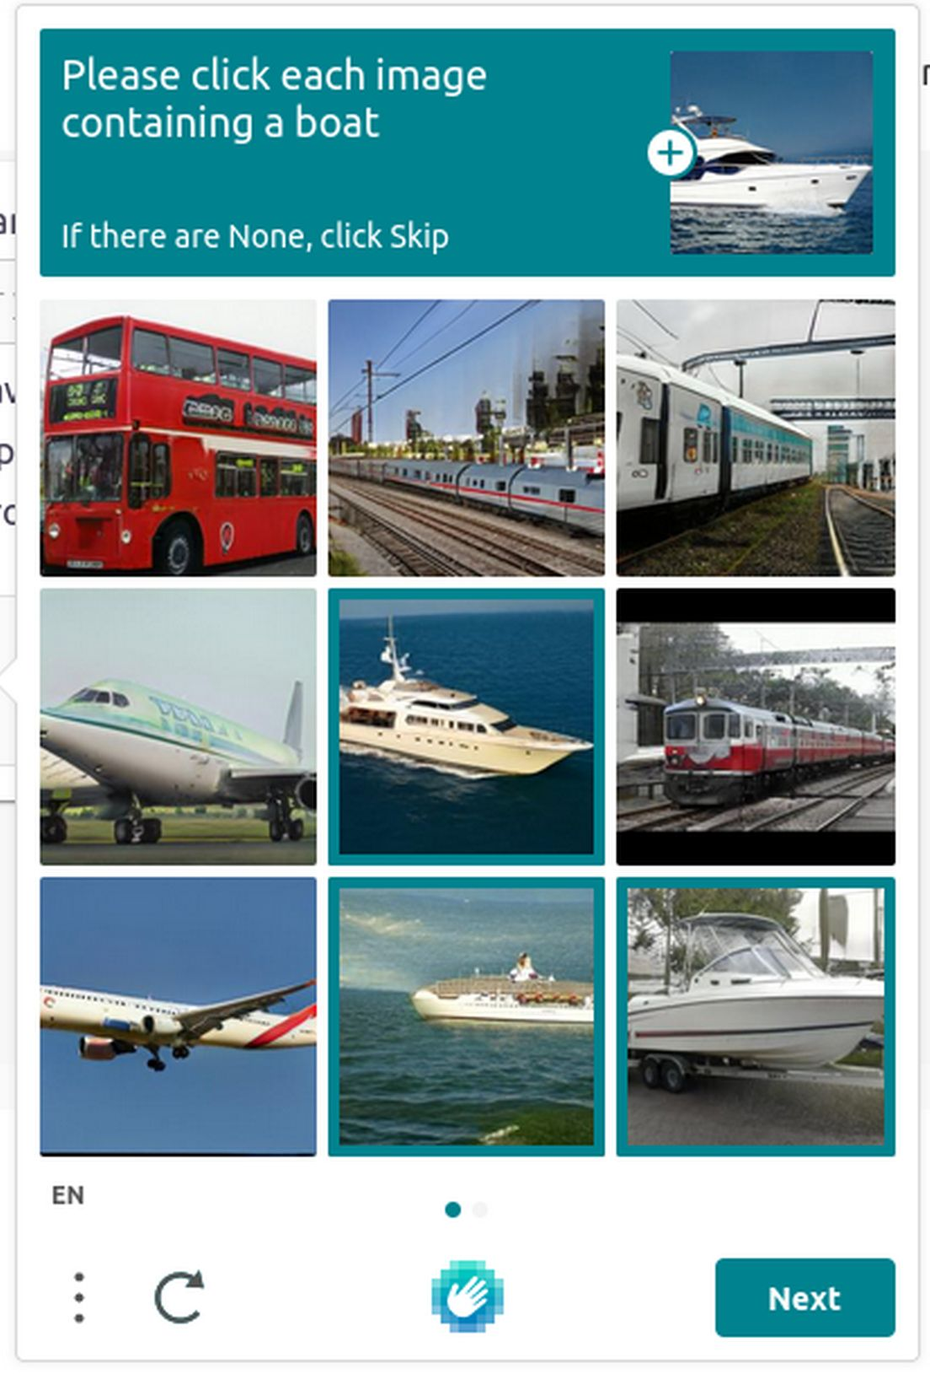
Notes:
Anyway, let’s continue with the visual timed workflow. You would then be presented a challenge like this – select all images that contain a boat. You click them, then click next.

Slide 20
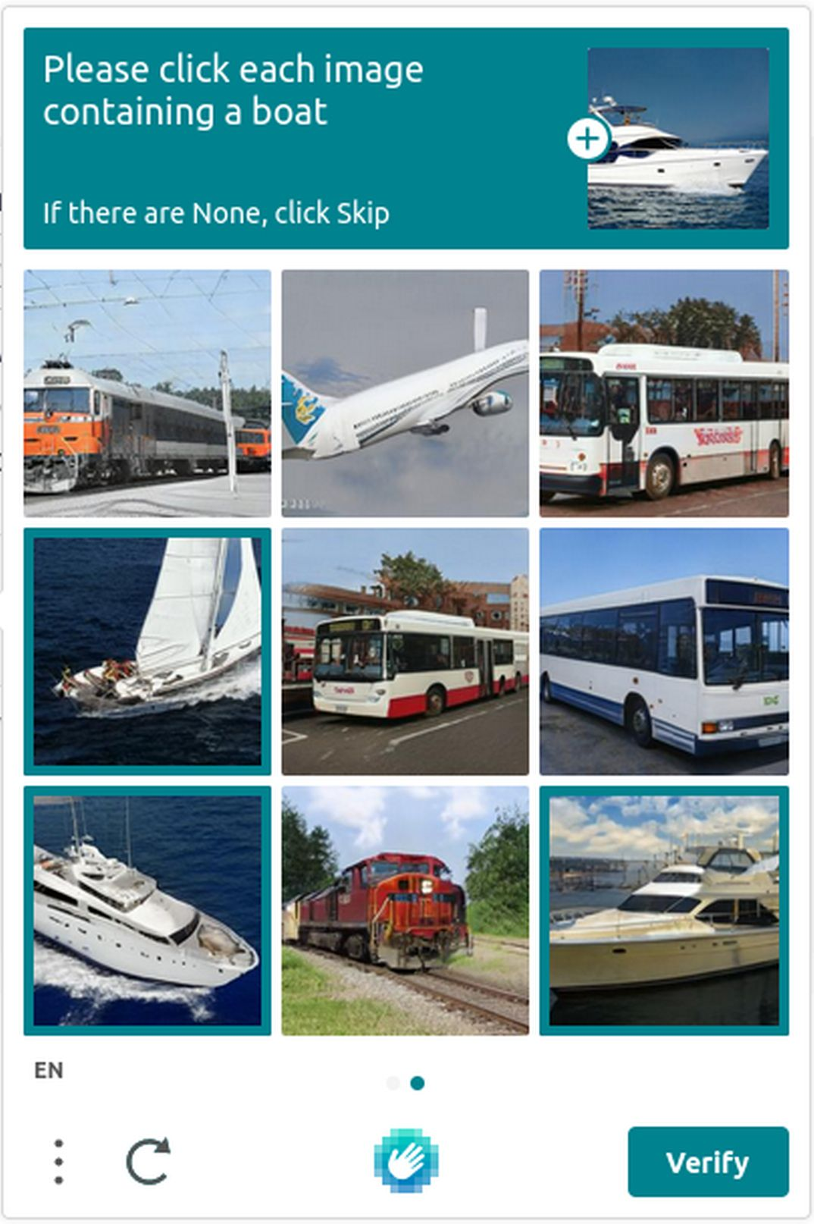
Notes:
Repeat for a new set of images….

Slide 21
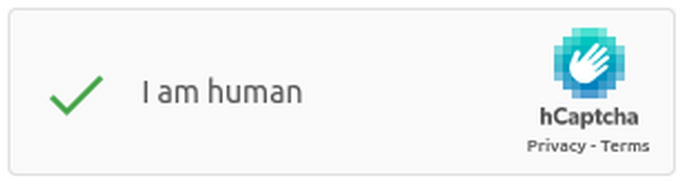
Notes:
And finally, the popup goes away, the box checks, you’re certified as human, and on you go.

Slide 22

Notes:
So let’s say you can’t use the visual, timed workflow. Perhaps you’re blind and can’t identify images. Or quadrapeligic and can’t select images quickly enough. How do you get through hCaptcha’s challenge?
Well, you use their “accessible workflow”.
So let’s start walking through that – at least as it stood when I started this work a year ago. It starts in the same place – with a form to fill out and an “I am human” box to check. So you check that box.

Slide 23

Notes:
And up pops the challenge. Unfortunately you can’t do it. If you’re lucky, you don’t spend time trying and instead look for accessible options.

Slide 24
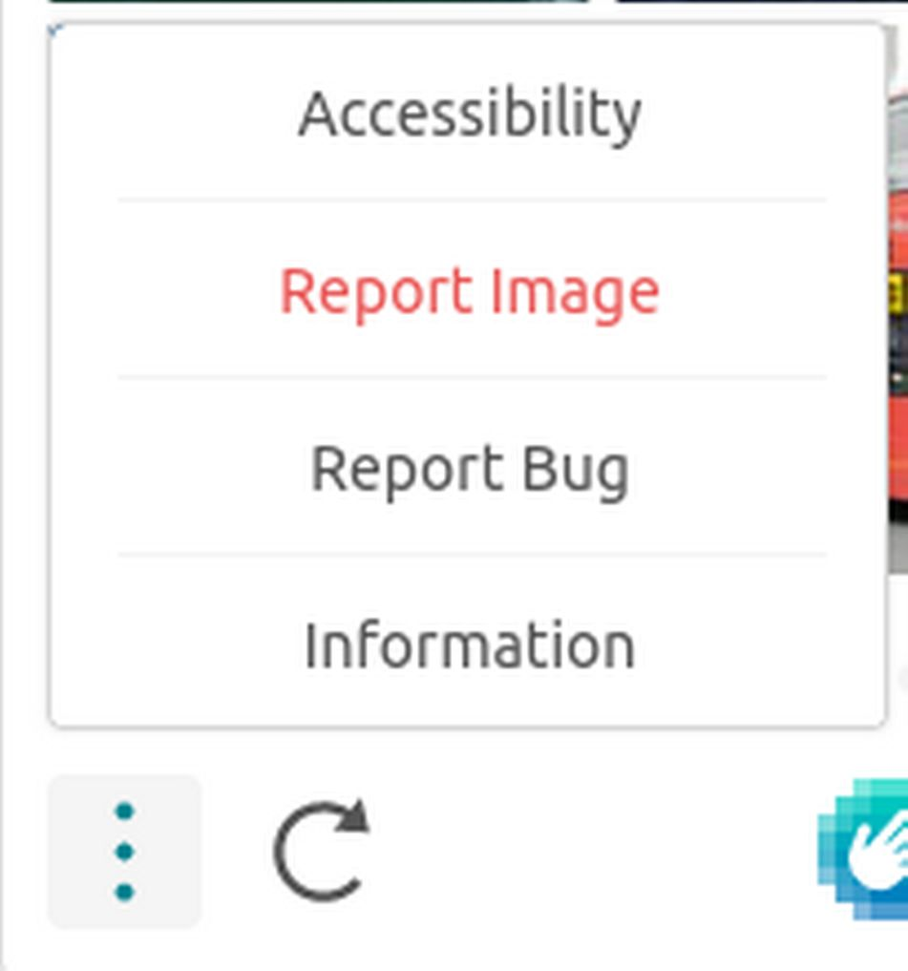
Notes:
Eventually you might find the burger menu in the bottom left corner of the popup. And from there the accessibility menu item. Clicking on that...

Slide 25
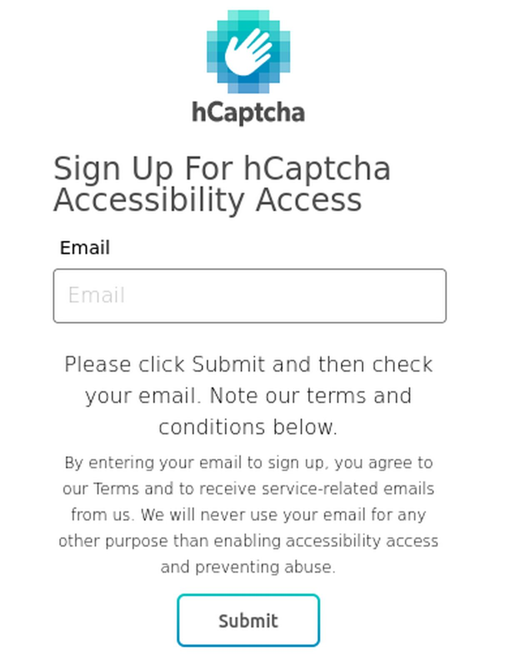
Notes:
Brings you to a page where you can put in your email to sign up for “accessibility access”. Submit that...

Slide 26
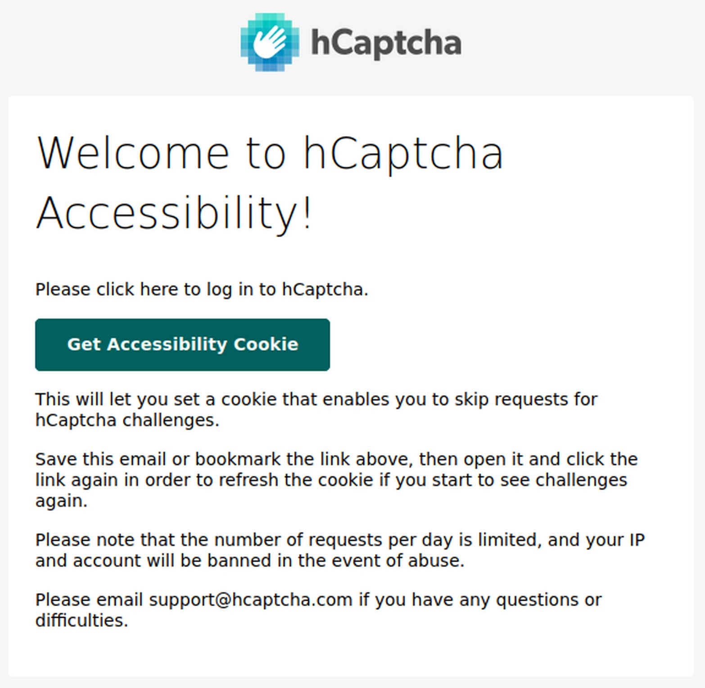
Notes:
So then you go to your email, and eventually this shows up. There’s a link (styled to look like a button) in there that says “Get Accessibility Cookie”, so you click that.

Slide 27
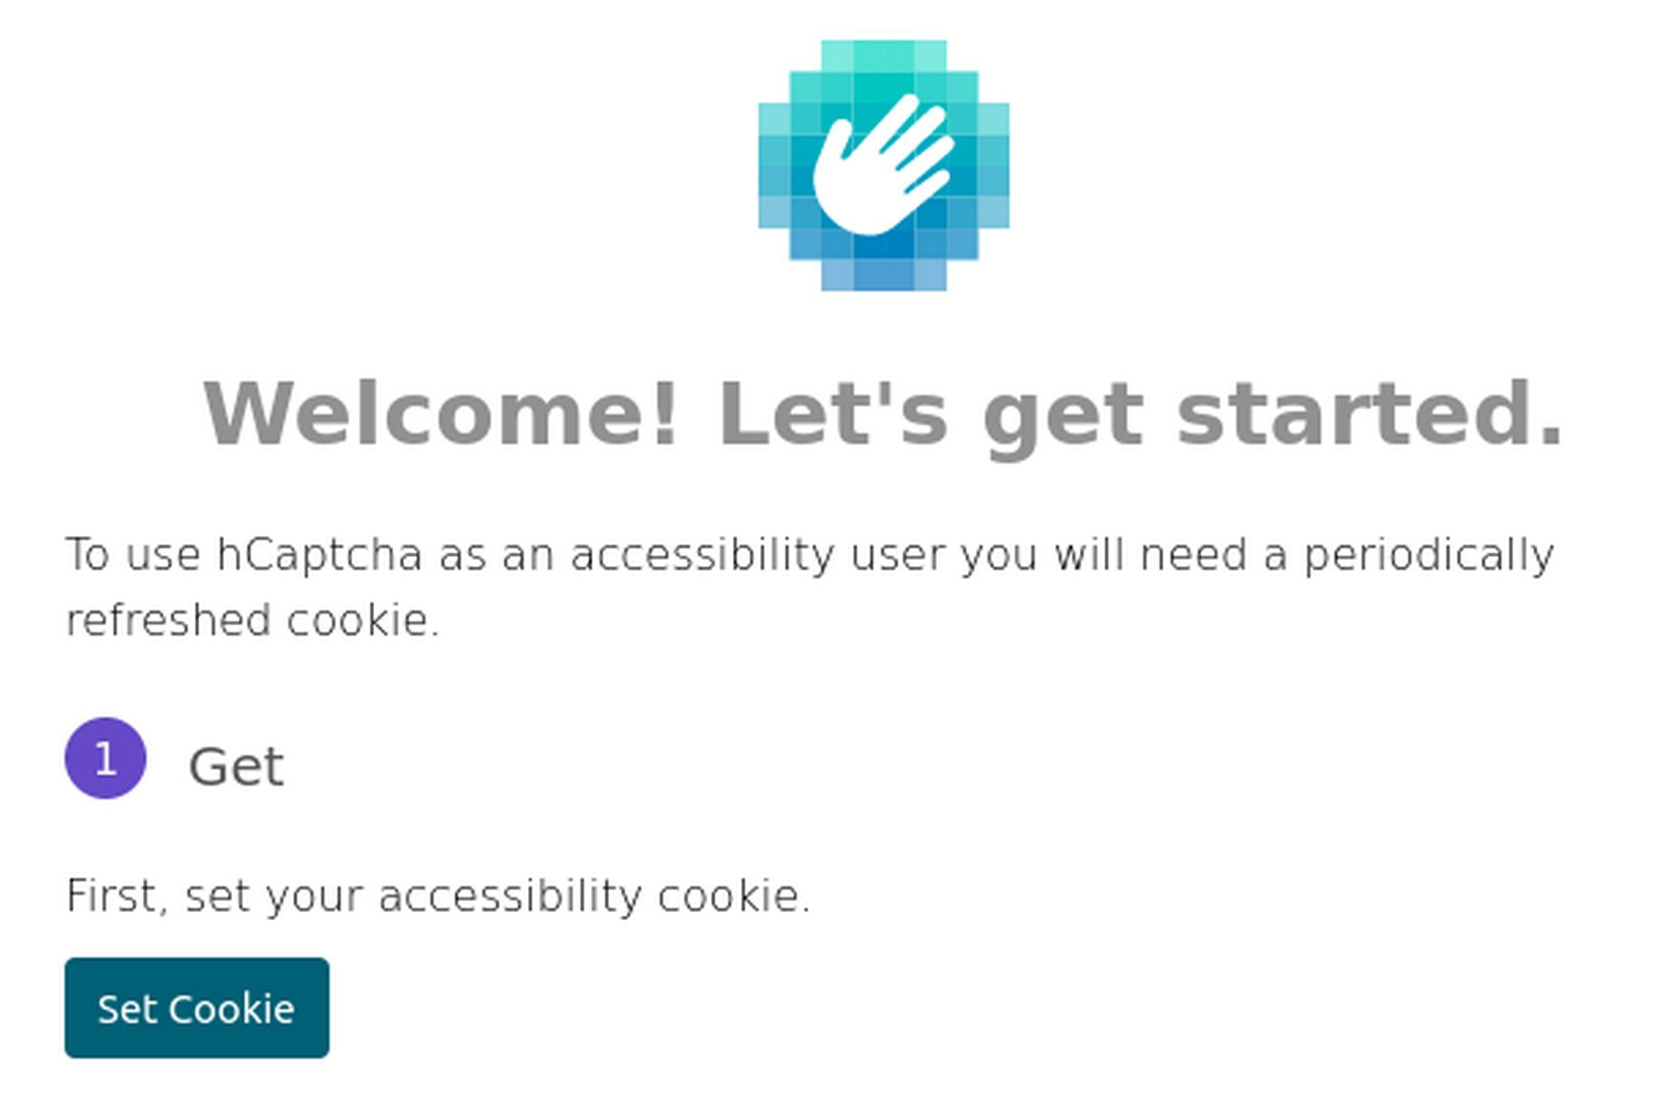
Notes:
Which brings you to a webpage that looks like this. You click “Set cookie”...

Slide 28
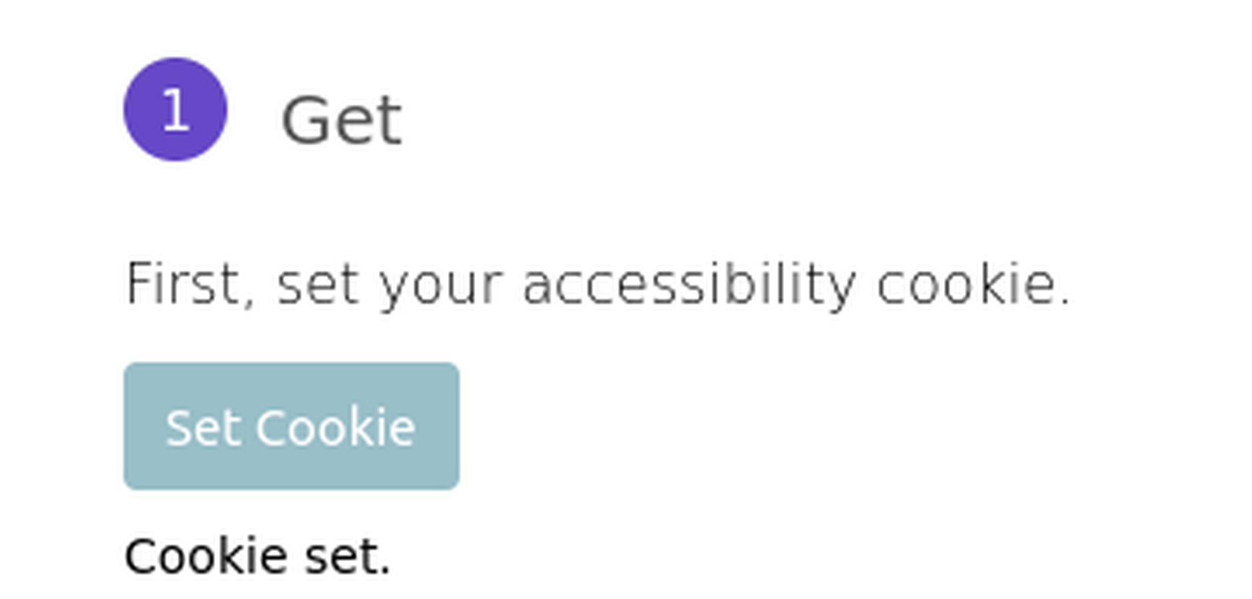
Notes:
And a little notification lets you know that a cookie is set.
When I first tested this, it seemed that this “cookie set” announcement didn’t work. When hCaptcha reached out, they told me this is something they regularly test. And that I have been able to verify – today the “cookie set” text announces on every screen reader and browser combination I used to test. So whatever else may be the case, hCaptcha does test for and fix accessibility issues.
Anyway, at last you go back to the form you were working on...

Slide 29

Notes:
Which has inevitably timed out. So you fill it in again and try to check the “I am human box”….

Slide 30

Notes:
Which works! Yay! Seems like a reasonable process, right? At least to cover the whole gamut of potential assistive technology and disabilities that might have trouble with the visual timed workflow.
This process is 7 or 8 steps, assuming everything works properly, some of which involve waiting. The visual, timed workflow is 3 steps. That’s a huge difference, especially in comparison to other captchas, which have accessible challenges that add no extra steps.
I should point out that this is the first-time workflow. It doesn’t always take so long. The cookie is good for some days once set, so you only have to deal with the dashboard rarely. I’ve previously said 24 hours and was informed by hCaptcha that that’s incorrect. And once you have the hCaptcha email, you can always use that to get back to the dashboard, so the signup process is skipped.

Slide 31
hCaptcha is...
Private
Secure
Faster/lower friction … except for people with
disabilities
Notes:
Nonetheless, that’s definitely not a low-friction workflow. So let’s go back to what hCaptcha is and mark that it is faster or lower friction… except for people with disabilities.
I have been told by hCaptcha that they want to reduce the step count in this workflow, but they did not have any specifics about that that they wanted to share with me. Some of what they’ve proposed is very interesting – but I’ll get to that later on.
But there are two big problems in how this workflow works, compared to the visual, timed workflow.

Slide 32
Privacy
Notes:
Let’s call the first one the privacy problem.

Slide 33
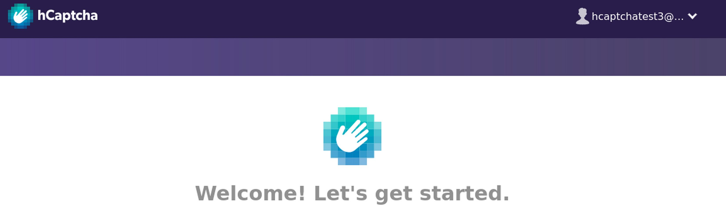
Notes:
This is a screenshot of hCaptcha’s accessibility dashboard – where you sign into with that link they send you. And in the red circle is the email I used to sign up.
This has some pretty significant privacy implications. This means that every cookie hCaptcha hands out via the accessibility workflow, they can tie back to a specific email – effectively to a permanent identity of an individual. And because hCaptcha embeds in many places, they could follow that cookie and therefore that user. With most captchas, you can just wipe cookies if you don’t want them to track you. But not with hCaptcha’s accessibility workflow – each cookie comes pre-tied to a user identity.
I was personally assured by the person I spoke to at hCaptcha (who I believe is in a position to know) that their infrastructure does not allow them to tie cookies to users. However, it’s not something I can personally verify. It also doesn’t rule out such a tie by 3rd parties or them being compelled to tie it by a government.

Slide 34
hCaptcha is...
Private … except for people with disabilities?
Secure
Faster/lower friction … except for people with
disabilities
Notes:
So let’s go back to what hCaptcha is and update that…
Strike privacy, and say “private except for people with disabilities”, with a question mark to indicate that we’ve been told it is private, but can’t verify – at least not yet.

Slide 35
Security
Notes:
I said there were two problems though. That was privacy. Now lets deal with security.
I’m not the first to look at security, “A low-cost attack against the hCaptcha system” Hossen & Hei, used images as training for machine learning, passed with a 95% success rate. hCaptcha and Cloudflare both dispute the accuracy and methodology of this study. hCaptcha, in particular says the researchers hit an anti-drain capability, and that passing the captcha doesn’t necessarily mean passing the evaluation of human-ness. Basically, that they detected the researchers’ automation, but passed them through the captcha anyway. There’s been no re-evaluation or repetition of the study, that I’m aware of.

Slide 36
hCaptcha is...
Private … except for people with disabilities?
Secure ... ?
Faster/lower friction … except for people with
disabilities
Notes:
So let’s go back to what hCaptcha is and put a question mark next to security. In my opinion, we members of the public don’t have enough to really know the truth here.

Slide 37
When the user clicks a button
When the user enters their email
When the user opens a link in an email
Whenever – check the User-Agent
Notes:
Alright, pop quiz before we go into the second problem. When does the accessible workflow verify the user is human? Show of hands...
Those of you who didn’t answer were the most correct – it doesn’t. No part of the accessible workflow is an AI-hard problem and difficult to automate.

Slide 38
Automation
Notes:
This is a short video of some quick automation I put together to prove this process can be automated. This is nothing fancy – xdotool driving the mouse and a little custom python to run a mail server. And as you can see, it’s perfectly capable of running through the entire accessibility workflow.
Putting this together was really interesting. When you hit a countermeasure, the page simply kicks back a “contact support” error. Debugging without any feedback other than “you did too much” is fun.
Video description: There is no audio in this video. It is a reduced length video demonstrating that software is able to walk through the accessible workflow automatically. The left and center are a browser window, initially at the hCaptcha accessibility signup page. A terminal window is shown on the right.
The video begins with a random email address being input to the signup page. The page then changes to read "Thank you. Please check your email and click the link". Next it changes to display the hcaptcha.com homepage and follows as the focus goes to the hcaptcha widget. At the widget, it checks the "I am Human" checkbox without being challenged. The entire time, the terminal scrolls lots of text about the minute details of the automation. This shows details of what the running code is doing. This starts with it detailing the keystrokes being input to the browser window. As the browser page changes to the thank you message, the terminal prints out the email message with the hCaptcha accessibility link. As the browser page changes to the hCaptcha homepage, the terminal shows keypresses being input again.

Slide 39
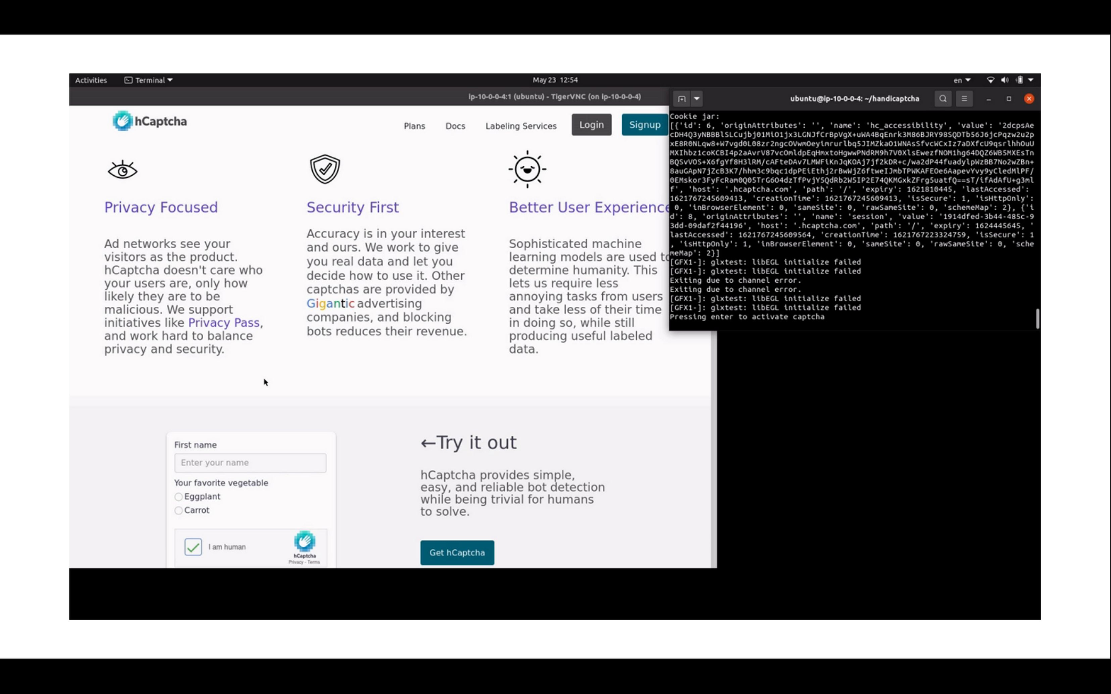
Notes:
One thing that was a challenge to me personally was handling the incoming email. I’ve never dealt with handling incoming email before and initially was trying to set up an email server that would pipe to a custom python script. That.. did not work out.
But now I can happily recommend the python smtpd module for handling incoming email messages.
hCaptcha does have some countermeasures to automation, mostly in the form of rate limiting. Each cookie can only be used so many times. Each account only gets so many cookies per day. Each IP address can only sign up for so many accounts per day. Each domain can only sign up for so many accounts per day. But domains are cheap and rotating IP addresses is easy, so it’s not clear how effective these are in the real world.

Slide 40
hCaptcha is...
Private … except for people with disabilities?
Secure … except that it can be automated
Faster/lower friction … except for people with
disabilities
Notes:
And let’s update what hCaptcha is again…
Strike secure, and say “except that it can be automated”
Hcaptcha’s initial written response to me, of course, said that I’d most likely been caught and was being allowed to pass anyway. Which … is a really convenient answer when researchers start poking your stuff – “we detected you attacking us and decided to let you believe you were successful”. As a security researcher, I can’t verify that either way. For now, let’s just say it looks like the automation was successful and any true verification would have crossed the line into real attacks on the system.

Slide 41

Notes:
So by now I hope I’ve convinced you that hCaptcha’s accessibility workflow is broken. All the work I did on it was under their bug bounty program. I disclosed this to them and to cloudflare (who run a second instance). Both declared it was not an issue due to mitigations that they declined to disclose or due to the resource usage required to circumvent the captcha. I’d like to give a really positive shoutout to cloudflare here. This isn’t their software, and they had pretty well written reasons for why it wasn’t a security issue, but they still paid out on the bug bounty.
One big question here is how should bug bounties deal with non-verifiable systems – where there isn’t a binary it worked/it didn’t work? Especially when the party responsible for verifying the bug is the one that pays out the bounty? This is beyond hCaptcha, more a question for the industry as a whole.

Slide 42

Notes:
So what’s changed, that I haven’t already mentioned? Or what haven’t I mentioned? One thing I was told about is something hCaptcha calls 99.9% mode. In this mode the captcha is entirely invisible, unless there’s a reason to challenge you. The name comes from the goal of only challenging 0.1% of legitimate users. So when you see hCaptcha – congratulations, you’re lucky.
Now, I haven’t been able to verify this, beyond the text that’s on their enterprise marketing page. If you know how to write browser extensions that can monitor for things like this, I’d love to hear from you – I’d like to put one together as the next step in this work.
Speaking of hCaptcha being invisible – I was talking about this work with a friend of mine, who made a brilliant observation. With hCaptcha being invisible except when it thinks you’re automation, it quickly becomes the annoying thing that always makes you do a stupid puzzle – because you only see it when it makes you do a puzzle! In contrast, reCaptcha at least lets you know it’s there, making it much more tolerable to see.

Slide 43

Notes:
Some other good things I heard, but can’t verify: Their training set for what is “human” includes users of various assistive technologies. This implies those users are not getting picked out as automation, at least hopefully.
They do run manual testing of the entire system with some frequency (both in-house and via a third party testing service), though the person I was talking to didn’t remember exactly how frequently.
From the point of view of assuring more-or-less equal access, these are both great things. This means my largest criticism of hCaptcha – at this moment – is that their accessibility workflow is significantly longer than their visual, timed workflow.

Slide 44
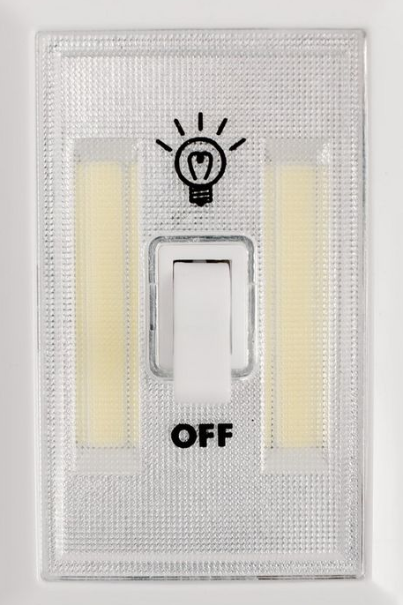
Notes:
In the past, I thought that hCaptcha had shut down their automated registration because it didn’t work and I couldn’t sign up for accounts. I was able to run through it myself this week and it does still work. My guess is that I hit a countermeasure against abuse and was unaware of it.
Hitting that countermeasure in the past did let me test the more manual process via support. In that version, you have to email support and wait for a human support person to handle your ticket. When I did this, they asked for my IP, browser, what website I was on, and what about hCaptcha doesn’t work for me. The last is particularly critical. This doesn’t quite require disclosing a disability, but gets real damn close. Saying “I can’t see the photos” isn’t the same as saying “I’m blind”, but it has the same effect.
That said, I’ve been told this is a place they’re willing and trying to improve. I got asked for feedback on this and how best to ask this question, if needed. If you’ve got thoughts on this, I’d like to hear them.

Slide 45
The Bigger Picture
Notes:
So let’s take a step back and look at the bigger picture

Slide 46
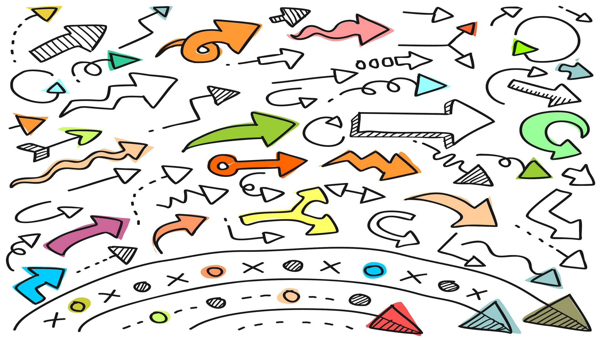
Notes:
Let’s talk about how such a flawed design came to be. Before I get into that, I want to be clear: this is derived from hCaptcha’s public writings, and is my best reconstruction. I have no private information and haven’t spoken with them about their process.
hCaptcha is a data labeling service, so they need data to label. Computers put out (typically) audio and visuals – not much for the other senses. So captchas will be either audio or visual captchas.

Slide 47
🎧
Notes:
Most captcha services provide an alternative audio captcha for those who cannot complete visual captchas. However, hcaptcha believes, and this is a direct quote from their support staff, that “audio options provide virtually no security” and that Google’s reCaptcha disables audio captchas if it believes traffic is suspicious. I have found no evidence that the last part is actually the case, despite many questions across the internet asking how to disable audio captchas.
This belief that audio captchas are low security is, in my opinion, what lead hCaptcha to choose to do a visual-only captcha. After all it’ll be high security!

Slide 48

Notes:
But somewhere along the way, someone realized they need to make this accessible. I don’t know the mechanism. To their credit, it does appear they implemented the accessible workflow at the end of the engineering process, but before launch.
However, discovering the accessibility requirement might have been a good time to step back and reconsider “no audio captchas”. Perhaps they even did – I don’t know. Instead of using audio, they came up with the strange “accessible” workflow we walked through earlier.
So what’s next for hCaptcha?

Slide 49
What object can give the time?
Notes:
Outside of the current state, hCaptcha says they’re moving a a new “text-based” challenge system. This is the system I alluded to earlier that’s both accessible and protects the privacy of users of the accessible workflow as much as that of the visual, timed workflow. This has users answer questions like this one – “What object can tell time” and makes determinations based on that. This has language and cultural challenges, but if done well is good for certain populations with disabilities – it’s one of the few, if not the only captcha that would be accessible to those who are deafblind – but could be bad for others, for example, those who are cognitively impaired. This is a game changer and – once it rolls out, means hCaptcha will be the best captcha in terms of accessibility and privacy. Enough so that I recommend using them – once this is available on all their captchas.
hCaptcha told me they’re still actively working on this, it’s in beta and that it’s currently something customers can opt-in to having on their captchas. This has been the case for more than half a year and it should roll out to all captchas in some months, depending on current uptake and how that affects the speed of validating the data set.

Slide 50

Notes:
Finally, here’s my closing thought on hCaptcha: they’re really close to being a best-in-class, accessible, effective and privacy-first anti-automation product. Once they roll out the text-based challenge for all their captchas, they will be the best product out there for accessible, effective, and privacy-first protection from automation. So watch for that to happen in the next few months.
So that’s hCaptcha. What about others? We’re starting to see a decoupling of automation detection from these AI hard problems to other methods of differentiating human from automation. Should we continue using AI-Hard, Human-easy problems? What do we do when these are exhausted? Are there other, more effective ways to handle automation on the internet? And how will any future solution interact with accessibility?

Slide 51
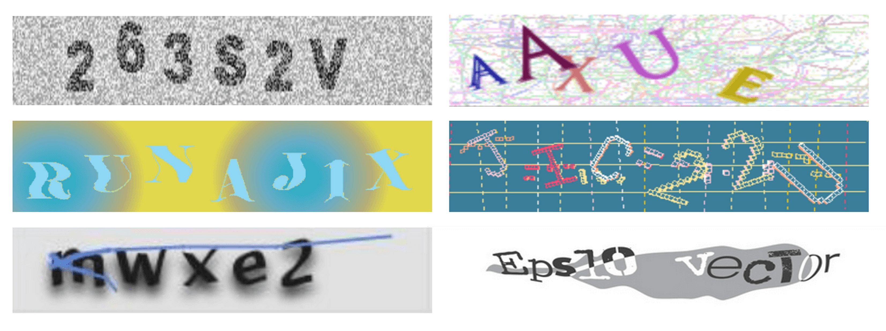
Notes:
Let’s start with what I wouldn’t use. I wouldn’t use any of these visual-only type the letters and numbers captchas. These are just inaccessible – and easily enough solved by automation at this point. They provide pretty minimal security, if any.
At this point I’d like to call out an internet darling – wikimedia. They use one of these captchas. They also have 16 year old bug pointing out that they’re inacessible. People have written code and whole new captchas for them, but they haven’t changed it. As far as I can tell this is simply due to a lack of institutional will. Instead, they’ve come up with a process where users reach out to admins – basically, what we just talked about with hCaptcha, but worse.

Slide 52

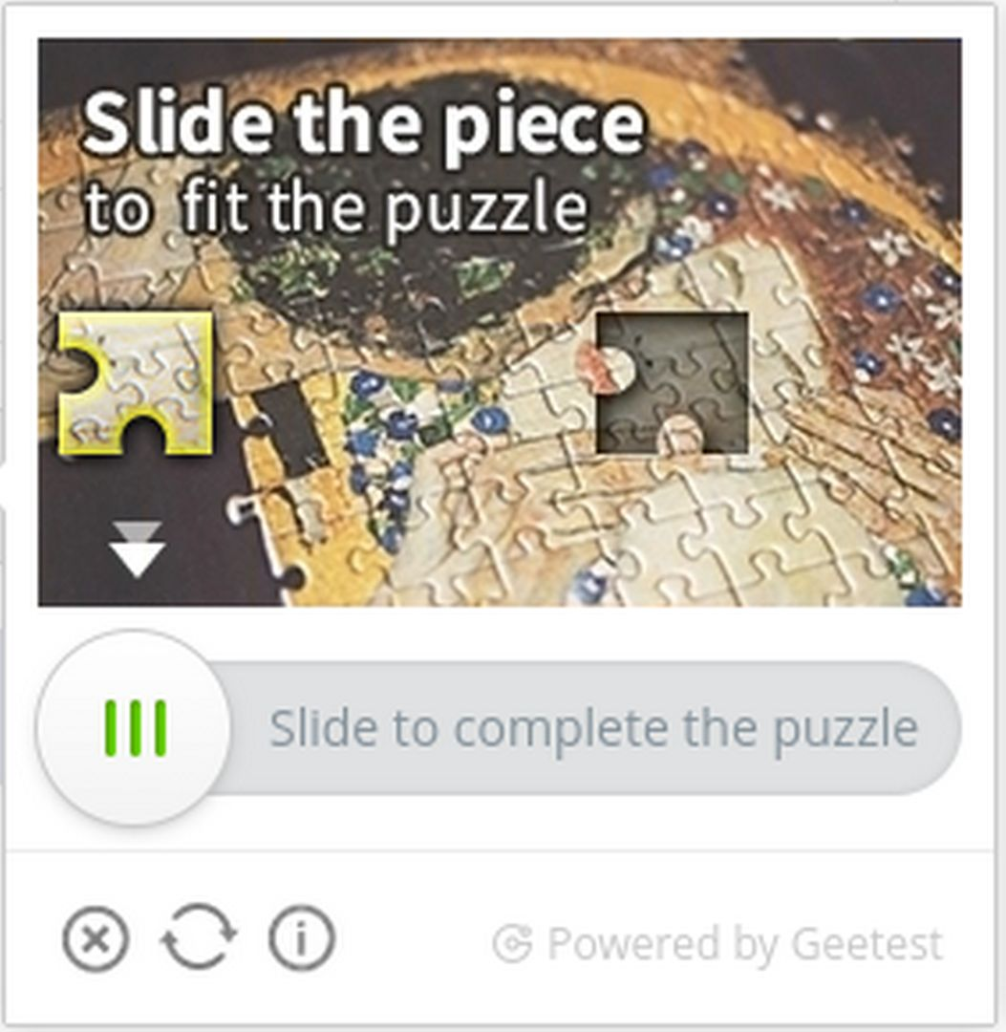
Notes:
I also wouldn’t use anything that is a slide the puzzle piece captcha. As simple as they look, they exclude anyone who can’t operate a mouse. And many of them are built by companies located in places without strong disability access laws, so don’t expect to see any accessible options from them soon.

Slide 53

Notes:
As it turns out, hCaptcha is actually one of the better captcha options, when examining security, accessibility and privacy. They’ve at least thought about accessibility, which is more than can be said for almost all their competitors. And they have a really strong story around privacy – if you can use the visual, timed workflow. In my current estimation, they’re the second-best currently available. As soon as they roll out their text-based challenge for all captchas, they will be the best. Honestly, the fact that they’re so close is what makes it all the more frustrating that their accessibility workflow is currently - in my opinion – problematic.

Slide 54

Notes:
We’ve already talked about reCaptcha and the “I’m not a robot” check box. Broadly speaking, this represents one option for the future – using patterns and machine learning to determine if a user is automation or a human. However, there will always be marginal cases, which have to fall back to something – probably one of these AI-Hard human-easy problems. It increases the difficulty of circumventing the captcha – now the automation has to behave like a human, have a full browser, and operate at human speed. But it doesn’t really stop automation, just slow it down.

Slide 55
CAPTCHA
Notes:
At this point I’d like to make a radical proposal: the age of the captcha is over and it’s time to replace it. I base this on two things: first, the shrinking category of AI-hard, human-easy problems. Quite frankly, I think we’re just running out of problems in this class as AI becomes better and better at solving more and more problems. Second, quite honestly, the fact that captcha farms exist mean they’re not even particularly reliable today. Some sources have placed the cost as low as $1 for 1000 captcha solves.

Slide 56
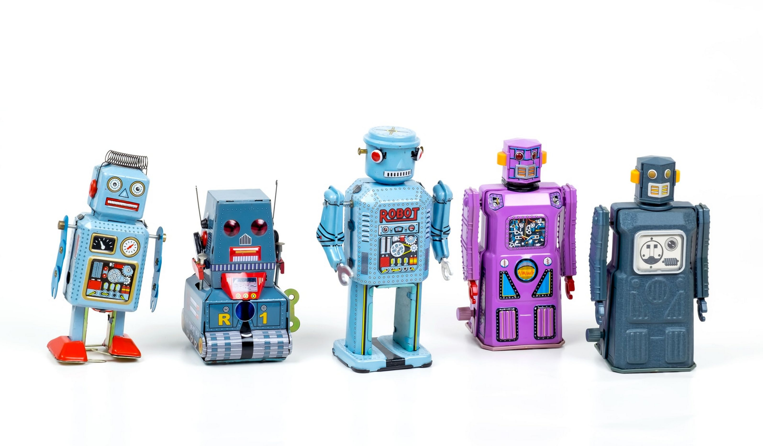
Notes:
CAPTCHAs are used for a lot of purposes. Broadly speaking, I split these into two categories – bot prevention and data integrity protection.

Slide 57

Notes:
Bot prevention includes a lot of things, but primarily is about fairness of resource usage. In this case, websites show a captcha if a user is doing something that may be unfair to other users. For example, requesting too many pages too quickly, or trying to log in too often (that is: attempting to guess passwords).
In this case, captchas often are a primitive form of rate limiting. So why not go straight to actual rate limiting? As a live example of this, Project Gutenberg is perfectly happy for you to download their full library – as long as you do it slowly enough not to impact other users. They actually hand out a curl command line to allow users to do that.

Slide 58

Notes:
Data integrity protection is more about making sure only good data is getting into systems – for example, spam prevention. This is a much harder problem partially due to the flexible nature of what is and isn’t spam. A post about photo editing software on a photography forum? Probably not spam. On a knitting forum? Probably spam.
The nerd in me wants to suggest AI as the solution to this. But honestly, it’s probably too complicated for most sites to set up, absent someone doing a really good job of building a user-friendly generalized AI anti-spam system.

Slide 59
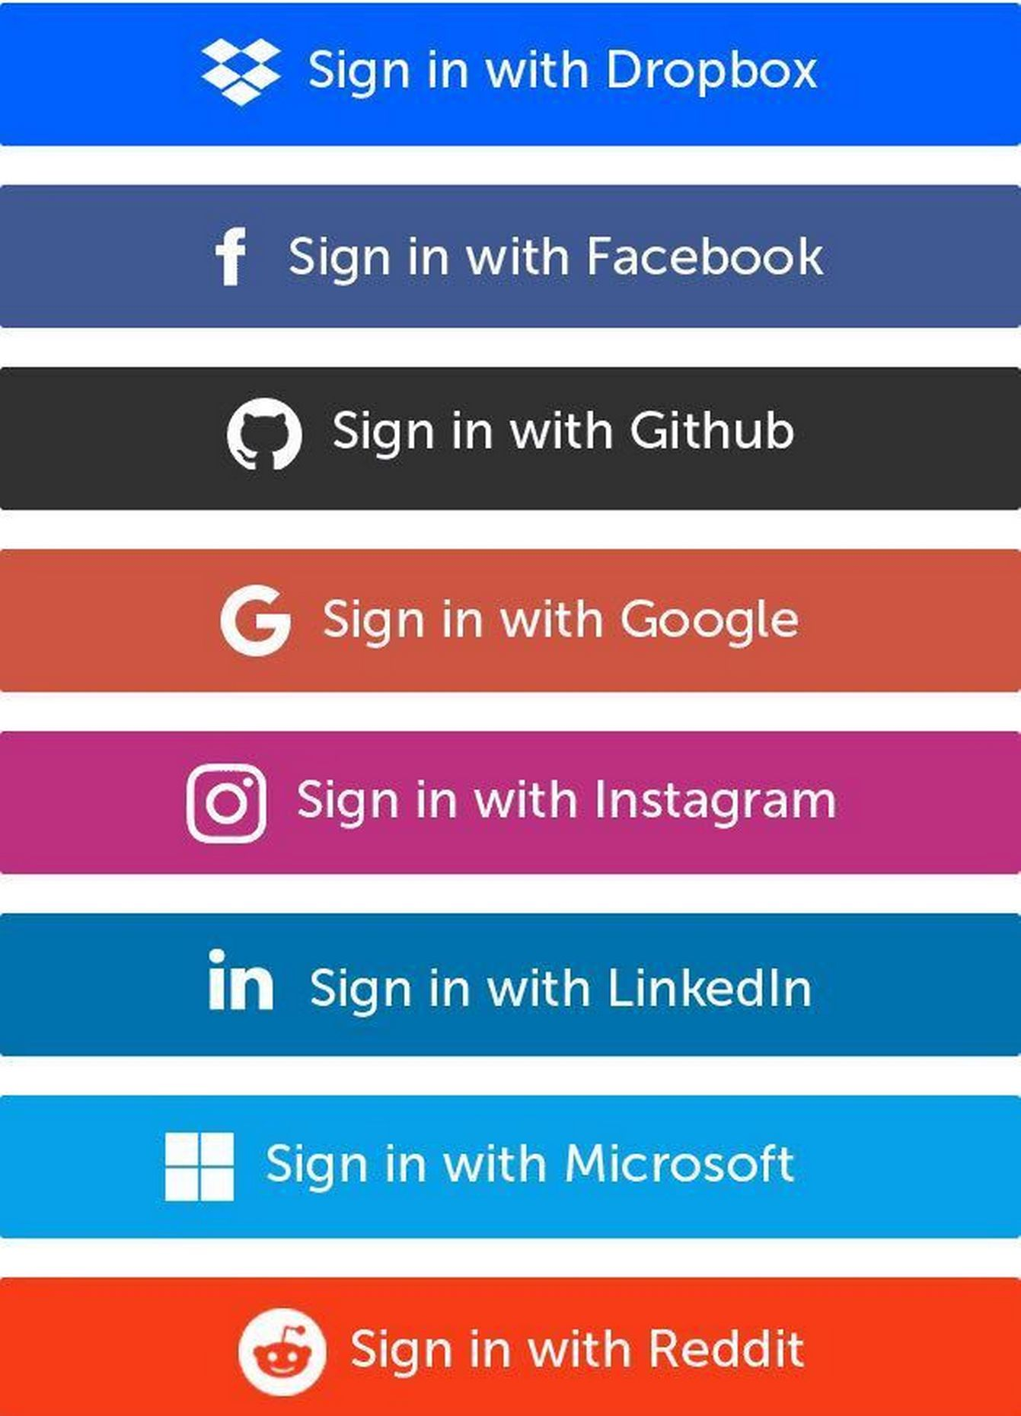
Notes:
This problem is complicated. If the site/service requires payment, you could require a valid credit card. If not, a valid email from a trusted provider. What all these solutions have in common is making validation of the user someone else’s problem. If you’re thinking this sounds an awful lot like federated or social sign in – it does to me too.
Beyond this, I’m not honestly sure what good solutions there are for spam reduction that a general purpose website owner without a high degree of technical expertise can deploy.

Slide 60
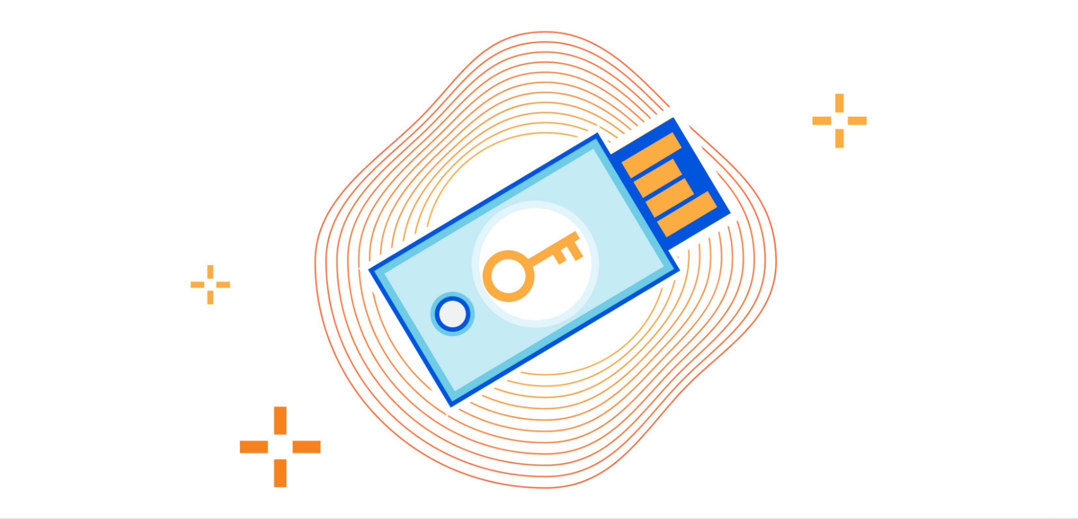
Notes:
Personally, though, I think something hardware-based is the way to go. It turns out I’m not alone. Cloudflare rolled out something they call Cryptographic Attenstation of Personhood in 2021. This uses FIDO keys in order to verify the user. Cloudflare claims this lets you anonymously attest to being a real person, withou having to solve any puzzle – and that it takes about 5 seconds.

Slide 61
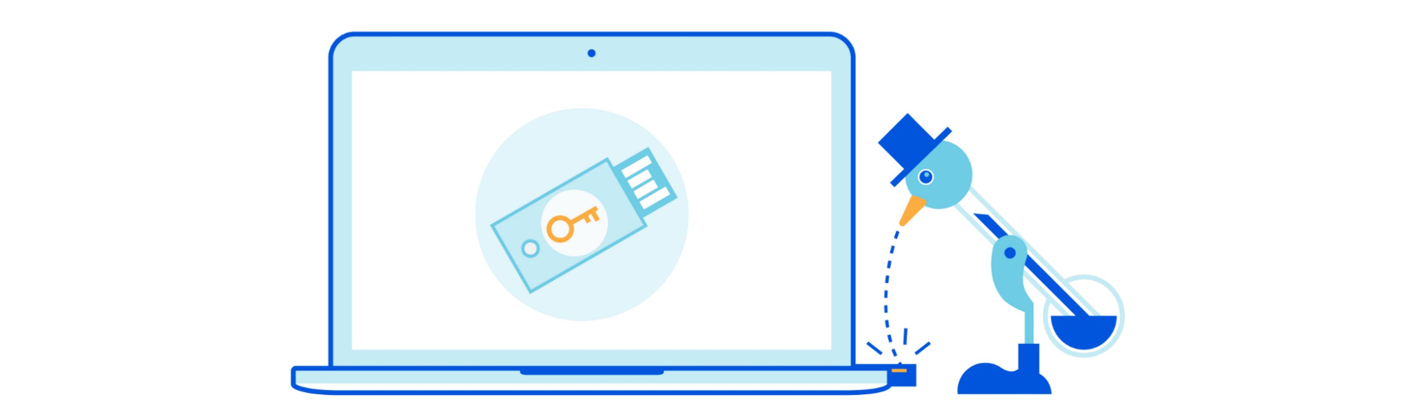
Notes:
However, they also say it’s vulnerable to what they call the “drinking bird attack”. Basically, these tokens verify a button is being pushed, not that there’s an actual human there pushing the button. To cloudflare, this isn’t an issue – they point out that the attestation process on the devices – which involves public key cryptography – takes long enough that it’s actually slower than most modern captcha farms. Therefore, this method may not perfectly prevent automation, but it does slow it down compared to current solutions.

Slide 62
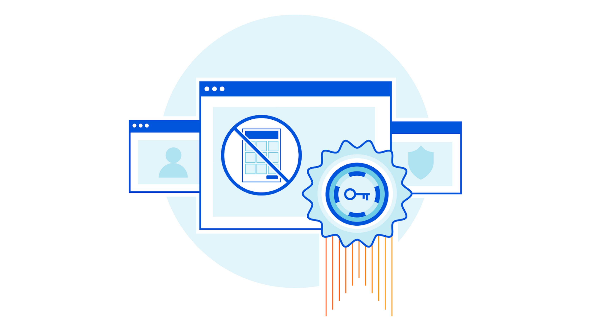
Notes:
As I was preparing this talk, I was thinking that that was really neat, but why should you need a separate device? Why not just build the security into the laptop or phone?
As it turns out, Cloudflare also got there first. On June 22, they rolled out Private Access Tokens. For now, this only works with Apple devices. But, it allows attestation of personhood without dedicated devices. In this process, Cloudflare asks Apple to attest to the device. Cloudflare learns your IP address and what webpage you want to visit, but no device IDs. Conversely, Apple learns device IDs, but nothing about what website you want to visit. In cloudflare’s estimation, this is quicker and more privacy protecting than their previous solutions.
And it’s built using open standards, so expect other manufacturers to start providing it soon – I hope. The person I spoke with at hCaptcha said they have hooks built in for protocols like this and are actually hoping to roll this out for their customers shortly.
Nor are they alone – there are indicators most or all of the major players in the CAPTCHA space, including apple and microsoft – are looking at zero-interaction humanity verification.

Slide 63

Notes:
So how does all of this relate to accessibility? Well, a lot of these solutions are minimal or no interaction. This works really well for people with disabilities – if you don’t need to interact with a device, it’s inherently equally accessible to all.
Minimal interaction, such as pressing a button, could still be a problem for some people, such as people who are quadrapalegic. So I’d like to see manufacturers make tokens that are usable by these people.
So given the option, I’d really recommend going with some kind of zero-interaction attestation protocol. It’s inherently accessible and will reduce friction for users at the same time.
And finally, to wrap up this section on the future – I believe the CAPTCHA - at least in the form of solving a puzzle - is going away. It’s just a matter of when and how. A future where automation doesn’t flood the internet with spam, your device can automatically be verified completely privately AND you never see a captcha sounds pretty nice, doesn’t it?

Slide 64

Notes:
As I wrap up and we all head off towards the next talk, what do I want you thinking about? Three things:
When doing design, make sure you’re considering all users and requirements. Tacking on accessibility at the end of the engineering process is a great way to fail spectacularly at actually being accessible.
Be aware of what happens at the margins. I spoke a lot about “Human-easy” problems – but for whom are those problems easy? Is it really ALL humans? Every design decision is a trade off, even the ones you think aren’t. A fancy searchable dropdown might be inaccessible to a screenreader user. So for every decision you make, consider who is at the margins and how that decision effects them.
Design for a mainstream that works for everyone. When it comes to accessibility, and trying to create and maintain parallel workflows or products is a truly excellent way to end up breaking your entire system. In accessibility, separate is never equal

Slide 65
Questions?
More information, code, full-length demos:
pressers.name/anewhope

