Slide 1
Java Server Pages
(JSP)

Slide 2
What is JSP?
Java based technology that simplifies the developing of dynamic web sites
JSP pages are HTML pages with embedded code that allows to access data from Java code running on the server
JSP provides separation of HTML presentation logic from the application logic

Slide 3
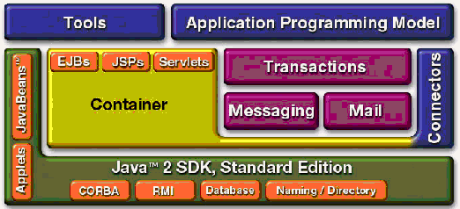
JSP in Java EE Architecture
An extensible Web technology that uses template data (typically HTML/XML), custom elements, scripting languages, and server-side Java objects to return dynamic content to a client

Slide 4
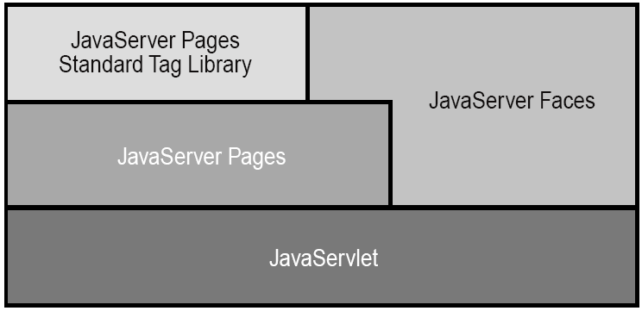
Java Web application technologies
JSP technology is built on top of Java Servlet technology and they are complimentary for the purpose of Web application development

Slide 5
The need for JSP
With servlets, it is easy to
  Read form data
  Read HTTP request headers
  Set HTTP status codes and response headers
  Use cookies and session tracking
  Share data among servlets
  Remember data between requests
But tedious to
  Use println statements to generate HTML
  Maintain that HTML

Slide 6
Generating HTML in servlet
import javax.servlet.*;
import javax.servlet.http.*;
import java.io.*;
public class HelloServlet extends HttpServlet {
public void doGet(HttpServletRequest request,
HttpServletResponse response)
throws ServletException, IOException
{
response.setContentType("text/html");
PrintWriter out = response.getWriter();
out.println("<html><body><h1>" +
"Hello World!</h1></body></html>");
...
out.close();
}
}

Slide 7
JSP technology
JSP technology provides a way to combine the worlds of HTML and Java servlet programming
Idea:
  Use regular HTML for most of page
  Mark servlet code with special tags
Entire JSP page gets translated into a servlet (once), and servlet is what actually gets invoked (for each request)

Slide 8
What is JSP Page?
A text-based document capable of returning both static and dynamic content to a client browser
Static content and dynamic content can be intermixed
Static content
  HTML, XML, Text
Dynamic content
  Java code
  Displaying properties of JavaBeans
  Invoking business logic defined in Custom tags

Slide 9
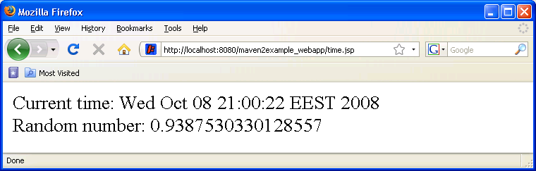
Example: a simple JSP page
<html>
<body>
Hello World!
<br>
Current time: <%= new java.util.Date() %> <br>
Random number: <%= Math.random() %>
</body>
</html>

Slide 10
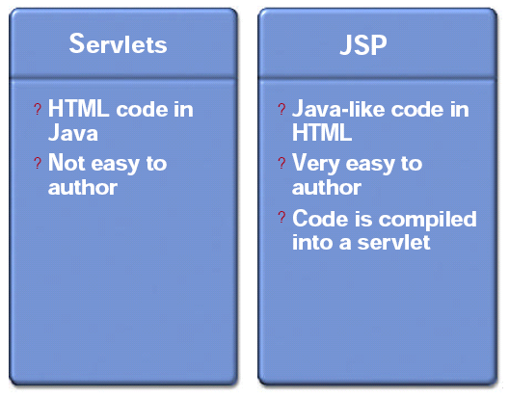
Servlets versus JSP

Slide 11
JSP benefits
Content and display logic are separated
Simplify web application development with JSP, JavaBeans and custom tags
Supports software reuse through the use of components (JavaBeans, custom tags)
Automatic deployment
  Recompile automatically when changes are made to JSP pages
Easier to author web pages
Platform-independent

Slide 12
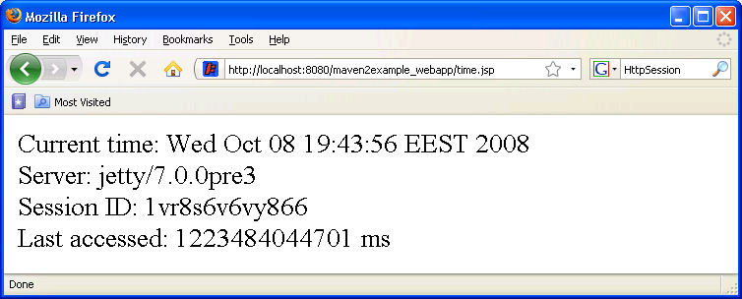
Example: another simple JSP
<html>
<body>
Current time: <%= new java.util.Date() %> <br>
Server: <%= application.getServerInfo() %> <br>
Session ID: <%= session.getId() %> <br>
Last accessed: <%= session.getLastAccessedTime() %> ms
</body>
</html>

Slide 13
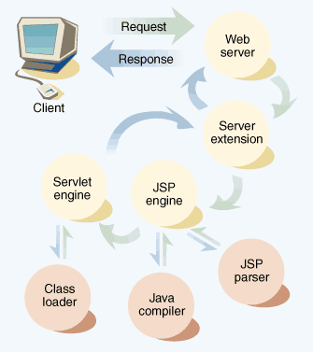
How does JSP work?
Client request for a page ending with ".jsp“
Web Server fires up the JSP engine
The JSP engine checks to see if the JSP file is new or changed
(if new) The JSP engine takes the page and converts it into a Java servlet (by JSP parser)

Slide 14
How does JSP work?
(if new) The JSP engine compiles the servlet (by standard Java compiler)
Servlet Engine executes the Java servlet using the standard API
Servlet’s output is transferred by Web Server as a HTTP response

Slide 15
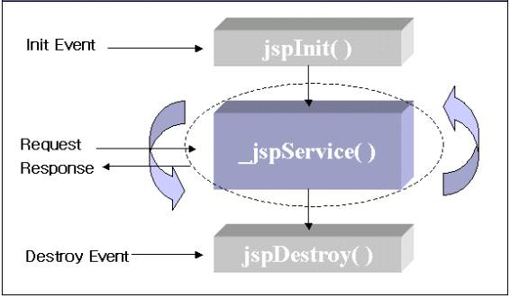
JSP lifecycle methods
The _jspService() is invoked every time a new request comes to a JSP page
Method arguments:
HttpServletRequest
and
HttpServletResponse
A page author cannot override _jspService(), as its implementation is provided by the container

Slide 16
Dynamic contents generation techniques
JSP supports two different styles for adding dynamic content to web pages:
  JSP pages can embed actual Java code
  JSP supports a set of HTML-like tags that interact with Java objects on the server (without the need for raw Java code to appear in the page)

Slide 17
Calling Java code directly
Insert Java code into JSP page (into the servlet that will be generated from JSP page)
Suitable only for a very simple Web application
  hard to maintain
  hard to reuse code
  hard to understand for web page authors
Not recommended for relatively sophisticated Web applications
  weak separation between contents and presentation

Slide 18
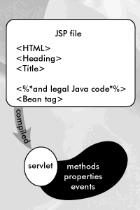
JSP page content
Standard HTML tags & scripts (JavaScript/VBscript)
New tags for scripting in
the Java language
There are three forms
  Expressions: <%= Expressions %>
  Scriptlets: <% Code %>
  Declarations: <%! Declarations %>

Slide 19
Expressions
During execution phase
  Expression is evaluated and converted into a String
  The String is then inserted into the servlet's output stream directly
  Results in something like out.println(expression)
  Can use predefined variables (implicit objects) within expression
Format
  <%= Expression %>
  OR
  <jsp:expression>Expression</jsp:expression>
  Semi-colons are not allowed for expressions

Slide 20
Example: Expressions
Display current time using Date class
  Current time: <%= new java.util.Date() %>
Display random number using Math class
  Random number: <%= Math.random() %>
Use implicit objects
  Your hostname: <%= request.getRemoteHost() %>
  Your parameter:
  <%= request.getParameter(“yourParameter”) %>
  Server: <%= application.getServerInfo() %>
  Session ID: <%= session.getId() %>

Slide 21
Scriptlets
Used to insert arbitrary Java code into servlet's jspService() method
Can do things expressions alone cannot do
  setting response headers and status codes
  writing to a server log
  executing code that contains loops, conditionals
Can use predefined variables (implicit objects)
Format:
  <% Java code %> OR
  <jsp:scriptlet> Java code</jsp:scriptlet>

Slide 22
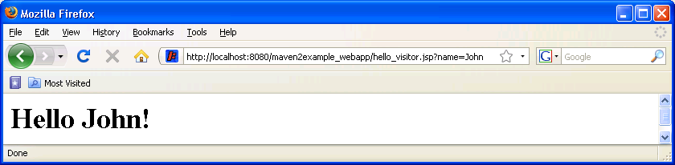
Example: Simple scriptlet
<html>
<body>
<% String visitor = request.getParameter("name");
if (visitor == null) visitor = "World"; %>
<h1>Hello <%= visitor%>!</h1>
</body>
</html>
/hello_visitor.jsp?name=John

Slide 23
Example: Scriptlet with a loop
<%
Iterator i = cart.getItems().iterator();
while (i.hasNext()) {
ShoppingCartItem item = (ShoppingCartItem)i.next();
BookDetails bd = (BookDetails)item.getItem();
%>
<tr>
<td align="right" bgcolor="#ffffff">
<%=item.getQuantity()%>
</td>
<td bgcolor="#ffffaa">
<strong><a href="<%=request.getContextPath()%>
/bookdetails?bookId=<%=bd.getBookId()%>"><%=bd.getTitle()%>
</a></strong>
</td>
...
<%
// End of while
}
%>

Slide 24
Example: JSP → Servlet
Suppose we have the following JSP page
<html>
<body>
  <H2> My HTML </H2>
  <%= myExpression() %>
  <% myScriptletCode(); %>
</body>
</html>
It will be translated into Java servlet code as follows…

Slide 25
Example: JSP → Servlet
public void _jspService(HttpServletRequest request,
HttpServletResponse response)
throws ServletException, IOException {
response.setContentType(“text/html”);
HttpSession session = request.getSession(true);
JSPWriter out = response.getWriter();
// Static HTML fragment is sent to output stream in “as is” form
out.println(“<H2>My HTML</H2>”);
// Expression is converted into String and then sent to output
out.println(myExpression());
// Scriptlet is inserted as Java code within _jspService()
myScriptletCode();
...
}

Slide 26
Declarations
Used to define variables or methods that get inserted into the main body of servlet class
  Outside of _jspSevice() method
  Implicit objects are not accessible to declarations
Usually used with Expressions or Scriptlets
For initialization and cleanup in JSP pages, use declarations to override jspInit() and jspDestroy()
Format:
  <%! method or variable declaration code %>
  <jsp:declaration> method or variable declaration code </jsp:declaration>

Slide 27
Example: Declaration
<H1>Random number generator</H1>
<%!
private double randomNumber() {
return Math.random();
}
%>
<%
double randomNumber1 = randomNumber();
double randomNumber2 = randomNumber();
double sum = randomNumber1 + randomNumber2;
%>
First random number: <%= randomNumber1 %> <br>
Second random number: <%= randomNumber2 %> <br>
Sum: <%= sum %>

Slide 28
Example: Servlet code
public class XXX implements HttpJSPPage {
private double randomNumber() {
return Math.random();
}
public void _jspService(HttpServletRequest request,
HttpServletResponse response)
throws ServletException, IOException {
. . .
out.write("<H1>Random number generator</H1>\n");
out.write('\n');
double randomNumber1 = randomNumber();
double randomNumber2 = randomNumber();
double sum = randomNumber1 + randomNumber2;
out.write("First random number: ");
out.print( randomNumber1 )
. . .

Slide 29
Comments
JSP supports three types of comments:
  XHTML comments
    Format <!-- and -->
    Can be placed throughout JSP, but not in scriplets
  JSP comments
    Format <%-- and --%>
    Can be placed throughout JSP, but not in scriplets
  Java comments
    Standard ones // and /* */
    Place within scriplets

Slide 30
Implicit objects
A JSP page has access to certain implicit objects that are always available, without being declared first
Provide programmers with access to many servlet capabilities in the context of a JSP
Created by container
Corresponds to classes defined in Servlet

Slide 31
Implicit objects
request (HttpServletRequest)
response (HttpServletRepsonse)
session (HttpSession)
application (ServletContext)
out (JspWriter)
config (ServletConfig)
pageContext

Slide 32
Scope objects
Application scope
  Container owns objects within application scope
  Any servlet or JSP can manipulate such objects
Session Scope
  Exists for the clients entire browsing session
Request Scope
  Exist for the duration of the requests
  Go out of scope when request is completed with a response to the client
Page scope
  Each page has it’s own instances of the page-scope implicit objects

Slide 33
Implicit object initialization [1/2]
Implicit objects are initialized in a servlet code generated by container
public void _jspService(HttpServletRequest request,
HttpServletResponse response)
throws java.io.IOException, ServletException {
PageContext pageContext = null;
HttpSession session = null;
ServletContext application = null;
ServletConfig config = null;
JspWriter out = null;
Object page = this;
JspWriter _jspx_out = null;
PageContext _jspx_page_context = null;
. . .

Slide 34
Implicit object initialization [2/2]
. . .
try {
response.setContentType("text/html");
pageContext = _jspxFactory.getPageContext(
this, request, response, null, true, 8192, true);
_jspx_page_context = pageContext;
application = pageContext.getServletContext();
config = pageContext.getServletConfig();
session = pageContext.getSession();
out = pageContext.getOut();
_jspx_out = out;
. . .
}

Slide 35
JSP standard actions
Provide JSP implementers with the access to several of the most common tasks performed in a JSP
  including content from other resources
  forwarding requests to other resources
  interacting with JavaBeans
  and other . . .
Format: <jsp:action> and </jsp:action> where action is the standard action name

Slide 36
JSP standard actions [1/3]
Action | Description
<jsp:include> | Dynamically includes another resource in a JSP. As the JSP executes, the referenced resource is included and processed.
<jsp:forward> | Forwards the request processing to another JSP, servlet or static page. This current action terminates the current JSP’s execution.
<jsp:param> | Used with the include, forward and plugin actions to specify additional name/value pairs of information for use by those actions.

Slide 37
JSP standard actions [2/3]
Action | Description
<jsp:plugin> | Allows a plug-in component to be added to a page in the form of a browser-specific object or embed HTML element. In the case of a Java applet, this action enables the downloading and installation of the java plug-in if it is not already installed on the client computer.
<jsp:useBean> | Specifies that the JSP uses a JavaBean instance. This action specifies the scope of the bean and assigns it an ID that scripting components can use to manipulate the bean.

Slide 38
JSP standard actions [3/3]
Action | Description
<jsp:setProperty> | Sets a property in the specified JavaBean instance. A special feature of this action is automatic matching of request parameters to bean properties of the same name.
<jsp:getProperty> | Gets a property in the specified JavaBean instance and converts the reusult to a string for output in the response.

Slide 39
Directives
A directive gives further information to the JSP container that applies to how the page is compiled
Syntax
<%@ directive attribute=“value” %>
Can also combine multiple attribute settings
<%@ directive
attribute1="value1“
attribute2="value2“
attributeN="value N" %>

Slide 40
Three main types of directives
page: specifies page dependent attributes and communicate these to the JSP container
  <%@ page import="java.util.* %>
include: used to include text and/or code at JSP page translation-time
  <%@ include file="header.html" %>
taglib: indicates a tag library that the JSP container should interpret
  <%@ taglib prefix="c" uri="http://java.sun.com/jsp/jstl/core" %>

Slide 41
Some page directives
Which classes are imported
  <%@ page import="java.util.* %>
What MIME type is generated
  <%@ page contentType="MIME-Type" %>
How multithreading is handled
  <%@ page isThreadSafe="false" %>
What page handles unexpected errors
  <%@ page errorPage="errorpage.jsp" %>

Slide 42
JSTL
JSTL = Java Standard Tag Library
Encapsulates core functionality common to many JSP applications
The following tags are provided by JSTL
  Core tags
  XML tags
  SQL tags
  Formatting tags
  Function tags

Slide 43
Reminder

Slide 44
How to use JSTL in JSP
To use JSTL in JSP, you need to do some configuration in JSP
  Step1: download standard.jar and jstl.jar
  Step2: ensure that both files are packaged in /WEB-INF/lib directory of WAR file
  Step3: Write JSP file that can use core tags
<dependency>
<groupId>taglibs</groupId>
<artifactId>standard</artifactId>
<version>1.1.2</version>
</dependency>
<dependency>
<groupId>javax.servlet</groupId>
<artifactId>jstl</artifactId>
<version>1.1.2</version>
</dependency>

Slide 45
taglib directive
To use JSTL tags in JSP need to include the following directive in a page:
Tag usage example:
<%@ taglib prefix="c"
uri="http://java.sun.com/jsp/jstl/core" %>
<c:set var="name" value="${param.text1}" />
Welcome <c:out value="${name}" ! />

Slide 46
Core tags [1/2]
Variable support
  <c:set>
  <c:remove>
Conditional
  <c:if>
  <c:choose>
    <c:when>
    <c:otherwise>
Iteration
  <c:forEach>
  <c:forTokens>

Slide 47
Core tags [2/2]
URL management
  <c:import>
    <c:param>
  <c:redirect>
    <c:param>
  <c:url>
    <c:param>
General purpose
  <c:out>
  <c:catch>

Slide 48
Example: iterating and printing
<table border="1">
<c:forEach var="customer" items="${customers}">
<tr>
<td><c:out value="${customer.firstName}"/></td>
<td><c:out value="${customer.lastName}"/></td>
<td><c:out value="${customer.phoneHome}"
default="no home phone specified"/></td>
</tr>
</c:forEach>
</table>

Slide 49
References
JSP Technology in Java EE 5 Tutorial
http://java.sun.com/javaee/5/docs/tutorial/doc/bnagx.html
JSP Documents in Java EE 5 Tutorial
http://java.sun.com/javaee/5/docs/tutorial/doc/bnajo.html
JSTL in Java EE 5 Tutorial
http://java.sun.com/javaee/5/docs/tutorial/doc/bnakc.html

