Slide 1

Deep learning and recomending systems
By Saioa Prieto and Alexander Pérez

Slide 2
Index

Slide 3
DLRM MODEL Deep Learning Recommendation Model

Slide 4
Basic components
Embbedings → DLRM will utilize embedding tables for mapping categorical features to dense representations
Matrix factorization → DLRM uses Matrix Factorization idea to calculate relations between features.
MLP → will use 2 layers of MLP (top and bottom), one for processing features and another for calculating relationships

Slide 5
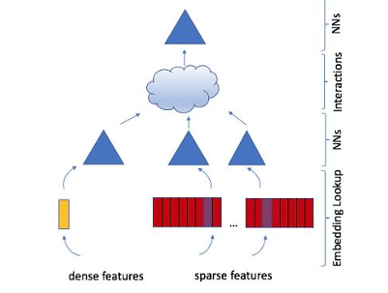
DLRM Architecture
Input → continous and categorical features
Bottom or dense MLP
Interactions → Calculated by making a dot producto
Predictions → thanks to a final sigmoid function
Top or output MLP

Slide 6
Parallelism

Slide 7
DIEN MODEL

