Slide 1

Learning Python from 0 to 0.1
Lesson 2 Hello python!
Sprindy

Slide 2
Lesson 1 Hello python!
Part 1
Homework of lesson 01
Part 2
基本语法
Part 3
读写Excel例子

Slide 3
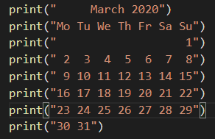
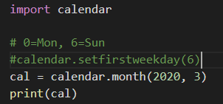
Homework of lesson 01
打印日历2020年3月份

Slide 4
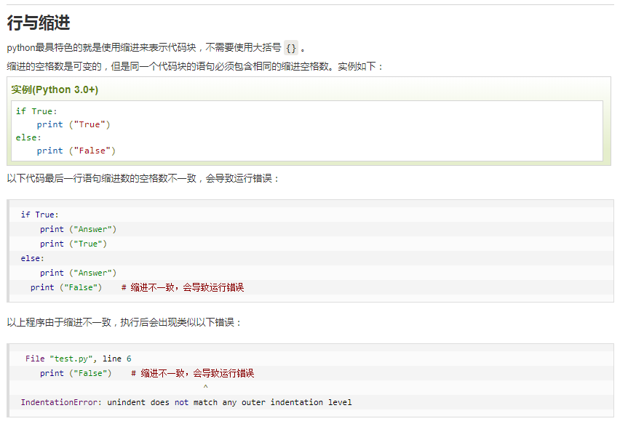
Basic Syntax of python

Slide 5
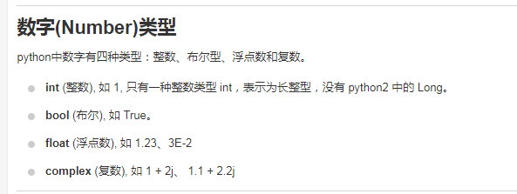
Basic Syntax of python

Slide 6
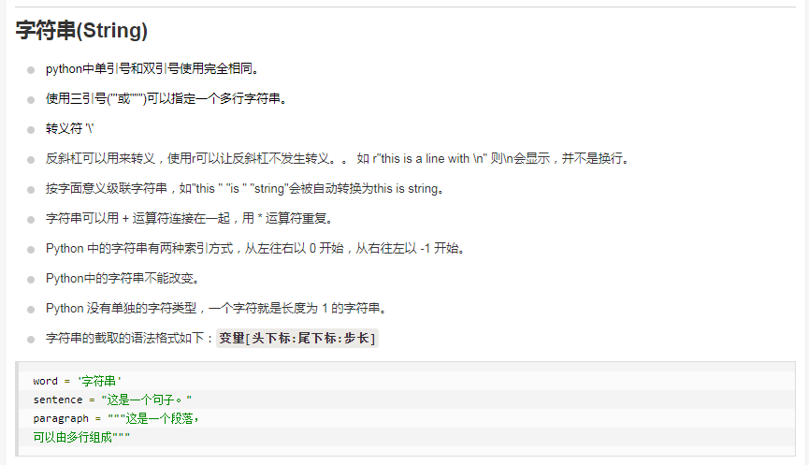
Basic Syntax of python

Slide 7
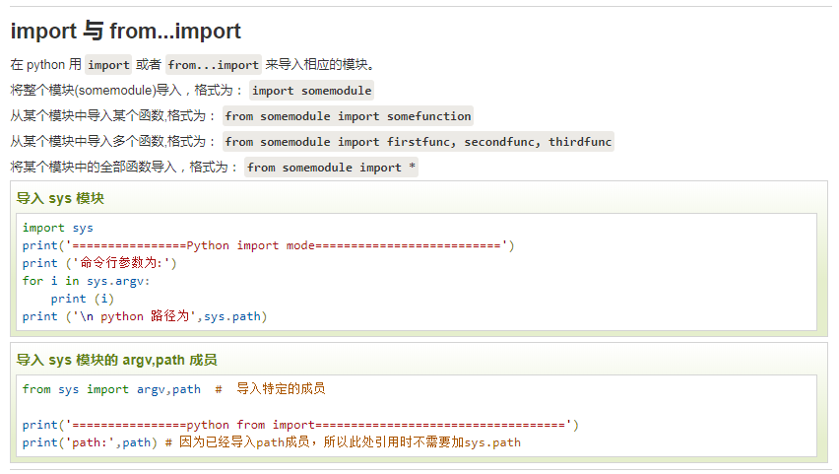
Basic Syntax of python

Slide 8
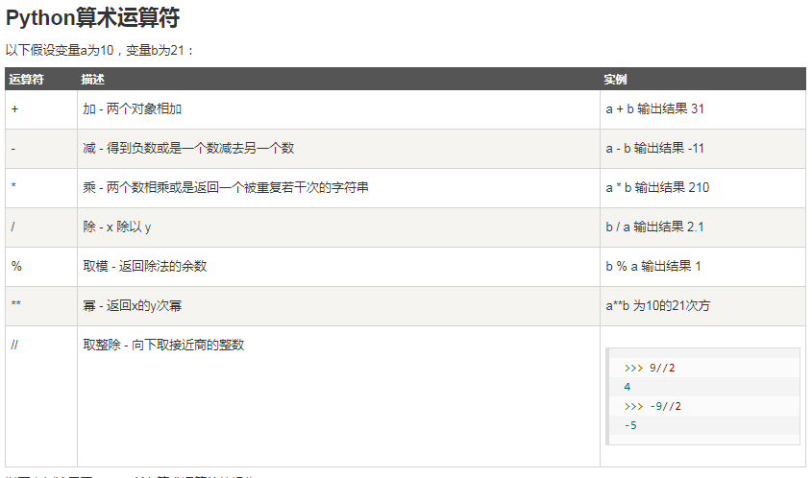
Basic Syntax of python

Slide 9
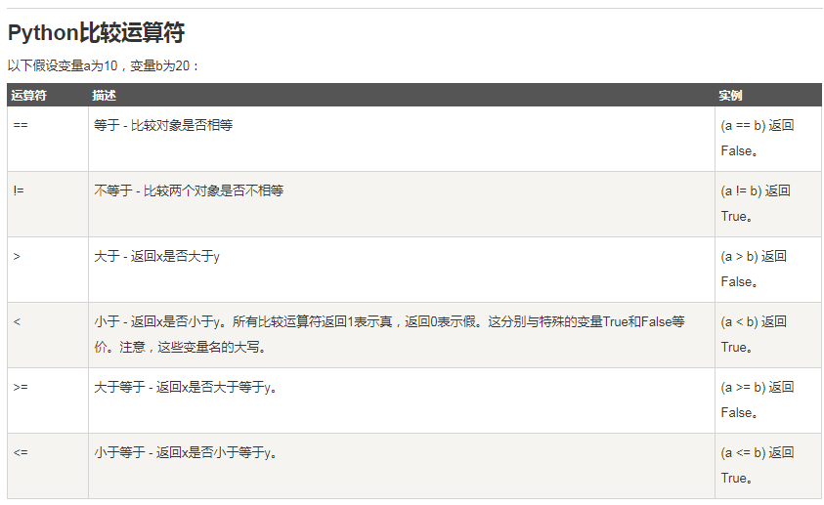
Basic Syntax of python

Slide 10
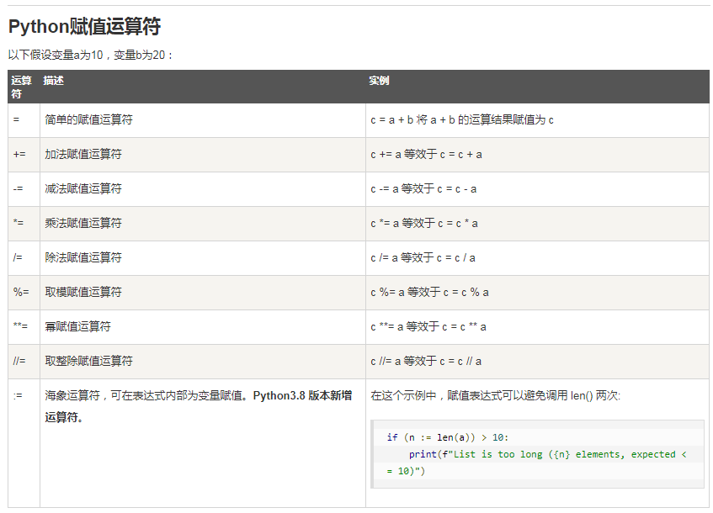
Basic Syntax of python

Slide 11
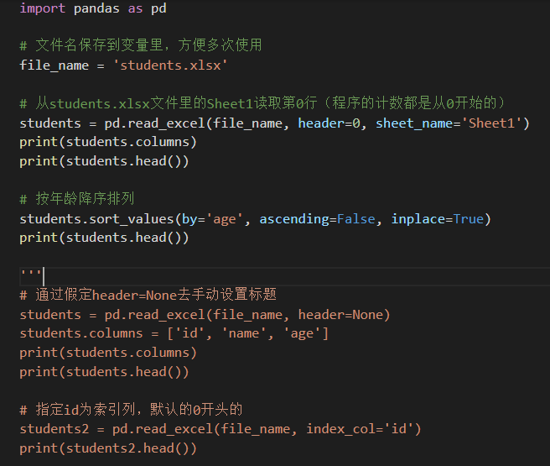
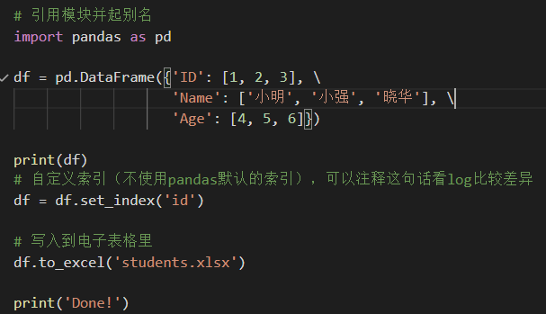
Write and read Excel file through pandas
通过pandas的DataFrame读写电子表格文件

Slide 12

QA

