Slide 1

Learning Python from 0 to 0.1
Lesson 3 Hello python!
Sprindy

Slide 2
Lesson 1 Hello python!
Part 1
Homework of lesson 02
Part 2
基本语法
Part 3
自动字幕生成的例子

Slide 3
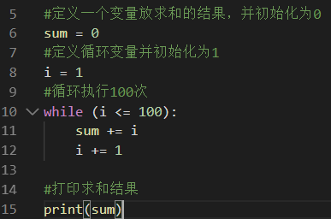
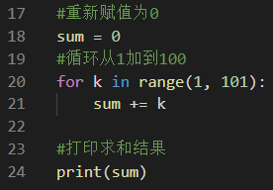
Homework of lesson 02
求和： 从1加到100

Slide 4
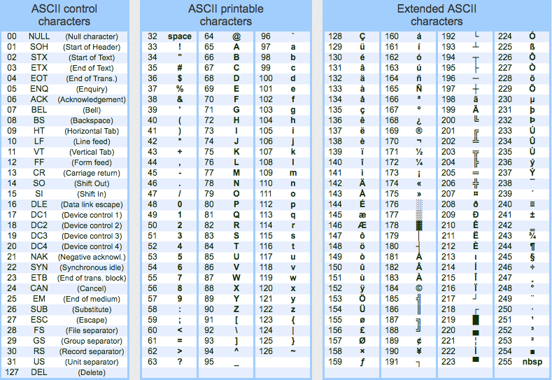
Basic Syntax of python -- ASCII table
https://www.ascii-code.com/ 计算机编程语言的“字母表”

Slide 5
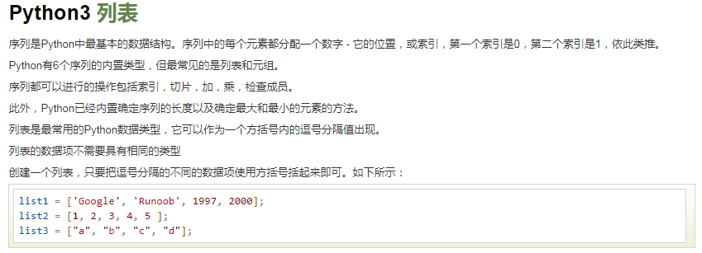
Basic Syntax of python -- List

Slide 6
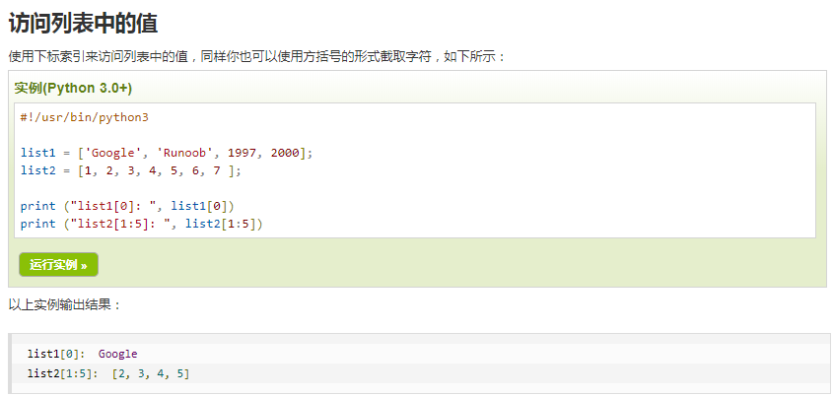
Basic Syntax of python -- List

Slide 7
Basic Syntax of python -- List
列表里元素的增加，（班里新来一个同学）
列表里元素的修改，（班里交换了一个同学）
列表里元素的删除，（班里走了一个同学）
列表里元素的个数统计，（班里一共有多少同学）

Slide 8
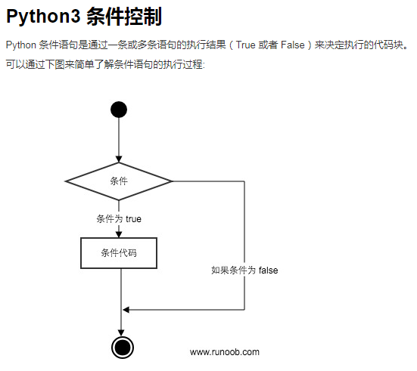
Basic Syntax of python -- if condition
只有，才

Slide 9
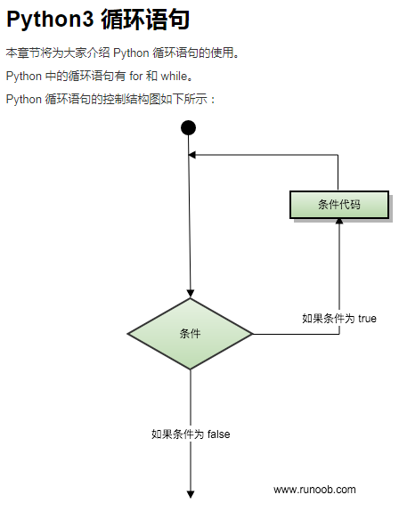
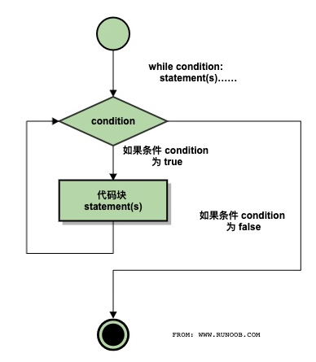
Basic Syntax of python -- while loop
只要，就

Slide 10
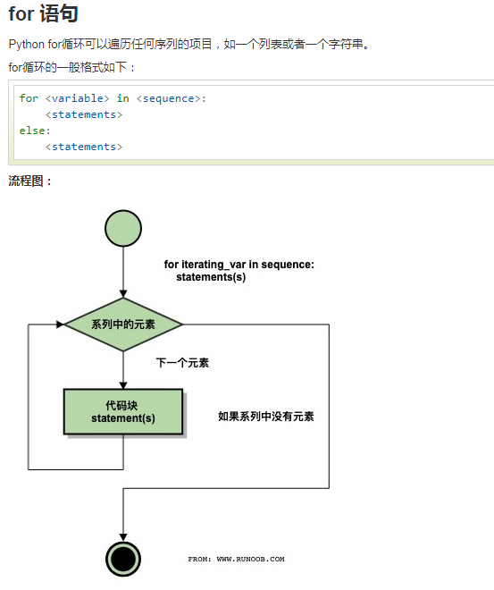
Basic Syntax of python -- FOR loop
只要，就

Slide 11
Automatic subtitle generation through autosub
通过autosub自动提取视频文件里的字幕
Autosub is a utility for automatic speech recognition and subtitle generation. It takes a video or an audio file as input, performs voice activity detection to find speech regions, makes parallel requests to Google Web Speech API to generate transcriptions for those regions, (optionally) translates them to a different language, and finally saves the resulting subtitles to disk. It supports a variety of input and output languages (to see which, run the utility with –list-src-languages and –list-dst-languages as arguments respectively) and can currently produce subtitles in either the SRT format or simple JSON.
Ubuntu 16.04 + Python 2.7

Slide 12

QA

