Slide 1
Automated Hate Speech Detection in Online Group Chat Platforms
Group – 4
Prepared by:
s. Rama krishna chaithanya

Slide 2
Introduction
Any statement or speech that expresses prejudice or animosity toward someone because of their race, colour, sexual orientation, religion, ethnicity, or other characteristics is considered hate speech.
Consequences of Hate Speech:
Psychological Impact on Individuals
Social and Community Consequences
Impact on Organizations and Online Platforms

Slide 3
Business Problem
Problem Statement:
The rise of anonymous online group chat rooms has provided a space for free and open communication.
However, these platforms are also prone to misuse, including the spread of hate speech.
The business problem we are addressing is the need for an effective mechanism to automatically detect and mitigate hate speech in these chat rooms, ensuring a safer and more welcoming environment for all users.
Solution Description:
The proposed solution for detecting and mitigating hate speech in online group chat platforms involves developing a deep learning model using a Bidirectional Long Short-Term Memory (LSTM) network with GloVe embeddings.

Slide 4
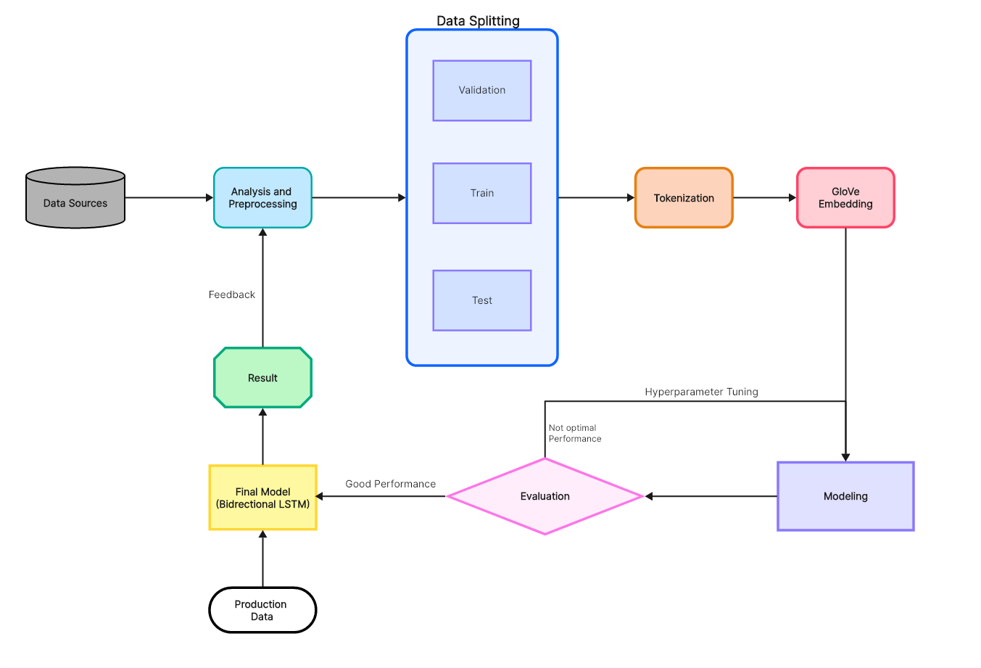
Proposed Solution

Slide 5
Dataset Description
Datasets Considered:
Cyberbullying Data from Formspring.me
Toxic Comment Classification Challenge Dataset
ConvAbuse Dataset
Final Dataset:
The final dataset is a combination of both Cyberbullying Data from Formspring.me and ConvAbuse Datasets. Because-
Formspring is a site where people can chat anonymously about each other and the dataset contains instances of cyberbullying, which is a subset of hate speech, annotated for bullying and offensive content.
The ConAbuse dataset provided with a large number of texts with various labels like is_abuse, racist, sexism, generalized and various texts have been collected by various chatbots from chats.
Dataset: https://drive.google.com/file/d/1tA_JHor89JwksdtKA4AeOvGPoHeG2D3m/view?usp=sharing

Slide 6
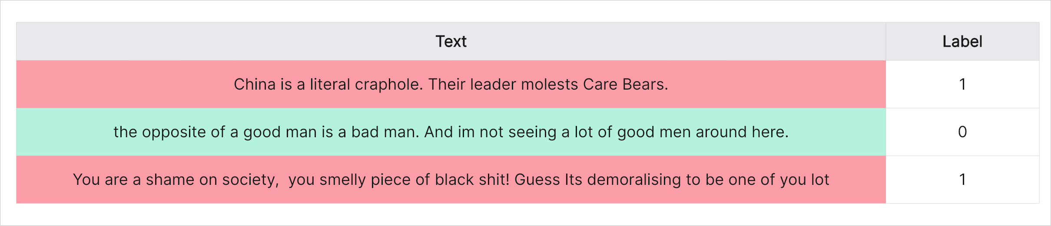
Dataset Description (Contd..)
Dataset Characteristics:
The dataset consists of 2 Columns:
Text: The text message.
Label: The label indicating whether the text is hate speech (1) or not (0).
Size of the dataset: 17,596
No. of columns: 2 - Text, Label
No. of records with label=1: 7,100
Percentage of hate records: 40.4%
Vocabulary Size: 22147
Sample rows:

Slide 7
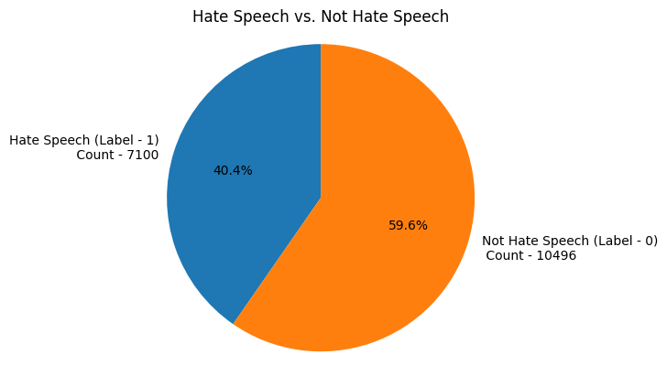
Data Visualization

Slide 8
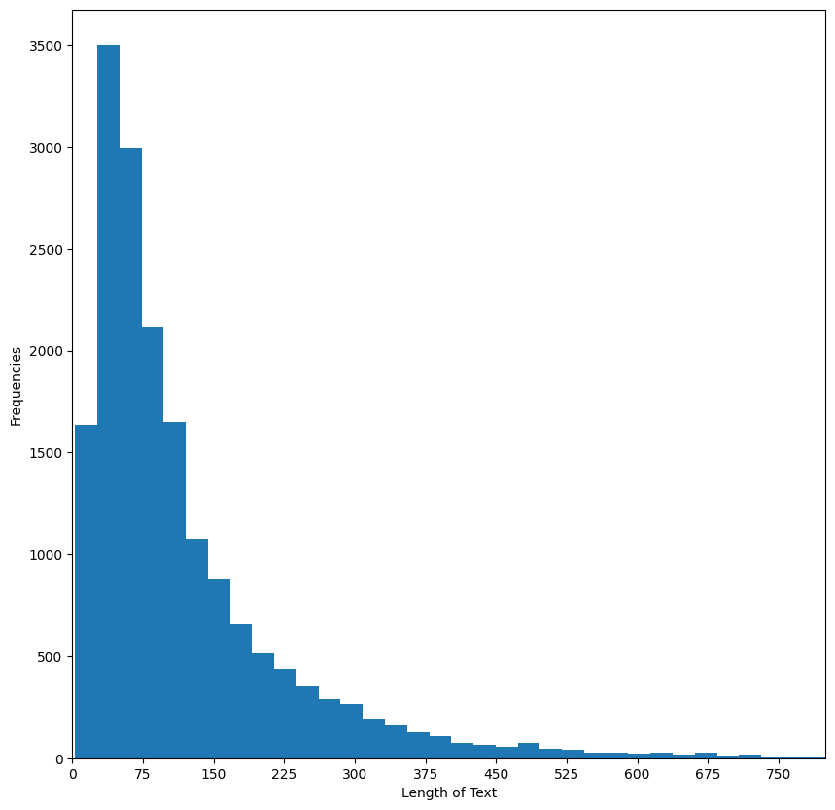
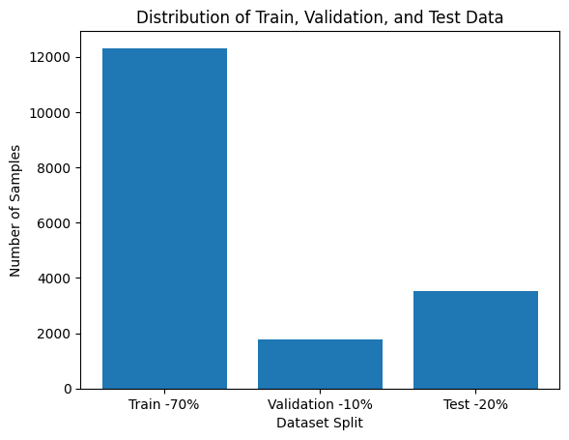
Data Visualization (Contd..)
Visualizing the data according to the 'Text' character length:

Slide 9
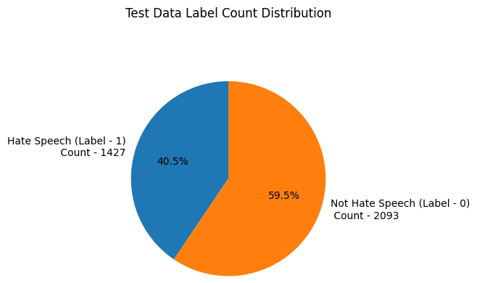
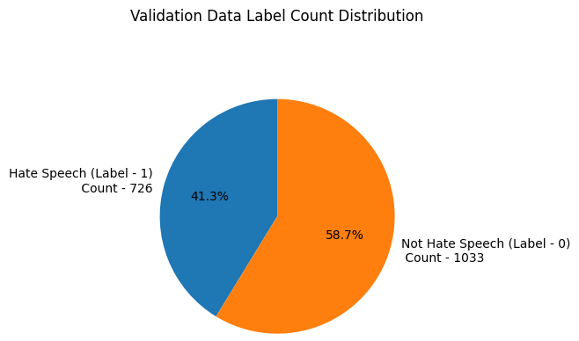
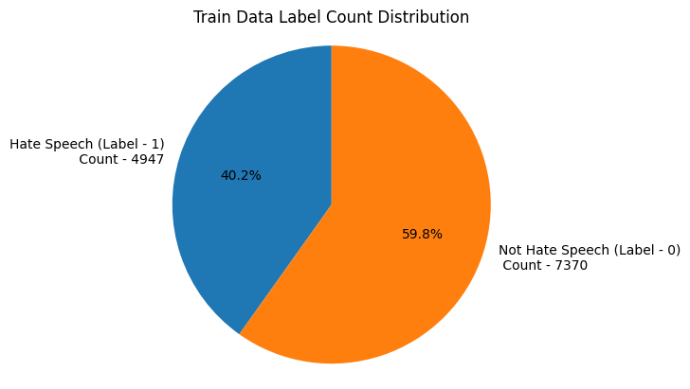
Data Visualization (Contd..)

Slide 10
Data Preprocessing
The first step in our hate speech detection model involves collecting and preprocessing the data. This step is crucial as the quality and cleanliness of the data significantly affect the model's performance.
Removing Extra Spaces: Normalize the spacing in the text to remove any extra spaces.
Removing usernames: Same as for the URL, a username in a text won’t give any valuable information because it won’t be recognized as a word carrying meaning. We will then remove it.
Removing Hashtags: Hashtags are hard to apprehend, but usually contain useful information about the context of a text and its content. So to utilize this we only remove the hashtag character(#) and the remaining word is preserved.
Handling Contractions: Handling contractions in text is an important step in text preprocessing where understanding the full meaning of the words is crucial. Contractions are shortened forms of words or combinations of words created by omitting certain letters and sounds (e.g., "don't" for "do not“).
Lowercasing: Convert all text to lowercase to ensure uniformity, as the model should treat "Hate" and "hate" as the same word.
Removing Punctuation: Strip out punctuation to focus on the words themselves.
Removing URLs: URLs do not give any information when we try to analyze text from words.
Removing Short words: Short words are the words whose length is less than three. Examples of this are - 'a', 'an', 'is' etc. Generally these words do not contain contextual meaning while detecting hate speech. Hence they can be removed.
Lemmatization: Lemmatization is the process of grouping together different inflected forms of the same word. The goal of lemmatization is to reduce a word to its root form, also called a lemma.

Slide 11
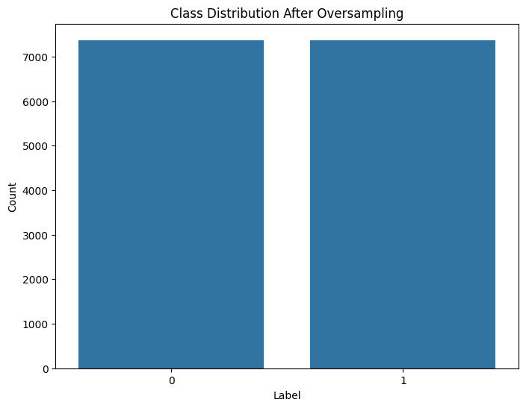
Handling Imbalances in training data:
After splitting the dataset into train, test and validation, we can observe that there is an imbalance in 'Label' column in the training dataset as we can see there are 4097 instances of label '0' where as there are only 7370 instances of label ‘1’.
This would significantly effect model training because models trained on this dataset might be biased towards the majority class (non-hate speech) and may not perform as well in identifying hate speech instances.
Resampling Training data using Random Oversampler:
Label Count
0 7370
1 7370

Slide 12
Tokenization and Embedding Techniques
Tokenization : Tokenization is the process of breaking down text into smaller units called tokens.
Word Tokenization - Word tokenization divides the text into individual words. In this tokenization technique, words are treated as the basic units of meaning.
Embedding: Embedding in the context of deep learning and natural language processing (NLP) is a way of representing words or phrases as dense vectors in a continuous vector space. These vectors capture semantic meanings and relationships between words.
One Hot Encoding
Term Frequency
TF-IDF
Word2Vec CBOW
Word2Vec Skip-Gram
GloVe

Slide 13
Tokenization and Embedding Techniques
Finalized Embedding Technique:
GloVe (Global Vectors for Word Representation) is an unsupervised learning algorithm for obtaining vector representations for words.
It was developed by researchers at Stanford University and is designed to capture the semantic relationships between words based on their co-occurrence in large text corpora.
We have applied embedding on our data by using pre-trained model: glove.6B.200d.txt.
glove.6B.200d.txt:
GloVe.6B.200d.txt is one of the pre-trained GloVe models, where:
6B: The model was trained on a corpus of 6 billion tokens (words).
200d: Each word is represented by a 200-dimensional vector.
Details of glove.6B.200d.txt:
Corpus: Common Crawl (a dataset containing 6 billion tokens).
Vocabulary Size: 400,000 unique words.

Slide 14
Modeling
Machine Learning Models:
Naive Bayes Model
Logistic Regression Model
Support Vector Machines
Deep Learning Models:
Convolutional Neural Networks (CNN)
Recurrent Neural Networks (RNN)
Bidirectional Long Short Term Memory (LSTM) Model

Slide 15
Modeling
Final Deep Learning Model:
Bidirectional Long Short Term Memory (LSTM) Model- Bi LSTM networks are particularly well-suited for text classification tasks, such as automated hate speech detection, due to several compelling reasons:
Bidirectional LSTM networks read the input sequence both forward and backward, enabling them to capture context from both directions.
Bidirectional LSTM networks are capable of retaining and utilizing long-term dependencies in text, making them more effective for understanding the nuanced relationships in hate speech.

Slide 16
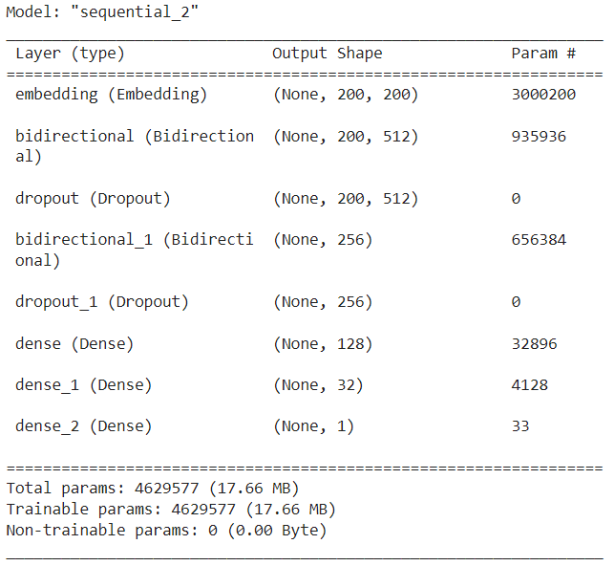
Bi LSTM Model Summary:

Slide 17
Model Evaluation
Key Metric-
ROC AUC Score: The Receiver Operating Characteristic Area Under the Curve (ROC AUC) score is the area under the ROC curve. It sums up how well a model can produce relative scores to discriminate between positive or negative instances across all classification thresholds. The ROC AUC score ranges from 0 to 1.
Score: 0.82
Other Metrics-
Precision: The ratio of true positive predictions to the total predicted positives. Important in scenarios where false positives (incorrectly classifying non-hate speech as hate speech) need to be minimized.
Scores: 0.79
Recall (Sensitivity): The ratio of true positive predictions to the total actual positives. Crucial in scenarios where it's important to identify as many hate speech instances as possible, even at the cost of some false positives.
Scores: 0.77
F1 Score: The harmonic mean of precision and recall, providing a single metric that balances both. Useful when you need to balance precision and recall in a specific way.
Scores: 0.80
In summary, while precision, recall, and F1 score offer specific insights at a particular threshold, ROC-AUC offers a holistic view of the model's performance across all possible thresholds, making it an essential complement to these other metrics in hate speech detection tasks.

Slide 18
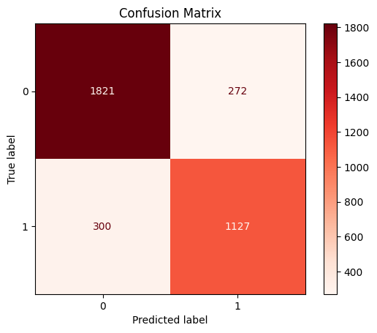
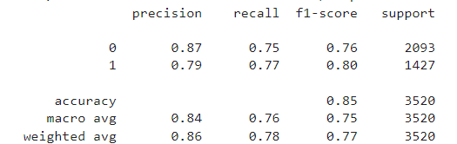
Model Performance
Classification Report:

Slide 19
Thank You

