Slide 1
Project Presentation and Demonstration
On
Hate Speech Detection in Social Media Platform(Snapchat dataset)
By
Vishal Venkatesh Sortur
Group 6

Slide 2
Business Problem
The problem in identifying a snapchat comments is one of challenging task,to classify either it is hateful of not hateful.
Snapchat generates tons of messages,content daily, making it difficult to review and moderate all user-generated content manually.

Slide 3
Solution For Business Problem
To classify the obtained sentence from snapchat either it is hate speech or not hate Speech
First we removed all the unwanted things inside text like special characters,punctuation, using data cleaning process.
Then we did tokenization I used word tokenizer which splits each word of a sentence.
Splitting a data into training and testing using of respective size and visualise a data
Final Choosing a model,building and training and testing, Finally ended with Validation

Slide 4
Dataset Description
Our dataset includes three columns like Content,Label and Content_Int.
Also it includes 421958 rows
We collected the dataset from online sources and made a data-processing.
Examples of our dataset includes
1.”this house is so awful i want to die” is one sentence in our dataset which is consider as Label ‘0’ which is hate speech.
2. “that is retarded you too cute to be single tha... ” is one sentence which is consider as Label “1” which is not hate speech
3. “this coffee is so awful i want to” this sentence is either consider as hate nor not hate it is consider as NaN.

Slide 5
Data Visualization
from sklearn.model_selection import train_test_split
X = data['Content']
y = data['Label']
X_train, X_test, y_train, y_test = train_test_split(X, y, test_size=0.2, random_state=42)
print(f'Number of training samples: {len(X_train)}')
print(f'Number of testing sa
Outcome Number of training samples: 334048
Number of testing samples: 83513

Slide 6
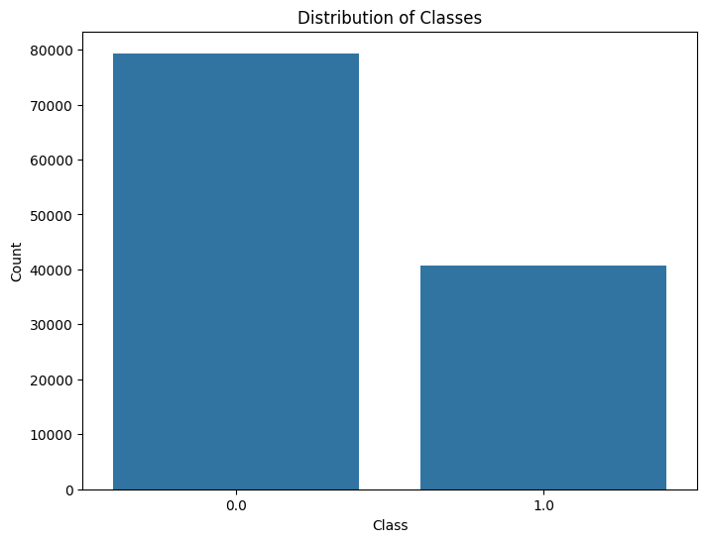
Data Visualization

Slide 7
Data Pre-Processing
Data-Preprocessing is a stage which we can clean a data into required into model easy understanding pattern.
So, we used data cleaning methodology it includes a removal of stop words, Punctuation,special characters etc
We used word tokenizer to convert or splits a sentence into words which makes model to understand and train the model.

Slide 8
The technique which i followed to make functional code
def clean_text(text):
text = BeautifulSoup(text, "html.parser").get_text()
text = re.sub(r'[^a-zA-Z\s]', '', text)
text = text.lower()
words = word_tokenize(text)
words = [lemmatizer.lemmatize(word) for word in words if word not in stop_words]
clean_text = ' '.join(words)
return clean_text

Slide 9
Tokenization and Embedding Techniques:
We followed with word_tokenizer for tokenization which splits a sentence into words.
In Deep learning we used BERT Tokenizer to split the sentence
import nltk
from nltk.tokenize import word_tokenize
nltk.download('punkt')
def tokenize_text(text):
return word_tokenize(text)
df['tokenized_text'] = df['Content'].apply(tokenize_text)
df.head()

Slide 10
We used word to vec embeddings in our pre-processing stage which helps a model to understand a text in mathematical format
It creates a vectors of text and confusion matrix using word2vec function
word2vec_model = Word2Vec(sentences=df['tokenized_text'], vector_size=100, window=5, min_count=1, workers=4)
def average_word_vectors(tokens, model, num_features):
feature_vec = np.zeros((num_features,), dtype="float32")
n_words = 0
for word in tokens:
if word in model.wv:
n_words += 1
feature_vec = np.add(feature_vec, model.wv[word])
if n_words > 0:
feature_vec = np.divide(feature_vec, n_words)
return feature_vec
df['word2vec'] = df['tokenized_text'].apply(lambda tokens: average_word_vectors(tokens, word2vec_model, 100))
print("Word2Vec Embeddings:\n", df[['Content', 'word2vec']])

Slide 11
Data Modeling
We used diffrent data models for our dataset to train model for hate speech detection.
We used machine learning model like Logestic Regression, Support Vector Machine(SVM)
Also to check beter performance we used deep learning models such as Covolutional Neural Network, RNN and BERT Model for evalution
Finaly we achieved 98% of accuracy for CNN Model, for Logistic regression of Machine learning we achieved 73% of accuracy.

Slide 12
Evaluation metrics of Models
We considered all aspects of diffrent models such as F1 score, Precision, loss Percentage and accuracy to consider it as best model.

