Slide 1


GROUP 8
HATESPEECH
DETECTION
IN YOUTUBE COMMENTS
Shreyansh Kahate
Nikitha S
Madhuri K

Slide 2


CONTENTS
Business Problem
Solution
Dataset Description
Data Visualization
Data Preprocessing
Tokenization and Embedding Techniques
Modeling
Evaluation metrics

Slide 3
BUSINESS PROBLEM
The proliferation of online platforms has provided a space for people to connect, share ideas, and engage in discussions.
However, it has also led to the spread of hate speech, which can have serious social and psychological consequences.
This project aims to develop a deep learning model capable of detecting and classifying hate speech in textual content – comments from social media platforms.

Slide 4

SOLUTION
Development of a deep learning model to detect hate speech in YouTube comments.
This model aids social media platforms in efficiently identifying and managing harmful content, ensuring that community guidelines are maintained and creating a safer online environment for users.
Benefits include improved content moderation, better user experience, and enhanced brand reputation.

Slide 5
DATASET DESCRIPTION
Dataset is sourced from Kaggle.
Columns: Content, Label, Content_int, IsHatepeech.
The Content column contains the input text and the Label column contains the input label 0 and 1.
“0” - non-hateful
“1” - hateful
Examples:
"You are an idiot" - IsHatespeech: 1
"I love this video!" - IsHatespeech: 0
"This is the worst" - IsHatespeech: 1

Slide 6

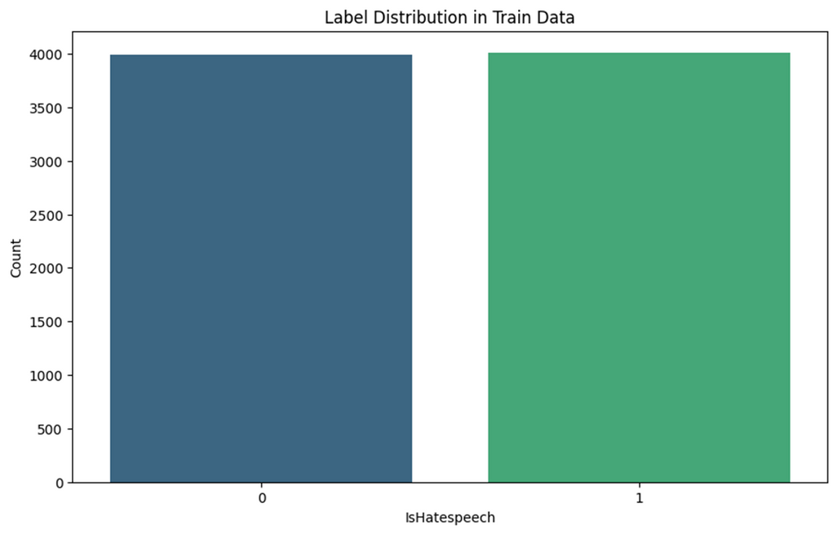
DATA VISUALIZATION
The data distribution is quite balanced, with half of the dataset labelled as hate speech and the other half as non-hate speech.
The entire dataset contains approximately 10,000 rows, with about 5,000 labelled as 1 (hate speech) and 5,000 labelled as 0 (non-hate speech).

Slide 7

DATA PREPROCESSING
Remove unnecessary elements such as punctuation, special characters, and URLs from the text data.
1
Removing punctuations
Removing common stopwords
Tokenization & Lemmatization
Reassembling tokens
Removing special characters and emojis
Removing URLs
Creating a feature for text length
Split sentences into individual words (tokens) and remove common words (stopwords) that do not contribute to the meaning of the text.
2
Convert words to their base or root form (lemmas) and normalize them to maintain consistency in the dataset.
3

Slide 8
TOKENIZATION AND EMBEDDING
Tokenization Techniques
By comparing various tokenization techniques, we determined that word tokenization would work best for our model.
Word Tokenization: Common for languages with clear separation (e.g., English).
Thus, we used word tokenization for our model building.
Embedding Techniques
We tried various word embedding techniques such as word embedding, one-hot embedding, TF-IDF, Word2Vec, GloVe, and advanced pre-trained models like BERT and RoBERTa.
The pre-trained models were computationally heavy and provided similar results to TF-IDF.
Among all the techniques, TF-IDF was the best performing one.

Slide 9
MODELING
Machine Learning Model:
We tried TF-IDF embedding and used it to train various machine learning models such as Random Forest, Logistic Regression, SVM, and Naive Bayes Classifier.
We compared their evaluation metrics and found that the SVM model was the best performing one.
To optimize its performance, we performed hyperparameter tuning on the SVM model to achieve the best possible score for the metrics.
Support Vector Machine (SVM):
It is a supervised machine learning algorithm used for classification and regression tasks. It works by finding the optimal hyperplane that maximally separates the classes in the feature space.
Findings:
SVM with TF-IDF embeddings provided the best performance.

Slide 10
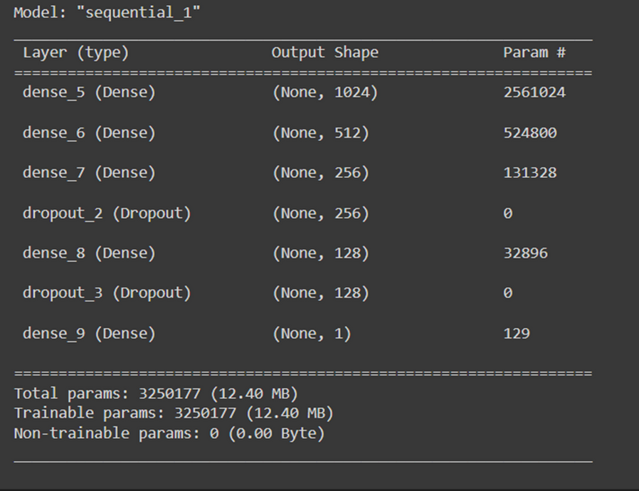
Deep Learning Model
We tried to build different deep learning models using LSTM, Bidirectional LSTM, CNN, and their various combinations.
We compared their performance metrics to determine the best model.
We also experimented with different optimizers and activation functions.
The best deep learning model chosen through this experimentation is shown.

Slide 11



EVALUATION METRICS
Accuracy
Measures the overall correctness of the model by calculating the ratio of correctly predicted instances to the total instances
Metrics used:
Accuracy
Precision
Recall
F1 Score
AUC-ROC
F1 Score
The harmonic mean of precision and recall.
Provides a single metric that balances precision and recall, especially useful for imbalanced datasets.
Recall
Measures the proportion of true positive predictions among all actual positive instances.
Indicates how well the model captures positive instances.

Slide 12
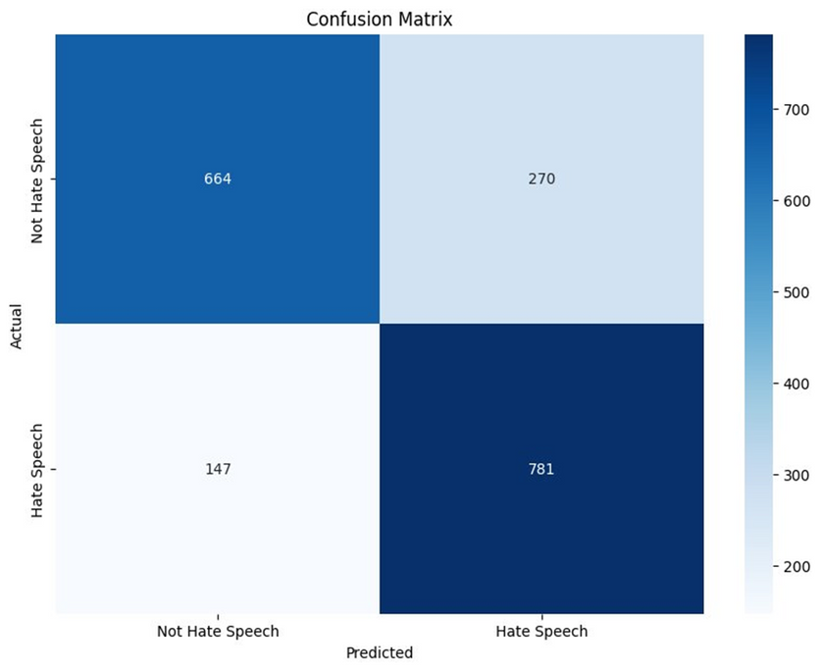
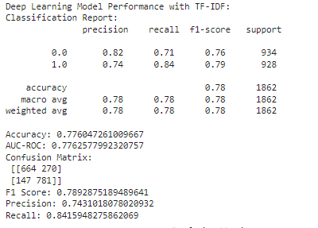
BEST MODEL EVALUATION METRICS
DEEP LEARNING MODEL EVALUATION METRICS
Metrics | Score
Accuracy | 0.77604726100966
F1 Score | 0.78928751894896
Precision | 0.74310180780209
Recall | 0.84159482758620

Slide 13
THANK YOU!
Shreyansh Kahate
Nikitha S
Madhuri K

