Slide 1
SARCASM DETECTION ON YOUTUBE COMMENTS
Presented-By: Manisankar Reddy Ravi

Slide 2
Contents:
Business Problem
Proposed Solution
Dataset Description
Data Visualization
Data Preprocessing and Tokenization
Modeling
Evaluation Matrix of Best Model

Slide 3
BUSINESS PROBLEM
Problem: Misinterpretation of Sarcastic Comments on YouTube
Impact:
Miscommunication: Distorted sentiment analysis leads to poor decision -making.
User Experience: Inappropriate responses frustrate users and damage credibility.
Analytical Flaws: Inaccurate data affects marketing and customer service strategies

Slide 4
SOLUTION APPROACH
3.Model Building
4.Model Evaluation and Optimization
1. Data Preprocessing
2.Tokenization and Embedding

Slide 5
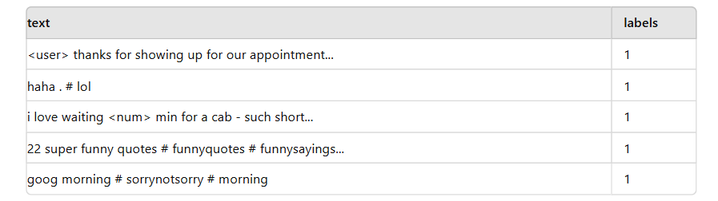
DATASET DESCRIPTION
This dataset contains 19,461 entries with two columns
text: This column contains the text data (comments) which will be analyzed for sarcasm
labels: This column contains the labels indicating whether the text is sarcasm(1) or not sarcastic (0)
Some examples of instances:

Slide 6
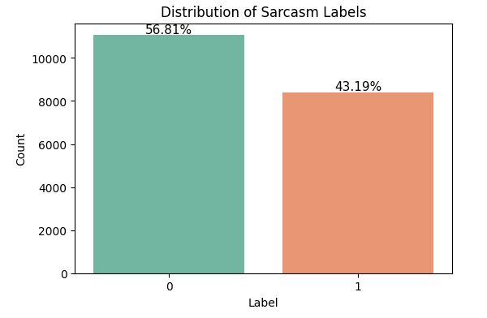
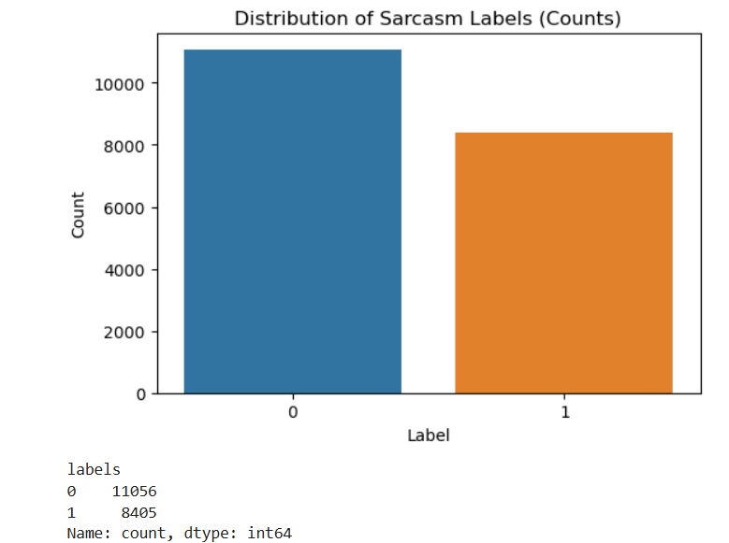
DATA VISUALIZATION
The dataset size:
- 19461 rows

Slide 7

DATA PREPROCESSING
Initial Data Cleaning
Handling Missing Values: Removed instances with null or missing text data.
Duplicate Row Detection and Removal: Eliminated duplicate comments to ensure uniqueness.
Text-Specific Cleaning
Emoji Removal: Removed emojis from comments.
Stopword Removal: Eliminated common stopwords to focus on meaningful words.
Punctuation Removal: Deleted punctuation marks to standardize text data.
Implementation and Output
New Data Column Added: Updated dataset with cleaned and processed comments.
Visual Representation: Provided visual summaries to show dataset size and distribution post-cleaning

Slide 8
TOKENIZATION AND EMBEDDING TECHNIQUES
Tokenization:
Text Preprocessing:
Lowercasing: Convert text to lowercase to ensure uniformity.
Punctuation Removal: Remove punctuation and special characters to focus on words.
Tokenization: Split text into tokens using NLTK's word_tokenize function.
Embedding Techniques:
TF-IDF Vectorization:
Feature Extraction: Convert tokens into numerical vectors using TF-IDF (TfidfVectorizer).
Importance Weighting: Reflects the importance of words in the context of the entire corpus.

Slide 9
MODELLING
Machine Learning Models:
Logistic Regression
Support Vector Machine
Random Forest Algorithm
Deep Learning Models:
LSTM (Long Short-Term Memory)
CNN (Convolutional Neural Network)
FNN (Feedforward Neural Network)

Slide 10

Best Models
SVM (Support Vector Machine)
The Support Vector Classifier (SVC) achieved an accuracy of 81.21% with an F1-score of 0.81
FNN(FeedForward Neural Network)
The Feedforward Neural Network (FNN) achieved an accuracy of 78.62% with an F1-score of 0.78 on the test set.

Slide 11
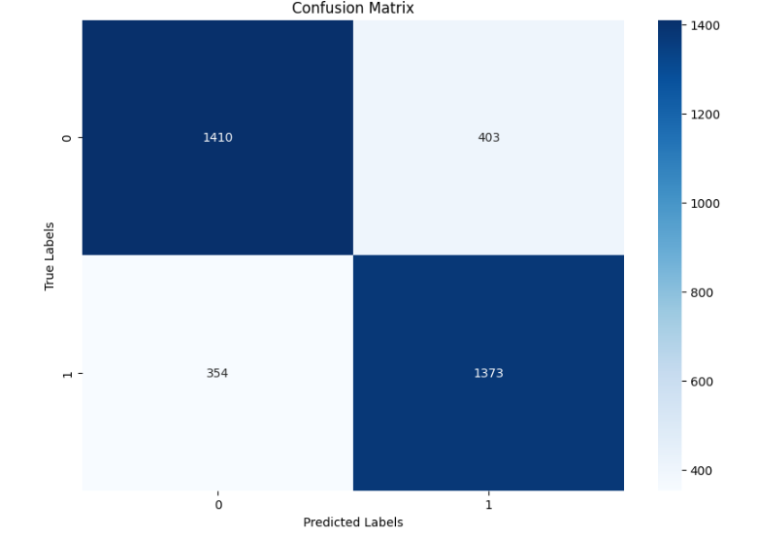
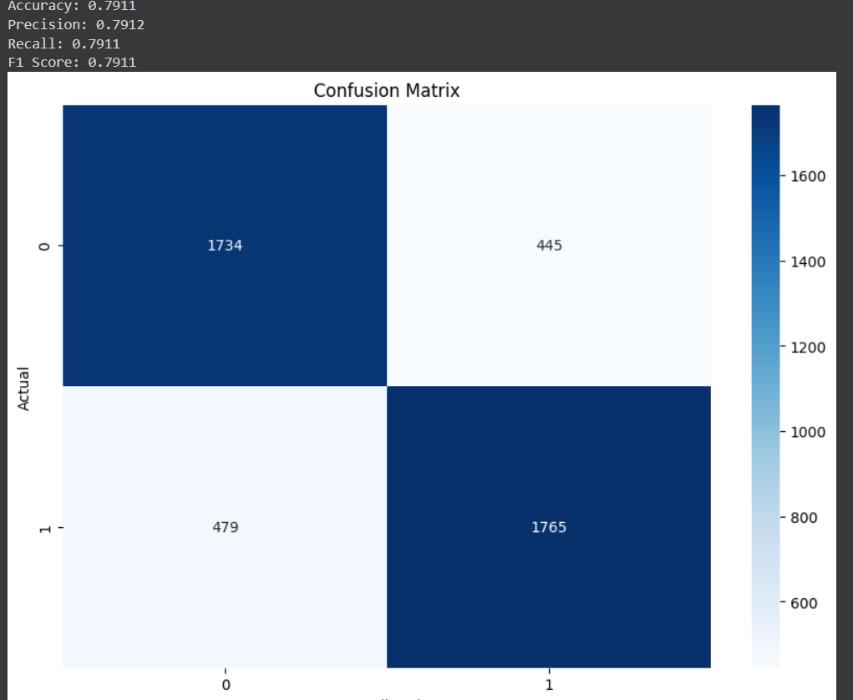
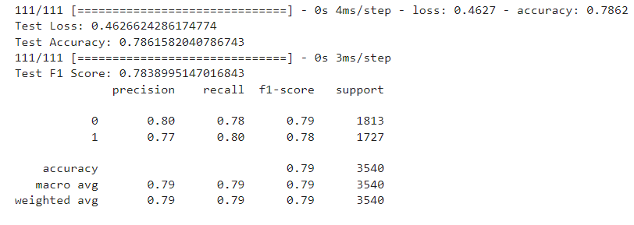
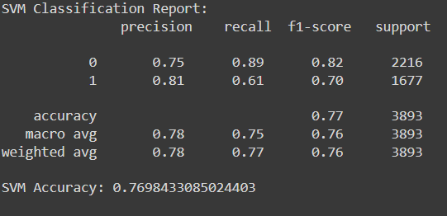
EVALUATION METRICS (FNN)

Slide 12

THANK YOU!!

