Slide 1
SARCASM DETECTION ON YOUTUBE COMMENTS
BY-NARENDRA KHADAYAT

Slide 2
BUSINESS PROBLEM
Problem: Misinterpretation of sarcastic comments on YouTube.
Impact:
Which leads to poor content recommendations and interactions.
Hard to filtering of harmful comments.
Promote the misunderstood user sentiment affecting brand image.

Slide 3
SOLUTION APPROACH
Specialized Sarcasm Detection:
- Develop a dedicated model.
Model Evaluation:
- Rigorously test and select the most effective ML and DL models.
Implementation:
- Deploy optimized models.

Slide 4
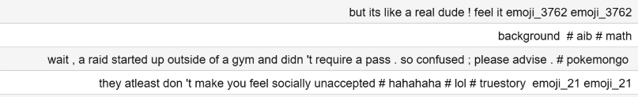
DATASET DESCRIPTION
The dataset contain a collection of youTube comments with correspond to a labels(1&0) indicating whether the comments are sarcastic and non sarcastic.
Dataset Format:
Text: This column contains the text data (comments).
labels: This column contains the labels indicating whether the text is sarcasm(1) or not sarcastic (0)
Some examples of row text:

Slide 5
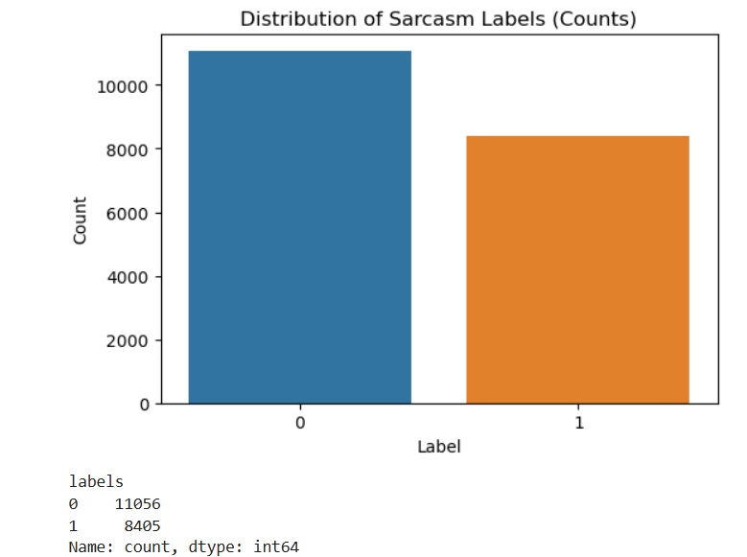
DATA VISUALIZATION
The dataset size:
- 19461 rows

Slide 6

DATA PREPROCESSING
Initial Data Cleaning:
-Handling Missing Values.
-Duplicate Row Detection and Removal.
Text-Specific Cleaning:
- Emoji Removal
-StopWord Removal:
- Punctuation Removal
Implementation and Output:
-New Data Column Added
-Visual Representation

Slide 7
TOKENIZATION AND EMBEDDING TECHNIQUES
Using Tokenizer from tensorflow.keras.preprocessing.text to tokenize text data.
Experiment did with pre-trained word embeddings like Word2Vec & BERT.
The tokenized sequences (X_train_seq and X_test_seq) are prepared for potential use in embedding layers of neural networks.

Slide 8
MODELLING
Models:
Logistic Regression Accuracy: 75%
Random Forest Accuracy: 73%
SVM Accuracy: 77%
Dense Model : 75%
CNN: 74%
LSTM: 74%
SVM(77%):
- Chosen for its robust performance in handling high-dimensional data and effective binary classification, particularly suitable for our sarcasm detection task.
Dense Neural Network(75%):
- Selected for its capability to learn intricate patterns in sequential data, leveraging multiple layers for improved feature extraction and model complexity.

Slide 9
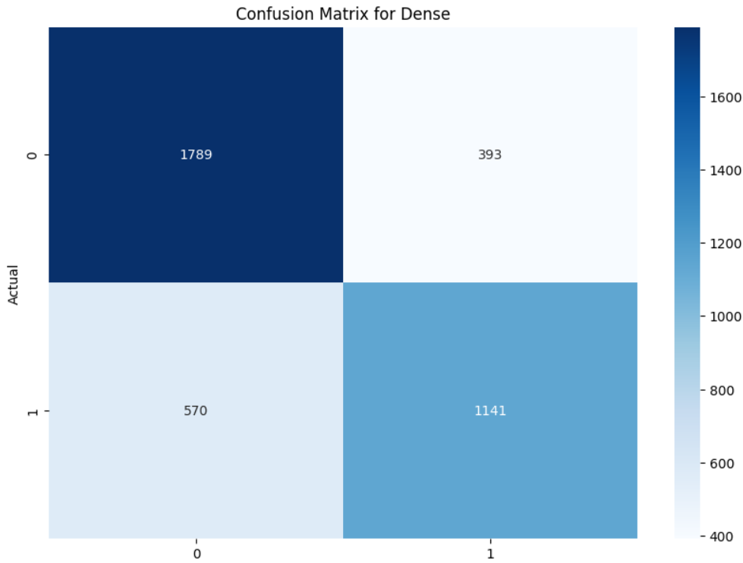
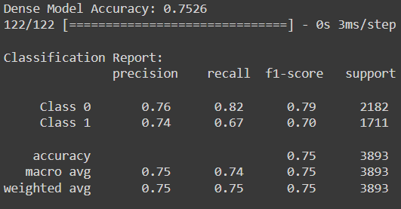
EVALUATION METRICS

Slide 10

CONCLUSION
Objective achieved:
-Developed and Tested Different ML & DL Model for sarcasm detection on YouTube comments.

Slide 11

THANK YOU!!

