Slide 1
Sarcasm Detection in Tweets to Reduce Misinformation
By – Group 5
Divya Khatarkar
Sanskriti Shukla
Jiya Goyal

Slide 2

Business Problem 1
Proposed Solution 2
Dataset Description and Data Visualization 3-4
Data Preprocessing and Tokenization 5-6
Modeling and Evaluation Matrix of Best Model 7-8

Slide 3

Sarcasm is a common linguistic tool on social media, often used to convey humor or criticism. However, its subtle nature makes it easily misinterpreted, especially by automated systems. When sarcastic tweets spread false information, it becomes difficult to distinguish between genuine news and fabricated content. This leads to rapidly disseminating misinformation, impacting public opinion and decision-making.
Business Problem:

Slide 4
Proposed Solution:
Developing accurate sarcasm detection technology can help mitigate the spread of misinformation due to tweets. This technology can be integrated into social media platforms to flag potentially sarcastic content, allowing users to interpret information correctly.

Slide 5
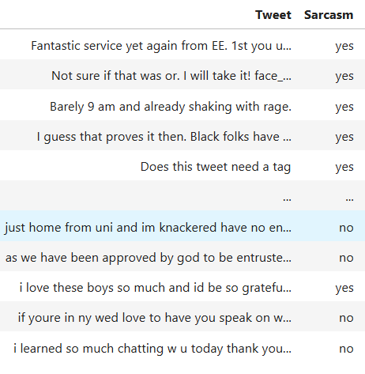
Dataset Description:
The dataset contain a collection of tweets with correspond to a labels indicating whether the tweets are sarcastic and non sarcastic.
Data Format:
Tweet: The text content of the tweet.
Sarcasm: A label (yes or no) indicating Sarcasm (yes) or non-sarcasm(no).
3

Slide 6
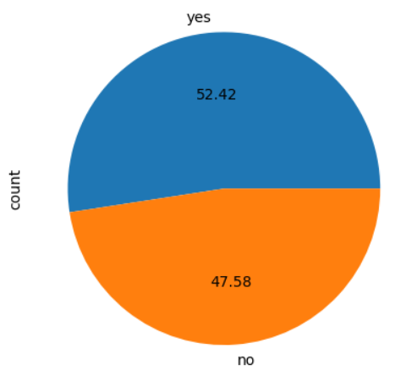
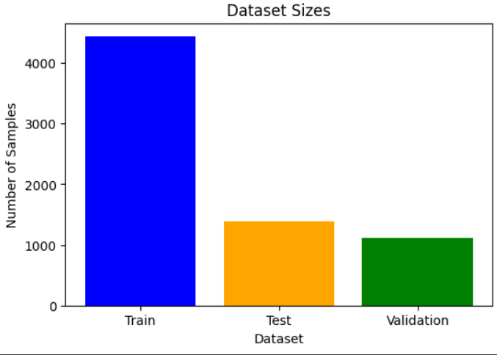
Data Visualization:
The dataset used for this sarcasm detection model comprises 6,930 Twitter comments. There are 3633 sarcastic tweets and 3297 non-sarcastic tweets in the dataset.
Train, Test and Validation data size: Train size: 4435 Test size: 1386 Validation size: 1109

Slide 7
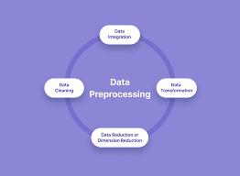
Data Preprocessing:
Drop unwanted column.
Replace emoji with its text description.
Replace abbreviations with their expansions.
Remove special characters like #, $, %, *, @ etc.
Check for duplicates and null values.
Removed URL’s.
Numeric labels are replace with textual labels.
Merged two dataset.

Slide 8
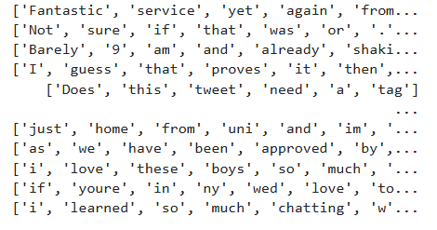
Tokenization and Embedding Techniques:
Word Tokenization: Useful for most NLP tasks where words are treated as basic units, such as text classification or sentiment analysis. Word tokenization breaks text into individual words or terms.
TFI-DF Vectorization (Term Frequency-Inverse Document Frequency): Represent documents as vectors based on word importance, where high frequency terms across documents are weighted lower.

Slide 9
Modeling Different model used and their corresponding Accuracy:-
Logistic Regression - 78.22%
Support Vector Machine- 77.55%
Naïve Bayes Model- 77.55%
Decision tree - 76.72%
K - Nearest Neighbor - 43.22%
Bidirectional LSTM (Long short-term memory) - 89.97%
GRU (Grated Recurrent unit) - 89.83%
CNN (Convolutional Neural Network) - 89.25%

Slide 10
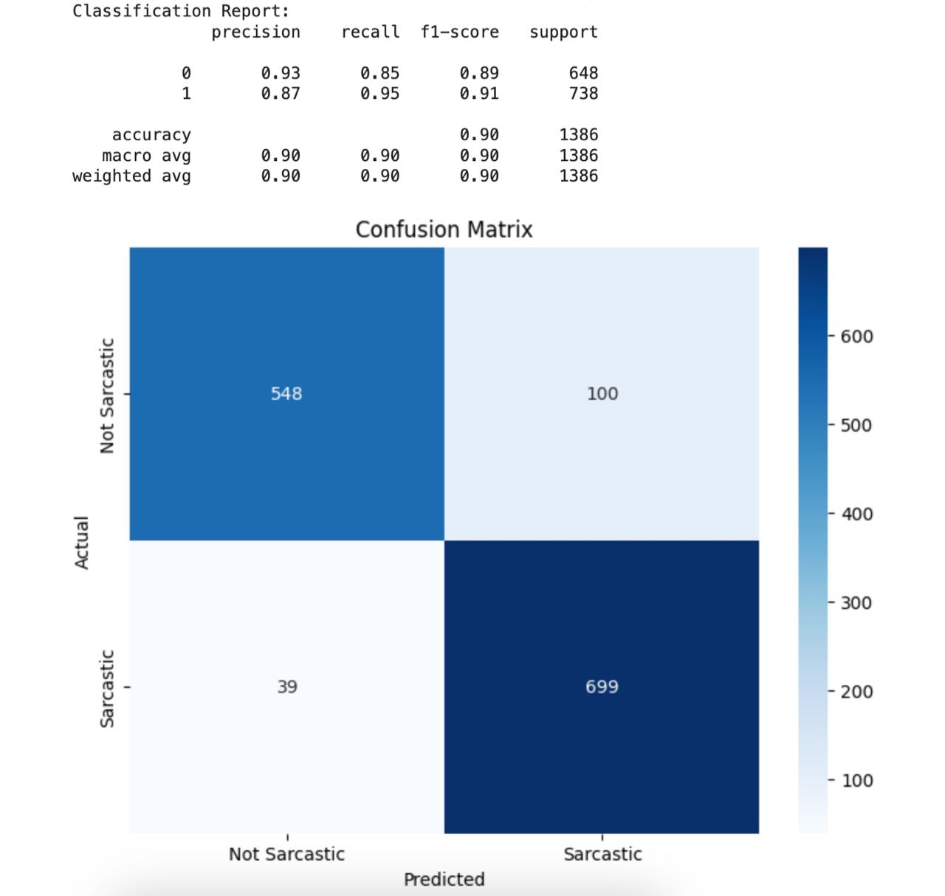
Evaluation metrics of Best Model
Best Model-
Bidirectional LSTM(Long Short Term Memory)
Reason – BLSTM excels at capturing both past and future context within a sequence. This makes it ideal for understanding the nuances of sarcasm, which often rely on contextual clues.

Slide 11
Thank you

