Slide 1

Disease Prediction from Personal Health Indicators
DSE-230
Project Proposal Presentation
Chunxia Tong
Camm Perera
Sergey Gurvich

Slide 2
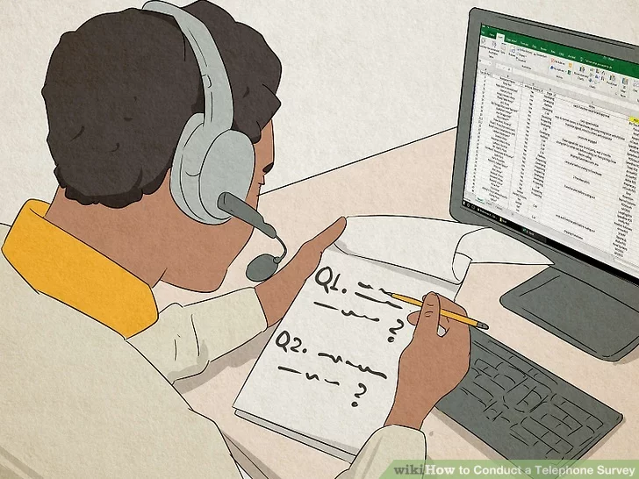
The Dataset
Source:https://www.wikihow.com/Conduct-a-Telephone-Survey

Slide 3

Data Preparation
Source: https://www.lumahealth.io/

