Slide 1
How to develop Big Data Pipelines for Hadoop
Dr. Mark Pollack – SpringSource/VMware

Slide 2


About the Speaker
Now… Open Source
Spring committer since 2003
Founder of Spring.NET
Lead Spring Data Family of projects
Before…
TIBCO, Reuters, Financial Services Startup
Large scale data collection/analysis in High Energy Physics (~15 yrs ago)
Notes:
600-700TB of data during first years.

Slide 3
Agenda
Spring Ecosystem
Spring Hadoop
Simplifying Hadoop programming
Use Cases
Configuring and invoking Hadoop in your applications
Event-driven applications
Hadoop based workflows
Applications (Reporting/Web/…)
Data
Collection
Structured
Data
Analytics
MapReduce
Data copy
HDFS
Notes:
This diagram shows some of the main components in a big data pipelines.
The main flows are collecting data into HDFS, analyzing that data with a combination of on-hadoop and off hadoop analytics.
Results of analysis are copied to structured data (memcache, mysql) for analysis and consumption by applications

Slide 4
Spring Ecosystem
Spring Framework
Widely deployed Apache 2.0 open source application framework
“More than two thirds of Java developers are either using Spring today or plan to do so within the next 2 years.“ – Evans Data Corp (2012)
Project started in 2003
Features: Web MVC, REST, Transactions, JDBC/ORM, Messaging, JMX
Consistent programming and configuration model
Core Values – “simple but powerful’
Provide a POJO programming model
Allow developers to focus on business logic, not infrastructure concerns
Enable testability
Family of projects
Spring Security
Spring Data
Spring Integration
Spring Batch
Spring Hadoop (NEW!)

Slide 5
Relationship of Spring Projects
Spring Batch
On and Off Hadoop workflows
Spring
Hadoop
Simplify Hadoop
programming
Spring Integration
Event-driven applications
Spring Data
Redis, MongoDB, Neo4j, Gemfire
Spring Framework
Web, Messaging Applications
Notes:
Notes: all apache 2.0 projects.
Can be deployed as standalone apps and web apps

Slide 6
Spring Hadoop
Simplify creating Hadoop applications
Provides structure through a declarative configuration model
Parameterization based on through placeholders and an expression language
Support for environment profiles
Start small and grow
Features – Milestone 1
Create, configure and execute all type of Hadoop jobs
MR, Streaming, Hive, Pig, Cascading
Client side Hadoop configuration and templating
Easy HDFS, FsShell, DistCp operations though JVM scripting
Use Spring Integration to create event-driven applications around Hadoop
Spring Batch integration
Hadoop jobs and HDFS operations can be part of workflow

Slide 7
Configuring and invoking Hadoop in your applications
Simplifying Hadoop Programming

Slide 8
Hello World – Use from command line
Running a parameterized job from the command line
applicationContext.xml
<context:property-placeholder location="hadoop-${env}.properties"/>
<hdp:configuration>
fs.default.name=${hd.fs}
</hdp:configuration>
<hdp:job id="word-count-job"
input-path=“${input.path}"
output-path="${output.path}"
mapper="org.apache.hadoop.examples.WordCount.TokenizerMapper"
reducer="org.apache.hadoop.examples.WordCount.IntSumReducer"/>
<bean id="runner" class="org.springframework.data.hadoop.mapreduce.JobRunner"
p:jobs-ref="word-count-job"/>
hadoop-dev.properties
input.path=/user/gutenberg/input/word/
output.path=/user/gutenberg/output/word/
hd.fs=hdfs://localhost:9000
java –Denv=dev –jar SpringLauncher.jar applicationContext.xml
Notes:
What you see here is a spring configuration file, can also be type safe java code.

Slide 9
Hello World – Use in an application
Use Dependency Injection to obtain reference to Hadoop Job
Perform additional runtime configuration and submit
public class WordService {
@Inject
private Job mapReduceJob;
public void processWords() {
mapReduceJob.submit();
}
}

Slide 10
Hive
Create a Hive Server and Thrift Client
<hive-server host=“${hive.host}" port="${hive.port}" >
someproperty=somevalue
hive.exec.scratchdir=/tmp/mydir
</hive-server/>
<hive-client host="${hive.host}" port="${hive.port}"/>b
Create Hive JDBC Client and use with Spring JdbcTemplate
No need for connection/statement/resultset resource management
<bean id="hive-driver" class="org.apache.hadoop.hive.jdbc.HiveDriver"/>
<bean id="hive-ds"
class="org.springframework.jdbc.datasource.SimpleDriverDataSource"
c:driver-ref="hive-driver" c:url="${hive.url}"/>
<bean id="template" class="org.springframework.jdbc.core.JdbcTemplate"
c:data-source-ref="hive-ds"/>
String result = jdbcTemplate.query("show tables", new ResultSetExtractor<String>() {
public String extractData(ResultSet rs) throws SQLException, DataAccessException {
// extract data from result set
}
});

Slide 11
Pig
Create a Pig Server with properties and specify scripts to run
Default is mapreduce mode
<pig job-name="pigJob" properties-location="pig.properties">
pig.tmpfilecompression=true
pig.exec.nocombiner=true
<script location="org/company/pig/script.pig">
<arguments>electric=sea</arguments>
</script>
<script>
A = LOAD 'src/test/resources/logs/apache_access.log' USING PigStorage() AS (name:chararray, age:int);
B = FOREACH A GENERATE name;
DUMP B;
</script>
</pig>

Slide 12
HDFS and FileSystem (FS) shell operations
Use Spring File System Shell API to invoke familiar “bin/hadoop fs” commands
mkdir, chmod, ..
Call using Java or JVM scripting languages
Variable replacement inside scripts
Use FileSystem API to call copyFromFocalFile
<hdp:script id="inlined-js" language=“groovy">
name = UUID.randomUUID().toString()
scriptName = "src/test/resources/test.properties"
fs.copyFromLocalFile(scriptName, name)
// use the shell (made available under variable fsh)
dir = "script-dir"
if (!fsh.test(dir)) {
fsh.mkdir(dir); fsh.cp(name, dir); fsh.chmod(700, dir)
}
println fsh.ls(dir).toString()
fsh.rmr(dir)
<hdp:script/>
<script id="inlined-js" language="javascript">
importPackage(java.util);
importPackage(org.apache.hadoop.fs);
println("${hd.fs}")
name = UUID.randomUUID().toString()
scriptName = "src/test/resources/test.properties“
// use the file system (made available under variable fs)
fs.copyFromLocalFile(scriptName, name)
// return the file length
fs.getLength(name)
</script>

Slide 13
Hadoop DistributedCache
Distribute and cache
Files to Hadoop nodes
Add them to the classpath of the child-jvm
<cache create-symlink="true">
<classpath value="/cp/some-library.jar#library.jar" />
<classpath value="/cp/some-zip.zip" />
<cache value="/cache/some-archive.tgz#main-archive" />
<cache value="/cache/some-resource.res" />
</cache>

Slide 14
Cascading
Spring supports a type safe, Java based configuration model
Alternative or complement to XML
Good fit for Cascading configuration
@Configuration
public class CascadingConfig {
@Value("${cascade.sec}") private String sec;
@Bean public Pipe tsPipe() {
DateParser dateParser = new DateParser(new Fields("ts"),
"dd/MMM/yyyy:HH:mm:ss Z");
return new Each("arrival rate", new Fields("time"), dateParser);
}
@Bean public Pipe tsCountPipe() {
Pipe tsCountPipe = new Pipe("tsCount", tsPipe());
tsCountPipe = new GroupBy(tsCountPipe, new Fields("ts"));
}
}
<bean class="org.springframework.data.hadoop.cascading.CascadingConfig "/>
<bean id="cascade"
class="org.springframework.data.hadoop.cascading.HadoopFlowFactoryBean"
p:configuration-ref="hadoop-configuration" p:tail-ref="tsCountPipe" />

Slide 15
Hello World + Scheduling
Schedule a job in a standalone or web application
Support for Spring Scheduler and Quartz Scheduler
Submit a job every ten minutes
Use PathUtil’s helper class to generate time based output directory
e.g. /user/gutenberg/results/2011/2/29/10/20
<task:scheduler id="myScheduler"/>
<task:scheduled-tasks scheduler="myScheduler">
<task:scheduled ref=“mapReduceJob" method=“submit" cron="10 * * * * *"/>
</task:scheduled-tasks>
<hdp:job id="mapReduceJob" scope=“prototype"
input-path="${input.path}"
output-path="#{@pathUtils.getTimeBasedPathFromRoot()}"
mapper="org.apache.hadoop.examples.WordCount.TokenizerMapper"
reducer="org.apache.hadoop.examples.WordCount.IntSumReducer"/>
<bean name="pathUtils" class="org.springframework.data.hadoop.PathUtils"
p:rootPath="/user/gutenberg/results"/>

Slide 16
Mixing Technologies
Simplifying Hadoop Programming

Slide 17
Hello World + MongoDB
Combine Hadoop and MongoDB in a single application
Increment a counter in a MongoDB document for each user runnning a job
Submit Hadoop job
<hdp:job id="mapReduceJob"
input-path="${input.path}" output-path="${output.path}"
mapper="org.apache.hadoop.examples.WordCount.TokenizerMapper"
reducer="org.apache.hadoop.examples.WordCount.IntSumReducer"/>
<mongo:mongo host=“${mongo.host}" port=“${mongo.port}"/>
<bean id="mongoTemplate" class="org.springframework.data.mongodb.core.MongoTemplate">
<constructor-arg ref="mongo"/>
<constructor-arg name="databaseName" value=“wcPeople"/>
</bean>
public class WordService {
@Inject private Job mapReduceJob;
@Inject private MongoTemplate mongoTemplate;
public void processWords(String userName) {
mongoTemplate.upsert(query(where(“userName”).is(userName)), update().inc(“wc”,1), “userColl”);
mapReduceJob.submit();
}
}

Slide 18
Event-driven applications
Simplifying Hadoop Programming

Slide 19

Enterprise Application Integration (EAI)
EAI Starts with Messaging
Why Messaging
Logical Decoupling
Physical Decoupling
Producer and Consumer are not aware of one another
Easy to build event-driven applications
Integration between existing and new applications
Pipes and Filter based architecture

Slide 20
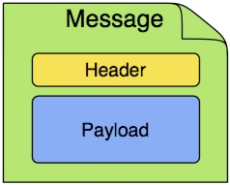


Pipes and Filters Architecture
Endpoints are connected through Channels and exchange Messages
TCP
File
Consumer
Endpoint
Endpoint
Producer
JMS
Route
Channel
$> cat foo.txt | grep the | while read l; do echo $l ; done

Slide 21
Spring Integration Components
Channels
Point-to-Point
Publish-Subscribe
Optionally persisted by a MessageStore
Message Operations
Router, Transformer
Filter, Resequencer
Splitter, Aggregator
Adapters
File, FTP/SFTP
Email, Web Services, HTTP
TCP/UDP, JMS/AMQP
Atom, Twitter, XMPP
JDBC, JPA
MongoDB, Redis
Spring Batch
Tail, syslogd, HDFS
Management
JMX
Control Bus
Notes:
Enpoints can be message operations, transformation, adapters

Slide 22
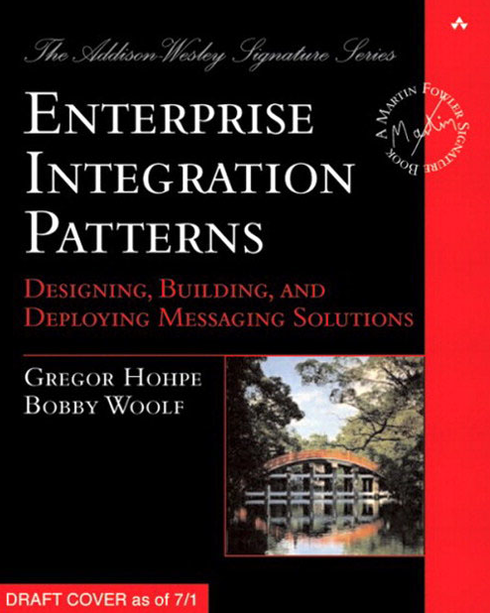
Spring Integration
Implementation of Enterprise Integration Patterns
Mature, since 2007
Apache 2.0 License
Separates integration concerns from processing logic
Framework handles message reception and method invocation
e.g. Polling vs. Event-driven
Endpoints written as POJOs
Increases testability
Endpoint
Endpoint

Slide 23
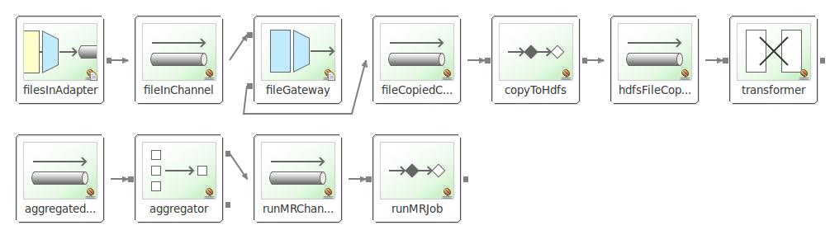
Spring Integration – Polling Log File example
Poll a directory for files, files are rolled over every 10 seconds.
Copy files to staging area
Copy files to HDFS
Use an aggregator to wait for “all 6 files in 1 minute interval” to launch MR job
Notes:
Broke up process into multiple reusable blocks.
Transformer adds data needed by aggregator to specify that “this is the first file of 6 for a given minute”

Slide 24
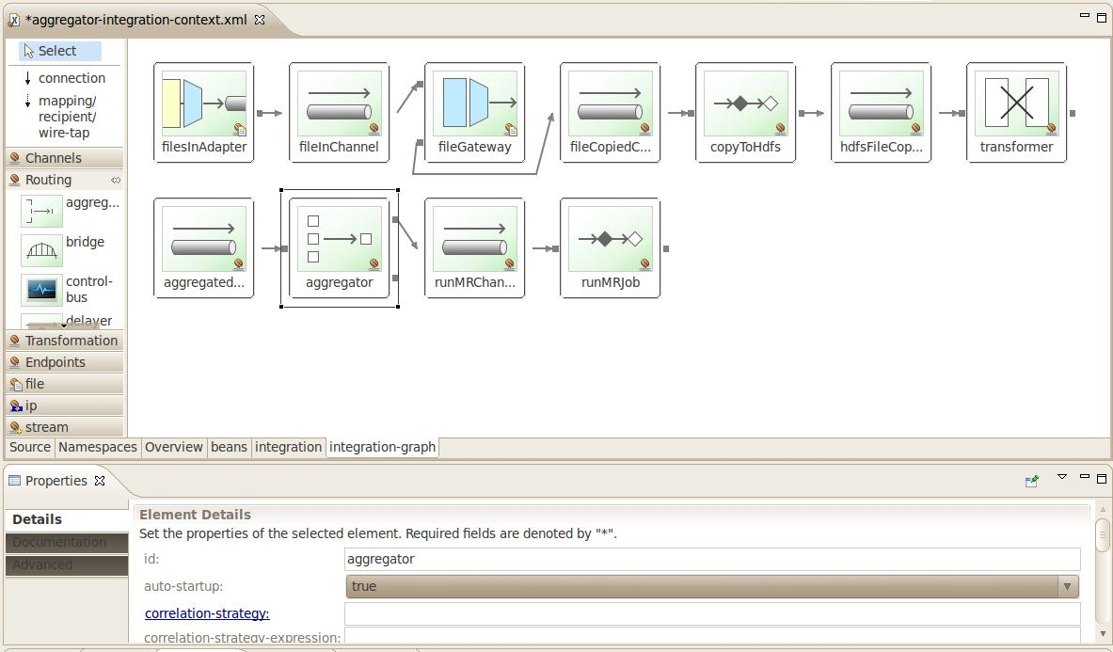
Spring Integration – Configuration and Tooling
Behind the scenes, configuration is XML or Scala DSL based
Integration with Eclipse
<!-- copy from input to staging -->
<file:inbound-channel-adapter id="filesInAdapter" channel="filInChannel"
directory="#{systemProperties['user.home']}/input">
<integration:poller fixed-rate="5000"/>
</file:inbound-channel-adapter>

Slide 25
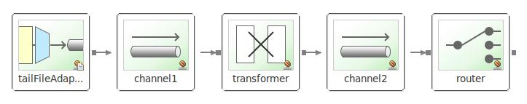
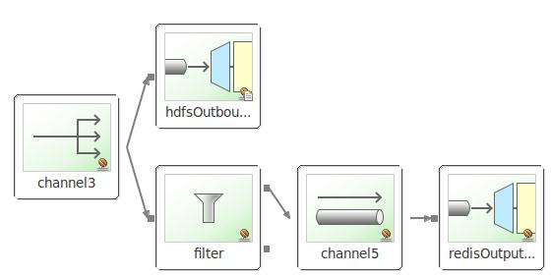
Spring Integration – Streaming data from a Log File
Tail the contents of a file
Transformer categorizes messages
Route to specific channels based on category
One route leads to HDFS write and filtered data stored in Redis

Slide 26
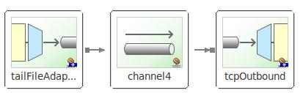
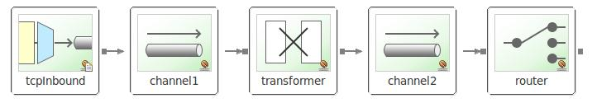
Spring Integration – Multi-node log file example
Spread log collection across multiple machines
Use TCP Adapters
Retries after connection failure
Error channel gets a message in case of failure
Can startup when application starts or be controlled via Control Bus
Send(“@tcpOutboundAdapter.retryConnection()”), or stop, start, isConnected.

Slide 27
Hadoop Based Workflows
Simplifying Hadoop Programming

Slide 28
Spring Batch
Enables development of customized enterprise batch applications essential to a company’s daily operation
Extensible Batch architecture framework
First of its kind in JEE space, Mature, since 2007, Apache 2.0 license
Developed by SpringSource and Accenture
Make it easier to repeatedly build quality batch jobs that employ best practices
Reusable out of box components
Parsers, Mappers, Readers, Processors, Writers, Validation Language
Support batch centric features
Automatic retries after failure
Partial processing, skipping records
Periodic commits
Workflow – Job of Steps – directed graph, parallel step execution, tracking, restart, …
Administrative features – Command Line/REST/End-user Web App
Unit and Integration test friendly
Notes:
5 major releases.
2 books

Slide 29
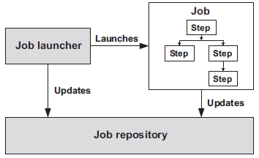
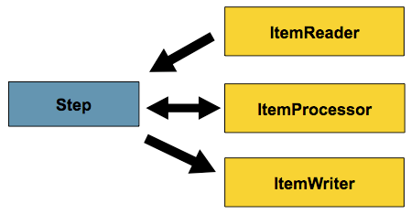
Off Hadoop Workflows
Client, Scheduler, or SI calls job launcher to start job execution
Job is an application component representing a batch process
Job contains a sequence of steps.
Steps can execute sequentially, non-sequentially, in parallel
Job of jobs also supported
Job repository stores execution metadata
Steps can contain item processing flow
Listeners for Job/Step/Item processing
<step id="step1">
<tasklet>
<chunk reader="flatFileItemReader" processor="itemProcessor" writer=“jdbcItemWriter"
commit-interval="100" retry-limit="3"/>
</chunk>
</tasklet>
</step>
Notes:
Can also have a “job of jobs” so you can compose larger and larger workflows.

Slide 30
Off Hadoop Workflows
Client, Scheduler, or SI calls job launcher to start job execution
Job is an application component representing a batch process
Job contains a sequence of steps.
Steps can execute sequentially, non-sequentially, in parallel
Job of jobs also supported
Job repository stores execution metadata
Steps can contain item processing flow
Listeners for Job/Step/Item processing
<step id="step1">
<tasklet>
<chunk reader="flatFileItemReader" processor="itemProcessor" writer=“mongoItemWriter"
commit-interval="100" retry-limit="3"/>
</chunk>
</tasklet>
</step>

Slide 31
Off Hadoop Workflows
Client, Scheduler, or SI calls job launcher to start job execution
Job is an application component representing a batch process
Job contains a sequence of steps.
Steps can execute sequentially, non-sequentially, in parallel
Job of jobs also supported
Job repository stores execution metadata
Steps can contain item processing flow
Listeners for Job/Step/Item processing
<step id="step1">
<tasklet>
<chunk reader="flatFileItemReader" processor="itemProcessor" writer=“hdfsItemWriter"
commit-interval="100" retry-limit="3"/>
</chunk>
</tasklet>
</step>

Slide 32
On Hadoop Workflows
Reuse same infrastructure for Hadoop based workflows
Step can any Hadoop job type or HDFS operation
HDFS
PIG
MR
Hive
HDFS

Slide 33
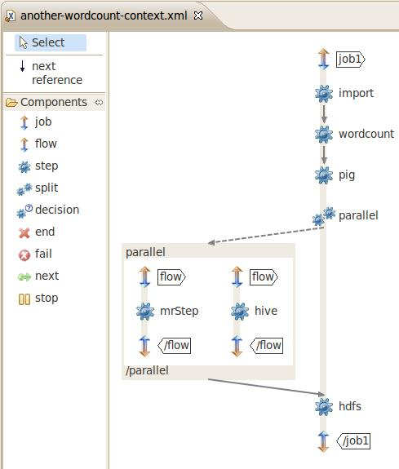
Spring Batch Configuration
<job id="job1">
<step id="import" next="wordcount">
<tasklet ref=“import-tasklet"/>
</step>
<step id="wordcount" next="pig">
<tasklet ref="wordcount-tasklet" />
</step>
<step id="pig">
<tasklet ref="pig-tasklet"
</step>
<split id="parallel" next="hdfs">
<flow>
<step id="mrStep">
<tasklet ref="mr-tasklet"/>
</step>
</flow>
<flow>
<step id="hive">
<tasklet ref="hive-tasklet"/>
</step>
</flow>
</split>
<step id="hdfs">
<tasklet ref="hdfs-tasklet"/>
</step>
</job>

Slide 34
Spring Batch Configuration
Additional XML configuration behind the graph
Reuse previous Hadoop job definitions
Start small, grow
<script-tasklet id=“import-tasklet">
<script location="clean-up-wordcount.groovy"/>
</script-tasklet>
<tasklet id="wordcount-tasklet" job-ref="wordcount-job"/>
<job id=“wordcount-job" scope=“prototype"
input-path="${input.path}"
output-path="#{@pathUtils.getTimeBasedPathFromRoot()}"
mapper="org.apache.hadoop.examples.WordCount.TokenizerMapper"
reducer="org.apache.hadoop.examples.WordCount.IntSumReducer"/>
<pig-tasklet id="pig-tasklet">
<script location="org/company/pig/handsome.pig" />
</pig-tasklet>
<hive-tasklet id="hive-script">
<script location="org/springframework/data/hadoop/hive/script.q" />
</hive-tasklet>

Slide 35


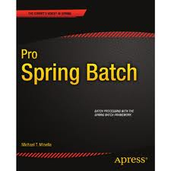



Questions
At milestone 1 – welcome feedback
Project Page: http://www.springsource.org/spring-data/hadoop
Source Code: https://github.com/SpringSource/spring-hadoop
Forum: http://forum.springsource.org/forumdisplay.php?27-Data
Issue Tracker: https://jira.springsource.org/browse/SHDP
Blog: http://blog.springsource.org/2012/02/29/introducing-spring-hadoop/
Books

