Slide 1

Introduction to the Spring Framework
Mark Eagle

Slide 2
Mark Eagle
Java Architect for MATRIX Resources in Atlanta
8 years of software development experience
Contributor to Spring, Hibernate, and Proxool
www.onjava.com
Sun Certified Java Programmer
Sun Certified Web Component Developer
Contact: meagle@meagle.com

Slide 3
Overview
Application Layering Architecture
Spring in the Middle Tier
Spring Inversion of Control + AOP
Wiring objects together
Spring Database Components
Demo

Slide 4
Application Layering

Slide 5
Application Layering
A clear separation of application component responsibility.
  Presentation layer
    Concentrates on request/response actions
    Handles UI rendering from a model.
    Contains formatting logic and non-business related validation logic.
    Handles exceptions thrown from other layers
  Persistence layer
    Used to communicate with a persistence store such as a relational database.
    Provides a query language
    Possible O/R mapping capabilities
    JDBC, Hibernate, iBATIS, JDO, Entity Beans, etc.
  Domain layer
    Contains business objects that are used across above layers.
    Contain complex relationships between other domain objects
    May be rich in business logic
    May have ORM mappings
    Domain objects should only have dependencies on other domain objects

Slide 6
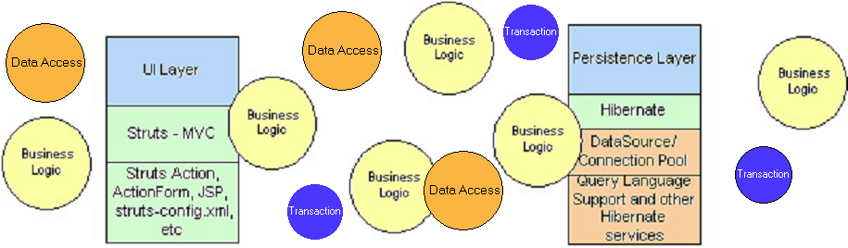
What about a Service Layer?
Where do we position loosely-coupled business logic?
What is service logic?
How should container level services be implemented?
How do we support transactions in a POJO based application?
How do we communicate from our presentation layer to our persistence layer?
How do we get to services that contain business logic?
How should our business objects communicate with our persistence layer?
How do we get objects retrieved from our persistence layer to our UI layer?
Notes:
There are typically four layers within a web container:
A presentation layer that concentrates on request/response actions which handles UI. Typically uses an MVC framework.
A business service layer to manage transactions and business logic. This is usually not addressed in many applications today or tightly coupled in an inappropriate layer.
A persistence layer to communicate with a back-end relational database.
A domain object model that can be used across all layers.

Slide 7
Application Layering (cont)
  Service layer
    Gateway to expose business logic to the outside world
    Manages ‘container level services’ such as transactions, security, data access logic, and manipulates domain objects
    Not well defined in many applications today or tightly coupled in an inappropriate layer.

Slide 8
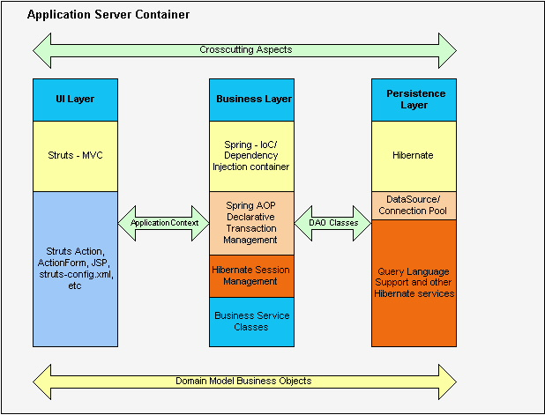
Proposed Web App Layering

Slide 9
More Application Layering Combinations
Presentation/Business/Persistence
Struts+Spring+Hibernate
Struts + Spring + EJB
JavaServer Faces + Spring + iBATIS
Spring + Spring + JDO
Flex + Spring + Hibernate
Struts + Spring + JDBC
You decide…

Slide 10
EJB (<=2.x) in the Service Layer
Sun’s traditional solution to middle tier business logic
Specification that did not always work as projected in real applications.
EJBs are less portable than POJO based architectures.
Inconsistencies by vendors make EJBs break the “write once, run anywhere” rule.
Fosters over-engineering in most cases
Entity Beans – very limiting compared to alternatives such as Hibernate.
Performance with POJOs are much faster then EJBs.
EJBs run in a heavy container
Your code becomes coupled to EJB API.
We need to redefine what J2EE means…

Slide 11
Spring In the Middle Tier

Slide 12
Spring Mission Statement
J2EE should be easier to use
OO design is more important than any implementation technology, such as J2EE.
Testability is essential, and a framework such as Spring should help make your code easier to test.
Spring should not compete with good existing solutions, but should foster integration.

Slide 13
Spring
A lightweight framework that addresses each tier in a Web application.
  Presentation layer – An MVC framework that is most similar to Struts but is more powerful and easy to use.
  Business layer – Lightweight IoC container and AOP support (including built in aspects)
  Persistence layer – DAO template support for popular ORMs and JDBC
    Simplifies persistence frameworks and JDBC
    Complimentary: Not a replacement for a persistence framework
Helps organize your middle tier and handle typical J2EE plumbing problems.
Reduces code and speeds up development
Current Version is 1.0.2
Notes:
Spring MVC
– a single shared controller instance handles a particular request type
- controllers, interceptors run in the IoC container
- allows multiple DispatcherServlets that can share an “application context”
- Interface based not class-based

Slide 14
Spring (continued)
Do I have to use all components of Spring?
Spring is a non-invasive and portable framework that allows you to introduce as much or as little as you want to your application.
Promotes decoupling and reusability
POJO Based
Allows developers to focus more on reused business logic and less on plumbing problems.
Reduces or alleviates code littering, ad hoc singletons, factories, service locators and multiple configuration files.
Removes common code issues like leaking connections and more.
Built in aspects such as transaction management
Most business objects in Spring apps do not depend on the Spring framework.
Notes:
Provides a good alternative to EJB for most applications
Provides end-to-end framework for applications.

Slide 15
Why Did I choose Spring?
Introduced to Spring by way of Hibernate
Originally wanted Spring to provide a way to simplify DAO objects and provide declarative transaction support to our non-EJB applications.
Needed a solution to loosely couple business logic in a POJO fashion.
Wanted to build portable applications that provided clearer separation of presentation, business, and persistence logic.
Easily integrated with our existing frameworks
Great documentation and community support

Slide 16
Simplify your code with Spring
Enables you to stop polluting code
No more custom singleton objects
  Beans are defined in a centralized configuration file
No more custom factory object to build and/or locate other objects
DAO simplification
  Consistent CRUD
  Data access templates
  No more copy-paste try/catch/finally blocks
  No more passing Connection objects between methods
  No more leaked connections
POJO Based
Refactoring experience with Spring
Caution Spring is addictive!

Slide 17
Spring IoC + AOP
IoC container
  Setter based and constructor based dependency injection
  Portable across application servers
  Promotes good use of OO practices such as programming to interfaces.
  Beans managed by an IoC container are reusable and decoupled from business logic
AOP
  Spring uses Dynamic AOP Proxy objects to provide cross-cutting services
  Reusable components
  Aopalliance support today
  Integrates with the IoC container
  AspectJ support in Spring 1.1

Slide 18
Spring IoC

Slide 19
Inversion of Control
Dependency injection
  Beans define their dependencies through constructor arguments or properties
  The container provides the injection at runtime
“Don’t talk to strangers”
Also known as the Hollywood principle – “don’t call me I will call you”
Decouples object creators and locators from application logic
Easy to maintain and reuse
Testing is easier
Notes:
Inversion of Control has already been referred to as Dependency Injection. The basic principle is that beans define their dependencies (i.e. the other objects they work with) only through constructor arguments or properties. Then, it is the job of the container to actually inject those dependencies when it creates the bean. This is fundamentally the inverse (hence the name Inversion of Control) of the bean instantiating or locating its dependencies on its own using direct construction of classes, or something like the Service Locator pattern. While we will not elaborate too much on the advantages of Dependency Injection, it becomes evident upon usage that code gets much cleaner and reaching a higher grade of decoupling is much easier when beans do not look up their dependencies, but are provided them, and additionally do not even know where the dependencies are located and of what actual type they are.
As touched on in the previous paragraph, Inversion of Control/Dependency Injection exists in two major variants:
setter-based dependency injection is realized by calling setters on your beans after invoking a no-argument constructor to instantiate your bean. Beans defined in the BeanFactory that use setter-based dependency injection are true JavaBeans. Spring generally advocates usage of setter-based dependency injection, since a large number of constructor arguments can get unwieldy, especially when some properties are optional.
constructor-based dependency injection is realized by invoking a constructor with a number of arguments, each representing a collaborator or property. Although Spring generally advocates usage of setter-based dependency injection as much as possible, it does fully support the constructor-based approach as well, since you may wish to use it with pre-existing beans which provide only multi-argument constructors, and no setters. Additionally, for simpler beans, some people prefer the constructor approach as a means of ensuring beans can not be constructed in an invalid state.

Slide 20
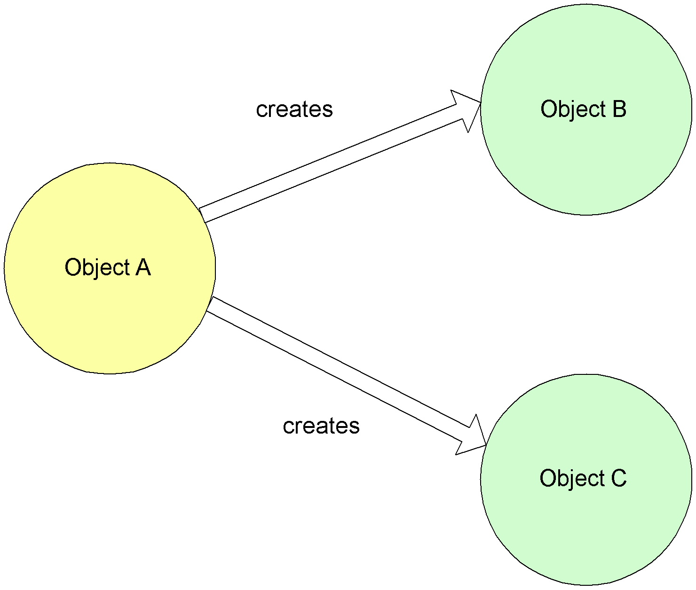
Non-IoC / Dependency Injection

Slide 21
Non-IoC Service Object
public class OrderServiceImpl implements IOrderService {
public Order saveOrder(Order order) throws OrderException{
try{
// 1. Create a Session/Connection object
// 2. Start a transaction
// 3. Lookup and invoke one of the methods in a
// DAO and pass the Session/Connection object.
// 4. Commit transaction
}catch(Exception e){
// handle e, rollback transaction, //cleanup, // throw e
}finally{
//Release resources and handle more exceptions
}
}

Slide 22
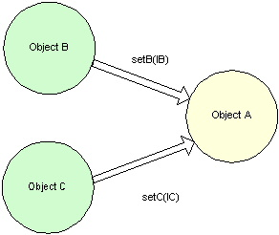
IoC / Dependency Injection

Slide 23
IoC Service Object
public class OrderSpringService implements IOrderService {
IOrderDAO orderDAO;
public Order saveOrder(Order order) throws OrderException{
// perform some business logic…
return orderDAO.saveNewOrder(order);
}
public void setOrderDAO(IOrderDAO orderDAO) {
this.orderDAO = orderDAO;
}
Program to interfaces for your bean dependencies!
Notes:
The DAO would be injected with a Session/Connection object

Slide 24
Spring Bean Definition
The bean class is the actual implementation of the bean being described by the BeanFactory.
Bean examples – DAO, DataSource, Transaction Manager, Persistence Managers, Service objects, etc
Spring config contains implementation classes while your code should program to interfaces.
Bean behaviors include:
  Singleton or prototype
  Autowiring
  Initialization and destruction methods
    init-method
    destroy-method
Beans can be configured to have property values set.
  Can read simple values, collections, maps, references to other beans, etc.

Slide 25
Simple Spring Bean Example
<bean id=“orderBean” class=“example.OrderBean” init-method=“init”>
<property name=“minimumAmountToProcess”>10</property>
<property name=“orderDAO”>
<ref bean=“orderDAOBean”/>
</property>
</bean>
public class OrderBean implements IOrderBean{
…
public void setMinimumAmountToProcess(double d){
this. minimumAmountToProcess = d;
}
public void setOrderDAO(IOrderDAO odao){
this.orderDAO = odao;
}
}

Slide 26
Spring BeanFactory
BeanFactory is core to the Spring framework
  Lightweight container that loads bean definitions and manages your beans.
  Configured declaratively using an XML file, or files, that determine how beans can be referenced and wired together.
  Knows how to serve and manage a singleton or prototype defined bean
  Responsible for lifecycle methods.
  Injects dependencies into defined beans when served
Avoids the use of singletons and factories

Slide 27
Spring ApplicationContext
A Spring ApplicationContext allows you to get access to the objects that are configured in a BeanFactory in a framework manner.
ApplicationContext extends BeanFactory
  Adds services such as international messaging capabilities.
  Add the ability to load file resources in a generic fashion.
Several ways to configure a context:
  XMLWebApplicationContext – Configuration for a web application.
  ClassPathXMLApplicationContext – standalone XML application context
  FileSystemXmlApplicationContext
Allows you to avoid writing Service Locators

Slide 28
Configuring an XMLWebApplicationContext
<context-param>
<param-name>contextConfigLocation</param-name>
<param-value>
/WEB-INF/applicationContext.xml
</param-value>
</context-param>
<listener>
<listener-class> org.springframework.web.context.ContextLoaderListener
</listener-class>
</listener>

Slide 29
Configuring an XMLWebApplicationContext
<context-param>
<param-name>contextConfigLocation</param-name>
<param-value>
/WEB-INF/applicationContext.xml
</param-value>
</context-param>
<servlet>
<servlet-name>context</servlet-name>
<servlet-class> org.springframework.web.context.ContextLoaderServlet
</servlet-class>
<load-on-startup>1</load-on-startup>
</servlet>
Notes:
For example WebSphere initializes Listeners after Servlets are loaded which is a bad thing in this case.

Slide 30
Locating a Bean with Struts
public abstract class BaseAction extends ActionSupport {
protected IOrderService getOrderService() {
return (IOrderService) getWebApplicationContext()
.getBean("orderService");
}
}
<bean id=“orderService" class="com.meagle.service.spring.OrderServiceImpl">

Slide 31
Spring AOP

Slide 32
AOP
Complements OO programming
Core business concerns vs. Crosscutting enterprise concerns
Components of AOP
  Aspect – unit of modularity for crosscutting concerns
  Join point – well-defined points in the program flow
  Pointcut – join point queries where advice executes
  Advice – the block of code that runs based on the pointcut definition
  Weaving – can be done at runtime or compile time. Inserts the advice (crosscutting concerns) into the code (core concerns).
Aspects can be used as an alternative to existing technologies such as EJB. Ex: declarative transaction management, declarative security, profiling, logging, etc.
Aspects can be added or removed as needed without changing your code.

Slide 33
Spring AOP
Framework that builds on the aopalliance interfaces.
Aspects are coded with pure Java code. You do not need to learn pointcut query languages that are available in other AOP implementations.
Spring aspects can be configured using its own IoC container.
  Objects obtained from the IoC container can be transparently advised based on configuration
Spring AOP has built in aspects such as providing transaction management, performance monitoring and more for your beans
Spring AOP is not as robust as some other implementations such as AspectJ.
  However, it does support common aspect uses to solve common problems in enterprise applications

Slide 34
Spring AOP
Supports the following advices:
  method before
  method after returning
  throws advice
  around advice (uses AOPAlliance MethodInterceptor directly)
Spring allows you to chain together interceptors and advice with precedence.
Aspects are weaved together at runtime. AspectJ uses compile time weaving.
Spring AOP also includes advisors that contain advice and pointcut filtering.
ProxyFactoryBean – sources AOP proxies from a Spring BeanFactory
IoC + AOP is a great combination that is non-invasive

Slide 35
Spring AOP Around Advice Example
public class PerformanceMonitorDetailInterceptor implements MethodInterceptor {
protected final Log logger = LogFactory.getLog(getClass());
public Object invoke(MethodInvocation invocation) throws Throwable {
String name =
invocation.getMethod().getDeclaringClass().getName()
+ "."
+ invocation.getMethod().getName();
StopWatch sw = new StopWatch(name);
sw.start(name);
Object rval = invocation.proceed();
sw.stop();
logger.info(sw.prettyPrint());
return rval;
}
}

Slide 36
Spring AOP Advice (Cont’)
Advisor references the advice and the pointcut
<bean id="perfMonInterceptor"
class=
"com.meagle.service.interceptor.PerformanceMonitorDetailInterceptor"/>
<bean id="performanceAdvisor"
class="org.springframework.aop.support.RegexpMethodPointcutAdvisor">
<property name="advice">
<ref local="perfMonInterceptor"/>
</property>
<property name="patterns">
<list>
<value>.*find.*</value>
<value>.*save.*</value>
<value>.*update.*</value>
</list>
</property>
</bean>

Slide 37
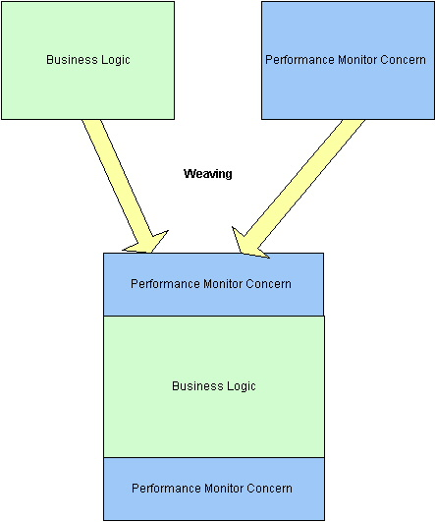
AOP Weaving

Slide 38
Wiring Beans Together with Spring

Slide 39
Wiring your Persistence Layer
<bean id=“mySessionFactory" class=
“org.springframework.orm.hibernate.LocalSessionFactoryBean“>
  <property name="mappingResources">
  <list> <value>com/matrix/bo/Order.hbm.xml</value>
  <value>com/matrix/bo/OrderLineItem.hbm.xml</value>
  </list>
  </property>
  <property name="hibernateProperties">
  <props>
  <prop key="hibernate.dialect">
  net.sf.hibernate.dialect.DB2Dialect
  </prop>
  <prop key="hibernate.default_schema">DB2ADMIN</prop>
  <prop key="hibernate.show_sql">false</prop>
  <prop key="hibernate.proxool.xml">
  /WEB-INF/proxool.xml</prop>
  <prop key="hibernate.proxool.pool_alias">spring</prop>
  </props>
  </property>
</bean>
Notes:
Remember to discuss how the names of the xml tags map to the Javadoc setters.

Slide 40
Wiring your Transaction Management
Four transaction managers available
  DataSourceTransactionManager
  HibernateTransactionManager
  JdoTransactionManager
  JtaTransactionManager
<bean id=“myTransactionManager" class="org
.springframework
.orm
.hibernate
.HibernateTransactionManager">
<property name=“sessionFactory">
<ref local=“mySessionFactory"/>
</property>
</bean>
Notes:
DataSourceTransactionManager - PlatformTransactionManager implementation for single JDBC data sources. Binds a JDBC connection from the specified data source to the thread, potentially allowing for one thread connection per data source.
HibernateTransactionManager- PlatformTransactionManager implementation for single Hibernate session factories. Binds a Hibernate Session from the specified factory to the thread, potentially allowing for one thread Session per factory. SessionFactoryUtils and HibernateTemplate are aware of thread-bound Sessions and participate in such transactions automatically. Using either is required for Hibernate access code that needs to support this transaction handling mechanism.
JdoTransactionManager - PlatformTransactionManager implementation for single JDO persistence manager factories. Binds a JDO PersistenceManager from the specified factory to the thread, potentially allowing for one thread PersistenceManager per factory. PersistenceManagerFactoryUtils and JdoTemplate are aware of thread-bound persistence managers and take part in such transactions automatically. Using either is required for JDO access code supporting this transaction management mechanism.
JtaTransactionManager - PlatformTransactionManager implementation for JTA, i.e. J2EE container transactions. Can also work with a locally configured JTA implementation. This transaction manager is appropriate for handling distributed transactions, i.e. transactions that span multiple resources, and for managing transactions on a J2EE Connector (e.g. a persistence toolkit registered as JCA Connector).

Slide 41
Wiring a Service Object
<bean id=“orderService" class="org.springframework.transaction.
interceptor.TransactionProxyFactoryBean">
<property name="transactionManager">
<ref local=“myTransactionManager"/>
</property>
<property name="target"><ref local=“orderTarget"/></property>
<property name="transactionAttributes">
  <props>
  <prop key="find*">
  PROPAGATION_REQUIRED,readOnly,-OrderException
  </prop>
  <prop key="save*">
  PROPAGATION_REQUIRED,-OrderMinimumAmountException
  </prop>
  <prop key="update*">
  PROPAGATION_REQUIRED,-OrderException
  </prop>
  </props>
</property>
</bean>
Notes:
TODO -Make sure to discuss naming methods with consistent names and how to handle rollbacks for a bean: <prop key="add*">PROPAGATION_REQUIRED,-PortalException</prop>
- TransactionAttributeEditor - A "+" before an exception name substring indicates that transactions should commit even if this exception is thrown; a "-" that they should roll back. RuntimeExceptions will automatically runback when encountered even if they are not declared.

Slide 42
Defining a Target to Proxy
public class OrderServiceSpringImpl implements IOrderService {
private IOrderDAO orderDAO;
// service methods…
public void setOrderDAO(IOrderDAO orderDAO) {
this.orderDAO = orderDAO;
}
}

Slide 43
Wiring a Service Object (cont’)
<bean id=“orderTarget" class="com.meagle.service.spring.OrderServiceSpringImpl">
<property name=“orderDAO">
<ref local=“orderDAO"/>
</property>
</bean>
<bean id=“orderDAO" class="com.meagle.dao.hibernate.OrderHibernateDAO">
<property name="sessionFactory">
<ref local=“mySessionFactory"/>
</property>
</bean>

Slide 44
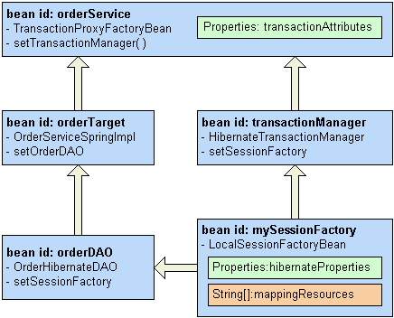

Slide 45
Spring Database Components

Slide 46
Consistent Abstract Classes for DAO Support
Extend your DAO classes with the proper xxxDAOSupport class that matches your persistence mechanism.
JdbcDaoSupport
  Super class for JDBC data access objects.
  Requires a DataSource to be set, providing a JdbcTemplate based on it to subclasses.
HibernateDaoSupport
  Super class for Hibernate data access objects.
  Requires a SessionFactory to be set, providing a HibernateTemplate based on it to subclasses.
JdoDaoSupport
  Super class for JDO data access objects.
  Requires a PersistenceManagerFactory to be set, providing a JdoTemplate based on it to subclasses.
SqlMapDaoSupport
  Supper class for iBATIS SqlMap data access object.
  Requires a DataSource to be set, providing a SqlMapTemplate

Slide 47
Spring DAO Templates
Built in code templates that support JDBC, Hibernate, JDO, and iBatis SQL Maps
Simplifies data access coding by reducing redundant code and helps avoid common errors.
Alleviates opening and closing connections in your DAO code.
No more ThreadLocal or passing Connection/Session objects.
Transaction management is handled by a wired bean
You are dropped into the template with the resources you need for data access – Session, PreparedStatement, etc.
Code only needs to be implemented in callback methods.
  doInXXX(Object)
Optional separate JDBC framework

Slide 48
Ex: Code without a template
public class OrderHibernateDAO implements IOrderDAO {
public Order saveOrder(Order order) throws OrderException{
Session s = null;
Transaction tx = null;
try{
s = ... // get a new Session object
tx = s.beginTransaction();
s.save(order);
tx.commit();
} catch (HibernateException he){
// log, rollback, and convert to OrderException
} catch (SQLException sqle){
// log, rollback, and convert to OrderException
} finally {
s.close(); // needs a try/catch block
}
return order;
}

Slide 49
Ex: Spring DAO Template Example
public class OrderHibernateDAO extends HibernateDaoSupport
implements IOrderDAO {
...
public Order saveOrder(final Order order) {
return (Order) getHibernateTemplate().execute(new HibernateCallback() {
public Object doInHibernate(Session session)
throws HibernateException, SQLException {
session.save(order);
return order;
}
});
}
...
}

Slide 50
Ex 2: Spring DAO Template Example
public class OrderHibernateDAO extends HibernateDaoSupport
implements IOrderDAO {
...
public List findOrdersByCustomerId(int id) {
return getHibernateTemplate()
.findByNamedQuery(“OrdersByCustomerID”,
new Integer(id));
}
public Order findOrderById(int orderId ) {
return (Order) getHibernateTemplate().load(
Order. class,
new Integer(orderId));
}
...
}

Slide 51
Consistent Exception Handling
Spring has it’s own exception handling hierarchy for DAO logic.
No more copy and pasting redundant exception logic!
Exceptions from JDBC, or a supported ORM, are wrapped up into an appropriate, and consistent, DataAccessException and thrown.
This allows you to decouple exceptions in your business logic.
These exceptions are treated as unchecked exceptions that you can handle in your business tier if needed. No need to try/catch in your DAO.
Define your own exception translation by subclassing classes such as SQLErrorCodeSQLExceptionTranslator

Slide 52
Spring and Testing
Easier test driven development (TDD)
Integration testing
  Can use a standalone Spring configuration with mock objects for testing.
  Consider XMLApplicationContext or FileSystemApplicationContext.
Unit testing
  Allows you to test outside the container without using the Spring container.
Easy to test POJOs

Slide 53
Struts Support
ContextLoaderPlugin - Struts 1.1 PlugIn that loads a Spring application context for the Struts ActionServlet. This context will automatically refer to the root WebApplicationContext (loaded by ContextLoaderListener/Servlet) as parent.
ActionSupport and DispatchActionSupport are pre-built convenience classes that provide easy access to the context. These classes alleviate the need to build custom service locators.

Slide 54
Even More Spring Components
JavaMail helpers
Scheduling support via Quartz
Convenience implementation classes for
  Remoting support – JAXRPC, RMI, Hessian, and Burlap
EJB support for easier access.
Acegi Security System for Spring
    http://acegisecurity.sourceforge.net/
    Very good framework!
Eclipse Plugin – Spring IDE for Eclipse
Coming soon
  JMS implementation classes
  JMX support

Slide 55
Future Trends and Predictions
Traditional J2EE development with EJB will become more POJO based with EJB 3.0
Lightweight IoC container support will become more popular
Future versions of J2EE will resemble frameworks like Spring and Hibernate for business logic and persistence logic respectively.
  EJB 3.0 ~ (Spring + Hibernate)
AOP is gaining momentum as an alternative to providing enterprise services
Annotations will be helpful for applying AOP advice – J2SE 1.5
IoC + AOP is a great non-invasive combination.
Spring is already available today!
If you are considering EJB 3.0 - Spring will make an easier migration path
Notes:
EJB might be necessary for applications that require distributed transaction management or RMI remoting capabilities.
IoC for orthogonal business/DAO dependency wiring and AOP for crosscutting concerns

Slide 56
Demo
Shows an end-to-end implementation using Struts, Spring, and Hibernate.
Demonstrates declarative transaction management with POJOs using Spring Aspect.
Demonstrates working with a custom Spring aspect for performance monitoring.
DAO replacement Hibernate << >> JDBC
Look at some code.

Slide 57
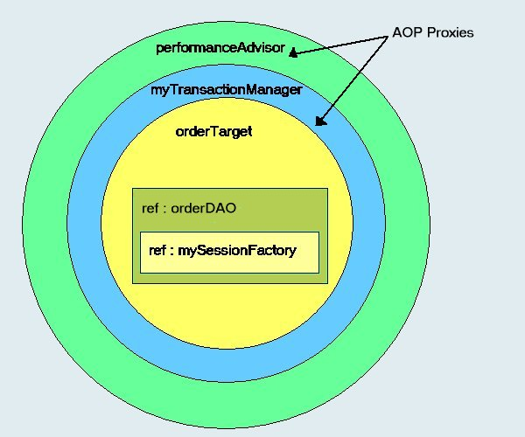

Slide 58
Resources
Spring – www.springframework.org
J2EE without EJB – Rod Johnson/ Jurgen Hoeller
Better, Faster, Lighter Java – Bruce Tate
Wiring your Web Application with Open Source Java http://www.onjava.com/pub/a/onjava/2004/04/07/wiringwebapps.html

Slide 59
The End
Questions?

Slide 60
Real World EJB Usage
Stateless Session Beans (SLSBs)
  One of the easiest beans to program, but still want to program with POJOs.
  Local interfaces alleviate remote interface performance issues.
  Used as facades to other objects
  Allows developers to provide declarative transaction management.
Message Driven Beans (MDBs)
  Easy to program
  Provides asynchronous messaging
Distributed Transaction Management
RMI Remoting
How do we get the benefits of EJB without using an EJB container?

Slide 61
Application Layering (cont)
More Architectural decisions…
  How do we achieve independent layers of code that can provide clear separation, loose coupling, and allow communication with each other?
  How can we design an architecture that can allow layer replacement without affecting existing layers?
  What technologies, and frameworks, should be implemented in each layer?
  How will we implement security?
  Will the application be flexible to technology changes?
  How will the application handle enterprise level services such as transactions, security, logging, resource pooling, profiling, etc?

Slide 62
More about the Service Layer
Often tightly coupled with other layers
  Struts is not where you place business logic and persistence logic!
The missing link IMHO in most applications today.
EJB – SLSB, SFSB provide the common J2EE business layer enterprise solutions for transactions within a container. What about POJO?
Hand code transaction logic with JTA
Frameworks – Spring, Picocontainer, HiveMind, etc.
Lighterweight containers use
  IoC/Dependency Injection
  AOP

Slide 63
Application Layering (cont)
Where do we code business logic?
  Domain objects
    Heavy domain model / thin service layer approach
    Business logic is embedded in domain objects
    Takes advantage of OO programming
    Behavior rich domain model
  Service Layer
    Thin domain model / heavy service layer approach
    Wraps procedural business logic over domain objects
    Anti-pattern according to Fowler – ‘Anemic Domain Model’
    Provides a separation of business logic concerns from the domain model
    Treats the domain model as ORM objects

Slide 64
ClassPathXMLApplicationContext
Usually used with a standalone application to obtain a context
  Ex: Swing application
Useful when performing integration testing
  In-container testing.
  Define a separate application context XML file that contains mappings to your mock objects.

