Slide 1
Advanced Concurrency
Design and Construction
Rob Harrop

Slide 2
About the speaker
Principal Software Engineer
Lead of dm Server
Author of Pro Spring
JMX expert group member

Slide 3
Agenda
Concurrency in Java 6 & 7
Building Concurrent Applications
  Patterns
  Considerations
  Pitfalls
Diagnosing concurrency bugs
Concurrency beyond Java
Q&A

Slide 4
Why is Concurrency Important?
Multi-core architecture
Increasing application workloads
Improved hardware utilization

Slide 5
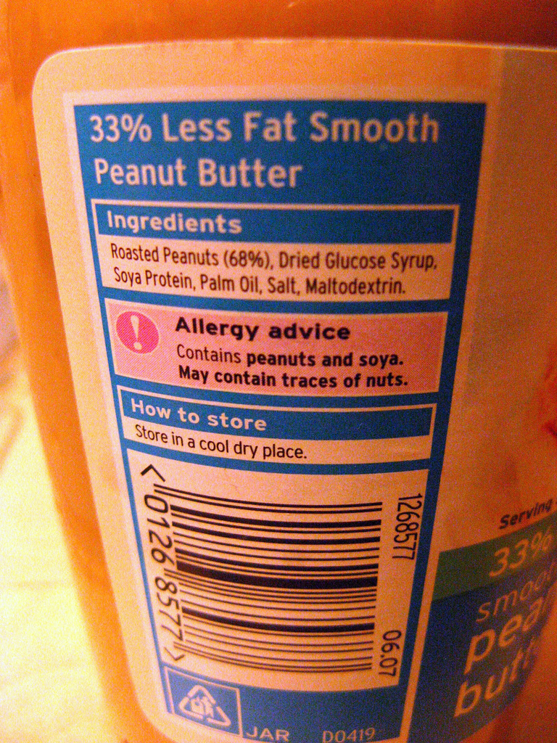

Slide 6
Java Concurrency 101
Java Memory Model
  Ordering
  Visibility
  Atomicity
Everything is governed by the 'happens-before' ordering

Slide 7
Happens Before
Program order rule
Monitor lock rule
Volatile variable rule
Thread start rule

Slide 8
Java 5 Concurrency Tools
BlockingQueue
ConcurrentHashMap
CopyOnWriteArray*
CountdownLatch
ExecutorService
Future
Atomic*

Slide 9
Concurrency in Java 6
Deques
SkipLists
Ownable Synchronizers

Slide 10
Concurrency in Java 7
TransferQueue
Phasers
Fork and Join

Slide 11
DEMO

Slide 12
Building Concurrent Applications

Slide 13
Make up of a concurrent app
Data structures
Asynchronous processing

Slide 14
Data Structures
Thread safe and/or concurrent
Typically supplied by the JDK
May have to build your own
  Refer to last year's talk
Simplicity is of the utmost importance

Slide 15
Asynchronous Processing
Typically application-specific
Many different 'blocks' of processing
Hard to create

Slide 16
Implementation Challenges
Race conditions
Deadlock
Livelock
Divergence
Coordination
Maintainability

Slide 17
Areas of Focus
General Issues
  Lock management
  Code organization
  Unsafe data structures
  Encapsulation
  Resource starvation

Slide 18
Areas of Focus
Asynchronous Processing
  Characteristics of asynchronous processing
  Implementation models
  Handling divergence
  Interaction and composition

Slide 19
General Issues

Slide 20
Lock Management
Incorrect lock management leads to:
  Deadlock
  Race conditions
  Broken invariants
Guidelines:
  Avoid alien calls
  Avoid client locking
Solutions:
  Locking protocol
  Lock ordering

Slide 21
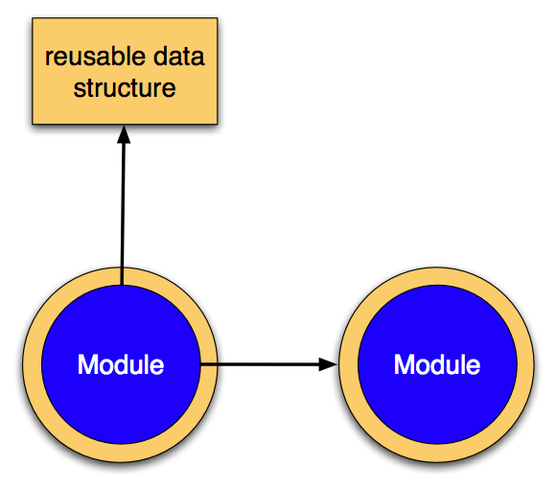
Code Organization

Slide 22
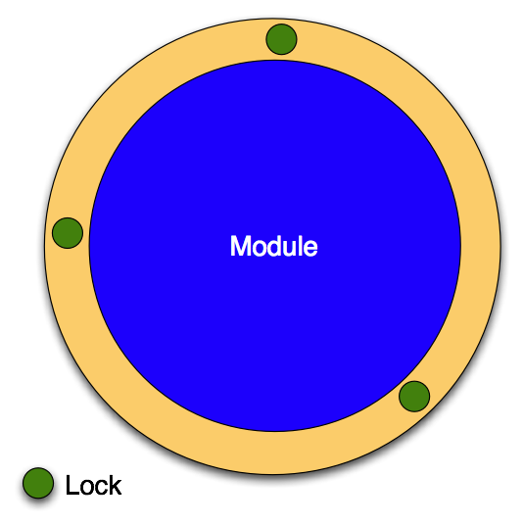
Encapsulation

Slide 23
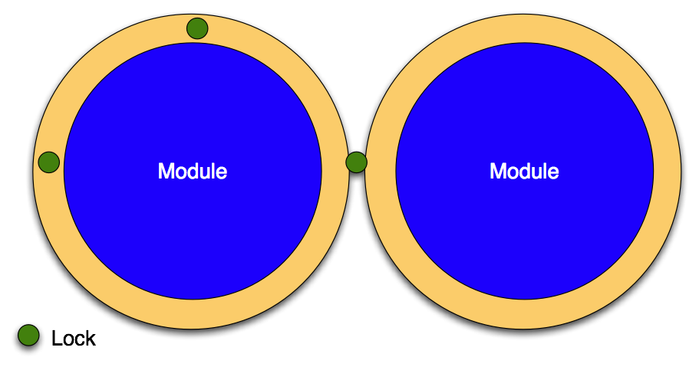
Breaking Encapsulation

Slide 24
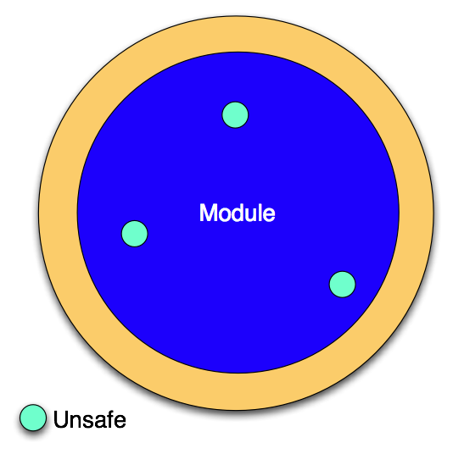
Unsafe data structures

Slide 25
Resource starvation
Acquisition order is important as with locks
Treat bounded resources as you would locks
  Acquisition protocol
  Ordering
  Encapsulation
Beware of single resource pool starvation
  Use Spring for resource acquisition

Slide 26
Livelock
Inability of part of the system to make progress
Hard to spot, hard to avoid in all cases
Examples:
  Unbounded retry
  Loop with incorrect synchronization
Diagnosis:
  Fine-grained trace
    Use aspects to apply

Slide 27
DEMO

Slide 28
Recap
Steer clear of client locking and alien calls
Be aware of lock encapsulation
Organize code so that thread safety is a thin layer
Modules are units of thread safety
Non-thread safe code is fine
  Just document its usage
  Fully encapsulate it in the module

Slide 29
Asynchronous Processing

Slide 30
Characteristics
Three possible outcomes
  Expected
    Success
    Failure
  Unexpected
    Divergence

Slide 31
Characteristics
May be result-bearing
Fire-and-forget task rarely exist
  Still need to track outcome
  Still need to deal with failure/divergence

Slide 32
Implementation Models
Ad-hoc
Task-based
Event-based
Actor-based

Slide 33
Requirements
Result tracking
  Separate success, failure and divergence
Coordination
  Multiple asynchronous processes can communicate
Composition
  Multiple processes working together to solve a larger use case

Slide 34
DEMO

Slide 35
Recap
Divergence and failure are different
  Use timeouts for divergence
  Use direct reporting for failure
  Timeouts can be long when tracking divergence

Slide 36
Recap
Ad-hoc processing is rarely suitable
  No mechanism for result passing
  Divergence and failure are hard to separate
  Coordination is non-existent

Slide 37
Recap
Task-based processing is great for uncoordinated processes
  Futures are great for result reporting
Tasks are limited when trying to integrate with event-based providers
  Lack of cause and effect
  No process concept

Slide 38
Recap
Event-based processing is great for integration and notification
Event-based systems are not for requesting work
  No easy mechanism for result tracking
  Coordination is difficult and race prone
Publish and subscribe means that publisher is decoupled from the suppliers
  Not strictly one-to-one

Slide 39
Recap
Actor-based processing provides a good model for composition
  Processes are manifested as concepts
  Integration with event systems is easy
Direct Java support is poor
Scala is difficult to learn and a bit of a beast :)

Slide 40
Diagnosing concurrency bugs

Slide 41
Deadlocks
Active diagnosis in dm Server
Passive diagnosis in Java 6
  JMX
  jstack

Slide 42
Hung process
Connect using jstack

Slide 43
Standard Deadlocks
B
A
C

Slide 44
Spur Deadlocks
B
D
A
C

Slide 45
DEMO

Slide 46
Concurrency Beyond Java

Slide 47
Scala
JVM language
Functional and object-oriented
Actor-based message-passing model
Excellent Java integration
Early tooling in Eclipse

Slide 48
Erlang
Functional
Actor-based message-passing concurrency
Interpreted
http://www.erlang.org/

Slide 49
Killim
Java with post proccessing stage
Annotation-driven message passing
Still in early development 0.5.1
http://www.malhar.net/sriram/kilim/

Slide 50
Q&A

