Slide 1
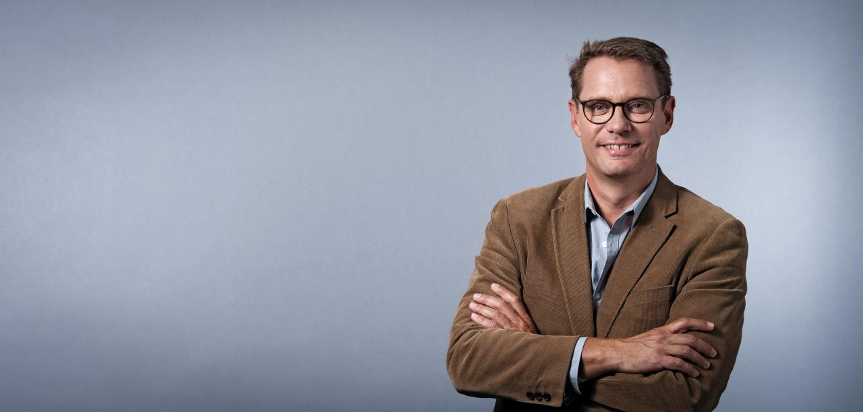


Slide 2
VS
Thomas
Sonja

Slide 3

VS
Thomas
Sonja

Slide 4
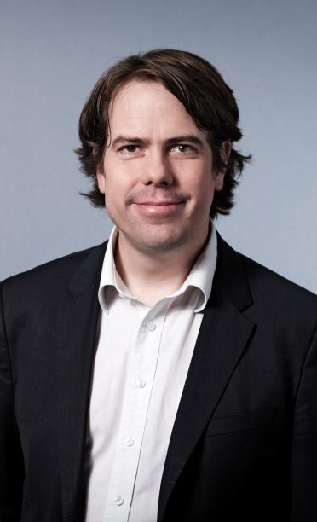

Slide 5


215
0
0

Slide 6


1315
0
0

Slide 7
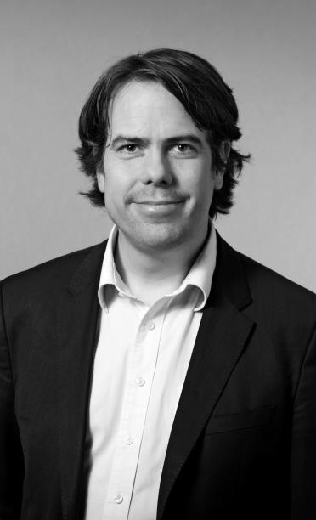
102
0
0
1315

Slide 8
20231
102
1315

