Slide 1
StepExecutor iterates over:
input file
Database
FileItemWriter
BusinessItemWriter
provides
items
Notes:
SimpleStepExecutor

Slide 2
Job
Database
2
JdbcItemReader
JdbcItemWriter
2
ItemProcessor
2
Query for details using
key as parameter
Existing
DAO
Keys obtained at step initialization
Notes:
drivingQueryJob.png

Slide 3
TransactionSynchronizationManager
Writer
TransactionSynchronization
FileResource
write(items)
register(…)
create
mark()
Error!
rollback()
reset()

Slide 4
ItemWriter
Step
Session
TransactionManager
execute()
begin()
write(items)
update
update
flush()
Error!
rollback()
Notes:
errorOnFlush.png

Slide 5
ItemWriter
Step
Session
TransactionManager
execute()
begin()
write(item)
update
flush()
write(item)
update
flush()
Error!
rollback()
Notes:
errorOnWrite.png

Slide 6
ItemWriter
Step
Session
TransactionManager
execute()
begin()
write(items)
update
update
commit()
flush()
Error!
fail
Notes:
errorOnCommit.png

Slide 7
Repeat Template
Repeat Callback
Input
Source
Output
Source
Incoming
Input
Parsed
Result
Processed
Item
Parse
Transform
Object
Validate
Item
Process
Serialize
File(Tokenizer)
XML (StAX)
SQL
LineMapper
RowMapper
OXM
Apache Validator
Spring VALANG
Business
Logic
Line Aggregator
XML (StAX)
SQL
Outgoing
Output
Item Reader
Item Writer

Slide 8
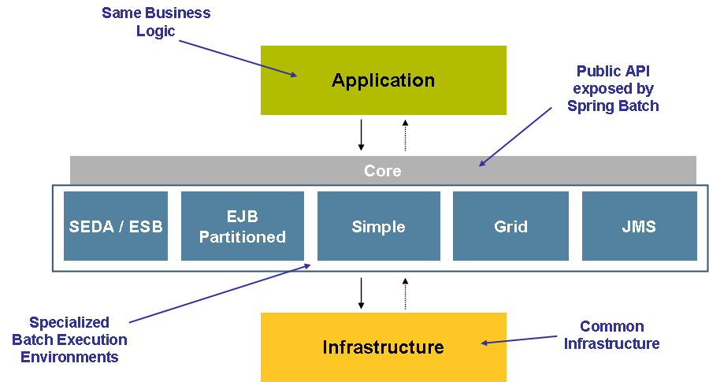

Slide 9
Bussiness Domain - Record Level data (i.e. Trade)
Application
Job, Step, JobLauncher
Batch Core
JobLauncher, Implementations of Core API
Declarative, plus Abstractions and Extension Points
Repeat, Retry, Transaction, Input, Output
Batch Infrastructure

Slide 10
High Level Overview
1
ItemReader
1
JobLauncher
Job
1
*
Step
1
1
ItemWriter
JobRepository

Slide 11
High Level Overview
1
ItemReader
1
1
*
Step
1
1
JobLauncher
Job
ItemProcessor
1
1
ItemWriter
JobRepository

Slide 12
Batch Domain
The EndOfDay Job
Job
*
JobInstance
The EndOfDay Job
for 2007/05/05
*
The first attempt at
EndOfDay Job
for 2007/05/05
JobExecution

Slide 13
Batch Domain
The EndOfDay Job
Job
schedule.date = 2007/05/05
*
JobParameters
JobInstance
The EndOfDay Job
for 2007/05/05
*
The first attempt at
EndOfDay Job
for 2007/05/05
JobExecution

Slide 14
Batch Domain
Job
*
Step
*
JobInstance
*
*
JobExecution
*
StepExecution

Slide 15
Item Oriented Processing
Step
ItemReader
ItemWriter
execute()
read()
item
write(item)
read()
item
write(item)
ExitStatus

Slide 16
Chunk Oriented Processing
Step
ItemReader
ItemWriter
execute()
read()
item
read()
item
write(items)
ExitStatus

Slide 17
Old Step Paradigm
ItemReader
Step
ItemWriter

Slide 18
Old Step Paradigm
ItemReader
Step
ItemTransformer
ItemWriter
ItemWriter
ItemTransformer

Slide 19
New Step Paradigm
ItemReader
Step
ItemProcessor
ItemWriter

Slide 20
Late Binding use case
ItemReader
StepA
ItemWriter
outputFile.txt
ItemReader
StepB
ItemWriter

Slide 21
Sequential Step Execution
In 1.x the only option is sequential execution. If the a step fails, the job fails, if it succeeds, the next is executed.
Step A
Step B
Step C

Slide 22
Non Sequential Step Execution
There are many scenarios in which different steps need to be executed depending upon the exit status of the last step.
Step A
Success?
Yes
No
Step B
Step C

Slide 23
Repository Enhancements
JobOperator
Combines all
JobLauncher
run(Job)
JobRepository
JobExplorer
CRUD operations
get* operations
Database

Slide 24
<trade>
<isin>XYZ0001</isin>
<quantity>5</quantity>
<price>11.39</price>
<customer>Customer1</customer>
</trade>
<trade>
<isin>XYZ0002</isin>
<quantity>2</quantity>
<price>72.99</price>
<customer>Customer2c</customer>
</trade>
<trade>
<isin>XYZ0003</isin>
<quantity>9</quantity>
<price>99.99</price>
<customer>Customer3</customer>
</trade>
Fragment 1
Fragment 2
Fragment 3

Slide 25
Spring OXM
JaxB2
Fragment 1
Fragment 2
Fragment 3
Castor
XmlBeans
Any binding framework supported by Spring OXM

Slide 26
FOO 2
id=2
name=foo2
bar=bar2
Select * from FOO
where id > 1 and id < 7
ID | NAME | BAR
1 | foo1 | bar1
2 | foo2 | bar2
3 | foo3 | bar3
4 | foo4 | bar4
5 | foo5 | bar5
6 | foo6 | bar6
7 | foo7 | bar7
8 | foo8 | bar8
FOO 3
id=3
name=foo3
bar=bar3
FOO 4
id=4
name=foo4
bar=bar4

Slide 27
Select ID from FOO
where id > 1 and id < 7
ID | NAME | BAR
1 | foo1 | bar1
2 | foo2 | bar2
3 | foo3 | bar3
4 | foo4 | bar4
5 | foo5 | bar5
6 | foo6 | bar6
7 | foo7 | bar7
8 | foo8 | bar8
2
2
2
Copyright © 2008 Accenture All Rights Reserved.

Slide 28
Client
JobLauncher
Job
Business
run()
execute()
ExitStatus
JobExecution
With ExitStatus.FINISHED or FAILED

Slide 29


Client
JobLauncher
JobExecutor
Business
run()
execute()
stop()
ExitStatus
JobExecution

Slide 30
Client
JobLauncher
Job
Business
run()
JobExecution
Starts with
ExitStatus.UNKNOWN
execute()
ExitStatus

Slide 31
Remote Chunking
Master:
Slave:
<<Step>>
<<Listener>>
ChunkProvider
ChunkProcessor
ItemReader
ItemWriter
Notes:
remote-chunking.png

Slide 32
Partitioning Overview
Job
Slave
Step
Slave
Slave
Master
Slave
Slave
Step
Slave
Notes:
partitioning-overview.png

Slide 33
PartitionStep
Step
PartitionHandler
execute()
StepExecutionSplitter
handle()
split()
execute()
repeat
join
aggregate
Notes:
partitioning-spi.png

Slide 34
Remote chunking
Master
Worker
ChunkMessageChannel
ItemWriter
- messagingTemplate
- Incoming replies
SimpleChunkProcessor
- itemProcessor
- itemWriter
Outgoing
requests
(SI channel)
Outbound
Channel
Adapter
requests
(physical queue)
Inbound
Channel
Adapter
Incoming
requests
(SI channel)
MessagingTemplate
- Outgoing requests
ChunkProcessorChunkHandler
- chunkProcessor
Incoming
replies
(SI channel)
Inbound
Channel
Adapter
replies
(physical queue)
Outbound
Channel
Adapter
Outgoing
replies
(SI channel)
Step
Item
Reader
Item
Processor
Item
Writer
Provided by Spring Batch
Provided by the user

Slide 35

Remote partitioning
(repository polling)
Master
Worker
MessageChannel
PartitionHandler
- messagingTemplate
StepExecutionRequestHandler
- stepLocator
- jobExplorer
Outgoing
requests
(SI channel)
Outbound
Channel
Adapter
requests
(physical queue)
Inbound
Channel
Adapter
Incoming
requests
(SI channel)
Poll StepExecution progress
execute
discard replies
MessagingTemplate
- Outgoing requests
Job
Repository
Worker
Step
Outgoing
replies
(SI NullChannel)
Update StepExecution progress
Master
Step
Partitioner
Step
Locator
Job
Explorer
Provided by Spring Batch
Provided by the user

Slide 36
Remote partitioning
(message aggregation)
Master
Worker
MessageChannel
PartitionHandler
- messagingTemplate
- Incoming replies
StepExecutionRequestHandler
- stepLocator
- jobExplorer
Outgoing
requests
(SI channel)
Outbound
Channel
Adapter
requests
(physical queue)
Inbound
Channel
Adapter
Incoming
requests
(SI channel)
MessagingTemplate
- Outgoing requests
send
replies
Incoming
replies
(SI channel)
Inbound
Channel
Adapter
replies
(physical queue)
Outbound
Channel
Adapter
Outgoing
replies
(SI channel)
execute
Aggregator
Incoming
staging
(SI channel)
Master
Step
Partitioner
Worker
Step
Step
Locator
Job
Explorer
Provided by Spring Batch
Provided by the user

Slide 37
Step1
Step2
Step3
ItemReader
ItemReader
ItemReader
ItemProcessor
ItemProcessor
ItemWriter
ItemWriter
ItemWriter
Step2a
Step2b
Step2c
ItemProcessor
ItemProcessor
ItemProcessor
ItemWriter
ItemWriter
ItemWriter

