Slide 1
Step iterates over items:
input file
Database
FileItemReader
BusinessItemWriter
provides
items
Notes:
SimpleStepExecutor

Slide 2
Step iterates over chunks:
input file
chunk
Database
FileItemReader
Chunker
Dechunker
BusinessItemWriter
provides
chunks
executes
chunks
Notes:
SimpleStepExecutor

Slide 3
input file
concurrent listeners
Step
QueueItemReader
BusinessItemWriter
Queue
Database
FileItemReader
RelayItemWriter
…
provides items
QueueItemReader
BusinessItemWriter
feedback to throttle input
Notes:
PipelineStepExecutor

Slide 4
concurrent Jobs
Database
Job
PartitionItemReader
EntityItemReader
BusinessItemWriter
stores partitions and sends messages to remote executor
Database
Database
PartitionHandler
…
PartitionItemReader
BusinessItemWriter
EntityItemReader
tracks progress
and manage
restart data
Notes:
PartitionStepExecutor

Slide 5
Database
Step 1
Step 2
input file
Database
FileItemReader
BusinessItemWriter
StagingItemWriter
EntityItemReader
Job
Notes:
Job with 2 Steps

Slide 6
concurrent Steps?
Database
Step 2
stores partitions and sends messages to remote executor
Step 1
Step 2
PartitionItemReader
EntityItemReader
BusinessItemProcessor
input file
Database
Database
FileItemReader
PartitionHandler
…
StagingItemWriter
PartitionItemReader
BusinessItemProcessor
EntityItemReader
tracks progress
and manage
restart data
Job
Notes:
Job with 2 Steps and Partitioning

Slide 7
JobLauncher
uses to identify job instance
Application
Developer
JobParameters
executes
configures
requires 2: inner and outer loop
RepeatOperations
uses
Job
ExceptionHandler
uses
*
CompletionPolicy
Step
other infrastructure dependencies
Notes:
ExecutionDomain

Slide 8
Application
Developer
implements
ItemReader
ItemWriter
configures
Job
*
contains
Step
RepeatOperations
ExceptionHandler
Notes:
ExecutionDomain

Slide 9
JobParameters
uses to identify and
manage jobs
JobLauncher
Application
Developer
JobExecution
executes
Job
configures
*
locates
StepExecution
executes
Step
Infrastructure dependencies
stored in
Database
Notes:
ExtendedExecutionDomain

Slide 10
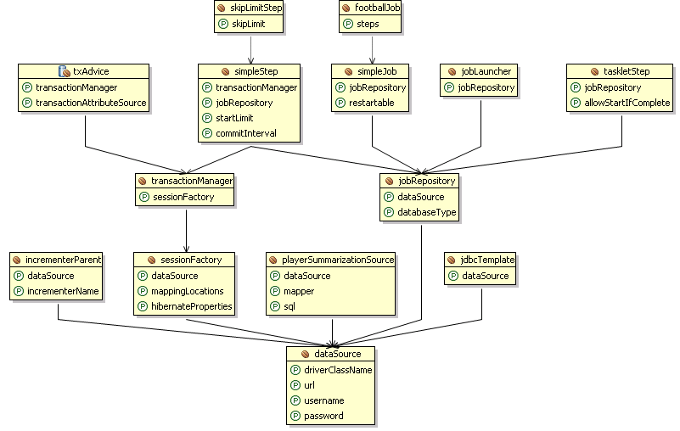
Notes:
FootballJob

