Slide 1
Trying to automate the process of deploying applications with CI environment
Mykolaishyn Oleh
Lviv
2021

Slide 2
Task - create automated system of building project, push it to docker hub and deploy
Stages:
Implement the deployment of the necessary infrastructure on GCP;
Setting up the CI system;
Deploying docker container with app

Slide 3
Task description
1. Pushing code to GitHub
2. Building project in Jenkins
3. Maven compilation of project
4. Building container on instance and pushing it to DockerHub
5. Running container on another GCP instance

Slide 4
Setup
1.Master – instance with Ansible to configure other instances
2. Dev-tools – instance with Jenkins
3. Builder – instance for building with maven and creating docker image
4. Agent-1 – instance which pulls docker image and launches container

Slide 5
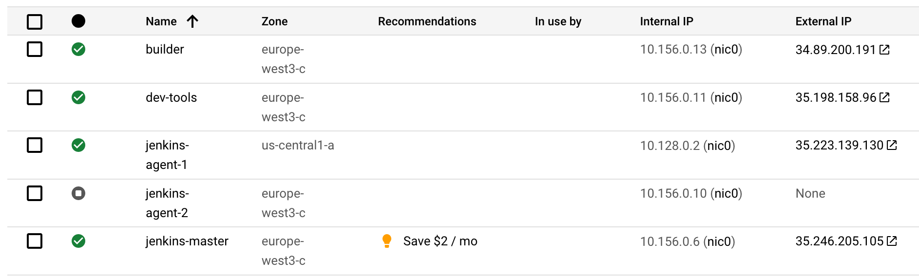

Slide 6
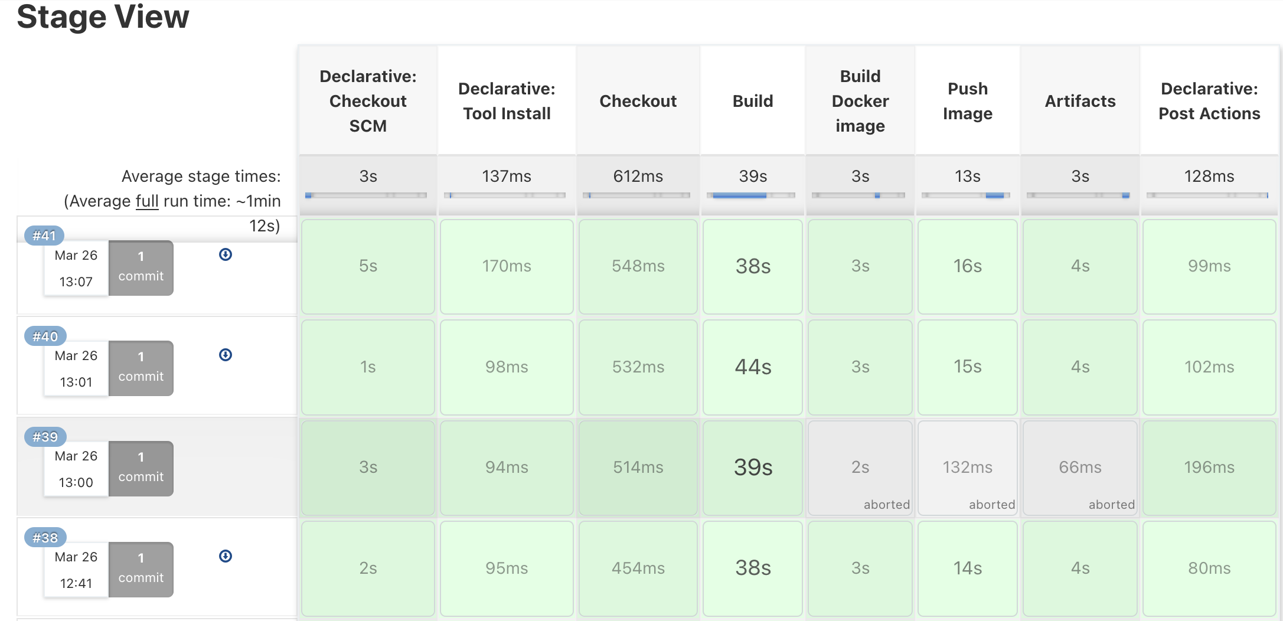

Slide 7
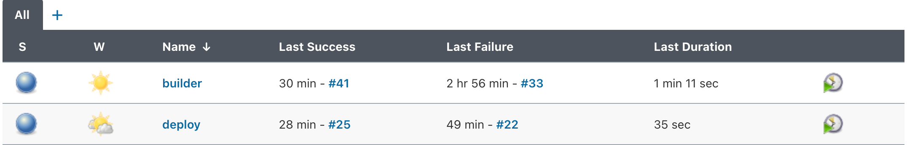

Slide 8
Deploy job
Jenkins job that invokes ansible-playbook on remote Master instance, which installs docker enviroment and pulls image from docker hub, then it launches container

Slide 9
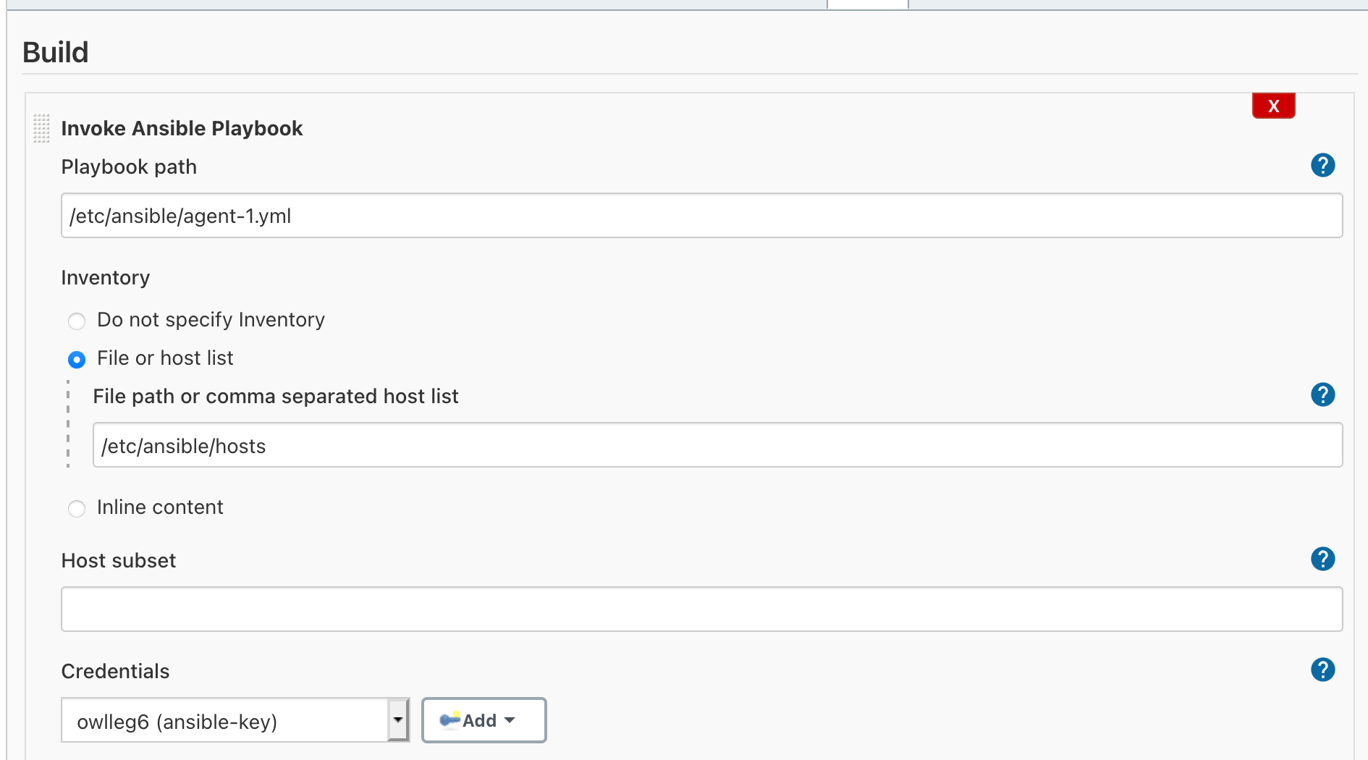

Slide 10
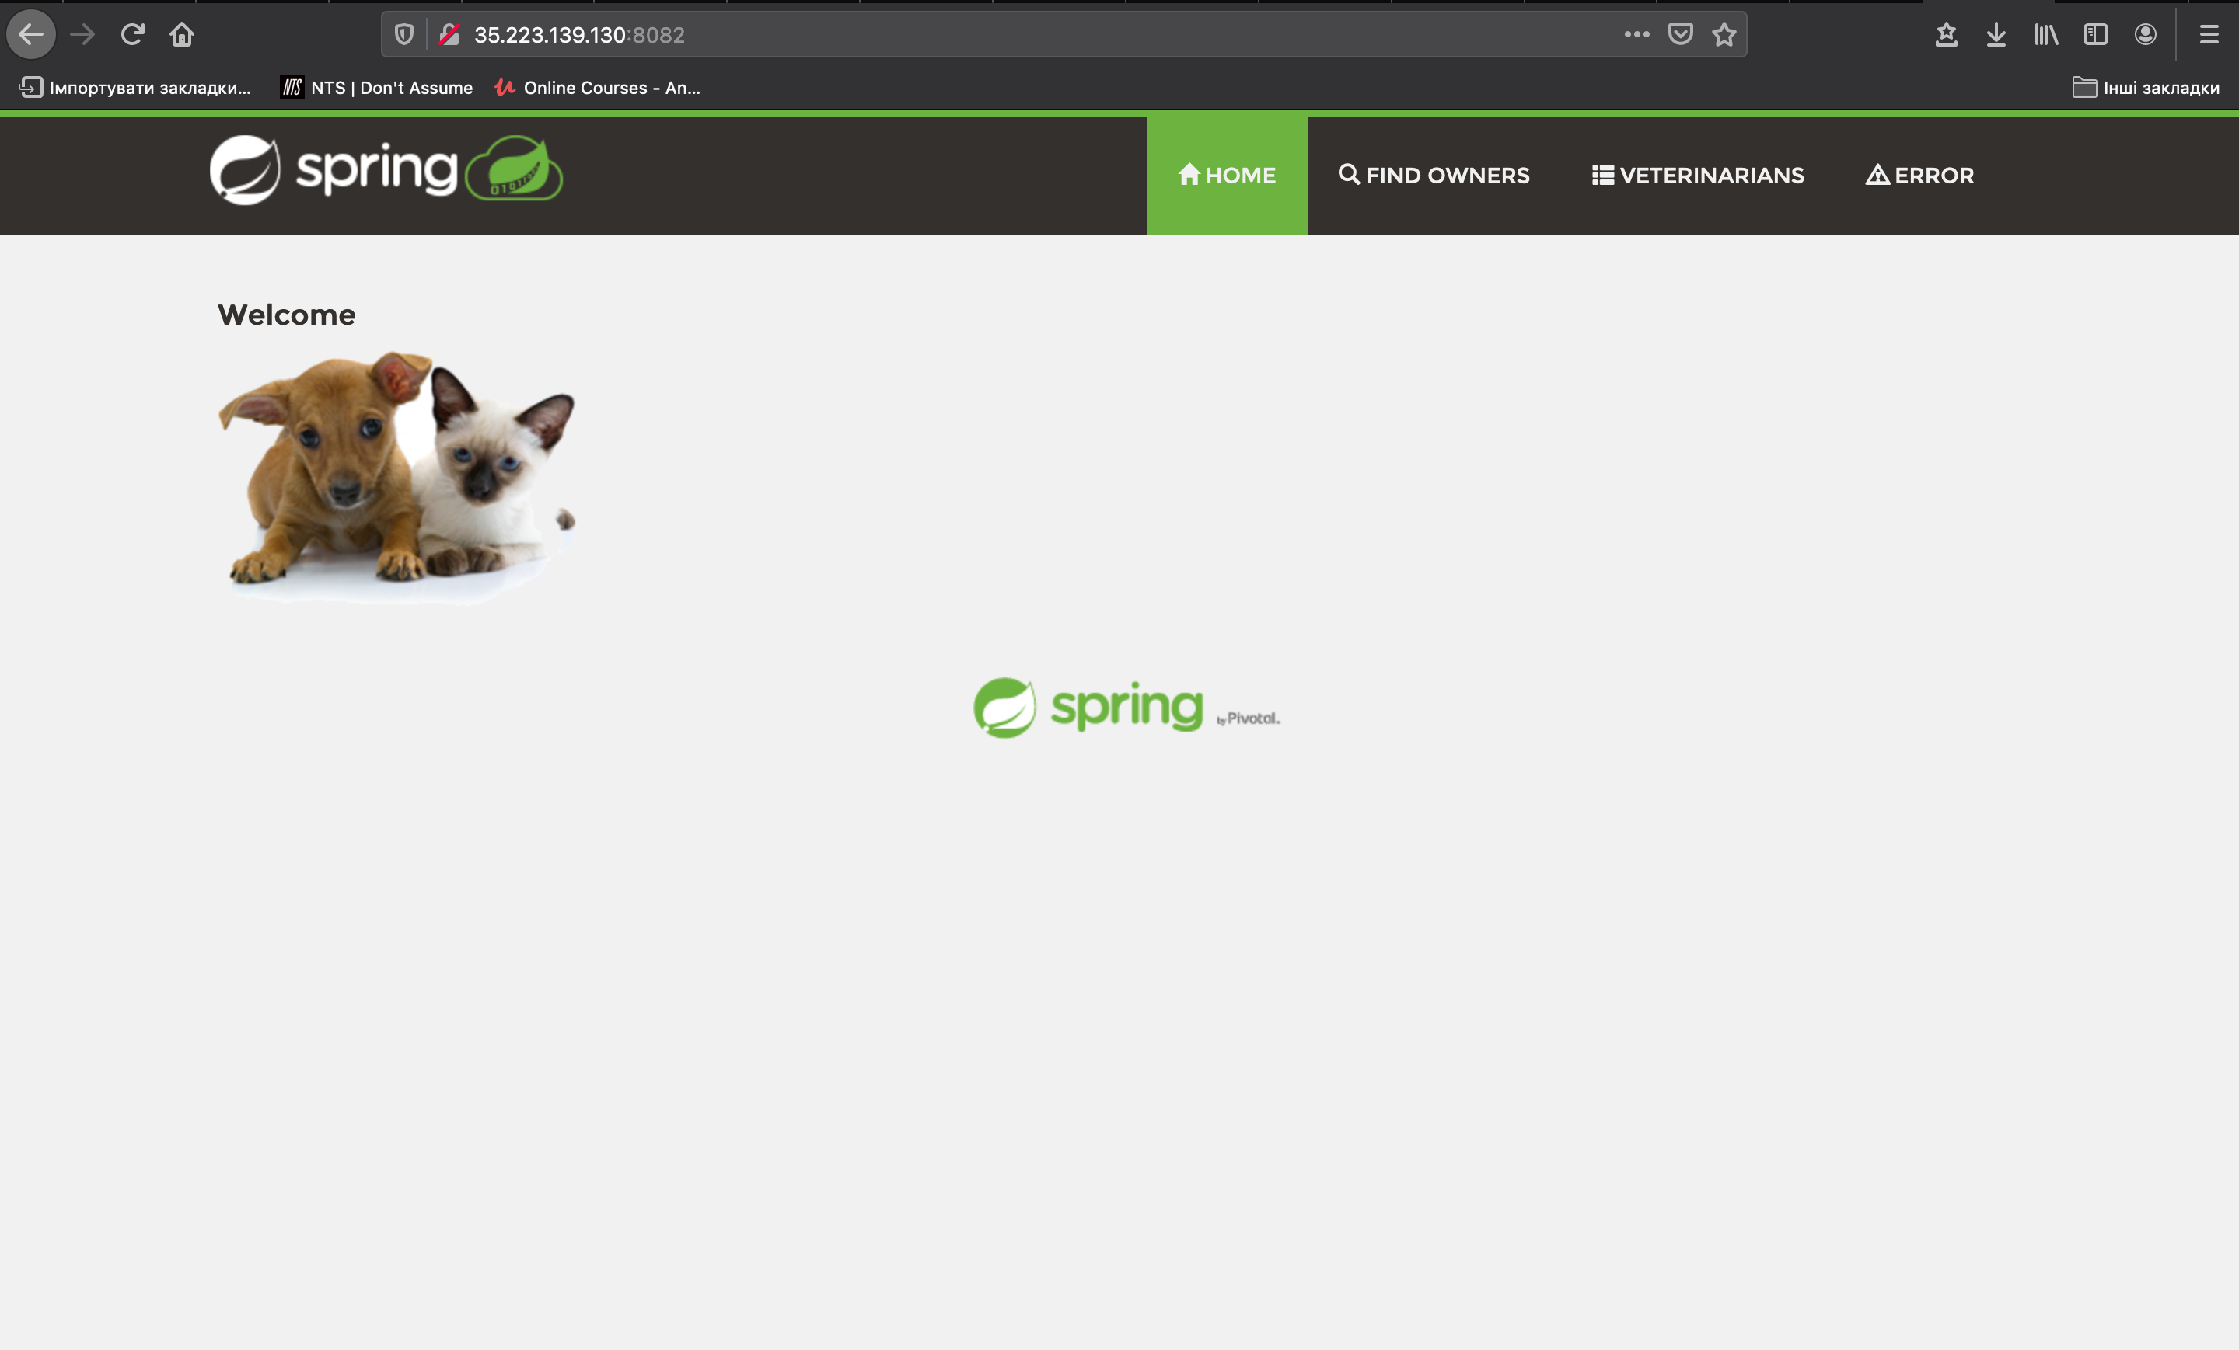

Slide 11
Thanks for the attention!

