Slide 1
Lab 5 Structure and Class
UEE 1303
Department of Electrical and Computer Engineering, Institute of Electronics
National Chiao Tung University

Slide 2
Outline
Structure in C
Class
Exercise
Appendix

Slide 3
Structure in C
A user-defined data type
(vs. built-in data types: int, double, …)
An aggregate (grouping) data type
Array - collection of elements of the same type
Structure - collection of elements of different types
Usage
First define your own structure
Then declare objects using new structure type just like declaring objects of built-in types

Slide 4
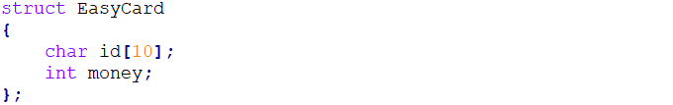
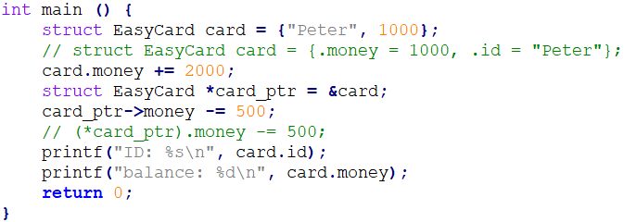
Structure Example (1/2)
Definition
Usage

Slide 5
Structure Example (2/2)
Output

Slide 6
Limitations of Structure
No access modifiers (public, private, protected, …)
Prohibit functions inside structures
No static members
No constructors and destructor
All above are the features of class in C++

Slide 7
Class
The foundation for OOP in C++
Class in C++ is an enhanced version of structure in C
Access modifiers
Functions inside classes
Static data members
Constructors and destructor
Operator overloading ➔ Can be used as built-in data types
Usage
Same as structures

Slide 8
Class Member Function
Must define(i.e., implement) class member functions
If defined outside class definition, MUST specify the class it belongs to
<ret_type> <cls_name>::<func_name> (…) {…}
“::” is called scope resolution operator
Different classes can have member functions with the same name
Items before “::” are called type qualifier
Class name serves as type qualifier here

Slide 9
Private vs. Public
Both data members and member functions can be either private or public
Data members are usually private
You don’t know exact representation ➔ encapsulation
Manipulated through member functions
Member functions are usually public
You can use public interface for manipulations
you needn’t know how these functions get implemented ➔ abstraction

Slide 10
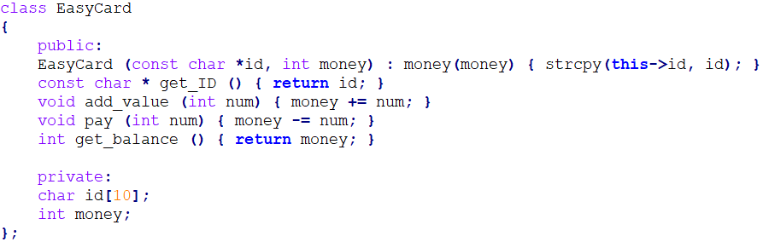
Class Example (1/2)
Definition

Slide 11
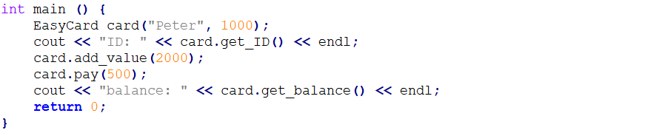
Class Example (2/2)
Usage
Output

Slide 12
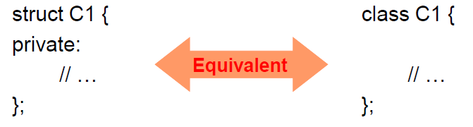
Structure in C++
In fact, structure in C++ is a class basically
Difference
a structure assumes all members public by default
a class assumes all members private by default

Slide 13
Exercise Objective
Practice to write a class
Learn how to solve a problem with the class

Slide 14
Lab Exercise (1/2)
You are asked to evaluate a given expression composed of integers, “+”, “-”, “*”, “/”, “(”, and “)”
Example
Enter the expression: -20
Result: -20
Enter the expression: 12 + 24 - 6
Result: 30
Enter the expression: 15 - (20 - -5)
Result: -10
Enter the expression: 5 * -2 - 1000 / (10 + 10)
Result: -60
Enter the expression: (10 - 20) * (-10) + 50
Result: 150
Enter the expression: 2 + ((1 - (1 - 3)) * 2 - 6) * 10
Result: 2
Enter the expression: exit
Process returned 0 (0x0) execution time : 314.087 s
Press any key to continue.

Slide 15
Lab Exercise (2/2)
You MUST use the template provided by TAs
Please DON’T touch the existed code
You CANNOT use STL container (e.g., list, stack, …)
You are asked to
Finish the implementation of stack member functions
Use stack to perform the algorithm described later
No checking of syntax error needed

Slide 16
Appendix

Slide 17
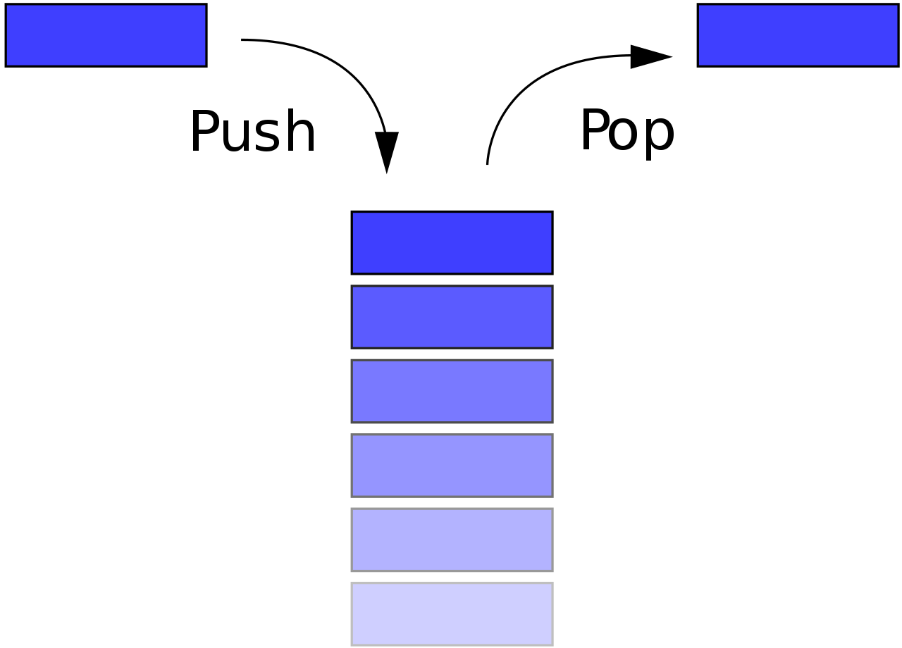
Introduction to Stack
A container with last-in-first-out (LIFO) property
Two operation
push – put a data on the top of the stack
pop – fetch a data from the top of the stack

Slide 18
Prescribed Functions for Stack
Stack ();
Constructor for initializing data members
void push (Data);
Perform push operation
Data pop ();
Perform pop operation
bool empty ();
Return true if the stack is empty, otherwise return false

Slide 19
Data Representation of Stack
array
array
array
array
array
7
A
B
A
C
B
A
B
A
6
5
4
3
2
1
0
index = 0
index = 1
index = 2
index = 3
index = 2

Slide 20
Algorithm Intuition
Fetch and solve partial expressions without parenthesis in order, from inner to outer, and from left to right
Example
2 + (3 - 1) * ((8 - 2) / 2)
2 + 2 * ((8 - 2) / 2)
2 + 2 * (6 / 2)
2 + 2 * 3
8

Slide 21
Algorithm Details
Fetch
2 + (3 - 1) * ((8 - 2) / 2)

Slide 22
Algorithm Details
Fetch
2 + (3 - 1) * ((8 - 2) / 2)
2

Slide 23
Algorithm Details
Fetch
2 + (3 - 1) * ((8 - 2) / 2)
+
2

Slide 24
Algorithm Details
Fetch
2 + (3 - 1) * ((8 - 2) / 2)
(
+
2

Slide 25
Algorithm Details
Fetch
2 + (3 - 1) * ((8 - 2) / 2)
3
(
+
2

Slide 26
Algorithm Details
Fetch
2 + (3 - 1) * ((8 - 2) / 2)
-
3
(
+
2

Slide 27
Algorithm Details
Fetch
2 + (3 - 1) * ((8 - 2) / 2)
1
-
3
(
+
2

Slide 28
Algorithm Details
Fetch
2 + (3 - 1) * ((8 - 2) / 2)
1
-
3
(
+
2

Slide 29
Algorithm Details
Fetch
2 + (3 - 1) * ((8 - 2) / 2)
temporary
1
-
3
(
+
2

Slide 30
Algorithm Details
Fetch
2 + (3 - 1) * ((8 - 2) / 2)
temporary
-
3
(
+
2
1

Slide 31
Algorithm Details
Fetch
2 + (3 - 1) * ((8 - 2) / 2)
temporary
3
(
+
2
-
1

Slide 32
Algorithm Details
Fetch
2 + (3 - 1) * ((8 - 2) / 2)
temporary
(
+
2
3
-
1

Slide 33
Algorithm Details
Fetch
2 + (3 - 1) * ((8 - 2) / 2)
temporary
+
2
3
-
1

Slide 34
Algorithm Details
Fetch
2 + (3 - 1) * ((8 - 2) / 2)
temporary
2
+
2

Slide 35
Algorithm Details
Fetch
2 + (3 - 1) * ((8 - 2) / 2)
temporary
*
2
+
2

Slide 36
Algorithm Details
Fetch
2 + (3 - 1) * ((8 - 2) / 2)
temporary
(
*
2
+
2

Slide 37
Algorithm Details
Fetch
2 + (3 - 1) * ((8 - 2) / 2)
temporary
(
(
*
2
+
2

Slide 38
Algorithm Details
Fetch
2 + (3 - 1) * ((8 - 2) / 2)
temporary
8
(
(
*
2
+
2

Slide 39
Algorithm Details
Fetch
2 + (3 - 1) * ((8 - 2) / 2)
temporary
-
8
(
(
*
2
+
2

Slide 40
Algorithm Details
Fetch
2 + (3 - 1) * ((8 - 2) / 2)
temporary
2
-
8
(
(
*
2
+
2

Slide 41
Algorithm Details
Fetch
2 + (3 - 1) * ((8 - 2) / 2)
temporary
2
-
8
(
(
*
2
+
2

Slide 42
Algorithm Details
Fetch
2 + (3 - 1) * ((8 - 2) / 2)
temporary
-
8
(
(
*
2
+
2
2

Slide 43
Algorithm Details
Fetch
2 + (3 - 1) * ((8 - 2) / 2)
temporary
8
(
(
*
2
+
2
-
2

Slide 44
Algorithm Details
Fetch
2 + (3 - 1) * ((8 - 2) / 2)
temporary
(
(
*
2
+
2
8
-
2

Slide 45
Algorithm Details
Fetch
2 + (3 - 1) * ((8 - 2) / 2)
temporary
(
*
2
+
2
8
-
2

Slide 46
Algorithm Details
Fetch
2 + (3 - 1) * ((8 - 2) / 2)
temporary
6
(
*
2
+
2

Slide 47
Algorithm Details
Fetch
2 + (3 - 1) * ((8 - 2) / 2)
temporary
/
6
(
*
2
+
2

Slide 48
Algorithm Details
Fetch
2 + (3 - 1) * ((8 - 2) / 2)
temporary
2
/
6
(
*
2
+
2

Slide 49
Algorithm Details
Fetch
2 + (3 - 1) * ((8 - 2) / 2)
temporary
2
/
6
(
*
2
+
2

Slide 50
Algorithm Details
Fetch
2 + (3 - 1) * ((8 - 2) / 2)
temporary
/
6
(
*
2
+
2
2

Slide 51
Algorithm Details
Fetch
2 + (3 - 1) * ((8 - 2) / 2)
temporary
6
(
*
2
+
2
/
2

Slide 52
Algorithm Details
Fetch
2 + (3 - 1) * ((8 - 2) / 2)
temporary
(
*
2
+
2
6
/
2

Slide 53
Algorithm Details
Fetch
2 + (3 - 1) * ((8 - 2) / 2)
temporary
*
2
+
2
6
/
2

Slide 54
Algorithm Details
Fetch
2 + (3 - 1) * ((8 - 2) / 2)
temporary
3
*
2
+
2

Slide 55
Algorithm Details
Fetch
2 + (3 - 1) * ((8 - 2) / 2)
temporary
*
2
+
2
3

Slide 56
Algorithm Details
Fetch
2 + (3 - 1) * ((8 - 2) / 2)
temporary
2
+
2
*
3

Slide 57
Algorithm Details
Fetch
2 + (3 - 1) * ((8 - 2) / 2)
temporary
+
2
2
*
3

Slide 58
Algorithm Details
Fetch
2 + (3 - 1) * ((8 - 2) / 2)
temporary
2
+
2
*
3

Slide 59
Algorithm Details
Fetch
2 + (3 - 1) * ((8 - 2) / 2)
temporary
2
+
2
*
3

Slide 60
Algorithm Details
Fetch
2 + (3 - 1) * ((8 - 2) / 2)
temporary
8

Slide 61
Algorithm Details
Solve
8 - 2 * 3 * 2 + 4
temporary
8
-
2
*
3
*
2
+
4

Slide 62
Algorithm Details
Solve
temporary
8
-
2
*
3
*
2
+
4
sum1
operator
sum2

Slide 63
Algorithm Details
Solve
temporary
-
2
*
3
*
2
+
4
sum1
operator
sum2
0 | + | 8

Slide 64
Algorithm Details
Solve
temporary
*
3
*
2
+
4
sum1
operator
sum2
8 | - | 2

Slide 65
Algorithm Details
Solve
temporary
*
2
+
4
sum1
operator
sum2
8 | - | 6

Slide 66
Algorithm Details
Solve
temporary
+
4
sum1
operator
sum2
8 | - | 12

Slide 67
Algorithm Details
Solve
temporary
sum1
operator
sum2
-4 | + | 4

Slide 68
Algorithm Details
Solve
temporary
sum1
operator
sum2
0

