Slide 1
Lab9 Inheritance
UEE 1303
Department of Electrical and Computer Engineering, Institute of Electronics
National Chiao Tung University

Slide 2
Outline
Inheritance basics
Derived class
Protected qualifier
Redefining member functions
Programming with Inheritance
Assignment operators and copy constructors
Destructors in derived classes
Exercise

Slide 3
Derived Class (1/3)
What’s inheritance?
Purpose: Object-Oriented Programming
Provide abstraction dimension
Define general form of class, then specialized versions inherit properties of general class
Add new/modify base’s functionality for it’s appropriate use
general form
specialized version
Employee
Part-timer
Manager

Slide 4
Derived Class (2/3)
Base class
"General" class from which others derive
Derived class
New class
Automatically has base class’s
Member variables
Member functions
Can add additional member functions and variables

Slide 5
Derived Class (3/3)
Example
Base Class
Each Employee has its name and will be paid
An Employee may be…
SalariedEmployee
HourlyEmployee
Manager
Each is "subset" of employees

Slide 6
Base Class: Employee
Class definition is just like what we done before
Example class Employee { string first_name, family_name; char middle_initial; Date hiring_date; short department; public: string full_name(); // … };

Slide 7
Derived Classes: Manager
Derived class interface only lists new or "to be redefined" members
Example:
class Manager: public Employee { // public inheritance Employee* group[100]; // people managed short level; // … };
Manager also has all the variables (first_name, department, …) which belong to Employee

Slide 8
Pointer’s Conversion
Because a Manager is an Employee, we can make the Employee‘s pointer point to a Manager object
Example (upcasting) Manager m; Employee *pe= &m; // “OK,” public inheritance
But the inverse conversion (downcasting) will cause a damage (An Employee is not a Manager certainly)

Slide 9
Access Controls
The same access control rules still apply in a inheritance relationship
Generally, data member won’t be public (packaging)
Use interface to access these data members
Example void Manager::print() const { cout<< “Name is ” << full_name() << endl; // OK, if full_name() is a public member (interface) } void Manager::print() const { cout<< “Name is ” << family_name<< endl; // ERROR, if family_name is a private member }
Belongs to Employee::
Belongs to Employee::

Slide 10
Constructor
Constructor (ctor) of a derived class is responsible to call ctors for its base classes (and its own non-static data members)
Example Manager::Manager(string& name, short dep, int lvl) : Employee(name, dep), level(lvl) { // … } // Initialize base and non-static data members
Initialize base and non-static data members using their corresponding ctors
Default ctor for base/derived should be well defined
Belongs to Manager::
Belongs to Employee::

Slide 11
Execution Order of Constructor
struct A { A() { cout<< “ctorA” << endl; } ~A() { cout<< “dtorA” << endl; } }; struct B { B() { cout<< “ctorB” << endl; } ~B() { cout<< “dtorB” << endl; } }; struct C : public B { A a; C()::B(), a() { cout<< “ctorC” << endl; } ~C() { cout<< “dtorC” << endl; } }; int main() { C c; return 0; }
B
C
A
Output:
========
ctor B
ctor A
ctor C
dtor C
dtor A
dtor B

Slide 12
Copy Ctor & Assignment Operator
Copy ctors and copy assignment operators are never inherited (should be rewrited)
Example
struct C : public B { A a; int d; int* pi; C(int n1=0, int n2=0, int n3=0) : B(n1), a(n2), d(n3) { pi = new int[10]; for(int i=0; i<10; ++i) pi[i] = i; } C(const C& c) : B(c), a(c.a), d(c.d) { // c is also of type B pi = new int[10]; for(int i=0; i<10; ++i) pi[i] = c.pi[i]; } C& operator=(const C& c) { B::operator=(c); a = c.a; d = c.d; int* tmp= new int[10]; for(int i=0; i< 10; ++i) tmp[i] = c.pi[i]; delete[] pi; pi = tmp; return *this; } ~C() { delete[] pi; } };
Call B’s constructor
Rewrite
copy ctor
Rewrite
Assignment operater

Slide 13
Protected Members
Protected members (data and functions)
Its name can be used by member functions and friends of the class only in which it is declared, and by member functions and friends of classes derived from this class
void D::d_func() { // D is derived from B
b_priv= 1; // error
b_prot(); // ok
b_pub(); // ok // … }
void func(B& b) { // a global function
b.b_priv= 1; // error
b.b_prot(); // error
b.b_pub(); // ok
// … }
Class B {
int b_priv;
protected:
void b_prot();
public:
void b_pub(); };
class D : public B {
public:
void d_func(); };

Slide 14
Different Kind of Inheritance
Like a member, a base class can be declared private, protected, or public
class X : public B { / * … */ }; // public inheritance
Public inheritance models is “is-a” relationship
class Y : protected B { / * … */ }; // protected inheritance
class Z : private B { /* … */ }; // private inheritance
Both model are “is-implemented-in-terms-of” relationship
Member in base class | Type of Inheritance
 | public | protected | private
public | public | protected | private
protected | protected | protected | private
private | no access | no access | no access

Slide 15
Is-a vs. Has-a
“Is-a” relationship is modeled by public inheritance
class Manager : public Employee { /* … */ };
It says a Manager is an Empoyee
“Has-a” relationship is modeled through composition
Also called layering
class Employee { string first_name, family_name; // … };
It says every Employee has a first_name and a family_name

Slide 16
Lab9 Exercise
Input: Given an employee list of a company
This list may contain 3 kinds of employees
Part-timer (P), Manager (M), and Chairman (C)
File format
Total number of employees
[Name] [Title] [Years of service]
Output: Print out information of employees according to their salaries in descending order
Format
[Name] [Years of service] [Salary]

Slide 17
Salary Formula
For each kind of employee, their base salary is
Base salary of employee (BSE): 20000/month
Part-timer: BSE + 1,000 * years of service
Manager: BSE + 15,000 + 5,000 * years of service
Chairman: manager’s payment + 50,000

Slide 18
Input Example
15
ADAR C 8
Terry M 4.7
Carl M 3.7
Shan P 1.4
Peter P 3.3
Sali M 5.5
Anita P 3.2
Mindy P 3
...
Mia P 3.8
Kate P 3

Slide 19
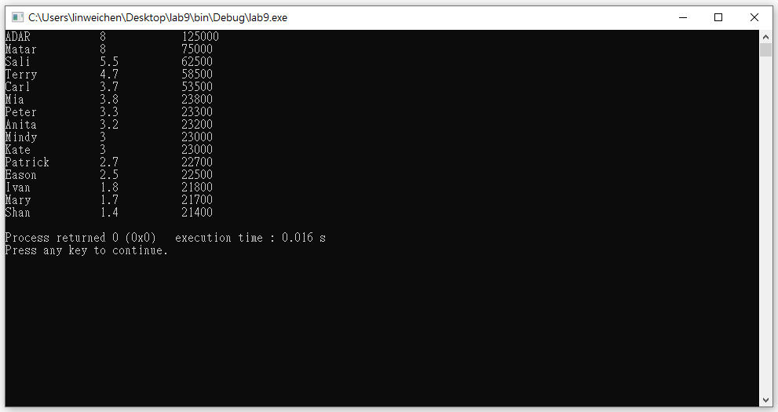
Output Example

Slide 20
Constraints
Build up 3 derived classes (Parttimer, Manager, and Chairman) by yourself, and the base class Employee is given
Parttimer and Manager is derived from Employee, and Chairman is derived from Manager

