Slide 1
Lab 4 array
UEE 1303
Department of Electrical and Computer Engineering, Institute of Electronics
National Chiao Tung University

Slide 2
Outline
Array introduction
Lab4 exercise

Slide 3
Array Declaration
<type> <array_name> [<size>], e.g.,
int score[5]
5 variables of int named score, score[0]~score[4]
size must be an expression evaluating to integral constant
int a_arr[10+20]; // ok
const int K = 100;
int b_arr[K]; // ok, b_arr[100];
int n = 100;
int c_arr[n]; // error, n is not a constant

Slide 4
Array Initialization (1/3)
An array can be initialized like:
int score[3] = {2, 12, 1};
which is equivalent to:
int score[3];
score[0] = 2;
score[1] = 12;
score[2] = 1;

Slide 5
Array Initialization (2/3)
If fewer values than the size
fills from the beginning
fills the remaining elements with 0 of array base type
E.g., int a[6] = {10, 11, 12, 13}; // a[4] = 0, a[5] = 0
If more values than size
compilation error
E.g., double b[3] = { 6.0, 6.5, 7.0, 8.0}; // error

Slide 6
Array Initialization (3/3)
If the size is unspecified, then it is automatically determined based on number of initialization values
example:
int b[]= {5, 12, 11}; // equivalent =>int b[3] = {5, 12, 11};
int c[]; // error, unknown size

Slide 7
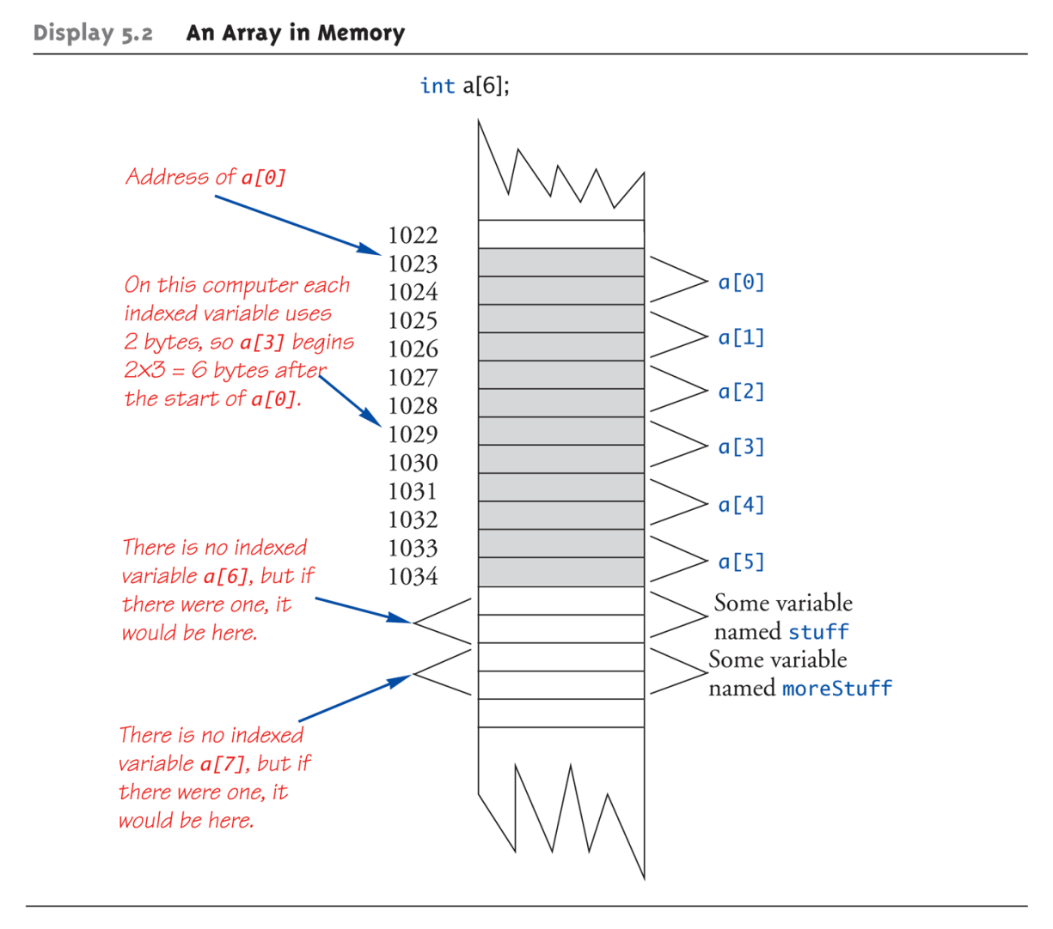
Array in Memory
// example
// a short int takes 2bytes
short a[6]; // start @ 1023
short stuff; // start @ 1035
moreStuff; // start @ 1037
address of a[4]
= 1023+ 4 * 2 = 1031

Slide 8
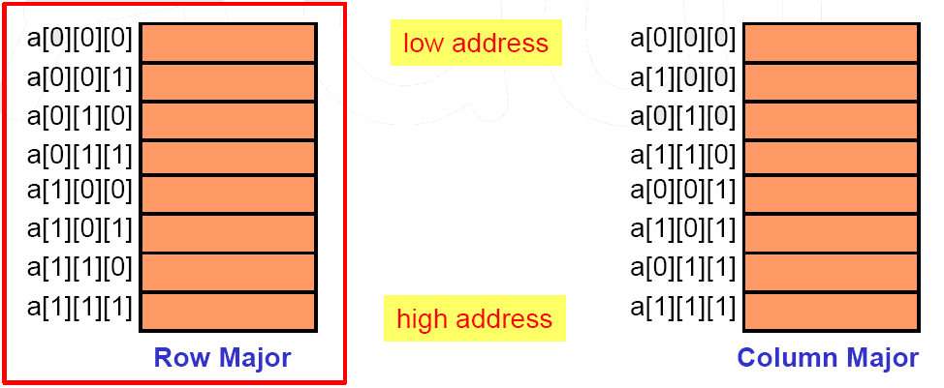
Multidimensional Array (1/2)
How to put a multidimensional array into linearly addressed memory?
row major (used in C/C++, …)
column major (used in age-old FORTRAN, …)
Example: (a[2][2][2] has 8 elements)

Slide 9
Multidimensional Array (2/2)
For an array a[u1][u2]…[un] starting at the address A, what is the address of a[i1][i2]…[in] ?
Example:
int a[6][7][8]; // Starts from address 1000, sizeof(int) = 4
a[1][2][3] = 10;
What is the address of a[1][2][3]?
address = 1000 + ( (1 * 7 * 8) + (2 * 8) + 3) * 4 = 1300

Slide 10
Array in Function (1/2)
In function declarations and definitions
void f1(char arr[ ]); // Just use empty brackets
void f2(char arr[10]);
still ok, compiler simply ignores what’s inside [ ]
In function calls, use array name as actual argument
char table[1000];
f1(table); // ok
f2(table); // still ok
Need another parameter for array size if required
void f3(char arr[ ], int size);

Slide 11
Array in Function (2/2)
In function declarations and definitions, MUST specify sizes for ALL dimensions except for the first one
void f1(char arr[ ][6][7][8]); // a 4-dimentional array
void f2(char arr[9][6][7][8]);
still ok, compiler ignores what’s inside [ ]
In function call, use array name as actual argument
char table1[5][6][7][8];
char table2[5][5][7][8];
f1(table1); // ok
f2(table1); // still ok
f1(table2); // compilation error, array size not matched!

Slide 12
Exercise (1/3)
Exercise 1
You will get the 10*10 binary maze, then you should output the path that the rat went from (1,1) to (10,10).
0 means the block is a dead block 1 means the block can be used
You can only go down or go right.
If there are many solutions, the output direction should be down first, then right.

Slide 13
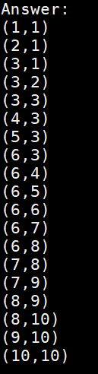
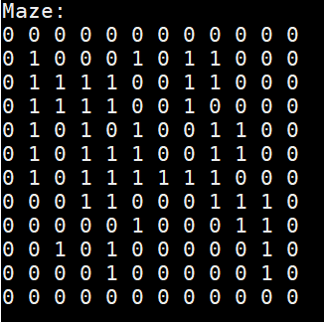
Exercise (2/3)
Output
Show the maze first
And then output the path step by step

Slide 14
Exercise (3/3)
Hint
The total step is fixed, so you can store your path in a static array.
After you output the maze, you can modify the maze to help you find the path.

Slide 15
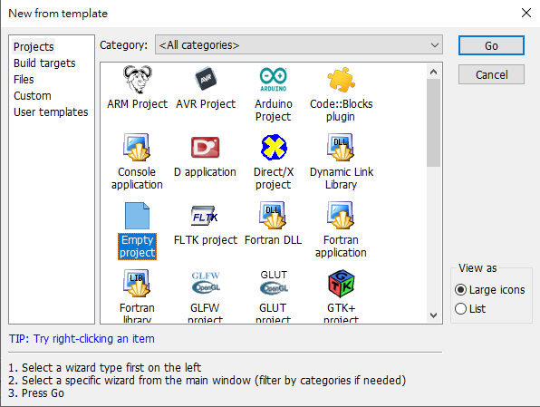
Appendix (1/3)
Create an empty project

Slide 16
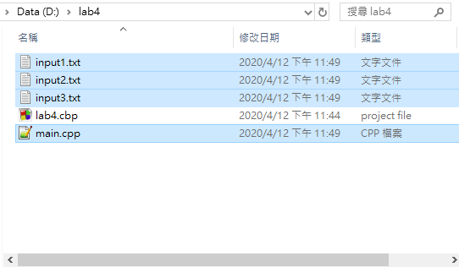
Appendix (2/3)
Add all files into your project folder

Slide 17
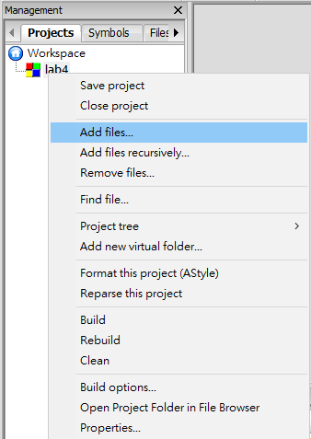
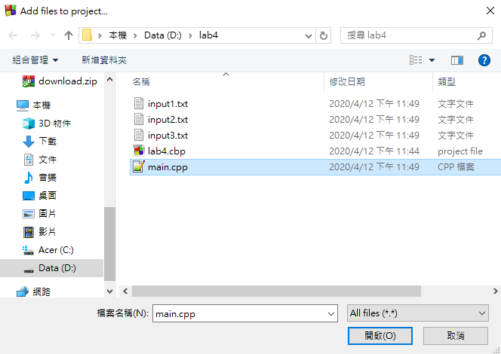
Appendix (3/3)
Import code into your project

