Slide 1
Lab 1 C++ Basics & Flow of Control
UEE 1303
Department of Electrical and Computer Engineering, Institute of Electronics
National Chiao Tung University

Slide 2
Outline
C++ Basics and Flow of Control Review
Lab1 Exercise

Slide 3
C++ Identifier
Identifier is the name of variables, constants, etc.
An identifier
Consists of a sequence of letters, digits, and the underscore character ( _ )
Must start with either a letter or an underscore character // AVOID doing so in general
Is case-sensitive
Can be of any length // NOT true in reality
Keywords are special identifiers
E.g., if, for, char, …
CANNOT be used for user-defined entities

Slide 4
C++ Variable
Variable
Its name is an identifier
Is a memory location to store data
MUST be declared before being used int number; // declaration & definition
double width, length; // declaration & definition
extern int count; // declaration ONLY, discuss later
Better to use meaningful names!
Naming convention
Starting with a lowercase letter, e.g., weight, total_weight, …

Slide 5
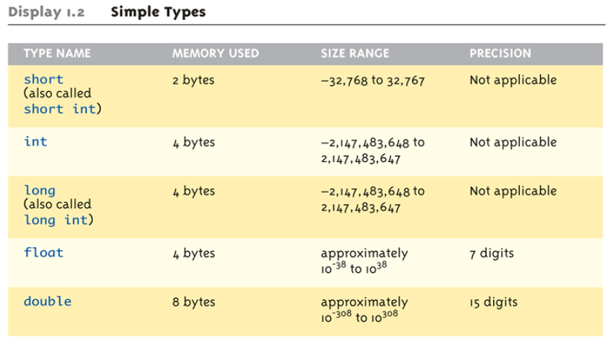
Fundamental Data Type (1/2)
long long ( also called long long int) 8 bytes -9,223,372,036,854,775,808 to 9,223,372,036,854,775,807

Slide 6
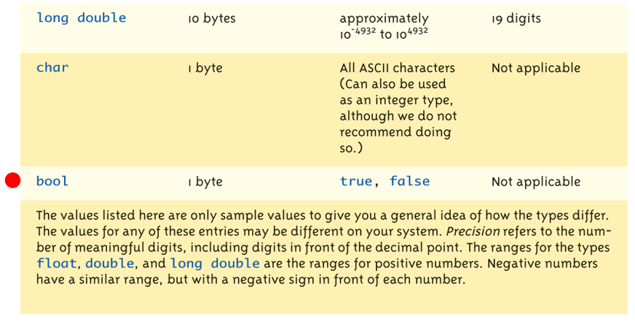
Fundamental Data Type (2/2)

Slide 7
Constant
double money *= (1 + 0.05); // What is 0.05?
const double RATE = 0.05; // All uppercase letters double money *= (1 + RATE); // Better readability RATE = 0.1; // Compilation error
Using constants
Better readability and maintainability
Constants MUST be initialized when definition
const double RATE; // Compilation error
extern const double RATE; // OK

Slide 8
Arithmetic Precision
Examples:
17 / 5 evaluates to 3 in C++
Both operands are integers (Integer division)
17.0 / 5 evaluates to 3.4 in C++
Highest-order operand is "double“ (Double division)
int intVar1 =1, intVar2 = 2; intVar1 / intVar2 = ?
Calculations done one-by-one
1 / 2 / 3.0 / 4 performs 3 separate divisions
First ➔ 1 / 2 equals to 0
Second ➔ 0 / 3.0 equals to 0.0
Third ➔ 0.0 / 4 equals to 0.0
So NOT necessarily sufficient to change just one operand in a large expression

Slide 9
Type Casting
Casting for variables
C style
double dvar = (double) ivar;
C++ style
Syntax - static_cast<type>(expression)
double dvar = static_cast<double>(ivar) ;
Two kinds
Implicit, also called automatic
Done for you automatically, e.g., 17 / 5.5 ➔ Casting 17 to 17.0
Explicit
Using static_cast operator

Slide 10
Library
C++ standard library
Input/output, numerics, strings, containers, etc.
Directive to add (simply copies) the contents of the specified library header file to your code
Syntax - #include <library_header_file>
Called "preprocessor directive"
Executed before compilation

Slide 11
Namespace
Namespace is
A declarative region that provides a scope to the identifiers inside it
using namespace std;
Include all the identifiers of specified standard library header files

Slide 12
Basic Input/Output
I/O stream object
“cin” for standard input
“cout” for standard output
“cerr” for standard error output
Defined in the C++ library header file called <iostream>
Must have these lines near the start of your code
#include <iostream>
using namespace std;
Tells C++ compiler to add the library header file so we can use the I/O stream objects cin, cout, and cerr

Slide 13
Console Output
Any data can be output to the screen with “cout <<”
Variables, constants, and literals
Cascading - multiple “<<” in one cout
New lines in output
cout << “Hello World/n”;
cout << "Hello World" << endl;
Example
cout << numberOfGames << " games played.”;
The value of the variable “numberOfGames” and character sequence “games played.” are output

Slide 14
Console Input
Data can be input with “cin >>”
Program halts and waits for keyboard entry
Value entered from the keyboard is assigned to the variable
">>" (extraction operator) points opposite
Think of it as pointing toward where the data goes
NO literals allowed for cin, Must input to a variable
cin >> 23; // Compilation error

Slide 15
if-else
if-else statement
Choice of two mutually exclusive statements based on condition expression
Syntax: if (<condition_expression>) { <true_statements> }
else { <false_statements> }

Slide 16
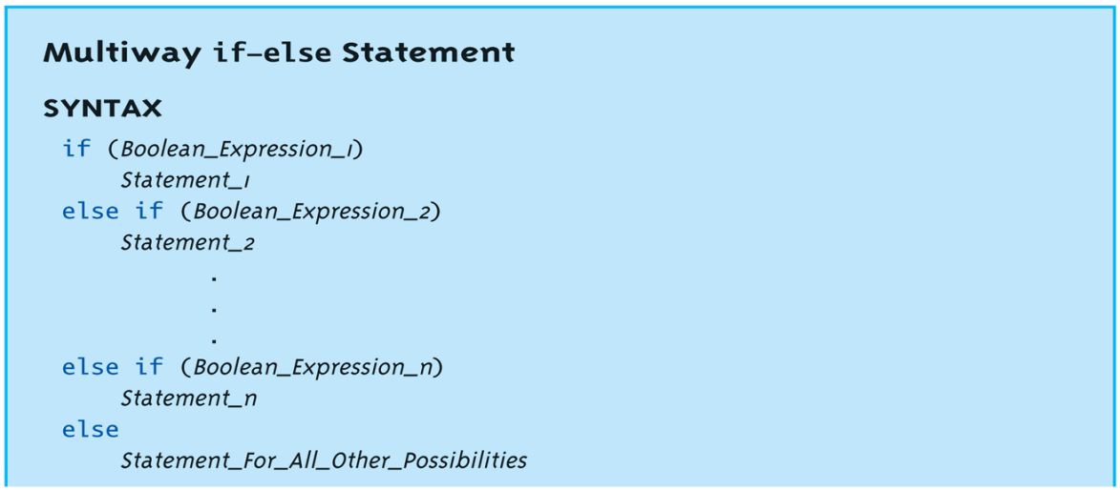
Multiway if-else (1/2)
Avoid excessive indentation
Syntax

Slide 17
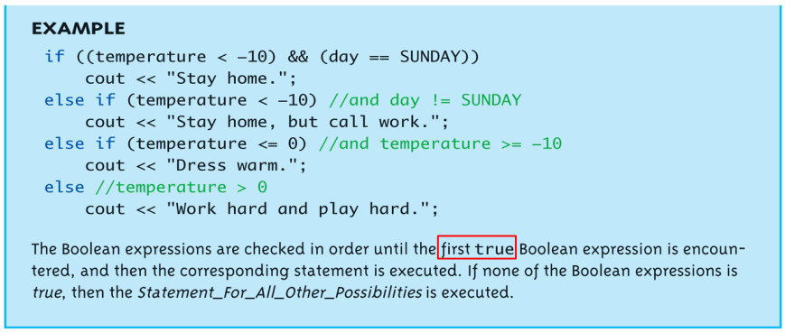
Multiway if-else (2/2)
Example

Slide 18
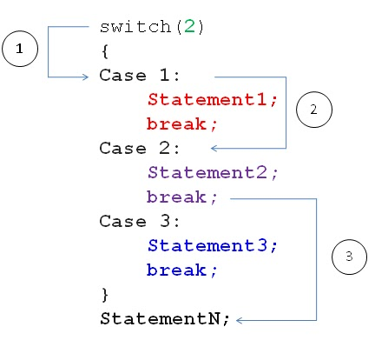
Switch Statement (1/3)
Controlling expression MUST return an integral value
OK - char, int, bool, enum
not OK - float, double, …
Case labels must also be integral values
“break” and “default” are optional
Execution falls thru until break

Slide 19
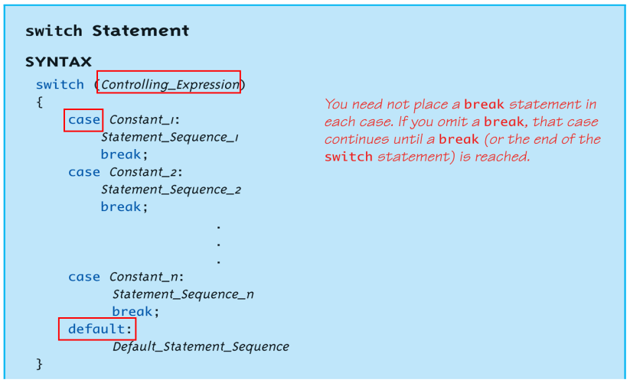
Switch Statement (2/3)
Syntax

Slide 20
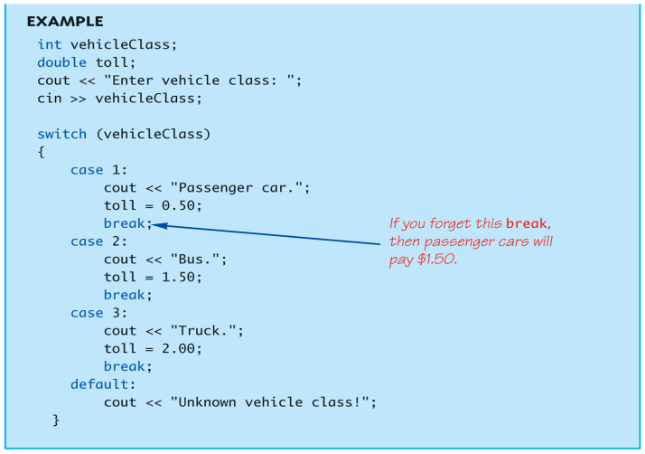
Switch Statement (3/3)
Example

Slide 21
Loop
3 types of loops in C++
while
do-while
Enter the loop body at least once
for
Appropriate for counting loops

Slide 22
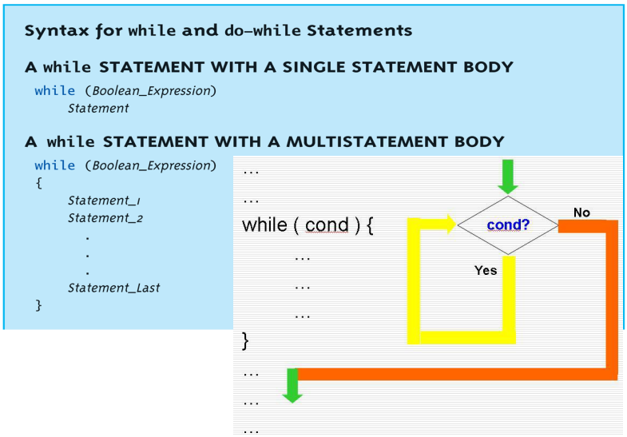
while Loop Syntax

Slide 23
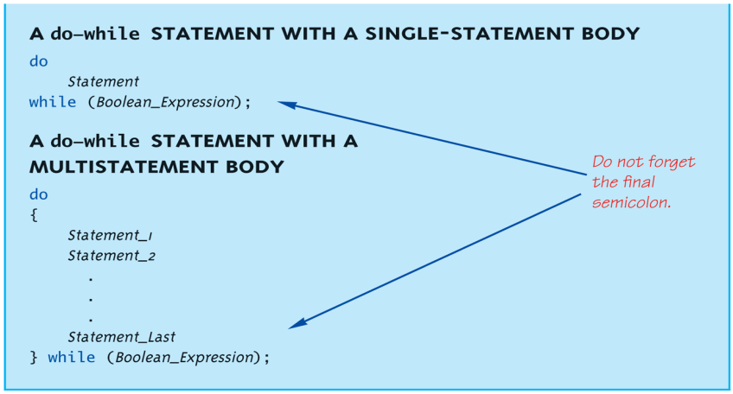
do-while Loop Syntax

Slide 24
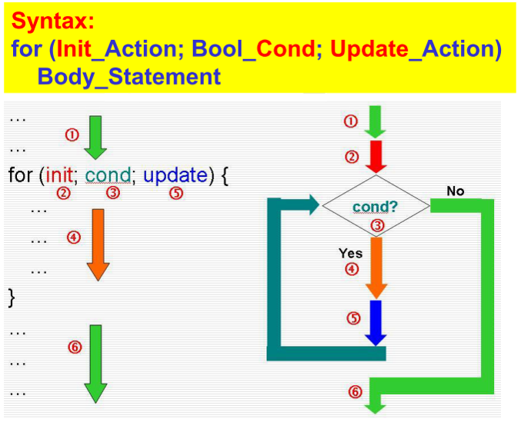
for Loop Syntax

Slide 25
Lab Exercise (1/2)
Write a C++ program such that
It collects scores until “-1” is entered
It prints out the total number of score, average score, and the failed rate, which is the percentage of scores less than 60, after “-1” is entered
Specifications & Restrictions
You should print out “Invalid score.” when the input score is less than 0 or greater than 100
You CAN ONLY use int data type in this program

Slide 26
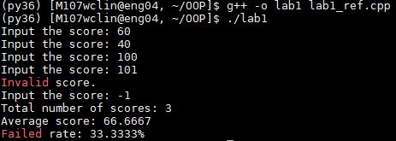
Lab Exercise (2/2)
Example:

