Slide 1
Lab2 Function Basics
UEE 1303
Department of Electrical and Computer Engineering, Institute of Electronics
National Chiao Tung University

Slide 2
Learning Objectives
Standard Library Predefined functions
Must include appropriate library header file
Programmer-defined functions
declaration, definition, call
recursive functions
Scope rules
local names (constants, variables, …)
global names
Header file

Slide 3
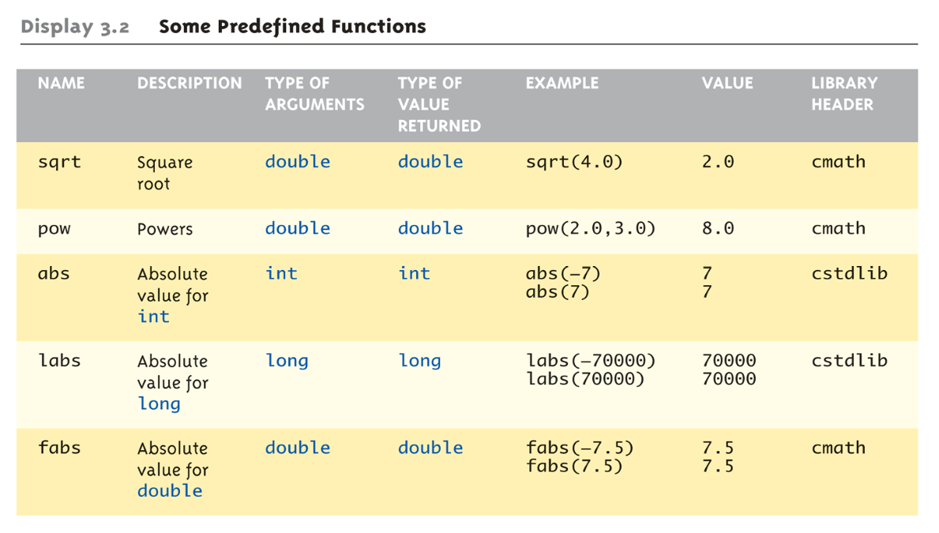
Some Predefined Math Functions (1/2)

Slide 4
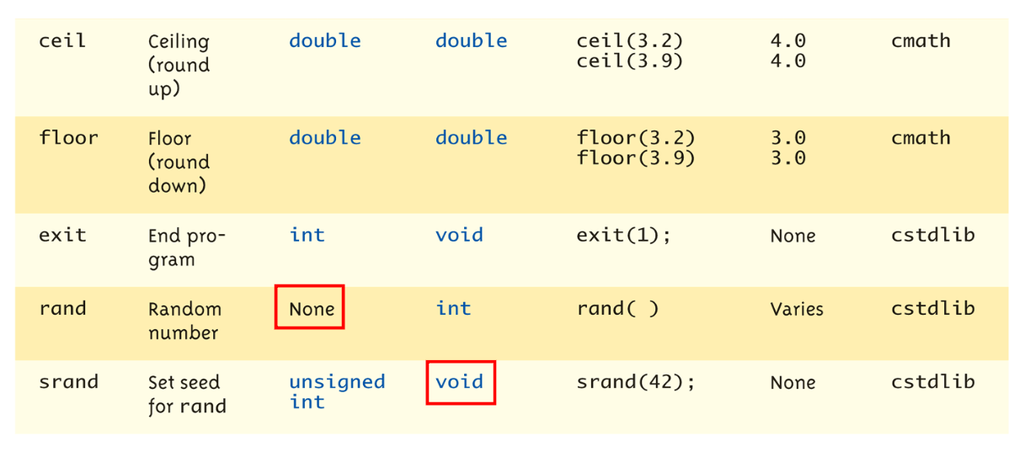
Some Predefined Math Functions (2/2)

Slide 5
Introduction to Functions
Building blocks of programs
Other terminologies equal to functions in other languages:
procedures, subprograms, subroutines, methods, …
Input-process-output model
e.g., double root = sqrt(9.0);

Slide 6
Components of Function Use
3 steps for using functions
Function declaration (or function prototype)
Information required by compiler to properly interpret calls
Function definition
Actual implementation/code for what function does
Function call (or function invocation)
Transfer control to the function

Slide 7
Function Declaration
Also called function prototype
Can define multiple functions with the same name but different parameters
An informational declaration for compiler
Tell compiler how to interpret calls
Syntax: <return_type> FuncName(<formal-parameter-list>);
Example
double totalCost(int numberParameter, double priceParameter);
or,
double totalCost(int, double);
Placed before any calls, declaration-before-use scenario
optional

Slide 8
Function Definition
Implementation of function, just like implementing function main()
Definition: one and only one
Example
double totalCost( int numberParameter, double priceParameter)
{
const double TAXRATE = 0.05;
double subTotal;
subtotal = priceParameter * numberParameter;
return (subtotal + subtotal * TAXRATE);
}
formal parameter, mandatory

Slide 9
Function Call
Just like calling predefined function
bill = totalCost(number, price);
totalCost returns double value, which is assigned to a variable named bill
Arguments here – number and price
Arguments can be literals, variables, expressions, or combinations of above
In function call, arguments often called actual arguments because they contain the actual data being sent
actual arguments, mandatory

Slide 10
Local Names
Local names
Declared inside a function
Scope
Available (visible) from its declaration to the end of the block in which its declaration occurs
Hence, different functions can define their own variables/constants even with a same name

Slide 11
Global Names (1/2)
Global names
Scope
Available (visible) from its declaration to the end of the file
Typically, it is declared at the beginning of the file (before function definitions)

Slide 12
Global Names (2/2)
Global names are typical for constants
e.g., const double TAXRATE = 0.05;
All functions in that file can use it
Global variables
You can use them, but you’d better avoid using them
Hard to understand and maintain, a disaster for debugging!

Slide 13
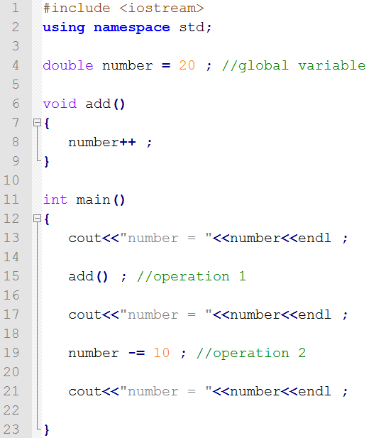
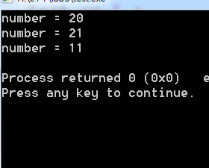
Example (1/2)

Slide 14
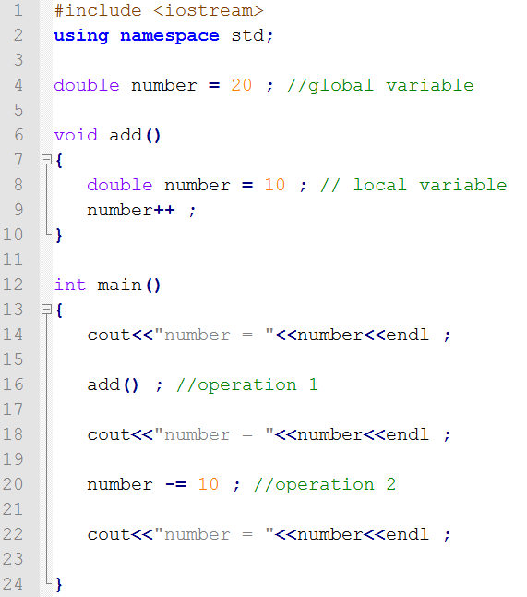
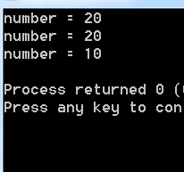
Example (2/2)

Slide 15
Header File (1/2)
A file with extension “.h”
Library and user-defined header files
Separate function declarations and definitions
Often contain functions with high correlation. E.g.,
sqrt, pow in <cmath>
Class member functions
Included by source files whenever it is used
Easy to maintain, improve the readability

Slide 16
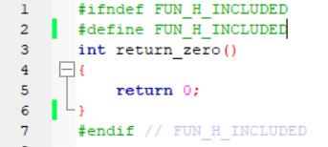
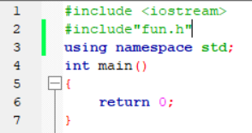

Header File (2/2)
You should avoid defining a function in a header file
func.h:
main.cpp:
a.cpp:
main.o
a.o
Linking error !! (multiple definitions)

Slide 17
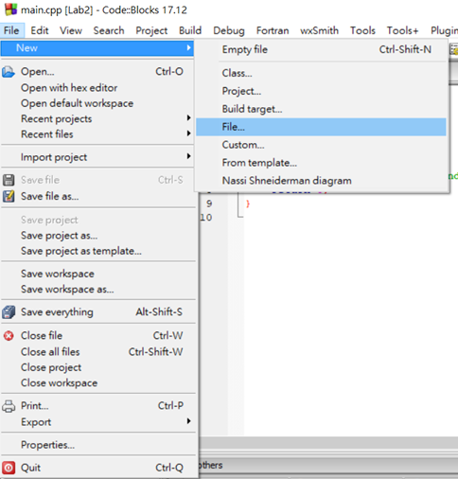
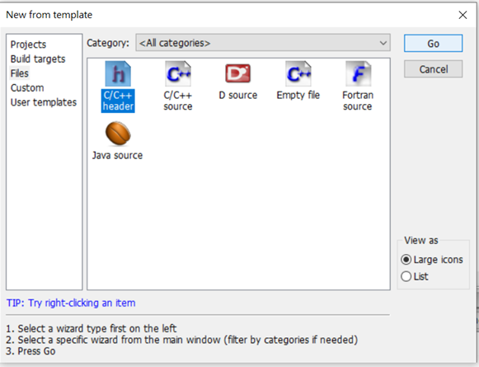
Create Header File (1/5)

Slide 18
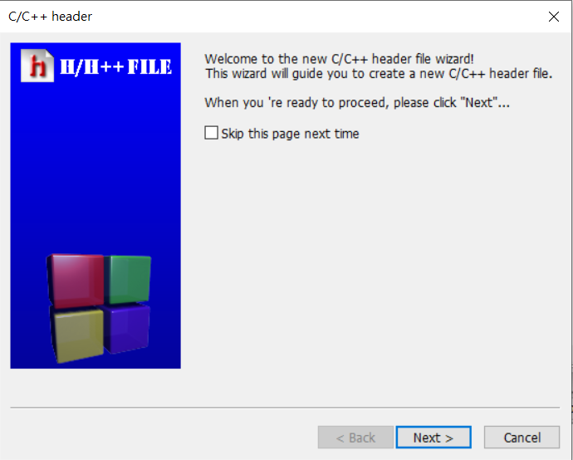
Create Header File (2/5)

Slide 19
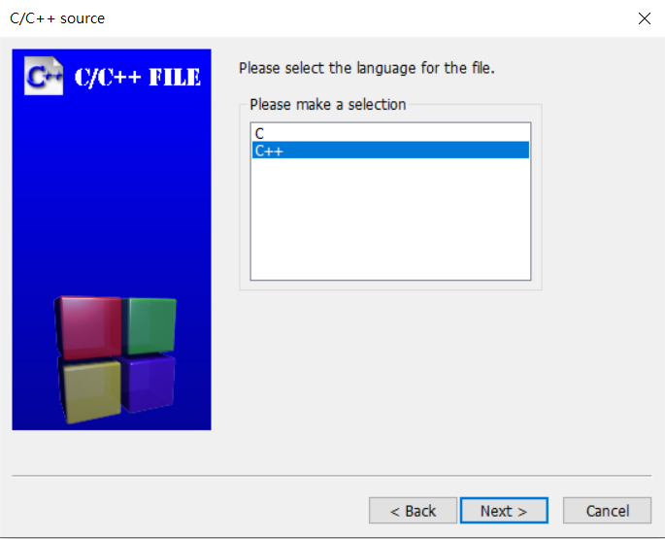
Create Header File (3/5)

Slide 20
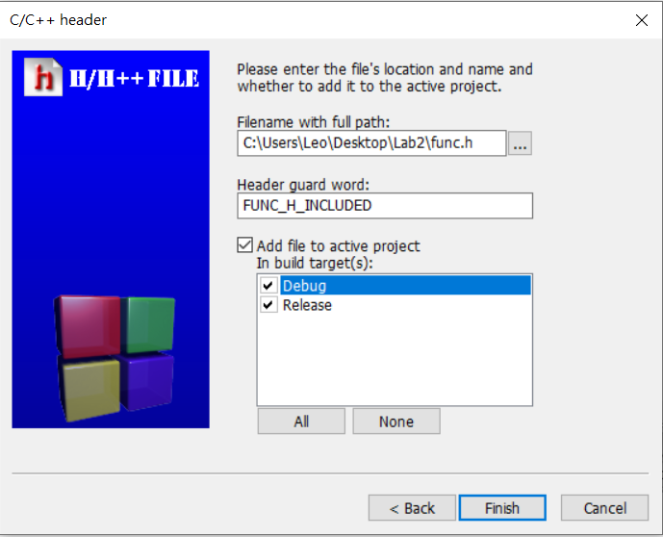
Create Header File (4/5)
Create your header file in the same folder of the project

Slide 21
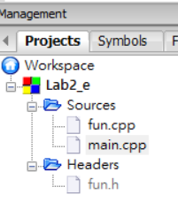
Create Header File (5/5)

Slide 22
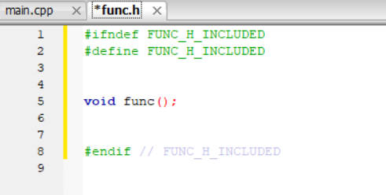
Header Guard
Prevent you from including one header file multiple times
Write your code between #define and #endif

Slide 23
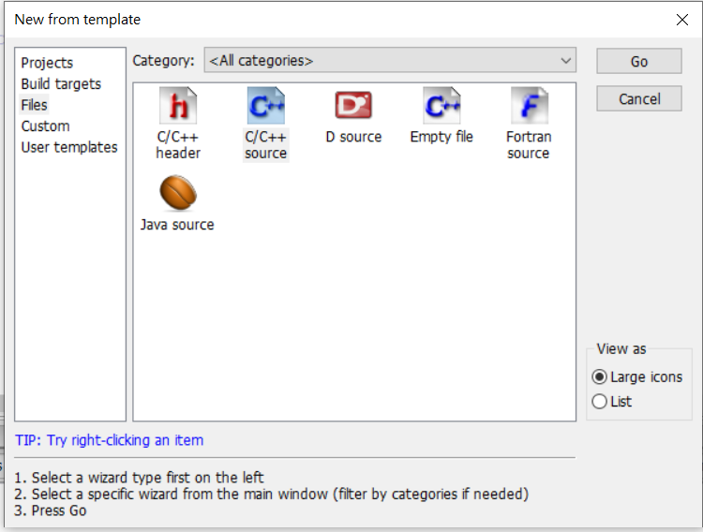
Create Source File (1/4)

Slide 24
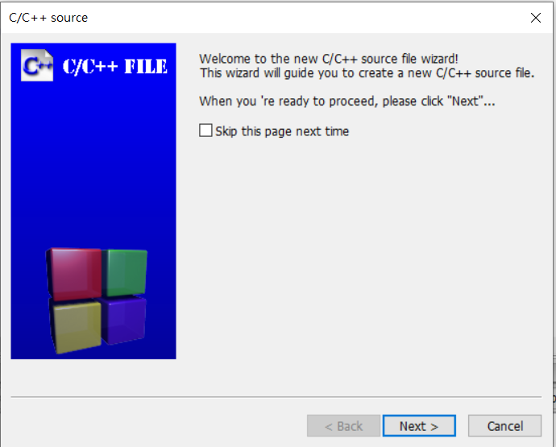
Create Source File (2/4)

Slide 25
Create Source File (3/4)

Slide 26
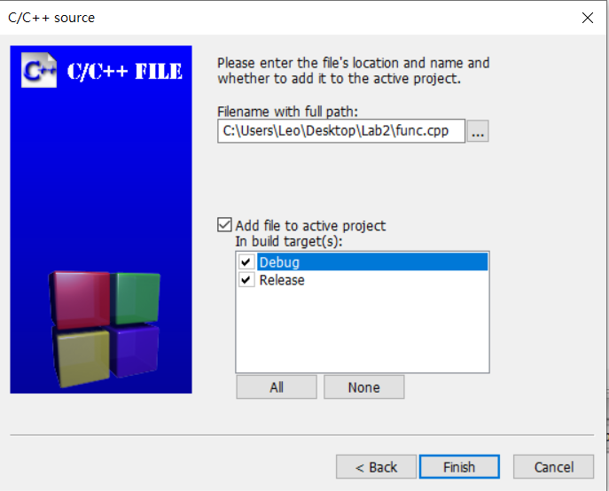
Create Source File (4/4)
Select Debug and Release

Slide 27
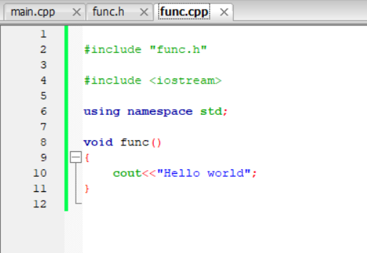
Function Definition
Write your function definitions here
Use quotes instead of angled brackets for your header file

Slide 28
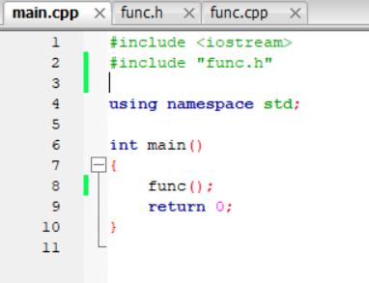
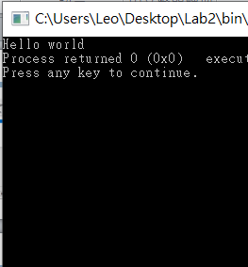
Function Call
Call the function in source file

Slide 29
Lab exercise (1/4)
Input
Three points’ coordinates (type: double)
Output
Three side lengths of the triangle
Area of the triangle using Heron's formula
Absolute value of difference between longest side and shortest side
Hint
You can use pow, sqrt, and fabs functions in Library
You must write the following three files in this Lab
main.cpp: input, output and function calls
.h file : function declarations
.cpp file : function definitions

Slide 30
Lab exercise (2/4)
Function 1
Input: 2 points’ coordinates
Output: one side length
Function 2
Input: Three side lengths
Output: area
Function 3
Input: Three side lengths
Output: absolute difference between longest side and shortest side

Slide 31


Lab exercise (3/4)
Heron's formula:

Slide 32
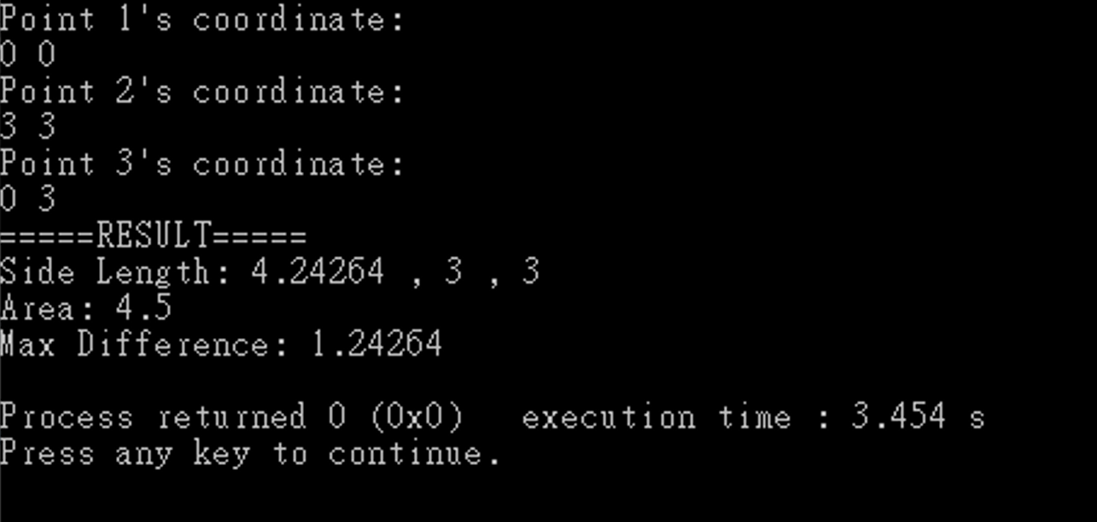
Lab exercise (4/4)

