Slide 1
Lab 3 Parameters & Overloading
UEE 1303
Department of Electrical and Computer Engineering, Institute of Electronics
National Chiao Tung University

Slide 2
Outline
Parameters
Function overloading
Default arguments
Testing and debugging program
Exercise

Slide 3
Parameters
Call-by-value
Call-by-pointer-value
Call-by-reference

Slide 4
Call-by-Value (1/2)
Only the value of actual argument is passed
Passed value is used to initialize formal parameter
Call-by-value mechanism keeps callers safe. Actual argument is guaranteed unaltered

Slide 5
Call-by-Value (2/2)
void func (int pa) { // pa: formal parameter
pa += 5;
cout << pa << endl;
}
int main () {
int a = 10;
func(a); // a: actual argument, won’t be altered after function call
cout << a << endl;
}
Output
15 // pa
10 // a

Slide 6
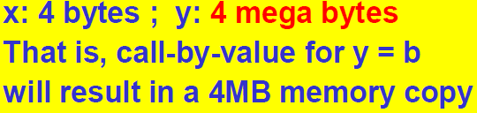
Issue Raised by Call-by-Value
What if an actual argument is large?
Result in large memory copy
→ More memory & time consuming
struct my_struct {
int arr[1000000];
};
void func(int x, my_struct y) {...}
int main() {
int a;
my_struct b;
// a and b get initialized here
func(a, b);
// …
}
Use pointers to solve this problem

Slide 7
Call-by-Pointer-Value
Variables in caller CAN be modified indirectly with pointer
Function can also return multiple values in this way
void func(int *x, int *y) {
*x = 5; *y = 6;
}
int main() {
int a = 1, b = 2;
func(&a, &b);
cout << a << endl << b << endl;
// …
}
Output:
5
6

Slide 8
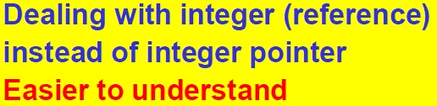
Call-by-Reference
Caller’s actual arguments can be modified by callee!
Formal parameter becomes alias of actual argument
Specified by ampersand, &, after type
void func (int &x, int &y) {
x = 5; y = 6;
}
int main () {
int a = 1, b = 2;
func(a, b);
cout << a << endl << b << endl;
}
Output:
5
6

Slide 9
Function Overloading
Two or more functions with a same name but different parameter lists
They have their own function definitions
Every function MUST have a unique function signature
Allows several functions performing conceptually the same task with different parameters having same name
They still have their own unique signature

Slide 10
Overloading Example - Average
Function computes average of 2 numbers
double average(double n1, double n2) {
return ((n1 + n2) / 2.0);
}
Now compute average of 3 numbers
double average(double n1, double n2, double n3) {
return ((n1 + n2 + n3) / 3.0);
}
Same name but two different functions
Function name average is overloaded

Slide 11
Default Arguments (1/2)
Allows functions omitting some arguments
Default arguments are specified when function is declared
Default arguments are provided for trailing arguments only
void func(int, int = 0, char* = 0); // ok
void g(int = 0, int, char* = 0); // error
Must omit arguments starting from the right.
func(3, 2); // ok, func(3, 2, 0)
func(3, , p_char); // error

Slide 12
Default Arguments (2/2)
Default arguments cannot be repeated or changed in a subsequent declaration
Be aware of potential ambiguous calls
void func(int = 1, int = 2, int = 3);
void func(int, int);
void f(){
func(3, 6); // error, ambiguous call, func(3, 6, 3) or func(3,6)?
}

Slide 13
Testing and Debugging Functions
Many methods
cout statements in calls and definitions
used to trace execution
Built-in debugger provided by compiler
Environment-dependent
assert macro
Early termination as needed

Slide 14
Assert Example
#include <cassert>
char int_to_hexchar (int num) {
assert( (num >= 0) && (num <= 15) ); //check precondition here
if (num < 10)
return num + ’0’;
else
return - 10 + ’A’;
}
Check precondition
If precondition is not satisfied, then assert_condition is false, and program execution terminates

Slide 15

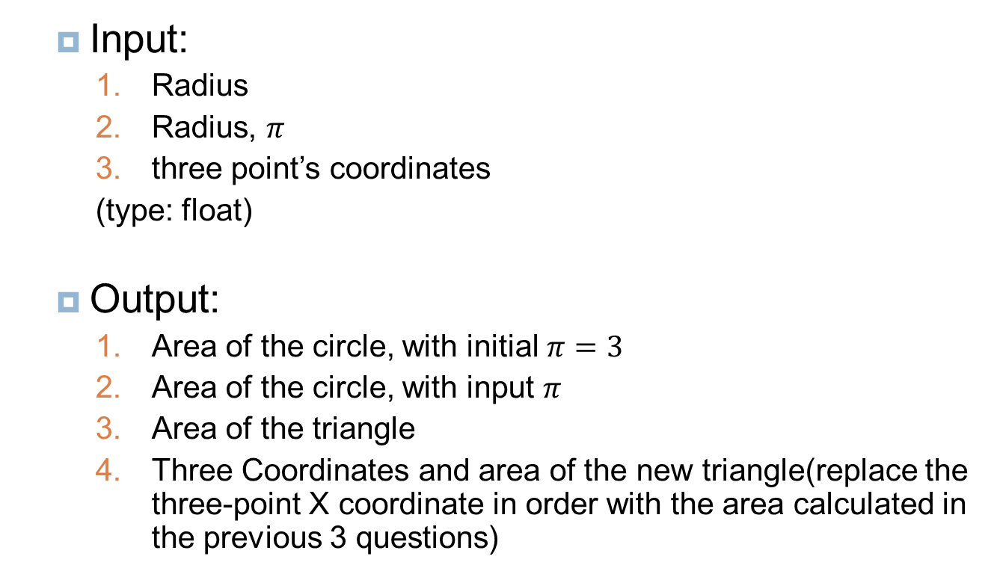


Exercise (1/3)
Input:
Radius
Radius, $π$
three point’s coordinates
(type: float)
Output:
Area of the circle, with initial $π=3$
Area of the circle, with input $π$
Area of the triangle
Three Coordinates and area of the new triangle(replace the three-point X coordinate in order with the area calculated in the previous 3 questions)
(${Area}_{circle 1}$, y1)
(${Area}_{circle 2}$, y2)
(${Area}_{triangle}$, y3)

Slide 16
Exercise (2/3)
No numbers or calculations are allowed in main function
Don’t use global variable
You can only declare 2 void function with same name
Hint: default argument & call-by-reference

Slide 17
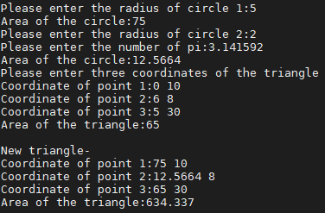
Exercise (3/3)

