Slide 1
Lab 7 STRINGS
UEE 1303
Department of Electrical and Computer Engineering, Institute of Electronics
National Chiao Tung University

Slide 2
Outline
C-string
String class

Slide 3
Strings
Two string types:
Legacy C-string
represented as an array of characters
end of string marked with a null character, ‘\0’
old string style inherited from C
String class
newly provided in C++
part of the C++ standard library
uses templates (Chapter 16, 19)

Slide 4
C-String Storage
A C-style string:
char s[10];
if s contains a string “Hi Mom!”, it is stored as:
‘\0’ is implicitly appended at the end
the value of ‘\0’is actually 0

Slide 5
C-String Initialization
C-string initialization
char msg[20] = “Hi there.”; // needn’t fill up the entire array
char msg[10] = “Hello world!”; // error! string literal is too long
Array size can be omitted
char short_String[] = “abc”; // initialized by a string literal
automatically makes size one more than length of string literal
in this case, equivalent to short_String[4]
NOT same as: char short_String[] = {‘a’, ‘b’, ‘c’};
in this case, equivalent to short_String[3]

Slide 6
Header File and Library
Declaring C-strings
require no C++ library
no need to include any header files
built into standard C++ (just like int, double, …)
Extra manipulation functions
need to include the header file <cstring>
typically included when using C-strings

Slide 7
C-String Assignment (1/2)
C-strings are not like other built-in types
Assignment
int val = 10; // ok, val is initialized with 10
val = 20; // ok, val is assigned with 20
char str[10] = “Hello”; // str is initialized with a string literal
char str2[10] = “world!”
str = “world!”; // error!! str is a constant pointer
str = str2; // error!! str is a constant pointer
int ia[10], ib[10];
ia = 100; // error!! ia is a constant pointer
ia = ib; // error!! ia is a constant pointer
The reason is → the type of str:
array of characters, or
a constant pointer pointing to character
that is, str cannot be on the left side of assignment operator

Slide 8
C-String Assignment (2/2)
Q: How to do C-string assignment?
A: Use a library function: char* strcpy(char* dest, const char* src);
a built-in library function declared in <cstring>
string copy from src to dest char-by-char until ‘\0’ is reached
NO checks for string size! programmer’s responsibility!
Example
char str1[10] = “Hello”;
char str2[20] = “world!”;
strcpy(str1, “C++”); // ok now!
strcpy(str1, “Adar’s handsome”); // no compilation error,
// but big runtime problem!
strcpy(str1, str2); // ok!

Slide 9
C-String Comparison (1/2)
C-strings are not like other built-in types
Comparison
char str1[10] = “Hello”; char str2[10] = “Hello”;
bool eq1 = (str1 == str2); // eq1 ← false!!!
int a1[2] = {1, 2}; int a2[2] = {1, 2};
Bool eq2 = (a1 == a2); // eq2 ← false
The reason is → the type of str:
array of characters, or
a constant pointer pointing to character
that is, the value of str represents a specific address

Slide 10
C-String Comparison (2/2)
Q: How to do C-string comparison?
A: Use a library function: int strcmp(const char* str1, const char* src);
a built-in library function declared in <cstring>
compare str1 against str2 using lexicographic order
return value:
negative → str1 < str2
0 → str1 == str2 (str1 and str2 are identical)
positive → str1 > str2
Example
char str1[10] = “Hello”;
char str2[20] = “world!”
if ( strcmp(str1, str2) == 0 )
cout<< “Same!\n” << endl;

Slide 11
Other Functions
strlen()
Get string length → size_t strlen(const char*);
char myString[10] = “dobedo”;
cout << strlen(myString); //result: 6 (not 10)
strcat()
Concatenate two strings char* strcat(char* dest, const char*src);
No checks for string size! programmer’s responsibility!
char str1[30] = “Hello ”;
char str2[20] = “wonderful world!\n”;
strcat(str1, str2);
cout<< str1; // “Hello wonderful world!”
strcat(str1, str2); // a big runtime problem here

Slide 12
C-String Input with Operator >>
Input C-strings with operator >>
istream& operator>>(istream&, char*);
Whitespace is delimiter
input breaks at delimiter while using “cin >> …”
must be large enough to hold entered string!
C++ gives no warnings; programmer’s responsibility!
char a[80], b[80];
cout << “Enter input: ”;
cin >> a >> b;
cout << a << b << “End of Output\n”;
Dialogue
Enter input: Do be do to you!
DobeEnd of Output

Slide 13
C-String Line Input (1/2)
Q: What if we want to input a string having whitespaces?
A: Use cin.getline()
getline(char* s, stream_size n)
a member function of class istream
it can receive an entire input line into C-string
char a[80];
cout<< “Enter input:” ;
cin.getline(a, 80);
cout<< a << “END OF OUTPUT\n”;
Dialogue:
Enter input: Do be do to you!
Do be do to you!END OF OUTPUT

Slide 14
C-String Line Input (2/2)
Can explicitly tell the maximum length to receive:
char shortString[5];
cout<< “Enter input: ”;
cin.getline (shortString, 5);
cout<< shortString<< “END OF OUTPUT\n”;
Results:
Enter input: dobedowap
dobeEND OF OUTPUT
forces FOUR characters only be read
the last one for a null character!

Slide 15
Functions in <cctype> (1/2)
Upper-lower case conversions
int toupper(int);
int tolower(int);
Examples: char ch1, ch2;
ch1 = ‘a’;
ch2 = toupper(ch1); // ch2 = ‘A’
ch2 = toupper(‘B’); // ch2 = ‘B’
ch2 = toupper(‘5’); // ch2 = ‘5’
ch2 = tolower(‘A’); // ch2 = ‘a’
ch2 = tolower(‘b’); // ch2 = ‘b’
ch2 = tolower(‘5’); // ch2 = ‘5’

Slide 16
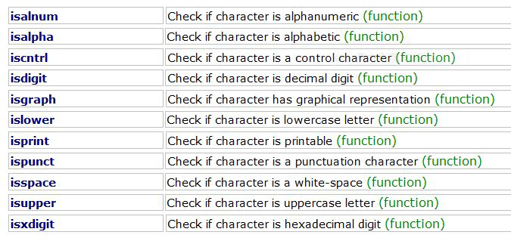
Functions in <cctype> (2/2)
int isXXXXX(int c);
return nonzero if true ; zero if false

Slide 17
Class string
Defined in the standard C++ library
#include <string>
using namespace std;
Can perform assignment, comparison, addition, …
Example:
string s1, s2, s3;
s3 = s1 + s2; // concatenation
s3 = “Hello Mom!” // assignment
note C-string “Hello Mom!” can be assigned to a string using string& operator=(const char*);

Slide 18
Constructors and Assignment
Ctors
string(); // default, an empty string
string(const string&); // copy ctor
string(const char* s); // a string initialized by s
and more …
Assignment operators (member functions)
string& operator=(const string&);
string& operator=(const char*);
string& operator+=(const string&);
string& operator+=(const char*);
and more …

Slide 19
Capacity and Element Access
Capacity (member functions)
size_t size() const; // get string length
size_t length() const; // get string length; same as size()
bool empty() const; // Is it an empty string?
and more …
Element access (member functions)
char& operator[](size_t p);
// return the reference of pth character in string, no range checking
char& at(size_t p);
// return the reference of pth character in string, with range checking
and more …
string str(“hello”);
str[0] = ‘H’; // str contains “Hello” now
int i= str.size(); // i= 5

Slide 20
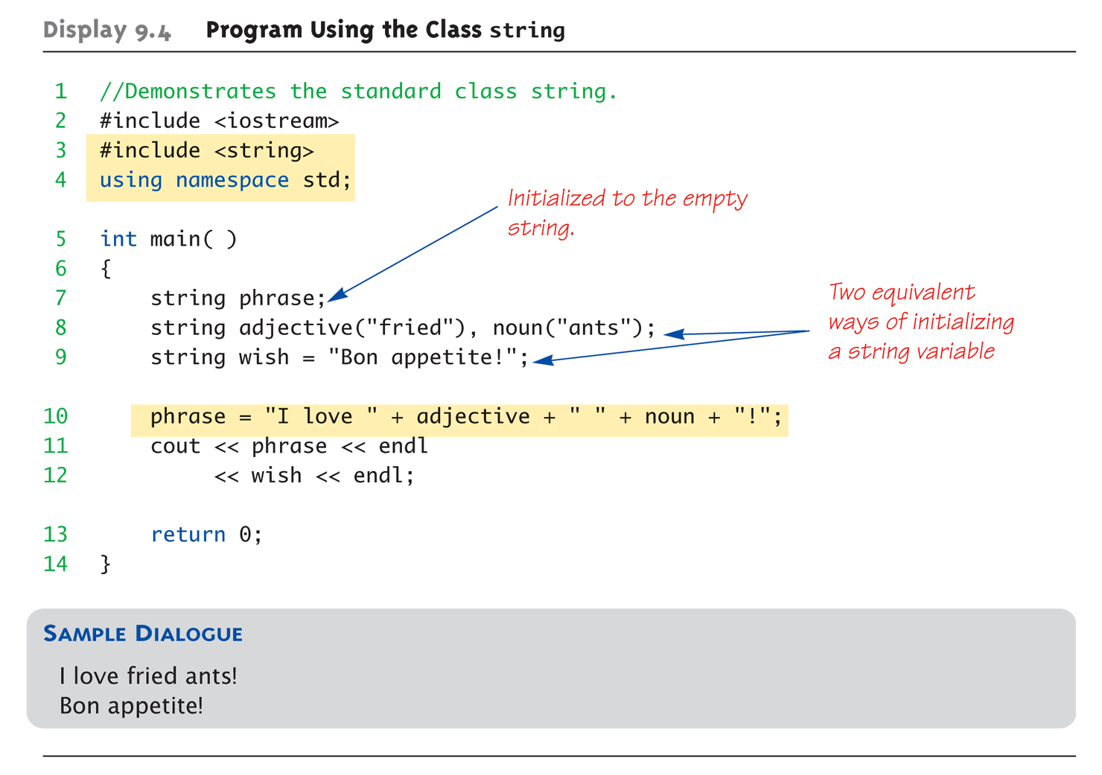
Uses of string

Slide 21
string I/O with >> and <<
Operators >> and << are overloaded for string type
istream& operator>>(istream&, string&);
ostream& operator<<(ostream&, const string&);
string s1, s2, s3(“Hello world!”);
cin >> s1 >> s2;
cout << s3;
Results
User types in: Long live the king!
Extraction still ignores whitespaces
s1 receives value “Long”
s2 receives value “live”

Slide 22
string I/O with getline() (1/2)
To get a complete input line
global function: istream& getline(istream&, string&);
string line;
cout << “Enter a line of input: ”;
getline(cin, line);
cout << line << “END OF OUTPUT”;
Dialogue produced
Enter a line of input: Do be do to you!
Do be do to you !END OF INPUT
Similar to C-string’s usage of getline()

Slide 23
string I/O with getline() (2/2)
You can specify your own delimiter character
istream& getline(istream&, string&, char delim);
string line;
cout<< “Enter input: ”;
cin.clear();
getline(cin, line, ‘?’);
receives input until ‘?’ is encountered
getline() returns reference
string s1, s2;
getline(cin, s1) >> s2; // ok to do this

Slide 24
Substring and Find Operations (1/2)
Substring (member functions)
string substr(size_t pos = 0, size_t n = npos) const;
Find (member functions)
size_t find(const string& str, size_t pos = 0) const; // first one
size_t find(const char* s, size_t pos = 0) const;
size_t rfind(const string& str, size_t pos = npos) const; // last one
size_t rfind(const char* s, size_t pos = npos) const;
size_t find_first_of(const string& str, size_t pos = 0) const;
size_t find_last_of(const string& str, size_t pos = npos) const;
size_t find_first_not_of(const string& str, size_t pos = 0) const;
size_t find_last_not_of(const string& str, size_t pos = npos) const;
and more …

Slide 25
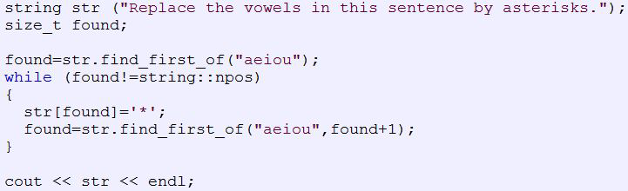
Substring and Find Operations (2/2)

Slide 26
Exercise (1/2)
Input:
an integer to choose mode
a string to convert
Output:
-1: the program ends
0: replaces substrings in left table with substrings in right table
1: replaces substrings in right table with substrings in left table
A | B
(happy) | ^w^
(heart) | <3
(confused) | ?_?
(kiss) | -3-
(speechless) | = =

Slide 27
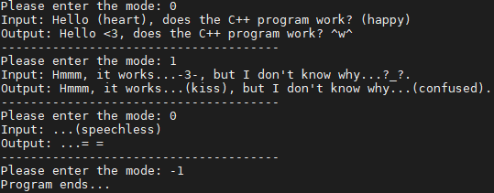
Exercise (2/2)

Slide 28
istream*& ignore(streamsize, int)
Problem with using cin >> and getline(cin, s) together
cin >> will left ‘\n’ in the buffer
If then execute getline(), it will receive ‘\n’ immediately
use cin.ignore (100, ‘\n’); to extract characters from the input sequence and discard them until either 100 characters have been extracted or one compares equal to ‘\n’
string s0, s1;
cin >> s0;
cin.ignore(100, ‘\n’); // If don’t add this, s1 will be an empty string
getline(cin, s1);
cout << “s0 = ” << s0 << endl;
cout << “s1 = ” << s1 << endl;

Slide 29
More Function of Class string
string - C++ Reference - Cplusplus.com

