Slide 1
Lab10 Polymorphism and Virtual Functions
DEE 1319
Department of Electronics Engineering
National Chiao Tung University

Slide 2
Learning Objectives
Virtual functions
Polymorphism
Abstract classes and pure virtual functions

Slide 3
Virtual vs. Non-Virtual Functions (1/2)
For non-virtual (member) functions
Function calls are STATICALLY bound (i.e., bound at compile time)
class B {
public: void mf();
};
class D:public B {
public: void mf(); //redefine mf();
}
void f() {
B b, *pB= &b; D d, *pD= &d;
b.mf(); // statically binding ➔ b is of type B ➔ call B::mf()
d.mf(); // statically binding ➔ d is of type D ➔ call D::mf()
pB->mf(); // statically binding ➔ pB is of type B* ➔ call B::mf()
pD->mf(); // statically binding ➔ pD is of type D* ➔ call D::mf()
pB= &d; // ok, D is derived from B
pB->mf(); // still statically binding ➔ pB is of type B* ➔ call B::mf()
} // though pB actually points to d (an object of type D)

Slide 4
Virtual vs. Non-Virtual Functions (2/2)
For virtual (member) functions
Must be non-static member functions
Function calls are DYNAMICALLY bound (i.e., bound at runtime) if they are invoked through pointers or references
class B {
public: virtual void mf();
};
void f() {
B b, *pB= &b; D d, *pD= &d;
b.mf(); d.mf();
pB->mf(); pD->mf();
pB= &d; // ok, D is derived from B
pB->mf();// dynamically binding ➔ pB actually points to d ➔ call D::mf()
}
class D:public B {
public: void mf(); //override mf();
}

Slide 5
Object slicing vs. Virtual function
Manipulate objects through pointers if you want to use virtual functions
void f() {
B b, *pB= &b; D d, *pD= &d;
pB= &d;
pB->mf();// call D::mf()
b = d; // ok, upcasting
b.mf(); // object slicing!! Always call B::mf()
}
class B {
public: virtual void mf();
};
class D:public B {
public: void mf(); //override mf();
}

Slide 6
Polymorphism
Polymorphism
While accessing a member function, the correct version based on the actual calling object is always invoked
Namely, the behavior of calling a member function through a pointer/reference may be different ➔ polymorphic
In C++, polymorphism is achieved through
Virtual functions, and
Manipulating objects through pointers or references
A class with virtual functions is called a polymorphic class
Polymorphism is another cornerstone of OOP

Slide 7
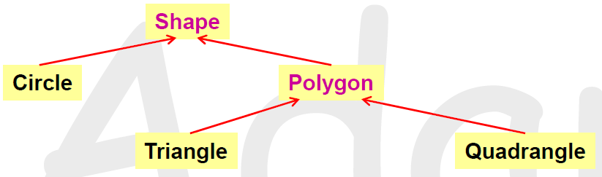
Concrete Class vs. Abstract Class
Some concepts are concrete and some are abstract
Abstract classes: Shape and Polygon
e.g., no idea how to draw or rotate an arbitrary shape
Objects of abstract classes should not exist (they are abstract)
Concrete classes : Circle, Triangle and Quadrangle
Objects of these types can exist
They can be drawn, rotated, …

Slide 8
Pure Virtual Functions & Abstract Class
class Shape {
public:
virtual void rotate(int) = 0; // pure virtual function
virtual void draw() = 0; // pure virtual function
virtual boolis_closed() = 0; // pure virtual function
// … // only declaration; no definition
};
void f() {
Shape s; // compilation error! it must be an error, or
s.draw(); //would be legal ; but draw() is a pure virtual function
};
A class with one or more pure virtual functions is called an abstract class
No objects of abstract class can be created in C++

Slide 9
Abstract Base Class (ABC)
Abstract class is always used as a base class ➔(ABC)
You cannot create objects of abstract class
It only makes sense that some classes derived from it and become concrete by overriding all pure virtual functions
Abstract class specifies interface requirements
A class derived from an ABC is still abstract if it doesn’t override ALL inherited pure virtual functions

Slide 10
Power of Abstract Base Class
void draw_shapes(Shape* sarr[], int size)
{
for(int i=0; i<size; i++)
sarr[i]->draw(); // draw object circle, triangle, rectangle …..
}
draw_shapes : pointer array
Can correctly call ALL kinds of objects of concrete classes
derived from Shape

Slide 11
Exercise(1/2)
Input: A set of shapes with side-information in a txt file
Shape type: triangle, rectangle, square and circle
Output:
1) Calculate the perimeter of each shape.
2) Check if the shapes are legal or illegal, and classify these shapes as the output.
The rules are the below:
For all shapes, all the numbers (length of size and radius) are greater than 0.
For triangles, the sum of any two of the sizes is always greater than the other side.
For rectangles, the up-side = down-side and right-side = left-side
For squares, the four side length are identical

Slide 12
Exercise(2/2)
The inheritance hierarchy should be:
shape and polygon is abstract base class
Set pi = 3.14
Set the perimeter of the illegal ones -1
shape
polygon
circle
triangle
rectangle
square

Slide 13
Format of Input File
10 //total number of shapes
Shape0 // [shape name]
triangle
3 3 2 //side lengths
Shape1 //[shape name]
circle
4 //radius
Shape2 //[shape name]
rectangle
3 4 3 4 //always in the order: up, right, down, and left
… …

Slide 14
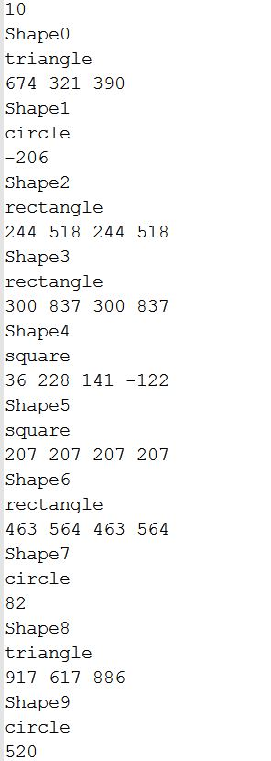
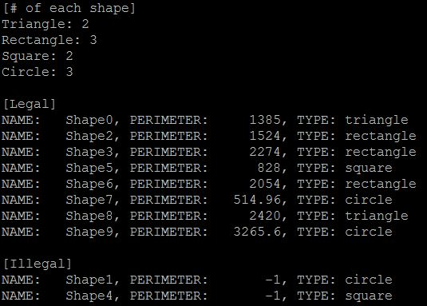
Execution Result (pattern1.txt)
INPUT FILE
OUTPUT RESULT

