Slide 1
Lab 6 Constructors and other Tools & OPERator overloading, Friends, Reference
UEE 1303
Department of Electrical and Computer Engineering, Institute of Electronics
National Chiao Tung University

Slide 2
Outline
Constructors
Operator Overloading

Slide 3
Constructors (ctors)
ctor is dedicated to
- initialization of some or all data members
- other necessary actions during initialization
ctor is a special kind of member function
- automatically called when an object is born
ctor is declared just like any other member functions except
- ctor name MUST be SAME as class name
- ctor has NO return type; not even void
Yes, there are destructors(dtors) too(Chapter 10)

Slide 4
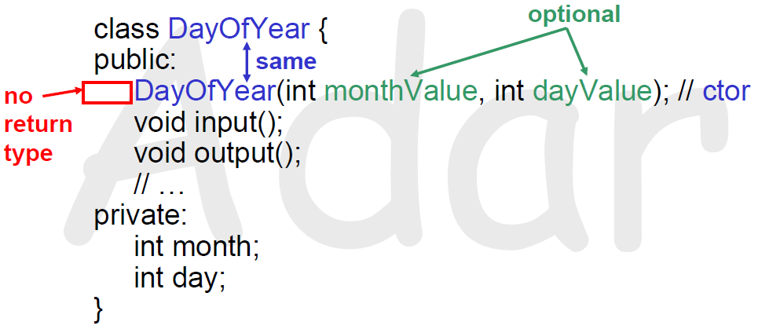
Constructor Declaration
Class definition with ctor declaration

Slide 5
Calling Constructors (1/2)
void f(){
DayOfYear date1(7, 4), date2(3, 6);
// implicit ctor call for date1 with (7, 4)
// implicit ctor call for date2 with (3, 6)
}
As soon as data1/date2 is born (created)
- ctor is automatically called for each
- Values in parentheses passed as arguments to the ctor
- Data members (month & day) are then initialized by the ctor

Slide 6
Calling Constructors (2/2)
void f() {
DayOfYear date1; // Error
date1.DayOfYear(7, 4); // Error
DayOfYear date2(3, 6); // ok
// …
}
Error
– If there is any existing ctor, compiler will NOT generate a default ctor for you
Error
– Object is NOT allowed to call ctors directly

Slide 7
Constructor Definition
ctor definition is like all other member functions
– except it has no return type
DayOfYear::DayOfYear(int monthValue, int dayValue) {
month = monthValue;
day = dayValue;
}
Note that same name around ::
– Clearly identifies a ctor
Note that no return type
– Just as in class definition

Slide 8
Complete Constructor Definition
DayOfYear::DayOfYear(int monthValue, int dayValue)
: month(monthValue), day(dayValue)
{ // can be empty if nothing to do here }
Prefer this style for ctor definition

Slide 9
Overloaded Constructors
Ctor can be overloaded just like other functions
- that is, a class can have multiple ctors
class DayOfYear{
public:
DayOfYear(int monthValue, int dayValue); // ctor#1
DayOfYear(int monthValue) // ctor#2
DayOfYear( ) // ctor#3
(default constructor)
// …
}
void f() { DateOfYear d1(7, 4), d2(9), d3; … }

Slide 10
Explicit Constructor Calls
Explicit Constructor Calls
A temporary object will be created by explicitly calling a ctor
– that object has no name
– it is destroyed at the end of expression
void f() {
DayOfYear holiday(7, 4);
holiday = DayOfYear(5, 5);
// 1. Explicitly call a ctor
// 2. Create a temp object w/o name and initialized by that ctor call
// 3. The temp object is assigned to holiday
// 4. After finishing assignment, the temp object is destroyed
}

Slide 11
Constant Member Functions (1/2)
If a member function does not make any modifications on data members - ALWAYS make it a constant member function
class DayOfYear { class Holiday {
public: public:
DayOfYear(int, int); Holiday( );
DayOfYear(int); Holiday(int, int, bool);
DayOfYear( ); void output( ) const;
void output( ) const; private:
int getMonthNumber( ) const; DayOfYear date;
int getDay( ) const; bool parkingEnforcement;
private: };
int month;
int month;
int month;
int day;
void testDate( ) const;
};

Slide 12
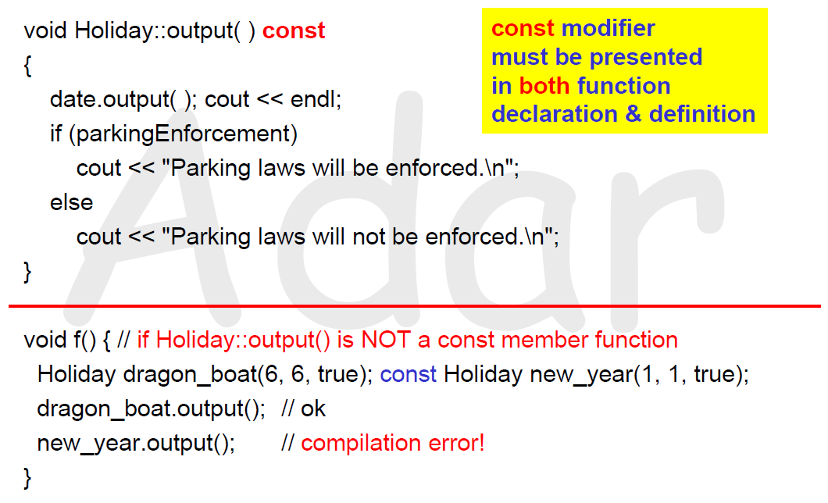
Constant Member Functions (2/2)

Slide 13
Why Operator Overloading?
Define a member function operator+
class complex {
double re, im;
public:
complex(double r = 0.0, double i = 0.0) : re(r), im(i) { }
const complex operator+(const complex&) const;
};
const complex complex::operator+(const complex& rhs) const {
complex result(rhs); // using copy ctor, too
result.re += re; result.im += im;
return result;
}
void f() {
complex a(1, 1), b(2, 2), c;
c = a.operator+(b); // ok! explicit call, just ugly!
c = a + b; // ok! it is just a shorthand for operator+
}

Slide 14
Another Way for Operator Overloading
Overloaded operators are NOT necessarily member functions!
class complex {
double re, im;
public:
complex(double r = 0.0, double i = 0.0) : re(r), im(i) { }
double real() const { return re; }
double image() const { return im; }
};
const complex operator+(const complex& lhs, const complex& rhs) {
double real, image;
real = lhs.real() + rhs.real(); image = lhs.image() + rhs.image();
return complex(real, image);
}
void f() {
complex a(1, 1), b(2, 2), c;
c = operator+(a, b); // ok! explicit call, just ugly!
c = a + b; // ok! it is just a shorthand for operator+
}

Slide 15
Returning Constant Value
const complex operator+(const complex& lhs , const complex& rhs)
complex operator+(const complex& lhs , const complex& rhs)
void f() {
complex a(1,1), b(2,2), c(3,3);
(a + b) = c; // no error if using red one; error if using blue one
if((a+b) = c) // Oops, programmer actually wants => if((a+b) ==c)
do_things // again, no error if using red one; error if using blue one
}
Hence, blue one is preferred

Slide 16
Member vs. Nonmember Operators
If mixed-mode arithmetic is allowed e.g., allow adding a complex with a double
void f() { // operator+ is a member function here
complex a(1,1), b;
b = a + 1.0; // ok! a.operator+( complex(1.0) )
b = 1.0 + a; // error! 1.0.operator+(a) <= no such function!
}
void f() { // operator+ is a nonmember function here
complex a(1,1), b;
b = a + 1.0; // ok! operator+( a, complex(1.0) )
b = 1.0 + a; // ok! operator+( complex(1.0), a )
}
In general, nonmember version is preferred

Slide 17
Friend Functions (1/3)
Nonmember functions
- access private members through accessors and mutators
- inefficient (overhead of calls to accessors and mutators)
Friend functions can directly access private members
- same access privilege as member functions
- no calls to accessors and mutators =>more efficient
You can make specific nonmember functions friends for better efficiency!

Slide 18
Friend Functions (2/3)
class complex {
double re, im;
public:
complex(double r = 0.0, double i = 0.0) : re(r), im(i) { }
double real() const { return re; }
double image() const { return im; }
friend const complex operator+(const complex&, const complex&);
};
const complex operator-(const complex&, const complex&);

Slide 19
Friend Functions (3/3)
// no need to add friend prefix in function definition
const complex operator+(const complex& lhs, const complex& rhs) {
complex result(lhs);
result.re += rhs.re; result.im += rhs.im;
return result;
} // a friend function has same access privilege as member functions
const complex operator-(const complex& lhs, const complex& rhs)
double real = lhs.real() + rhs.real();
double image = lhs.image() + rhs.image();
return complex(real, image);
} // need accessors to get private data

Slide 20
Overload <<
ostream& operator<<(ostream& os, const complex& rhs) {
os << rhs.real() << ‘+’ << rhs.image() << ‘i’ ;
return os;
}
void f() {
complex a(2,3), b(4,5);
cout << a << endl << b << endl; // more elegant!
}
It is common to make operator<< a friend

Slide 21
Return Value of Operator <<
If you make operator<< return void …
void operator<<(ostream& os, const complex& rhs) {
os << rhs.real() << ‘+’ << rhs.image() << ‘i’ ;
}
void f() {
complex a(2,3), b(4,5);
cout << a << endl << b << endl; // compilation error!
} void

Slide 22
Overload >>
You can use “cin >>” for user-defined types
- First, make istream& operator>>(istream&, complex&) a friend
- then,
istream& operator>>(istream& is, complex& rhs) {
is >> rhs.re >> rhs.im ;
return is;
}
void f() {
complex a, b;
cin >> a >> b; // more elegant!
} ifstream

Slide 23
Exercise (1/4)
Create a class science and provide the following functions
2 private data members : double and int type
a*10^n , where 1 ≤ |a| < 10 or a = 0 , n is an integer
Finish constructor, operator+,-,*,/,>>,<<
operator<< and operator>> for output/input science
The output format : a*10^n
Always in reduced form
The input format : a n
input can be in non-reduced form , ex: a=12.34, n=1
n will always be an integer

Slide 24
Exercise (2/4)
Please don’t touch the provided main function
Just finish operator overloading function declarations/definitions
Your class should be able to handle operations of large numbers
Ex: 1.23*10^1000 / 2.7*10^800 = 4.55556*10^199
TA will not input an expression with too large difference between two operands
Ex: 1*10^1000 + 1*10^10

Slide 25
Exercise (3/4)
Hint: You can use following predefined functions in
<cmath> and <cstdlib>:
double pow(double ),
double fabs(double ),
double log10(double ), ex: log10(120.0) == 2.07918
double ceil(double ), ex: ceil(10.5) == 11.0
double floor(double ), ex: ceil(10.5) == 10.0

Slide 26
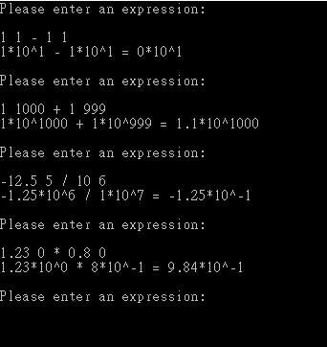
Exercise (4/4)

