Slide 1

TEAM 8: CHRISTINA BAILEY, COURTNEY JOHNSON, KELLY RAWLS, JT TAYLOR

Slide 2
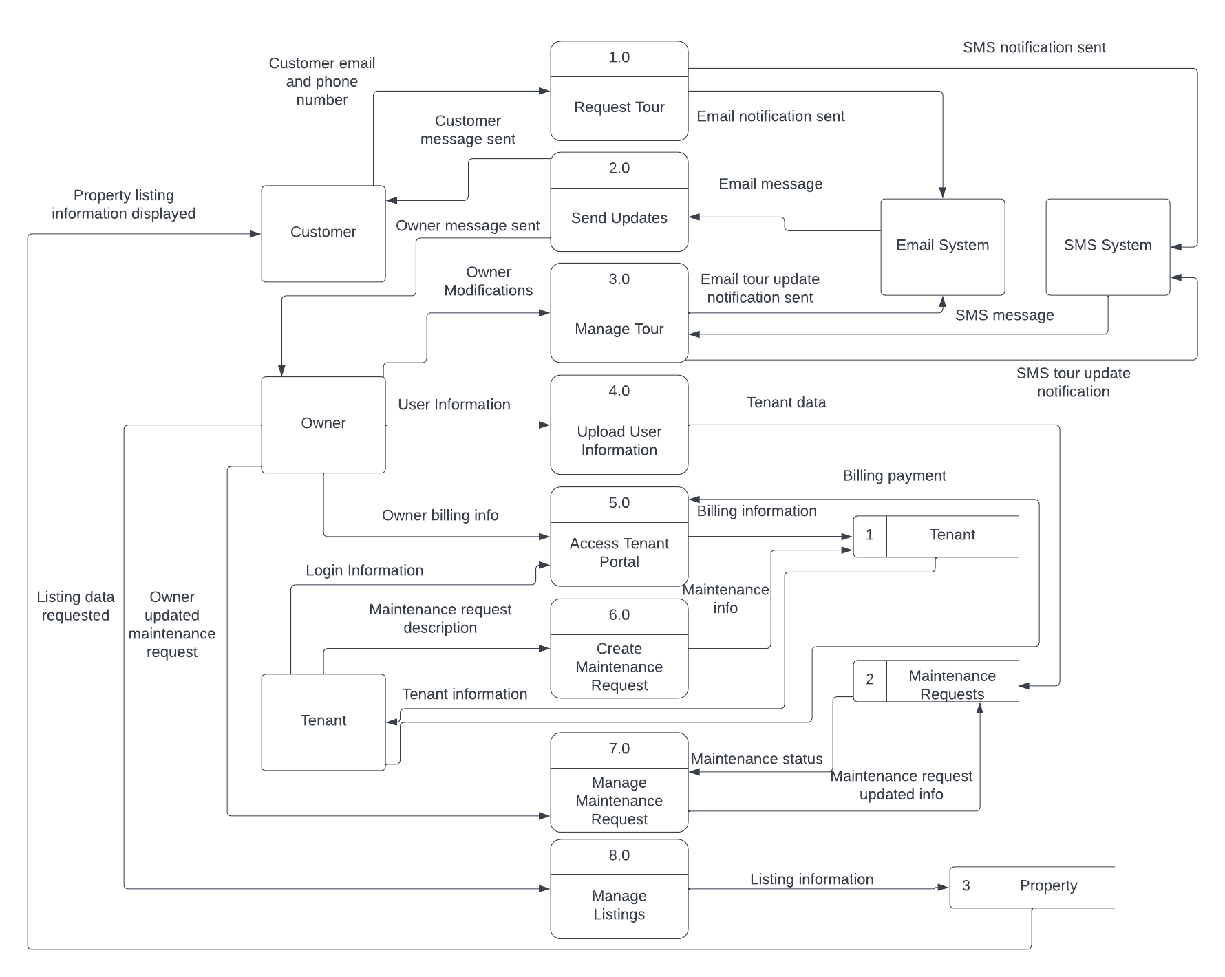
Updated
Level 0 DFD

Slide 3
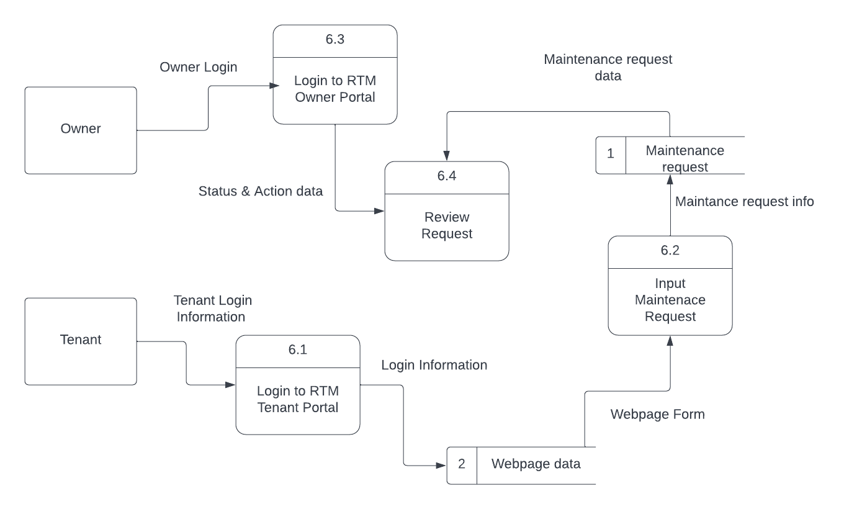
Updated
Level 1 DFD:
Create
Maintenance
Request

Slide 4
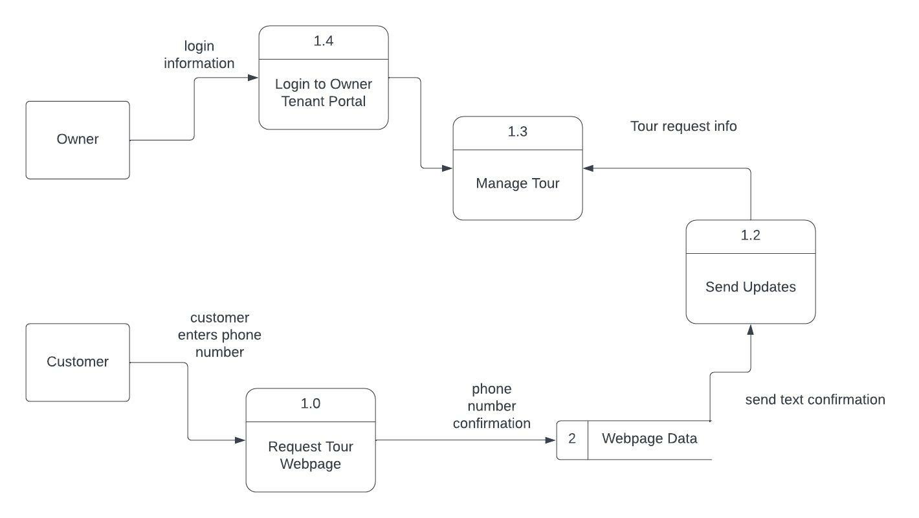
Updated
Level 1 DFD:
SMS Tour
Request

Slide 5
Migration Plan — Business Readiness
Conversion Strategy
Direct Simultaneous Conversion
Business Contingency Plan
Training/Technical Manuals
Revert to Old System

Slide 6
Migration Plan — Technical Readiness
Hardware
Ensure client has necessary hardware
Software
Ensure client has necessary software( Bluehost and WordPress)
Convert Data
Manual Data Entry

Slide 7
Migration Plan — People Readiness
Revise Management Policies
Assess Costs and Benefits
Low cost system that will save time
Increased organization
Motivate Adoption
Client Input
Minimize effort to learn
Conduct Training
One-on-One training at weekly meetings
Training & Technical Manuals

Slide 8
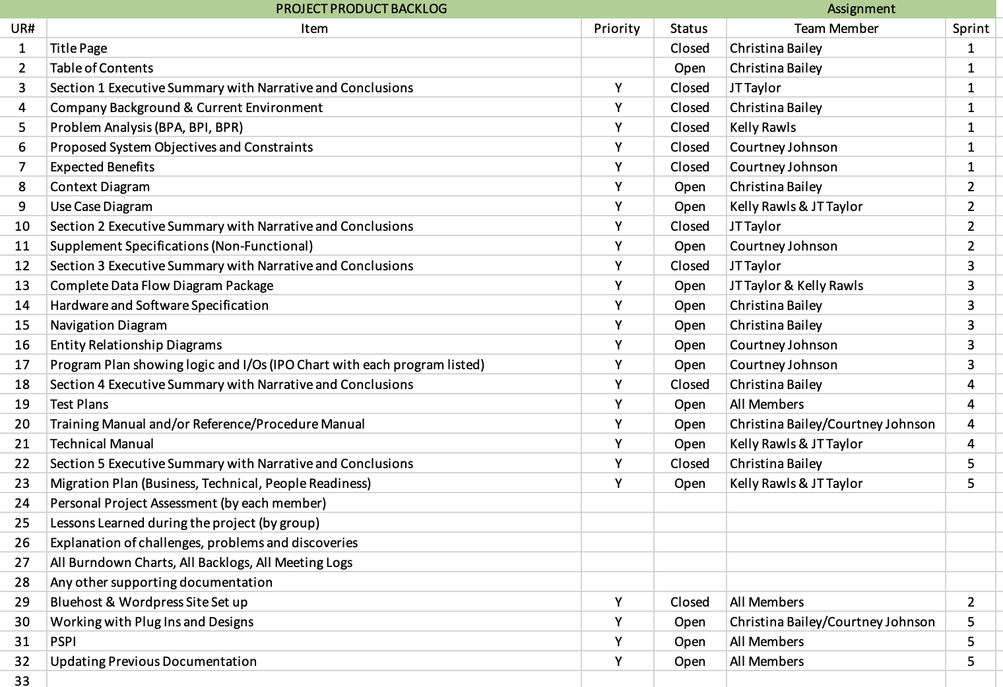
Product
Backlog

Slide 9
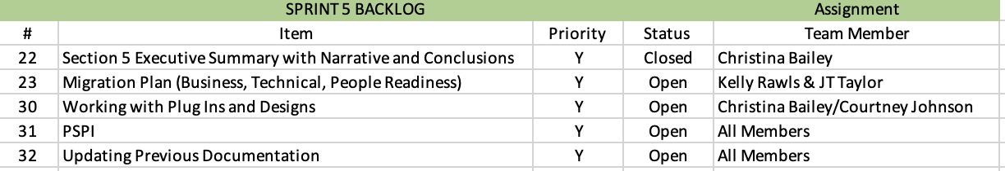
Sprint Backlog

Slide 10
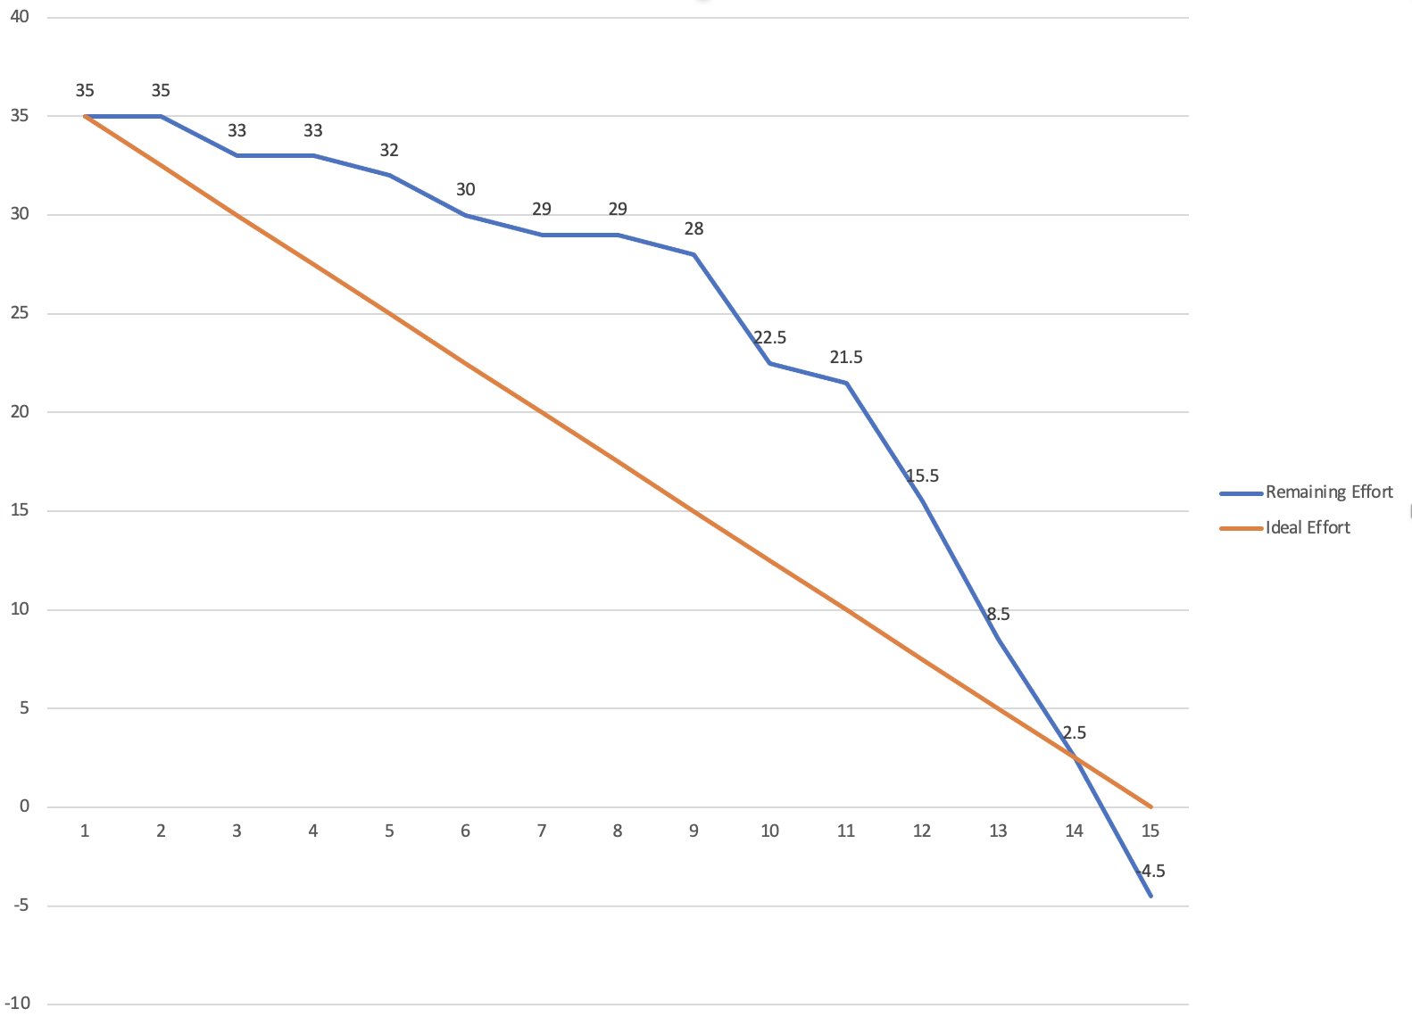
Burndown
Chart

Slide 11
PSPI

Slide 12
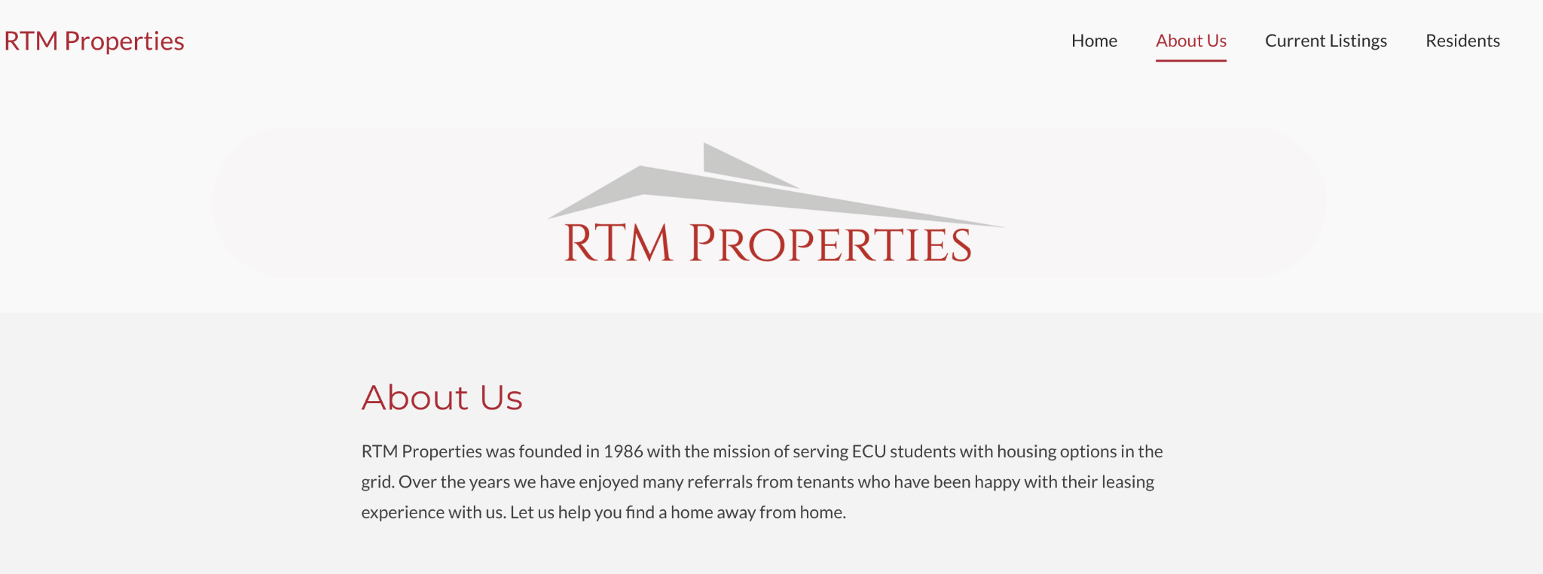

Slide 13
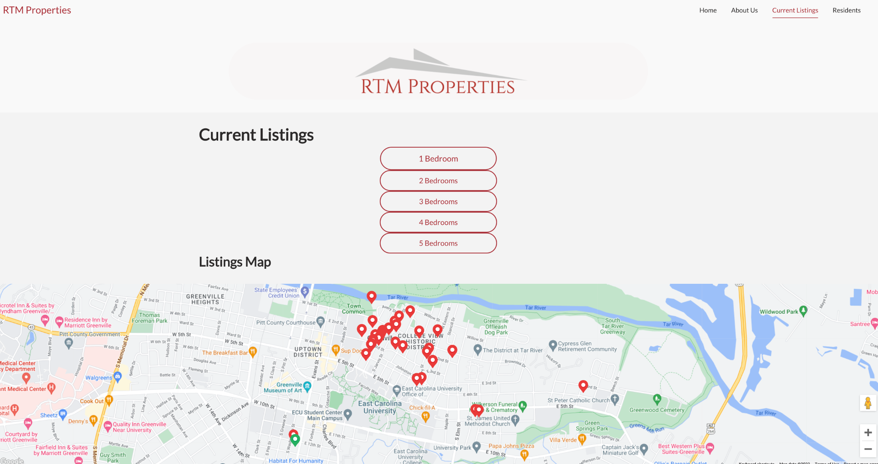

Slide 14
