Slide 1
What is Program
A Set of Instructions
Data Structures + Algorithms
Data Structure = A Container stores Data
Algoirthm = Logic + Control

Slide 2
Functions of Data Structures
Add
  Index
  Key
  Position
  Priority
Get
Change
Delete

Slide 3
Common Data Structures
Array
Stack
Queue
Linked List
Tree
Heap
Hash Table
Priority Queue

Slide 4
How many Algorithms?
Countless

Slide 5
Algorithm Strategies
Greedy
Divide and Conquer
Dynamic Programming
Exhaustive Search

Slide 6
Which Data Structure or Algorithm is better?
Must Meet Requirement
High Performance
Low RAM footprint
Easy to implement
  Encapsulated

Slide 7
Chapter 1 Basic Concepts
Overview: System Life Cycle
Algorithm Specification
Data Abstraction
Performance Analysis
Performance Measurement

Slide 8
1.1 Overview: system life cycle (1/2)
Good programmers regard large-scale computer programs as systems that contain many complex interacting parts.
As systems, these programs undergo a development process called the system life cycle.

Slide 9
1.1 Overview (2/2)
We consider this cycle as consisting of
five phases.
  Requirements
  Analysis: bottom-up vs. top-down
  Design: data objects and operations
  Refinement and Coding
  Verification
    Program Proving
    Testing
    Debugging

Slide 10
1.2 Algorithm Specification (1/10)
1.2.1 Introduction
  An algorithm is a finite set of instructions that accomplishes a particular task.
  Criteria
    input: zero or more quantities that are externally supplied
    output: at least one quantity is produced
    definiteness: clear and unambiguous
    finiteness: terminate after a finite number of steps
    effectiveness: instruction is basic enough to be carried out
  A program does not have to satisfy the finiteness criteria.

Slide 11
1.2 Algorithm Specification (2/10)
Representation
  A natural language, like English or Chinese.
  A graphic, like flowcharts.
  A computer language, like C.
Algorithms + Data structures = Programs [Niklus Wirth]
Sequential search vs. Binary search

Slide 12
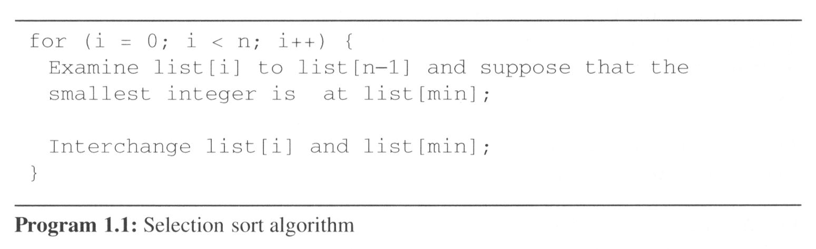
1.2 Algorithm Specification (3/10)
Example 1.1 [Selection sort]:
  From those integers that are currently unsorted, find the smallest and place it next in the sorted list.
i [0] [1] [2] [3] [4]
  - 30 10 50 40 20
  0 10 30 50 40 20
  1 10 20 40 50 30
  2 10 20 30 40 50
  3 10 20 30 40 50

Slide 13
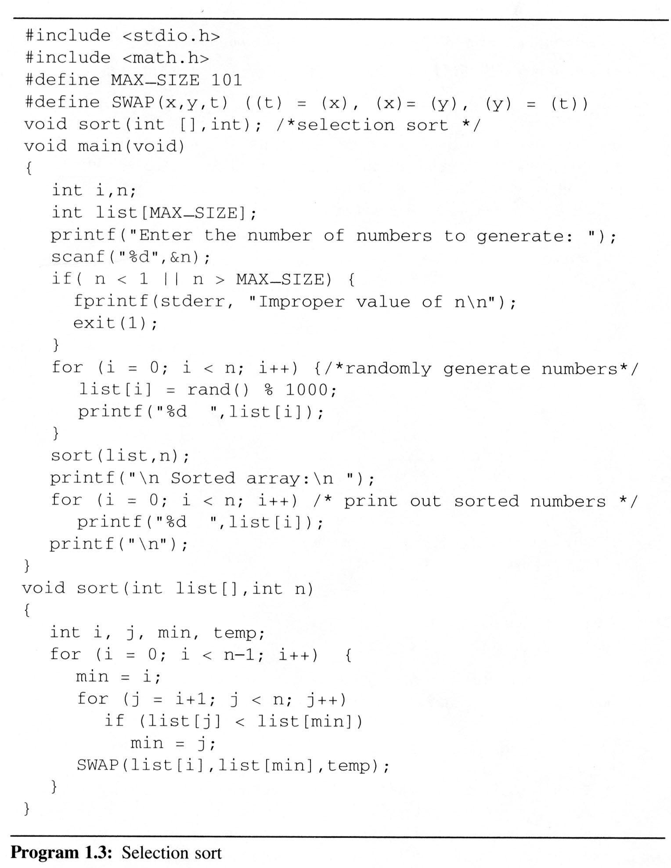
1.2 (4/10)
Program 1.3 contains a complete program which you may run on your computer

Slide 14
1.2 Algorithm Specification (5/10)
Example 1.2 [Binary search]:
    [0] [1] [2] [3] [4] [5] [6]
    8 14 26 30 43 50 52
    left right middle list[middle] : searchnum
    0 6 3 30 < 43
    4 6 5 50 > 43
    4 4 4 43 == 43
    0 6 3 30 > 18
    0 2 1 14 < 18
    2 2 2 26 > 18
    2 1 -
Searching a sorted list
    while (there are more integers to check) {
    middle = (left + right) / 2;
    if (searchnum < list[middle])
    right = middle - 1;
    else if (searchnum == list[middle])
    return middle;
    else left = middle + 1;
    }

Slide 15
int binsearch(int list[], int searchnum, int left, int right) {
/* search list[0] <= list[1] <= … <= list[n-1] for searchnum.
Return its position if found. Otherwise return -1 */
int middle;
while (left <= right) {
middle = (left + right)/2;
switch (COMPARE(list[middle], searchnum)) {
case -1: left = middle + 1;
break;
case 0 : return middle;
case 1 : right = middle – 1;
}
}
return -1;
}
*Program 1.6: Searching an ordered list

Slide 16
1.2 Algorithm Specification (7/10)
1.2.2 Recursive algorithms
  Beginning programmer view a function as something that is invoked (called) by another function
    It executes its code and then returns control to the calling function.

Slide 17
1.2 Algorithm Specification (8/10)
  This perspective ignores the fact that functions can call themselves (direct recursion).
  They may call other functions that invoke the calling function again (indirect recursion).
    extremely powerful
    frequently allow us to express an otherwise complex process in very clear term
  We should express a recursive algorithm when the problem itself is defined recursively.

Slide 18
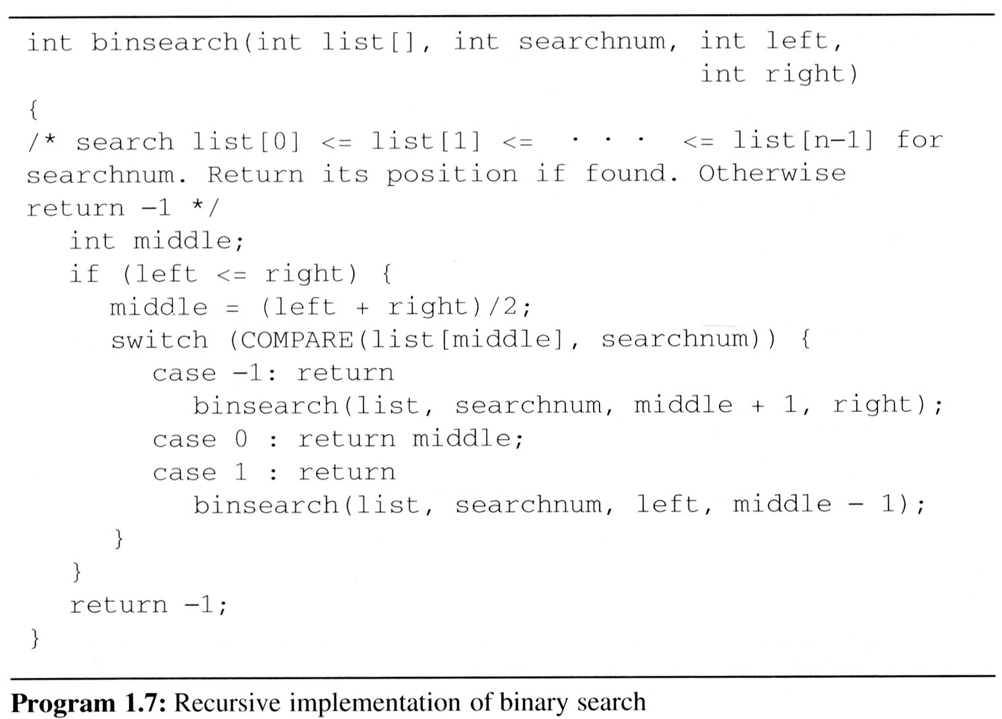
1.2 Algorithm Specification (9/10)
Example 1.3 [Binary search]:

Slide 19
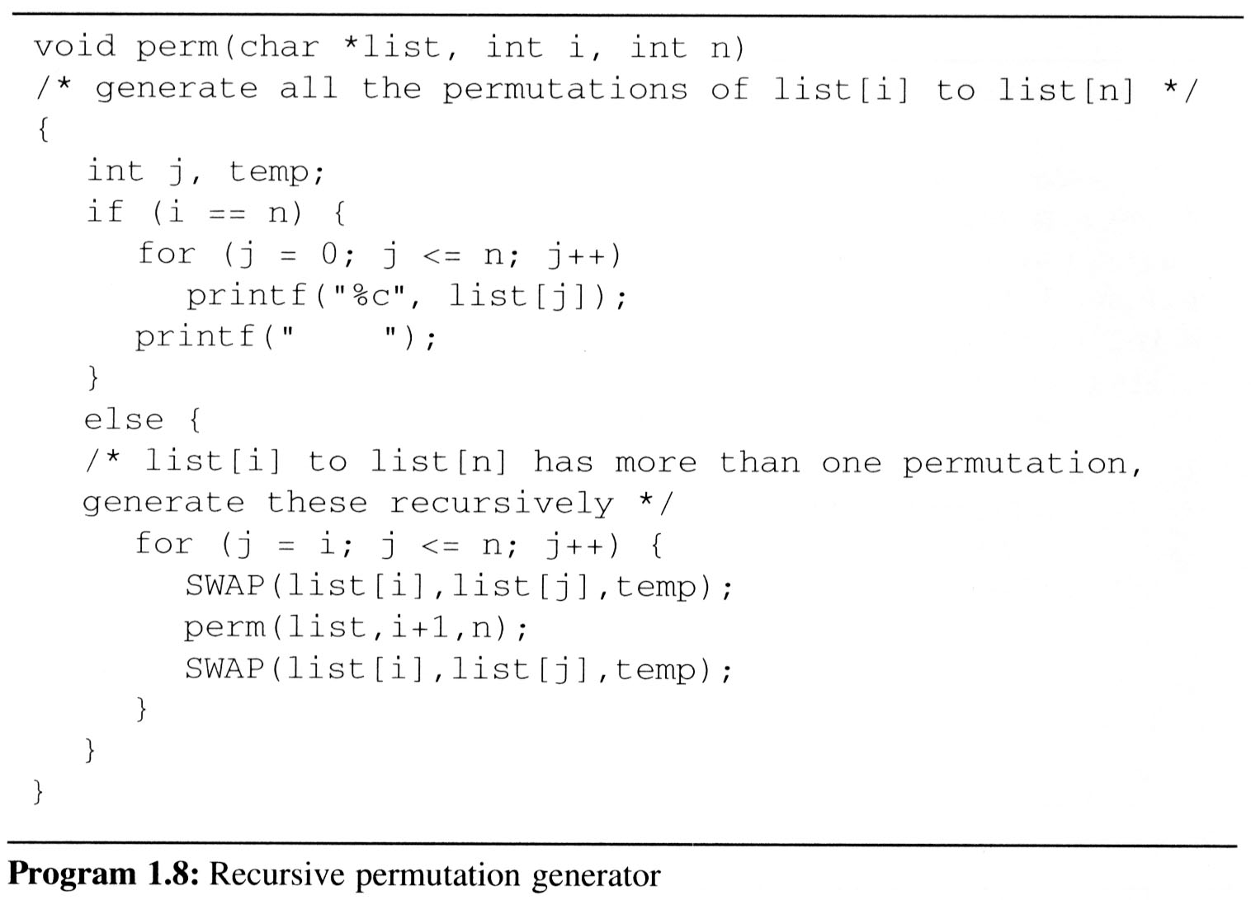
1.2 (10/10)
lv0 perm: i=0, n=2 abc
lv0 SWAP: i=0, j=0 abc
lv1 perm: i=1, n=2 abc
lv1 SWAP: i=1, j=1 abc
lv2 perm: i=2, n=2 abc
print: abc
lv1 SWAP: i=1, j=1 abc
lv1 SWAP: i=1, j=2 abc
lv2 perm: i=2, n=2 acb
print: acb
lv1 SWAP: i=1, j=2 acb
lv0 SWAP: i=0, j=0 abc
lv0 SWAP: i=0, j=1 abc
lv1 perm: i=1, n=2 bac
lv1 SWAP: i=1, j=1 bac
lv2 perm: i=2, n=2 bac
print: bac
lv1 SWAP: i=1, j=1 bac
lv1 SWAP: i=1, j=2 bac
lv2 perm: i=2, n=2 bca
print: bca
lv1 SWAP: i=1, j=2 bca
lv0 SWAP: i=0, j=1 bac
lv0 SWAP: i=0, j=2 abc
lv1 perm: i=1, n=2 cba
lv1 SWAP: i=1, j=1 cba
lv2 perm: i=2, n=2 cba
print: cba
lv1 SWAP: i=1, j=1 cba
lv1 SWAP: i=1, j=2 cba
lv2 perm: i=2, n=2 cab
print: cab
lv1 SWAP: i=1, j=2 cab
lv0 SWAP: i=0, j=2 cba
Example 1.4 [Permutations]:

Slide 20
1.3 Data abstraction (1/4)
Data Type
A data type is a collection of objects and a set of operations that act on those objects.
  For example, the data type int consists of the objects {0, +1, -1, +2, -2, …, INT_MAX, INT_MIN} and the operations +, -, *, /, and %.
The data types of C
  The basic data types: char, int, float and double
  The group data types: array and struct
  The pointer data type
  The user-defined types

Slide 21
1.3 Data abstraction (2/4)
Abstract Data Type
  An abstract data type(ADT) is a data type
  that is organized in such a way that
  the specification of the objects and
  the operations on the objects is separated from
  the representation of the objects and
  the implementation of the operations.
  We know what is does, but not necessarily how it will do it.

Slide 22
1.3 Data abstraction (3/4)
Specification vs. Implementation
  An ADT is implementation independent
  Operation specification
    function name
    the types of arguments
    the type of the results
  The functions of a data type can be classify into several categories:
    creator / constructor
    transformers
    observers / reporters

Slide 23
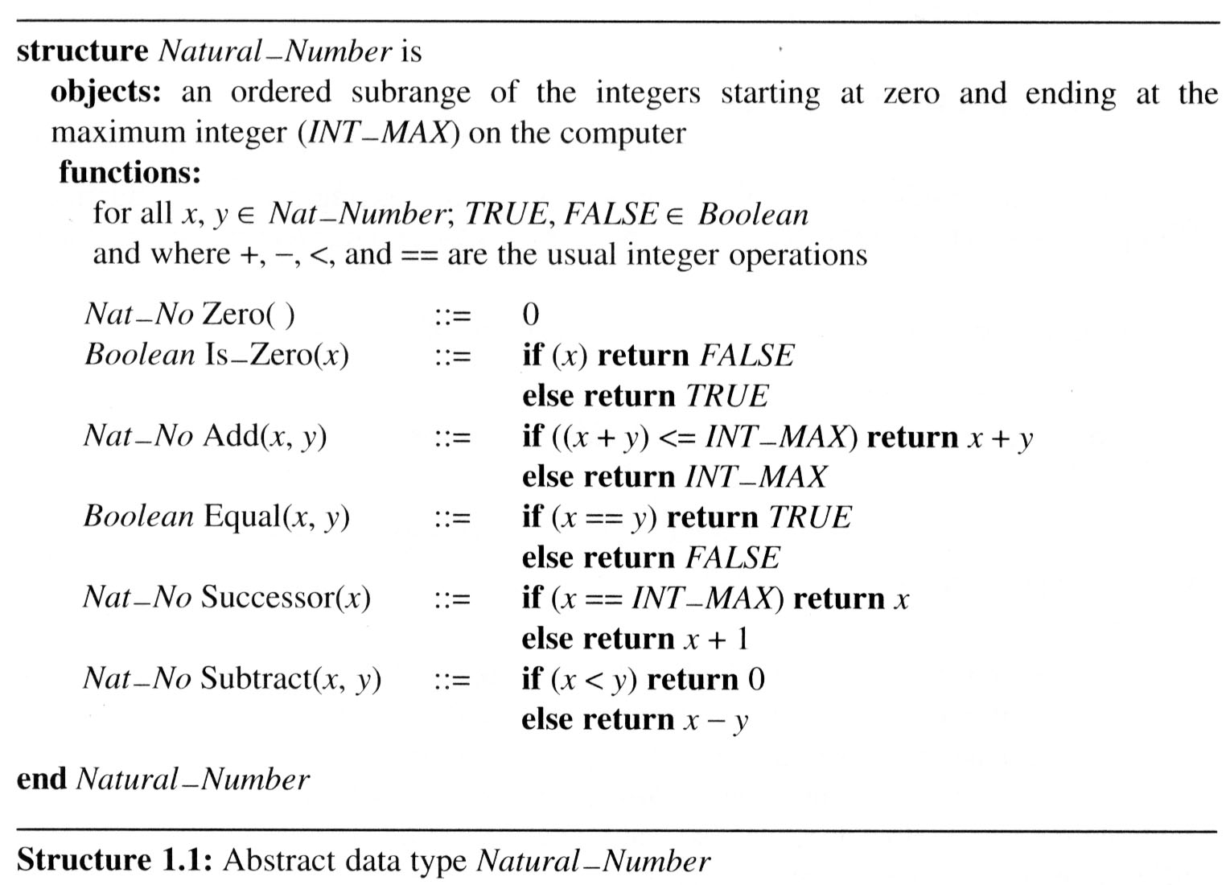
1.3 Data abstraction (4/4)
Example 1.5 [Abstract data type Natural_Number]
::= is defined as

Slide 24
1.4 Performance analysis (1/17)
Criteria
  Is it correct?
  Is it readable?
  …
Performance Analysis (machine independent)
  space complexity: storage requirement
  time complexity: computing time
Performance Measurement (machine dependent)

Slide 25
1.4 Performance analysis (2/17)
1.4.1 Space Complexity:
S(P)=C+S_{P}(I)
  Fixed Space Requirements (C)
  Independent of the characteristics
  of the inputs and outputs
    instruction space
    space for simple variables, fixed-size structured variable, constants
  Variable Space Requirements (S_{P}(I))
  depend on the instance characteristic I
    number, size, values of inputs and outputs associated with I
    recursive stack space, formal parameters, local variables, return address

Slide 26
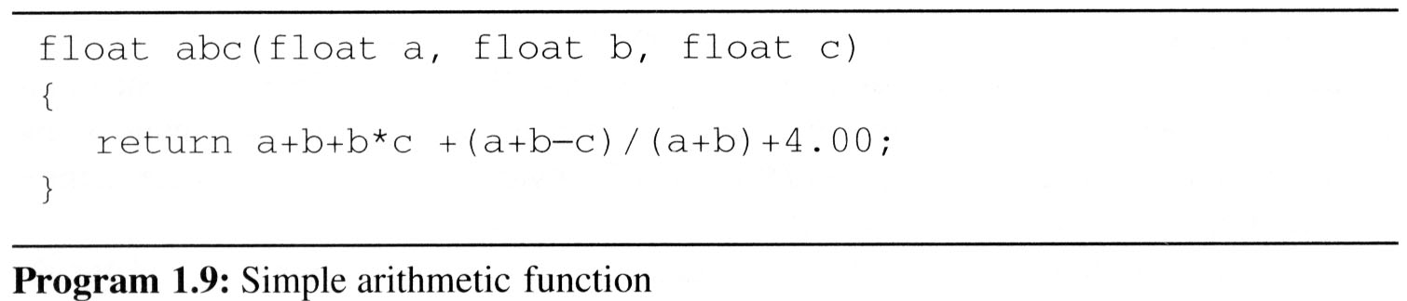
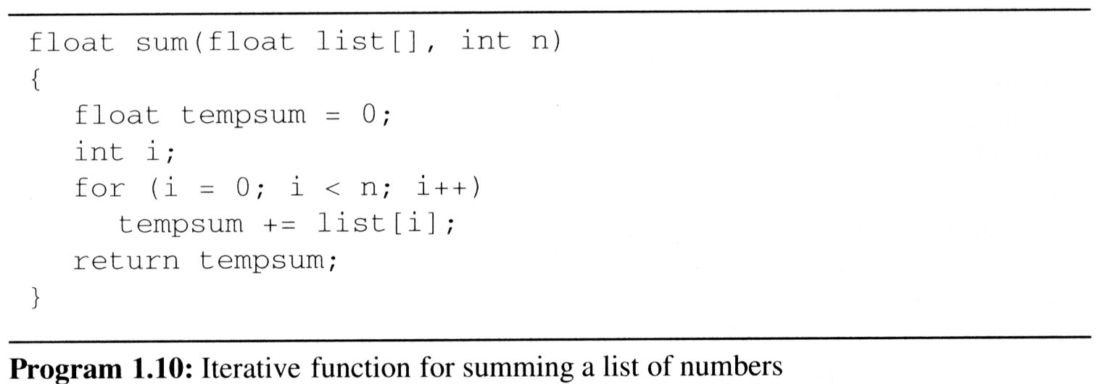
1.4 Performance analysis (3/17)
Examples:
  Example 1.6: In program 1.9, S_{abc}(I)=0.
    Example 1.7: In program 1.10, S_{sum}(I)=S_{sum}(n)=0.
Recall: pass the address of the
first element of the array &
pass by value

Slide 27
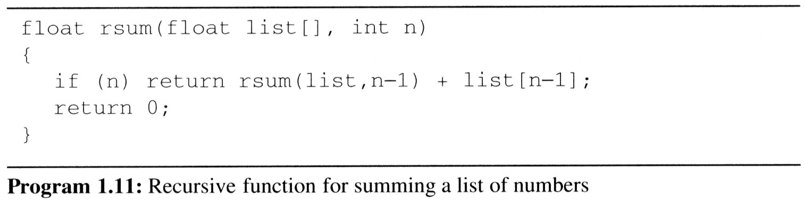
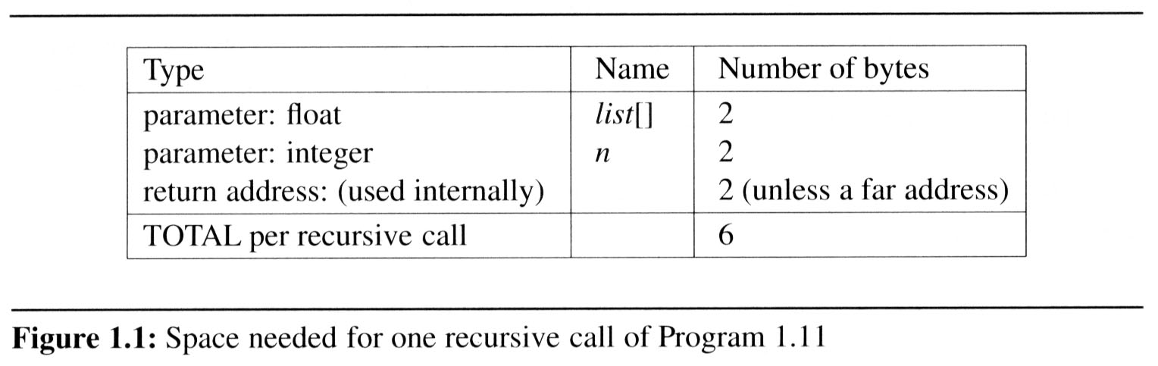
1.4 Performance analysis (4/17)
  Example 1.8: Program 1.11 is a recursive function for addition. Figure 1.1 shows the number of bytes required for one recursive call.
S_{sum}(I)=S_{sum}(n)=6n

Slide 28
1.4 Performance analysis (5/17)
1.4.2 Time Complexity:
T(P)=C+T_{P}(I)
  The time, T(P), taken by a program, P, is the sum of its compile time C and its run (or execution) time, T_{P}(I)
  Fixed time requirements
    Compile time (C), independent of instance characteristics
  Variable time requirements
    Run (execution) time T_{P}
    T_{P}(n)=c_{a}ADD(n)+c_{s}SUB(n)+c_{l}LDA(n)+c_{st}STA(n)

Slide 29
1.4 Performance analysis (6/17)
A program step is a syntactically or semantically meaningful program segment whose execution time is independent of the instance characteristics.
  Example
  (Regard as the same unit machine independent)
    abc = a + b + b * c + (a + b - c) / (a + b) + 4.0
    abc = a + b + c
Methods to compute the step count
  Introduce variable count into programs
  Tabular method
    Determine the total number of steps contributed by each statement step per execution × frequency
    add up the contribution of all statements

Slide 30
1.4 Performance analysis (7/17)
Iterative summing of a list of numbers
*Program 1.12: Program 1.10 with count statements (p.23)
float sum(float list[ ], int n)
{
float tempsum = 0; count++; /* for assignment */
int i;
for (i = 0; i < n; i++) {
count++; /*for the for loop */
tempsum += list[i]; count++; /* for assignment */
}
count++; /* last execution of for */
count++; /* for return */
return tempsum;
}
2n + 3 steps

Slide 31
1.4 Performance analysis (8/17)
Tabular Method
*Figure 1.2: Step count table for Program 1.10 (p.26)
Iterative function to sum a list of numbers
steps/execution

Slide 32
1.4 Performance analysis (9/17)
Recursive summing of a list of numbers
*Program 1.14: Program 1.11 with count statements added (p.24)
float rsum(float list[ ], int n)
{
count++; /*for if conditional */
if (n) {
count++; /* for return and rsum invocation*/
return rsum(list, n-1) + list[n-1];
}
count++;
return list[0];
}
2n+2 steps

Slide 33
1.4 Performance analysis (10/17)
*Figure 1.3: Step count table for recursive summing function (p.27)

Slide 34
1.4 Performance analysis (11/17)
1.4.3 Asymptotic notation (O, Ω, Θ)
  Complexity of c₁n²+c₂n and c₃n
    for sufficiently large of value, c₃n is faster than c₁n²+c₂n
    for small values of n, either could be faster
      c₁=1, c₂=2, c₃=100 --> c₁n²+c₂n ≤ c₃n for n ≤ 98
      c₁=1, c₂=2, c₃=1000 --> c₁n²+c₂n ≤ c₃n for n ≤ 998
    break even point
      no matter what the values of c1, c2, and c3, the n beyond which c₃n is always faster than c₁n²+c₂n

Slide 35
1.4 Performance analysis (12/17)
Definition: [Big “oh’’]
  f(n) = O(g(n)) iff there exist positive constants c and n₀ such that f(n) ≤ cg(n) for all n, n ≥ n₀.
Definition: [Omega]
  f(n) = Ω(g(n)) (read as “f of n is omega of g of n”) iff there exist positive constants c and n₀ such that f(n) ≥ cg(n) for all n, n ≥ n₀.
Definition: [Theta]
  f(n) = Θ(g(n)) (read as “f of n is theta of g of n”) iff there exist positive constants c₁, c₂, and n₀ such that c₁g(n) ≤ f(n) ≤ c₂g(n) for all n, n ≥ n₀.

Slide 36
1.4 Performance analysis (13/17)
Theorem 1.2:
  If f(n) = a_{m}n^{m}+…+a₁n+a₀, then f(n) = O(n^{m}).
Theorem 1.3:
  If f(n) = a_{m}n^{m}+…+a₁n+a₀ and a_{m} > 0, then f(n) = Ω(n^{m}).
Theorem 1.4:
  If f(n) = a_{m}n^{m}+…+a₁n+a₀ and a_{m} > 0, then f(n) = Θ(n^{m}).

Slide 37
1.4 Performance analysis (14/17)
Examples
  f(n) = 3n+2
    3n + 2 <= 4n, for all n >= 2, ∴3n + 2 = Ο (n)
    3n + 2 >= 3n, for all n >= 1, ∴3n + 2 = Ω (n)
    3n <= 3n + 2 <= 4n, for all n >= 2, ∴ 3n + 2 = Θ (n)
  f(n) = 10n²+4n+2
    10n²+4n+2 <= 11n², for all n >= 5, ∴ 10n²+4n+2 = Ο (n²)
    10n²+4n+2 >= n², for all n >= 1, ∴ 10n²+4n+2 = Ω (n²)
    n² <= 10n²+4n+2 <= 11n², for all n >= 5, ∴ 10n²+4n+2 = Θ (n²)
  100n+6=O(n) /* 100n+6≤101n for n≥10 */
  10n²+4n+2=O(n²) /* 10n²+4n+2≤11n² for n≥5 */
  6*2^{n}+n²=O(2^{n}) /* 6*2^{n}+n² ≤7*2^{n} for n≥4 */

Slide 38
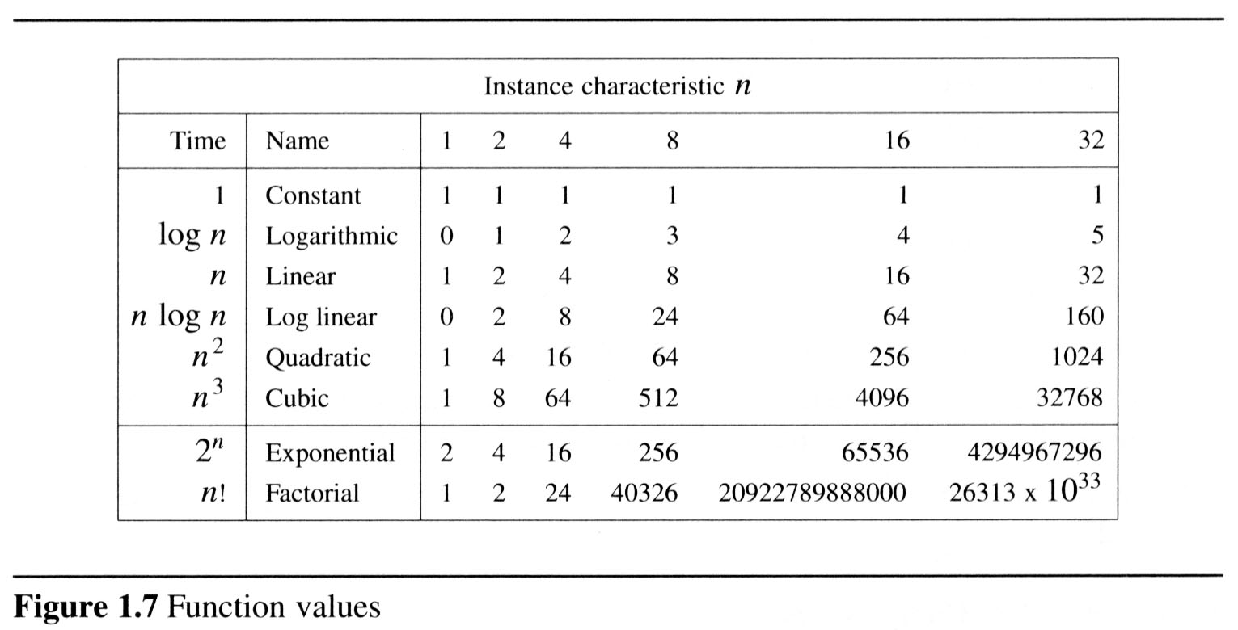
1.4 Performance analysis (15/17)
1.4.4 Practical complexity
  To get a feel for how the various functions grow with n, you are advised to study Figures 1.7 and 1.8 very closely.

Slide 39
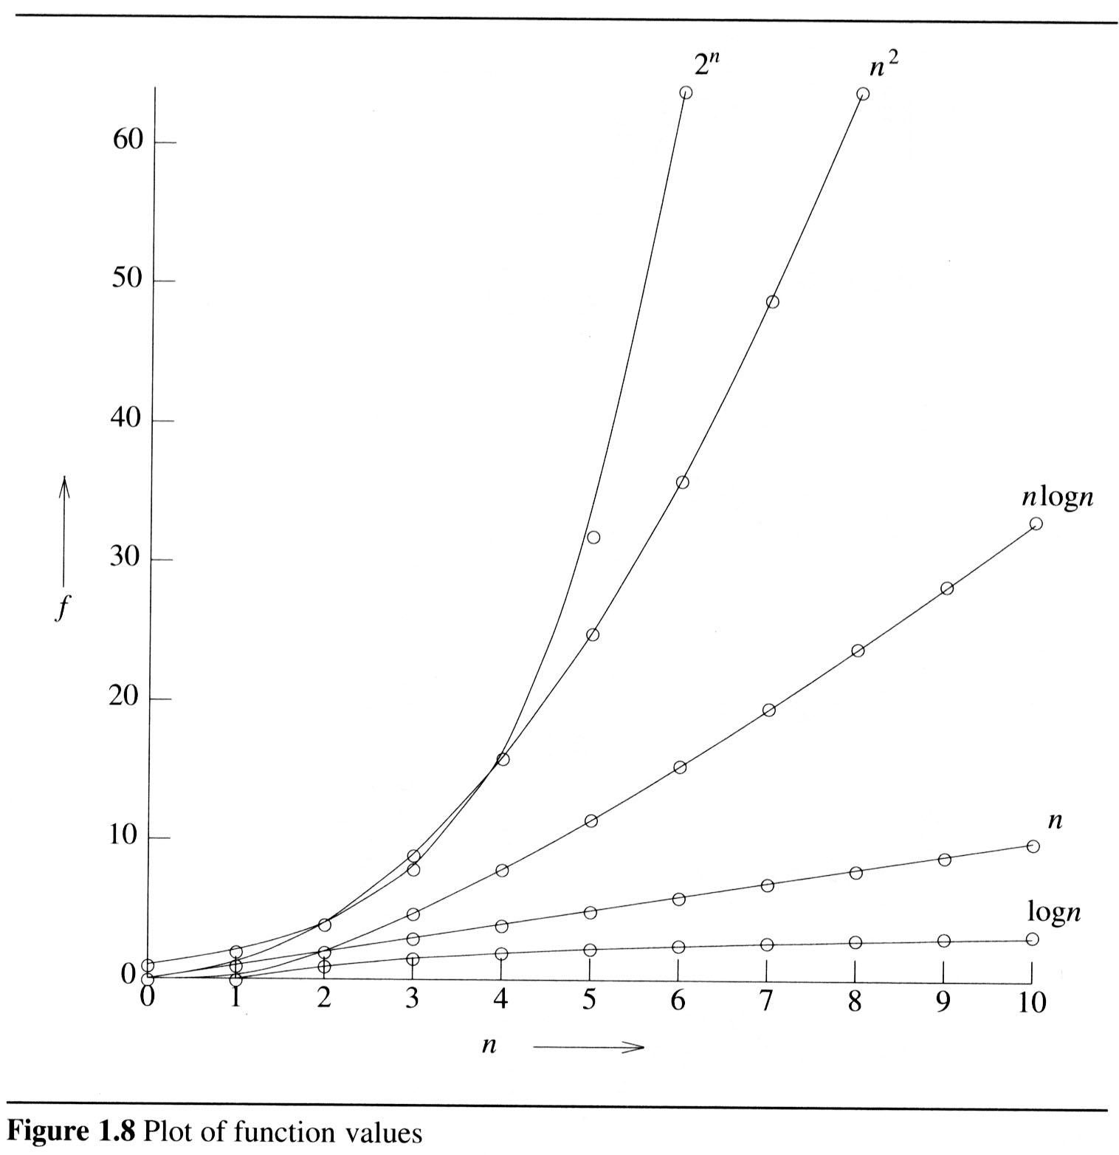
1.4 Performance analysis (16/17)

Slide 40
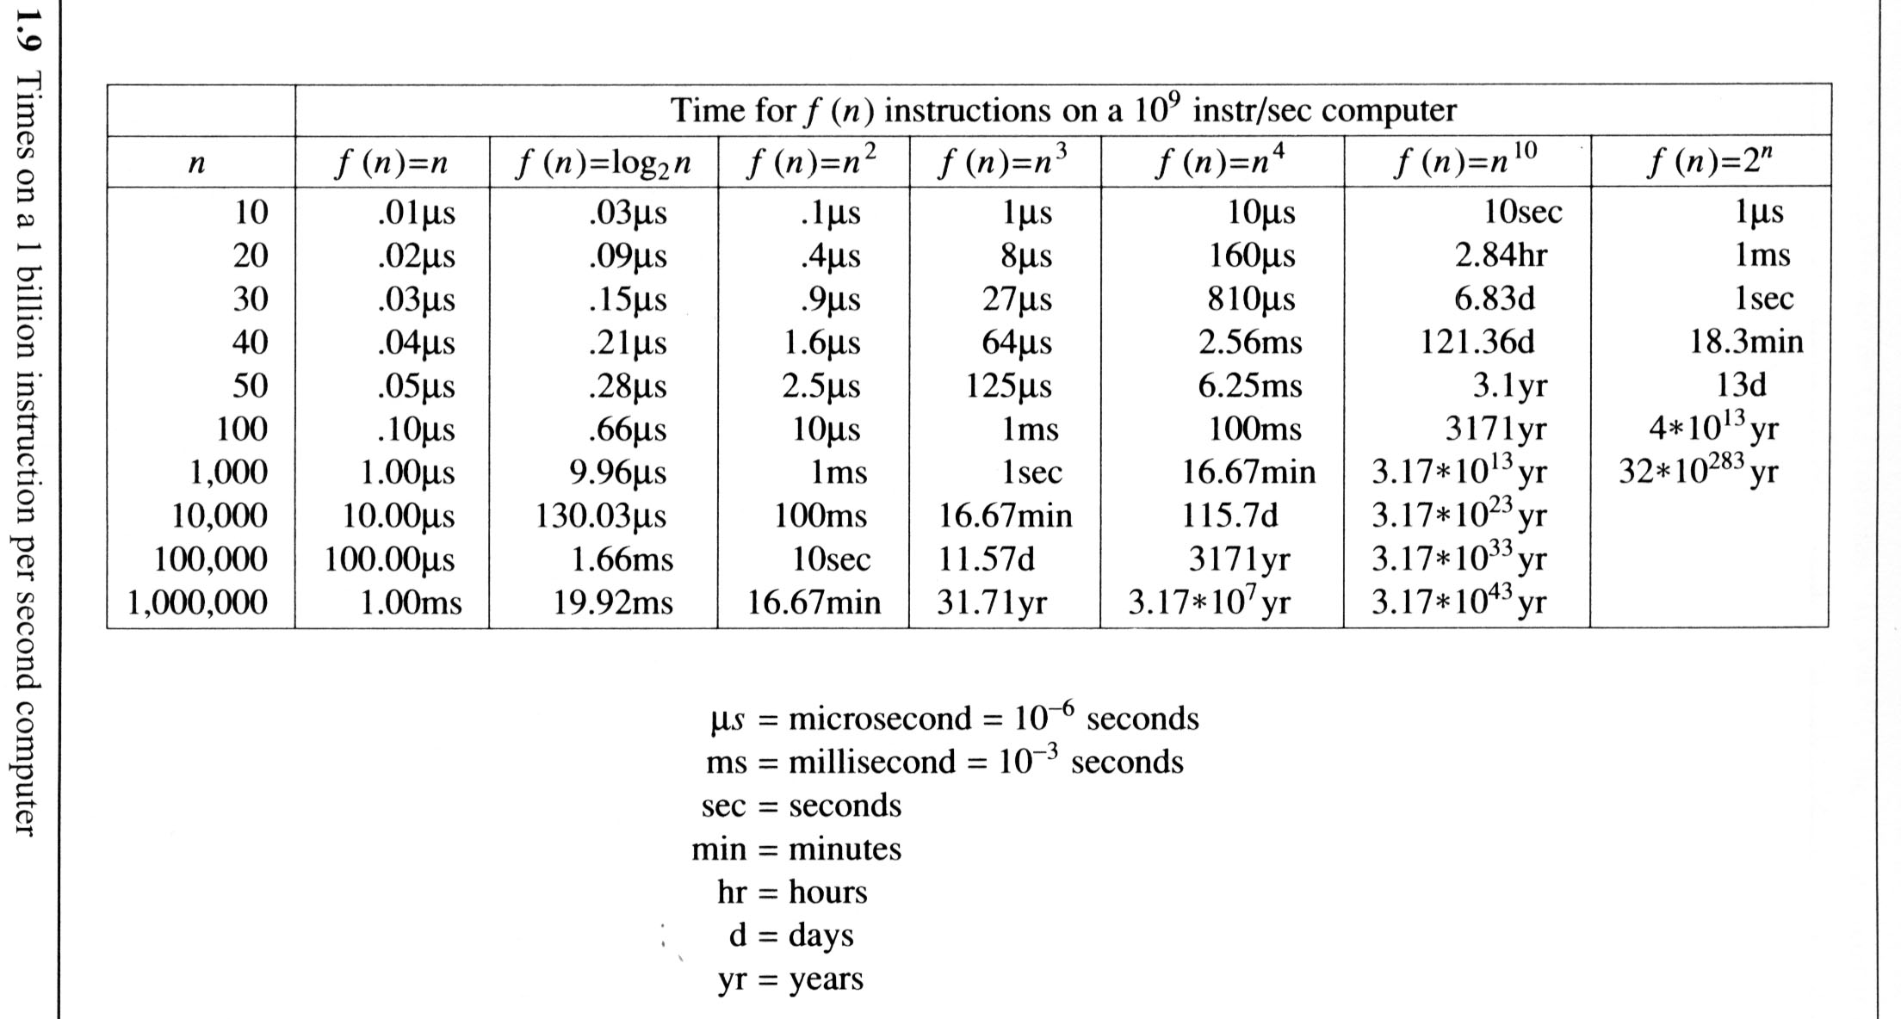
1.4 Performance analysis (17/17)
Figure 1.9 gives the time needed by a 1 billion instructions per second computer to execute a program of complexity f(n) instructions.

Slide 41
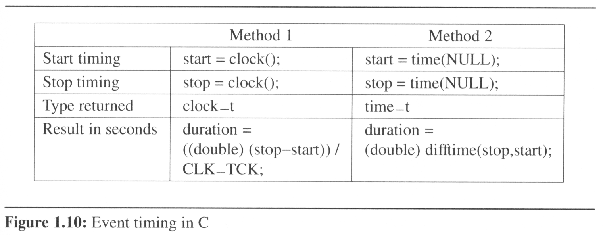
1.5 Performance measurement (1/3)
Although performance analysis gives us a powerful tool for assessing an algorithm’s space and time complexity, at some point we also must consider how the algorithm executes on our machine.
  This consideration moves us from the realm of analysis to that of measurement.

Slide 42
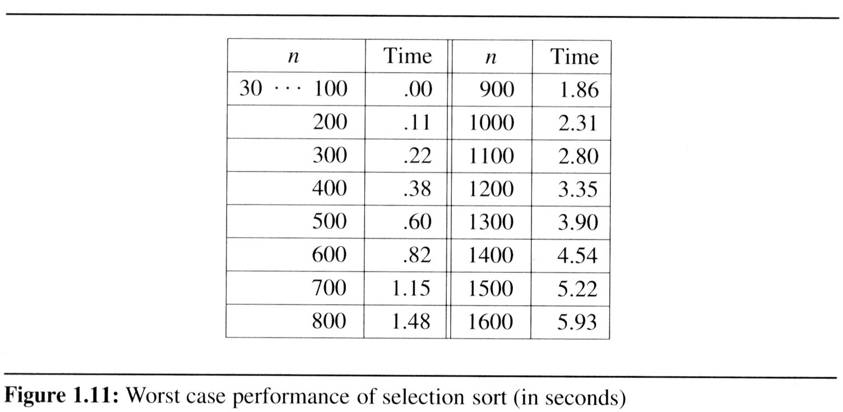
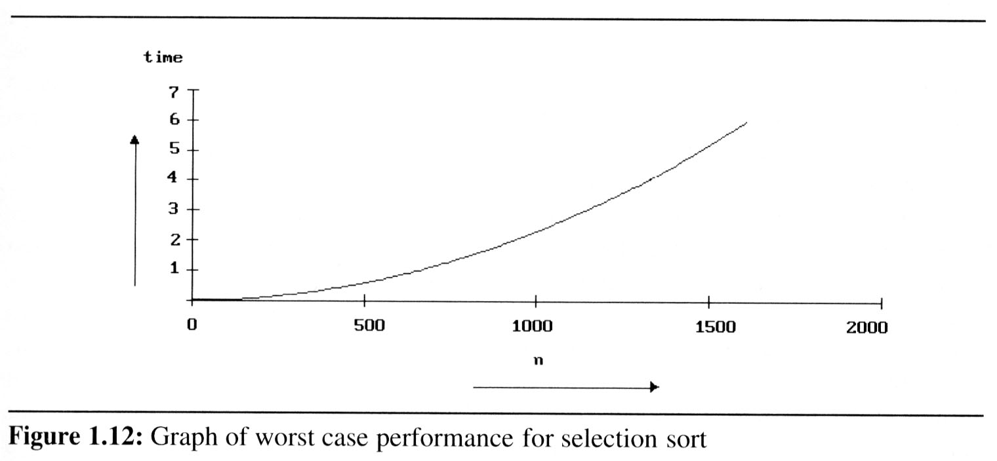
1.5 Performance measurement (2/3)
Example 1.22
[Worst case performance of the selection function]:
  The tests were conducted on an IBM compatible PC with an 80386 cpu, an 80387 numeric coprocessor, and a turbo accelerator. We use Broland’s Turbo C compiler.

Slide 43
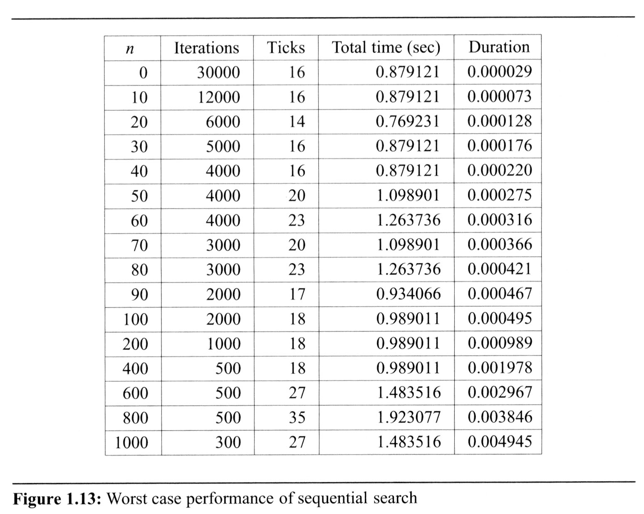
1.5 Performance measurement (3/3)

