Slide 1
TCSS 342, Winter 2006
Lecture Notes
Hashing

Slide 2
Objectives
Discuss the concept of hashing
Learn the characteristics of good hash codes
Learn the ways of dealing with hash table collisions:
  linear probing
  quadratic probing
  double hashing
  chaining
Discuss the java implementation of hashing

Slide 3
Hash tables
hash table: an array of some fixed size, that positions elements according to an algorithm called a hash function
0
 | …
hash func.
h(element)
length –1
elements (e.g., strings)
hash table

Slide 4
Hashing and hash functions
The idea: somehow we map every element into some index in the array ("hash" it);
this is its one and only place that it should go
  Lookup becomes constant-time : simply look at that one slot again later to see if the element is there
  add, remove, contains all become O(1) !
For now, let's look at integers (int)
  a "hash function" h for int is trivial:
  store int i at index i (a direct mapping)
    if i >= array.length, store i at index
    (i % array.length)
  h(i) = i % array.length

Slide 5
Hash function example
elements = Integers
h(i) = i % 10
add 41, 34, 7, and 18
constant-time lookup:
  just look at i % 10 again later
Hash tables have no ordering information!
  Expensive to do following:
    getMin, getMax, removeMin, removeMax,
    the various ordered traversals
    printing items in sorted order
0
1 | 41
2
3
4 | 34
5
6
7 | 7
8 | 18
9

Slide 6
Hash collisions
collision: the event that two hash table elements map into the same slot in the array
example: add 41, 34, 7, 18, then 21
  21 hashes into the same slot as 41!
  21 should not replace 41 in the hash table;
  they should both be there
collision resolution: a strategy for fixing collisions in a hash table
0
1 | 21
2
3
4 | 34
5
6
7 | 7
8 | 18
9

Slide 7
Linear probing
linear probing: resolving collisions in slot i by putting the colliding element into the next available slot (i+1, i+2, ...)
  add 41, 34, 7, 18, then 21, then 57
    21 collides (41 is already there), so we search ahead until we find empty slot 2
    57 collides (7 is already there), so we search ahead twice until we find empty slot 9
  lookup algorithm becomes slightly modified; we have to loop now until we find the element or an empty slot
    what happens when the table gets mostly full?
0
1 | 41
2 | 21
3
4 | 34
5
6
7 | 7
8 | 18
9 | 57

Slide 8
Clustering problem
clustering: nodes being placed close together by probing, which degrades hash table's performance
  add 89, 18, 49, 58, 9
  now searching for the value 28 will have to check half the hash table! no longer constant time...
0 | 49
1 | 58
2 | 9
3
4
5
6
7
8 | 18
9 | 89

Slide 9
Quadratic probing
quadratic probing: resolving collisions on slot i by putting the colliding element into slot i+1, i+4, i+9, i+16, ...
  add 89, 18, 49, 58, 9
    49 collides (89 is already there), so we search ahead by +1 to empty slot 0
    58 collides (18 is already there), so we search ahead by +1 to occupied slot 9, then +4 to empty slot 2
    9 collides (89 is already there), so we search ahead by +1 to occupied slot 0, then +4 to empty slot 3
  clustering is reduced
  what is the lookup algorithm?
0 | 49
1
2 | 58
3 | 9
4
5
6
7
8 | 18
9 | 89

Slide 10
Double Hashing
double hashing:
  Pick a secondary hash function hash2().
  when hashing item x, resolving collisions on slot i by putting the colliding element into slot i+hash2(x), i+2*hash2(x), i+3*hash2(x), i+4*hash2(x), ...
  Suppose hash2(x) = (x / 10) % 10.
  add 89, 18, 49, 58: What happens?
    49 collides (89 is already there); hash2(x) = 4, so check location i + 4 next; put 49 in slot 3.
    58 collides (18 is already there); hash2(x) = 5, so check location i + 5 next; still occupied, check location i+2*5; still occupied!
    will remain still occupied forever!
    Fix this particular problem by using a prime # for your table size. Then will visit all array entries eventually during probing.
  what is the lookup algorithm?
0
1
2
3 | 49
4
5
6
7
8 | 18
9 | 89

Slide 11
Open Addressing
Open Addressing is
  a collision resolution strategy
  on a collision, look for another empty spot in the array
  previous discussed examples are all examples of open addressing
    linear probing
    quadratic probing
    double hashing
  Look-up for open addressing scheme must continue looking for item until it finds it or an empty slot.

Slide 12
Chaining
chaining: All keys that map to the same hash value are kept in a linked list
0
1
2
3
4
5
6
7
8
9
10
22
12
42
107

Slide 13
Writing a hash function
If we write a hash table that can store objects, we need a hash function for the objects, so that we know what index to store them
We want a hash function to:
be simple/fast to compute
map equal elements to the same index
map different elements to different indexes
have keys distributed evenly among indexes

Slide 14
Hash function for strings
elements = Strings
let's view a string by its letters:
  String s : s₀, s₁, s₂, …, s_{n-1}
how do we map a string into an integer index? ("hash" it)
one possible hash function:
  treat first character as an int, and hash on that
    h(s) = s₀ % array.length
    is this a good hash function? When will strings collide?

Slide 15
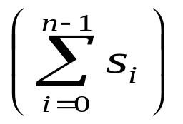
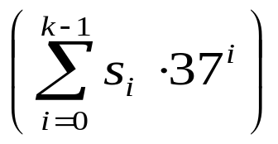
Better string hash functions
view a string by its letters:
  String s : s₀, s₁, s₂, …, s_{n-1}
another possible hash function:
  treat each character as an int, sum them, and hash on that
    h(s) = % array.length
    what's wrong with this hash function? When will strings collide?
a third option:
  perform a weighted sum of the letters, and hash on that
  h(s) = % array.length

Slide 16
Analysis of hash tables
main operation: lookup of item in table
What is worst-case cost of finding an item?
  assuming hash table e hash table has n items in it
Is the worst-case cost different for chaining, and the various open addressing schemes?
Worst-case analysis doesn’t make sense for hash tables, look at average case cost
Cost highly depend on the load factor (discussed next)

Slide 17

Analysis of hash table search
load: the load λ of a hash table is the ratio:
← no. of elements
← array size
Average case analysis of search
  Assume hashCode distributes entries uniformly at random into various indices.
  Using chaining implementation
    What is the average list size?
    What does this imply about search times?

Slide 18
Analysis of hash table search
Average case analysis of search, with chaining:
  Count number of link traversals necessary.
  unsuccessful: λ
  (the average length of a list at hash(i))
  successful: 1 + (λ/2)
  (one node, plus half the avg. length of a list)
Analysis of open addressing schemes:
  Are more lookups or less lookups required for open addressing, on average?

Slide 19
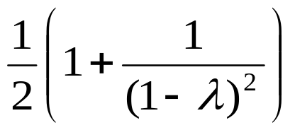
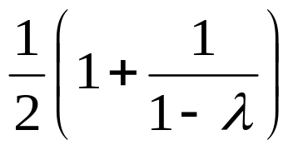
Analysis of hash table search
Average case analysis of search, with linear probing:
  Number of lookups worse than chaining
  Complicated to analyze; done by Knuth [1962]
  unsuccessful: ≈
  successful: ≈

Slide 20
Rehashing and hash table size
rehash: increasing the size of a hash table's array, and re-storing all of the items into the array using the hash function
  can we just copy the old contents to the larger array?
  When should we rehash? Some options:
    when load reaches a certain level (e.g., λ = 0.5)
    when an insertion fails
What is the cost (Big-Oh) of rehashing?
what is a good hash table array size?
  how much bigger should a hash table get when it grows?

Slide 21
Hash versus tree
Which is better, a hash set or a tree set?
Hash | Tree
Notes:
hash: (probably) faster add, contains, remove
tree: log(n) not that bad; sorted order; can implement finding of ranges, find min, find max, etc

Slide 22
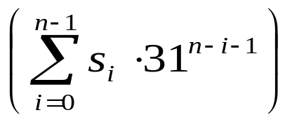
How does Java's HashSet work?
HashSet<T> stores generic type T;
All Objects; have a pre-defined hash code
  public int hashCode() in class Object
  Works by returning memory address that the object instance is stored in.
Since all types inherit from Object, T has a default hashCode method.
Many standard Java classes override the default Object hashCode().
Default hashCode for String:
  for a string s=s₀s₁s₂.. s_{n-1} of length n
  hashCode(s)=

Slide 23
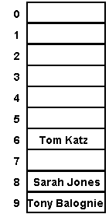
How does Java's HashSet work?
HashSet stores its elements in an array by their hashCode() value
  any element in the set must be placed in one exact index of the array
  Java uses chaining to handle collisions
  searching for this element later,
  check the proper index for the list of values stored there, and see if item is in the list.
    "Tom Katz".hashCode() % 10 == 6
    "Sarah Jones".hashCode() % 10 == 8
    "Tony Balognie".hashCode() % 10 == 9
  Java has a load factor that you can set; when the array is too full, it resizes (rehashing everything)
  Under ideal conditions, lookup is O(1) on average.

Slide 24
Membership testing in HashSets
When searching a HashSet for a given object (contains):
  the set computes the hashCode for the given object
  it looks in that index of the HashSet's internal array
    Java iterates through each item in the list there
    Java uses equals to see if the given item is present in list; if so return true
Hence, an object will be considered to be in the set only if both:
  It has the same hashCode as an element in the set, and
  The equals comparison returns true

Slide 25
Implementing Map with a hash table
HashMap
make a hash table of entries, where each key's hash code determines the position
the entry also contains the associated value
search for the key using the standard hash table lookup algorithm, then retrieve the associated value
HashMapEntry
HashMap
"Martin"
"692-4540"
0
HashMapEntry
2
"Paul"
"297-6312"
HashMapEntry
5
"Jenny"
"867-5309"

Slide 26
Map implementations in Java
Map is an interface; you can't say new Map()
There are two implementations:
  TreeMap: a (balanced) BST storing entries
  HashMap: a hash table storing entries

Slide 27
HashMap example
HashMap grades
Map grades = new HashMap();
grades.put("Martin", "A");
grades.put("Nelson", "F");
grades.put("Milhouse", "B");
// What grade did they get?
System.out.println(
grades.get("Nelson"));
System.out.println(
grades.get("Martin"));
grades.put("Nelson", "W");
grades.remove("Martin");
System.out.println(
grades.get("Nelson"));
System.out.println(
grades.get("Martin"));
HashMapEntry
HashMap
"Martin"
"A"
0
HashMapEntry
2
"Nelson"
"F"
HashMapEntry
5
"Milhouse"
"B"

Slide 28
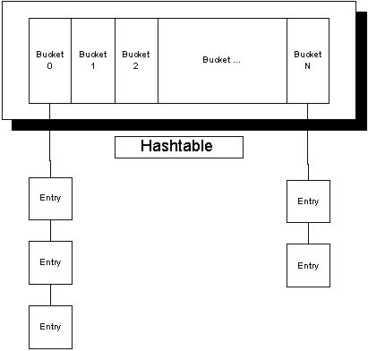
Compound collections
Collections can be nested to represent more complex data
example: A person can have one or many phone numbers
  want to be able to quickly find all of a person's phone numbers, given their name
implement this example as a HashMap of Lists
  keys are Strings (names)
  values are Lists (e.g ArrayList) of Strings, where each String is one phone number

Slide 29
Compound collection code 1
// map names to list of phone numbers
Map m = new HashMap();
m.put("Marty", new ArrayList());
...
ArrayList list = m.get("Marty");
list.add("253-692-4540");
...
list = m.get("Marty");
list.add("206-949-0504");
System.out.println(list);
[253-692-4540, 206-949-0504]

Slide 30
Compound collection code 2
// map names to set of friends
Map m = new HashMap();
m.put("Marty", new HashSet());
...
Set set = m.get("Marty");
set.add("James");
...
set = m.get("Marty");
set.add("Mike");
System.out.println(set);
if (set.contains("James"))
System.out.println("James is my friend");
{Mike, James}
James is my friend

Slide 31
Objects and Hashing: hashCode
HashMap uses hashCode method on objects to store them efficiently (O(1) lookup time)
  hashCode method is used by HashMap to partition objects into buckets and only search the relevant bucket to see if a given object is in the hash table
If objects of your class could be used as a hash key, you should override hashCode
  hashCode is already implemented by most common types: String, Double, Integer, List

Slide 32
Overriding hashCode
General contract: if equals is overridden, hashCode should be overridden also
Conditions for overriding hashCode:
  should return same value for an object whose state hasn’t changed since last call
  if x.equals(y), then x.hashCode() == y.hashCode()
  (if !x.equals(y), it is not necessary that
  x.hashCode() != y.hashCode() … why?)
Advantages of overriding hashCode
  your objects will store themselves correctly in a hash table
  distributing the hash codes will keep the hash balanced: no one bucket will contain too much data compared to others

Slide 33
Overriding hashCode, cont’d.
Things to do in a good hashCode implementation
  make sure the hash code is same for equal objects
  try to ensure that the hash code will be different for different objects
  ensure that the hash code value depends on every piece of state that is important to the object
  preferrably, weight the pieces so that different objects won’t happen to add up to the same hash code
public class Employee {
public int hashCode() {
return 7 * myName.hashCode()
+ 11 * new Double(mySalary).hashCode()
+ 13 * myEmployeeID;
}

Slide 34
Ensuring efficient hashtables
To get O(1) average case performance for lookups and adds, need
  good hashCode
    distributes objects evenly among all buckets
  a load factor that is not to high
    choose table size well appropriate to number of elements you expect to store
  keep rehashing to a minimum
    choose a the largest initial capacity size you can reasonably afford.

Slide 35
References
Lewis & Chase book, chapter 17.
Java API (available online)

