Slide 1

NarrativeNexus: The Dynamic Text Analysis Platform
Advanced NLP for Automated Insights and Summarization
Presented By AJAY VAIRAM T

Slide 2
Table of Contents
Overview of the Project and its Objectives
Dataset Overview and Key Insights
Methodology
Data Collection & Input Handling
Data Preprocessing
Topic Modeling
Sentiment Analysis
Summarization
Visualization & Reporting
Architecture Diagram
Expected Deliverables
Results & Insights
User Interface
Challenges
Future Scope
Conclusion

Slide 3
Project Overview
OBJECTIVE: To build a dynamic text analysis platform that processes raw text, extracts meaningful topics, detects sentiment, and summarizes data into concise insights.
GOAL: To automate text understanding and help users gain valuable insights efficiently.
OUTCOMES: • Extracts hidden themes from large text data • Classifies sentiments (positive/negative) • Generates automated summaries for quick review

Slide 4
Dataset Overview
DATASET USED: IMDb_10K Dataset
STRUCTURE: • 10,000 Rows • 2 Columns — Review and Sentiment
DESCRIPTION: Movie reviews labeled as positive or negative. Balanced data suitable for text and sentiment modeling.
REASON FOR CHOICE: • Contains diverse real-world movie reviews with clear emotional tone.
• Balanced dataset with equal positive and negative sentiments for unbiased analysis.
• Ideal for training and evaluating NLP models like topic modeling and sentiment analysis.

Slide 5
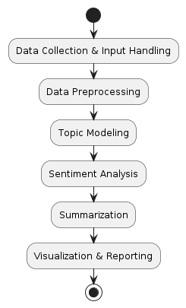
Methodology
Data Collection & Input Handling
• Upload IMDb_10K dataset (.csv, .txt, .docx).
• Validate and handle missing or invalid entries.
Data Preprocessing
• Clean text by removing punctuation, symbols, and stop words.
• Normalize data through tokenization and lemmatization.
Topic Modeling
• Apply LDA and NMF algorithms to extract hidden themes.
• Identify keywords representing major discussion topics.
Sentiment Analysis
• Classify text as positive or negative using NLP models.
• Determine emotional polarity from the review text.
Summarization
• Implement extractive and abstractive summarization.
• Generate concise summaries of lengthy IMDb reviews.
Visualization & Reporting
• Visualize results using word clouds, bar charts, and sentiment graphs.
• Generate analytical reports for end users.

Slide 6
Data Collection & Input Handling
DATA SOURCE: • IMDb_10K dataset consisting of 10,000 reviews labeled with sentiments.
INPUT HANDLING: • Accepts text data in multiple formats — .csv, .txt, and .docx. • User-friendly interface developed for uploading and managing files.
VALIDATION: • Ensures uploaded data follows required structure. • Detects and handles missing or corrupted entries automatically.

Slide 7
Data Preprocessing
TEXT CLEANING: • Removed punctuation, special characters, and numerical values. • Eliminated stop words such as is, the, and, of, etc. • Converted all text to lowercase for uniformity.
NORMALIZATION: • Applied tokenization to split text into words or tokens. • Used lemmatization to reduce words to their base form.
DATA QUALITY IMPROVEMENT: • Ensured consistent structure and removed redundant spaces or symbols.

Slide 8
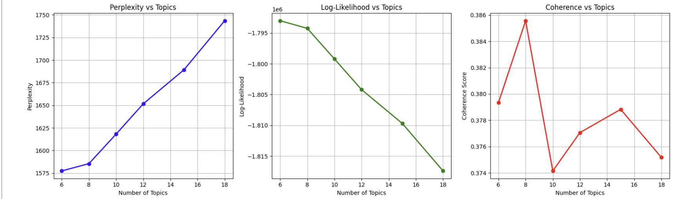
Topic Modeling
ALGORITHM USED: • Latent Dirichlet Allocation (LDA) for topic extraction.
PROCESS: • Trained LDA on IMDb_10K_CLEAN dataset using CountVectorizer. • Evaluated models with different topic counts using Perplexity and Coherence Score. • Selected optimal model with 8 topics (Best Coherence: 0.3856).
RESULTS: • Topics discovered: Storyline, Acting, Comedy, War, Life, Character, Horror, Crime. • Each topic represented distinct clusters of words and sentiments.

Slide 9
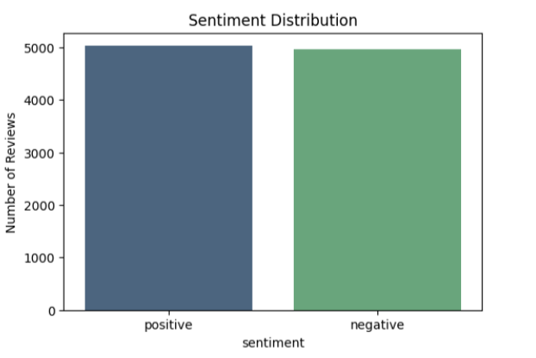
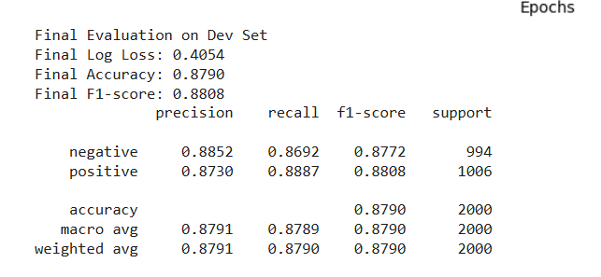
Sentiment Analysis
MODEL USED: • TF-IDF Vectorizer + SGDClassifier (Logistic Regression loss)
EVALUATION METRICS: • Final Accuracy → 87.9% • F1-Score → 0.88 • Log Loss → 0.4054
OBSERVATIONS: • Stable convergence across 30 epochs. • Balanced sentiment detection: - Positive Reviews → 50.3% - Negative Reviews → 49.7%

Slide 10
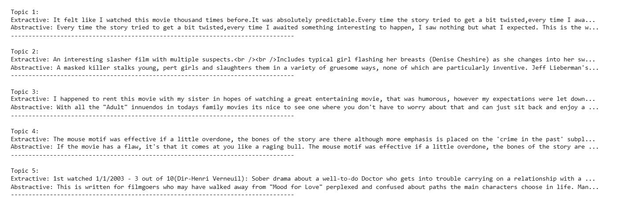
Summarization
TECHNIQUES USED: • Extractive Summarization — selected most representative sentences using sentence embeddings. • Abstractive Summarization — used BART-large CNN model for rewriting concise summaries.
RESULTS: • Generated summaries for 5 verified topics. • All summaries passed uniqueness validation (0 duplicates detected ). • Balanced between factual accuracy and readability.
Generated summaries for 5 verified topics:

Slide 11
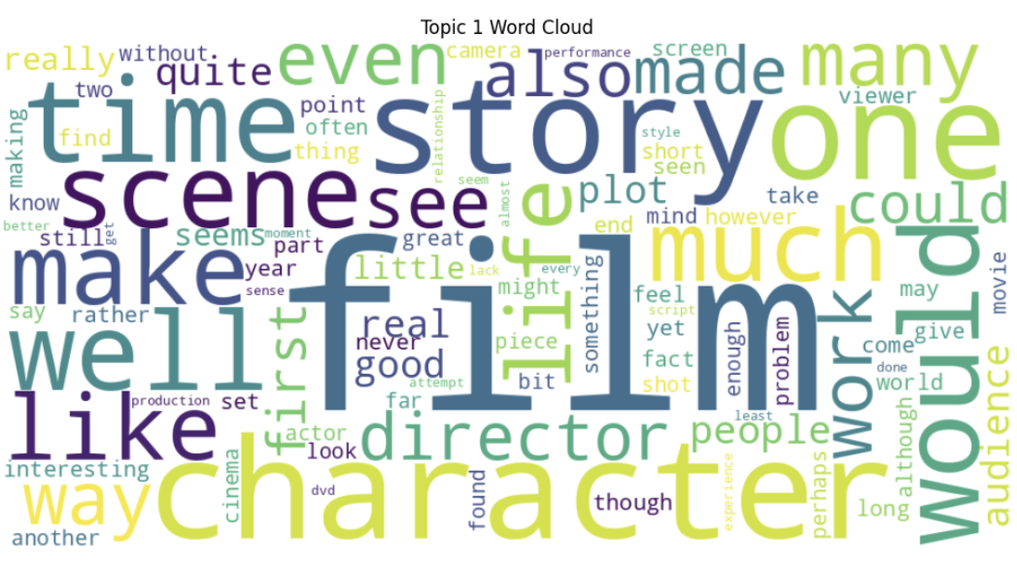
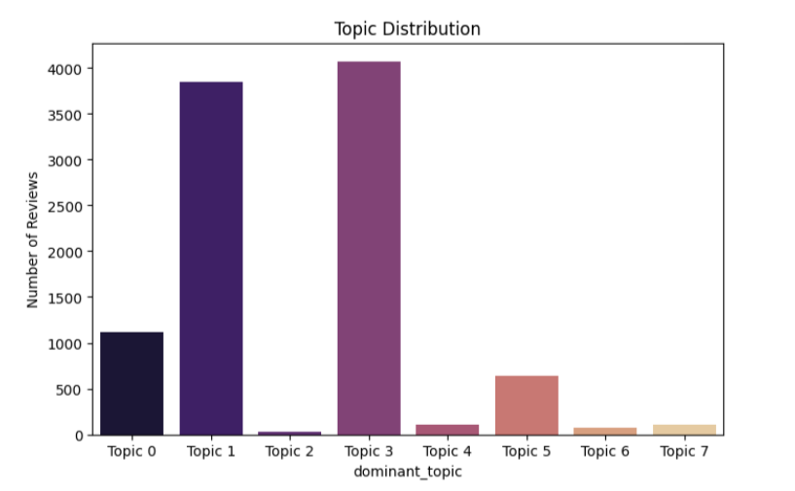
Visualization & Reporting
VISUAL TOOLS USED: • Matplotlib, Seaborn, and WordCloud.
OUTPUTS GENERATED: • Word Clouds: Displayed top keywords per topic. • Sentiment Graphs: Showed polarity distribution. • Topic Frequency Charts: Indicated dominant discussion areas.

Slide 12
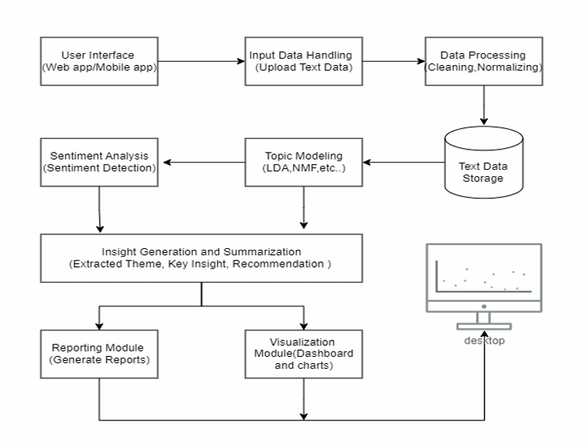
Architecture Diagram

Slide 13
Results
PERFORMANCE SUMMARY: • Topic Modeling – Optimal Topics: 8, Coherence: 0.3856 • Sentiment Analysis – Accuracy: 87.9%, F1: 0.88 • Summarization – Distinct and verified summaries for 10 topics.
MODEL OUTPUT FILES: • lda_model_8topics.pkl • vectorizer.pkl • IMDB_10K_SGD_SENTIMENT.csv • TOPIC_SUMMARIES_IMPROVED.csv
OVERALL RESULT: High-quality end-to-end pipeline successfully converting raw text into structured, insightful, and summarized data.

Slide 14
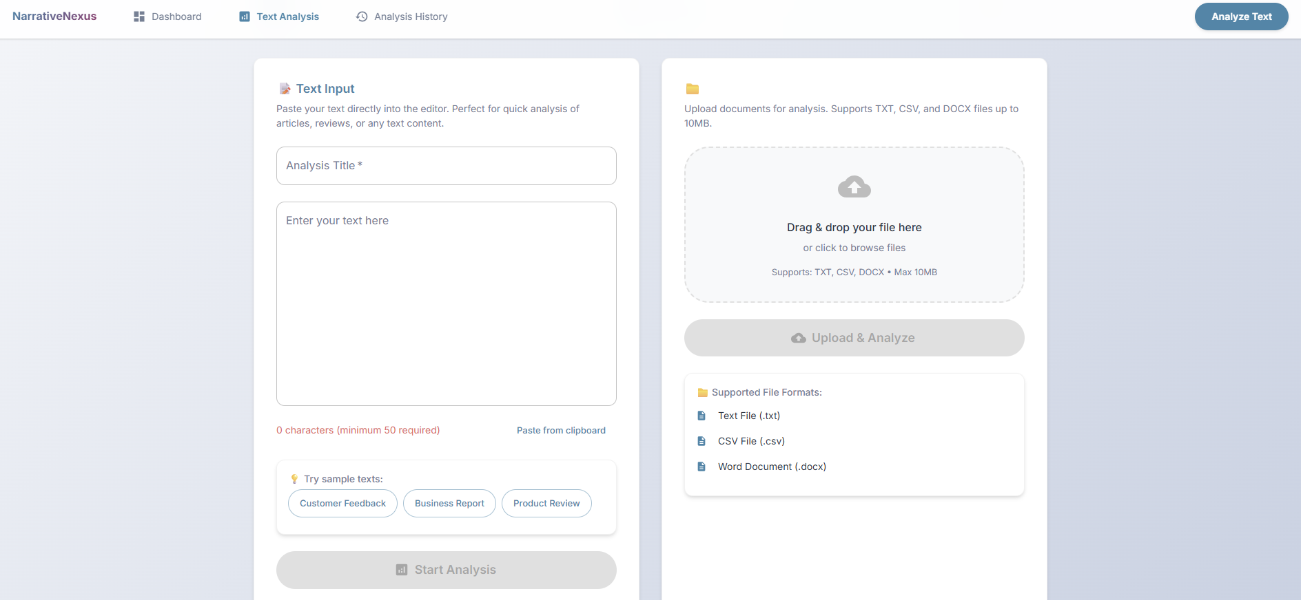
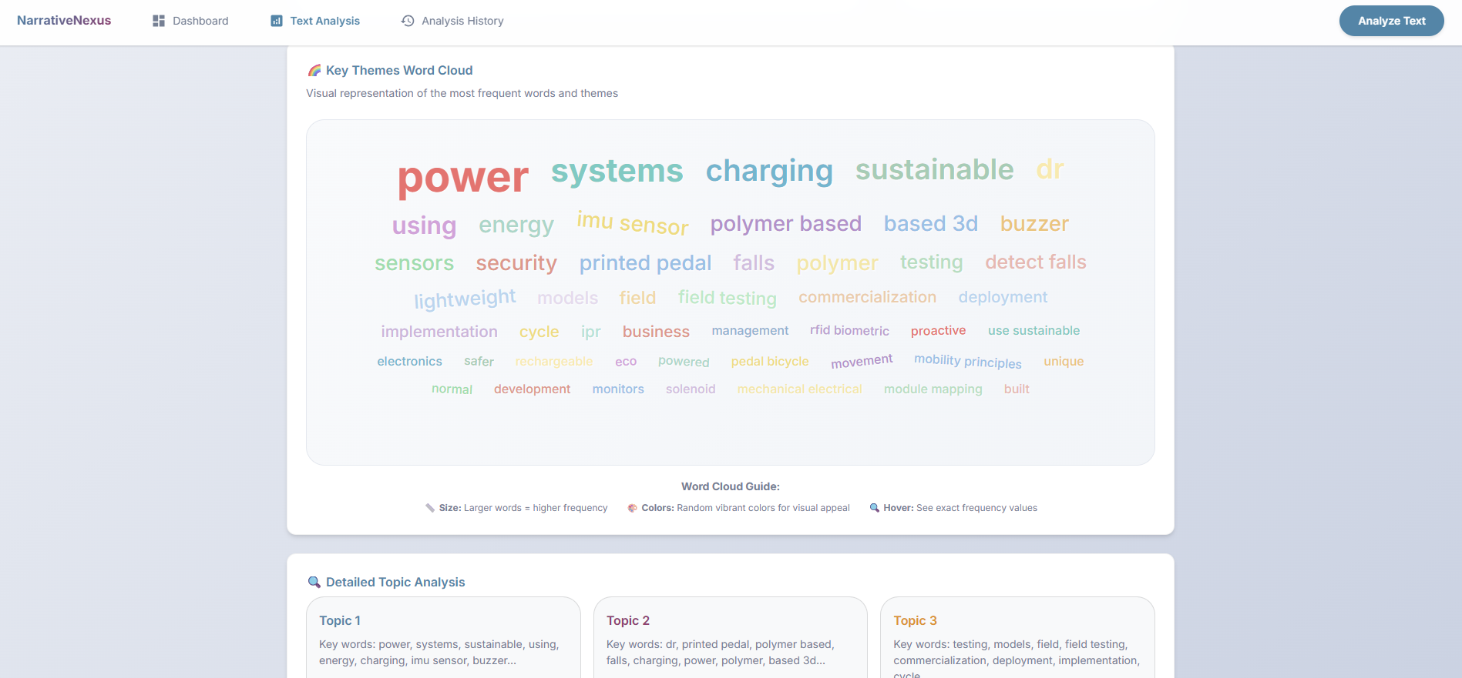
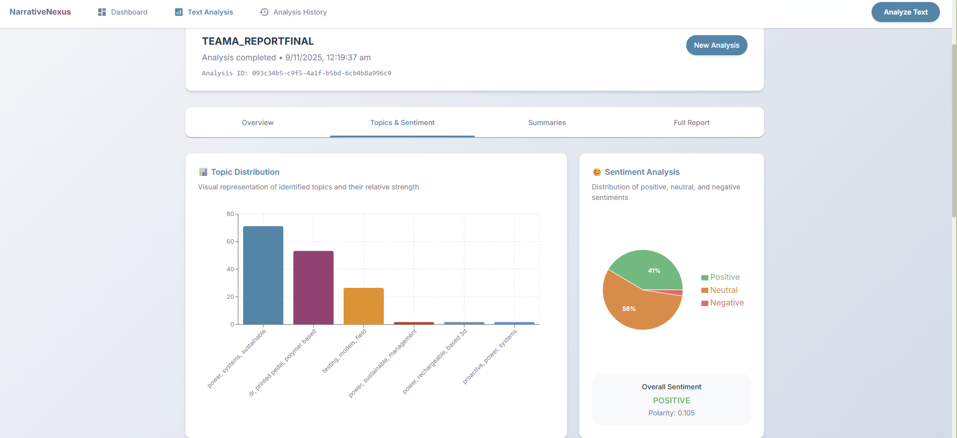
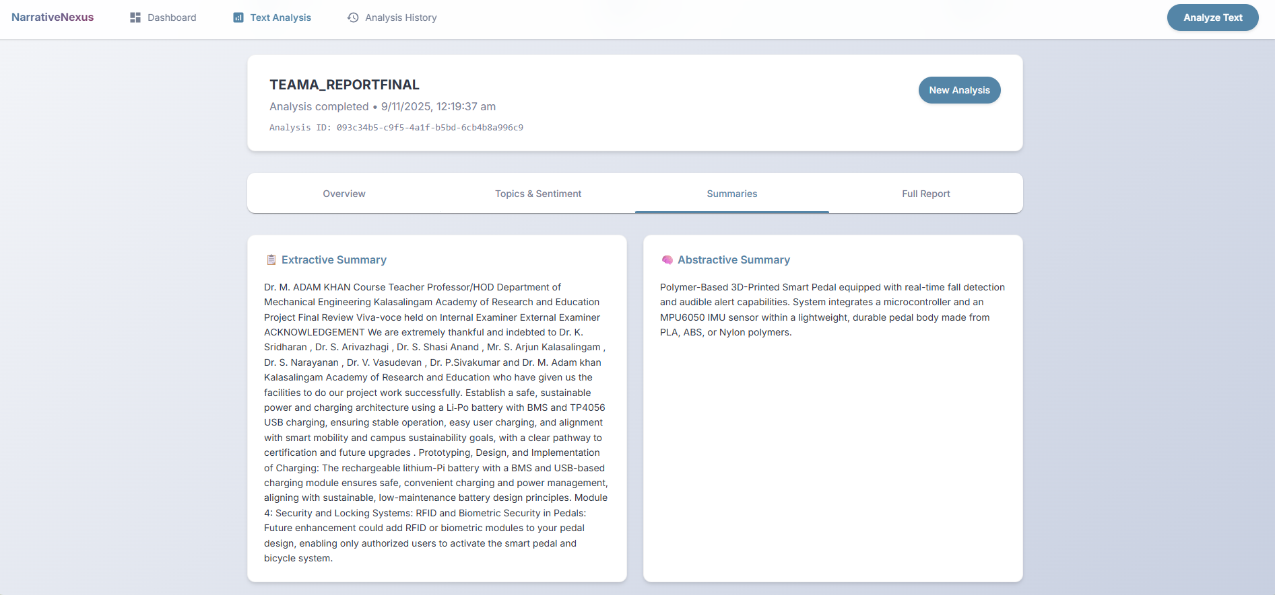
User Interface

Slide 15
Challenges
Data Quality Issues: • Presence of noisy, unstructured IMDb reviews with inconsistent formatting and HTML tags.
Model Tuning: • Optimizing hyperparameters (number of topics, coherence threshold, and TF-IDF features) required multiple experiments.
Performance Constraints: • High computational load for LDA training and BART summarization due to large text size.
Integration: • Combining preprocessing, topic modeling, sentiment analysis, and summarization into a seamless workflow.

Slide 16
Future Scope
Multilingual Expansion: Extend platform to handle multiple languages (Tamil, Hindi, Spanish, etc.).
Real-Time Analysis: Integrate with APIs and social media streams for live sentiment tracking.
Deep Learning Enhancement: Upgrade summarization with GPT-based abstractive models for richer context understanding.
Deployment: Host as a cloud-based SaaS platform with secure data access and scalability.

Slide 17
Conclusion
• Successfully designed and implemented a Dynamic Text Analysis Platform — NarrativeNexus. • Integrated NLP techniques — Topic Modeling, Sentiment Analysis, and Text Summarization — in one unified system. • Achieved 87.9% sentiment accuracy and distinct topic-based summaries with verified coherence. • Provides users with actionable insights, saving time and improving decision-making.

Slide 18
Thank You

