Slide 1

News Snap
“Instant, intelligent summaries of the news that matters”

Slide 2

Table of Contents
Project Overview
Dataset Overview and Insights
Model Architecture
Data Preprocessing
Topic Modelling
  Training and evaluation
Sentiment Analysis
Summarization
  Training and evaluation
User Interface
Challenges
Conclusion

Slide 3

Project
Overview
Objective
To develop an AI-powered news analysis system that generates short, clear, and informative summaries from lengthy news articles, enabling users to quickly understand key information without reading full reports.
Outcomes
Delivers concise and accurate news summaries using advanced NLP models.
Identifies dominant topics and overall sentiment to provide contextual understanding.
Enhances news consumption efficiency for users seeking quick and reliable insights.

Slide 4



Dataset Overview and insights
Dataset: CNN-DailyMail News Text Summarization
Size: 287,113 rows x 3 columns (used First 63293 rows)
Strengths: Journalist handmade Dataset, Easy to preprocess
Why this dataset?
Rich and Large-Scale Text Data
The dataset contains over 2,00,000+ news articles, providing sufficient data for summarization models.
Designed for Text Summarization
Each article is paired with a human-written summary, making it well-suited for both extractive and abstractive text summarization tasks.
Real-World and Structured Content
The news articles are professionally written, ensuring contextual coherence, linguistic accuracy, and real-world relevance.

Slide 5
Model
Architecture

Slide 6
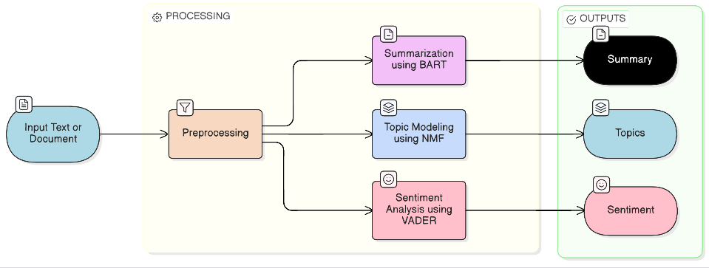
Model Architecture
Input: News text or document is provided as input to the system.
Preprocessing: Text is cleaned, normalized, and prepared for analysis.
Summarization (BART): A fine-tuned BART model generates a concise abstractive summary.
Topic Modeling (NMF): TF-IDF features are used with NMF to identify dominant topics.
Sentiment Analysis (VADER): The emotional tone of the text is classified as positive, neutral, or negative.
Outputs: The system presents the summary, extracted topics, and sentiment results.

Slide 7


Data
Preprocessing

Slide 8
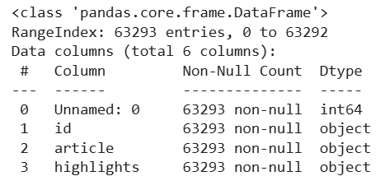
Data Preprocessing
Inspected the structure and quality of the data using df.info()
Data Cleaning
Converted text to Lower Case
Removed non-alphabetic characters
Remove extra whitespace
Converted text to word tokens using Word Tokenization
Removed Stop words
Converted Tokens to their respective Dictionary Form using Lemmatization
Cleaned Text
Preprocessed Text

Slide 9
Topic Modeling

Slide 10
Topic Modeling
Topic Modeling is a method used to identify the main topics or themes present in a set of text documents
Latent Dirichlet Allocation(LDA)
Non-Negative Matrix Factorization(NMF)
Preprocess the text documents
Convert text into numerical form (bag-of-words)
Assume each document contains multiple topics
Assign words to topics based on probability
Iteratively refine topic–word and document–topic distributions
Output the final topics with their most important words
Preprocess the text documents
Convert text into TF-IDF feature vectors
Apply Non-Negative Matrix Factorization (NMF)
Decompose the document–term matrix into topic and word matrices
Identify dominant topics based on highest weights
Extract top keywords representing each topic

Slide 11
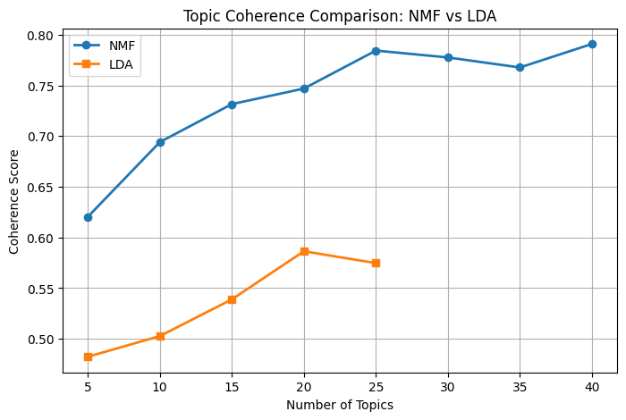
Training and Evaluation
Trained both LDA and NMF Models and evaluated their performance using Coherence Scores
For NMF Model
Coherence = 0.784 at K (Topics) = 25
For LDA Model
Coherence = 0.586 at K (Topics) = 20
Overall NMF Model performed well over LDA, As NMF has Comparatively High Coherence Score.

Slide 12
Sentiment Analysis

Slide 13

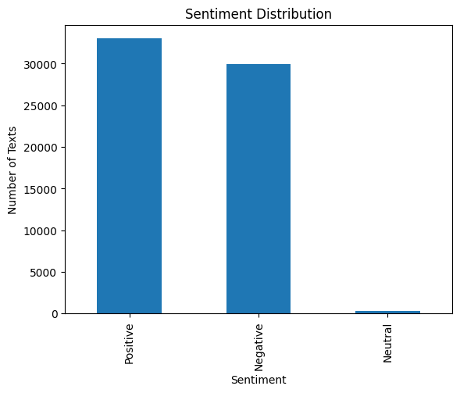
Sentiment Analysis
Input the preprocessed text
Split text into sentences or tokens
Use the VADER sentiment lexicon to score words
Apply linguistic rules (negation, intensity, punctuation)
Compute positive, negative, neutral, and compound scores
Assign the final sentiment label based on the compound score
Why this VADER?
Ruled-Based.
Useful on unlabelled data
No Explicit Training Needed
The accuracy of VADER sentiment analysis was manually verified through human evaluation and was found to be largely accurate and consistent with human judgment.

Slide 14
Summarization

Slide 15
Summarization
Collect and prepare document–summary pairs
Clean and tokenize the text data
Use a pre-trained BART model as the base
Fine-tune the model on the summarization dataset
Optimize the model using loss minimization
Evaluate summary quality using ROUGE metrics
Why this BART?
Understands full context of the input text.
Generates fluent and coherent summaries.
Pre-trained on large-scale text data.
Well-suited for summarization tasks.

Slide 16
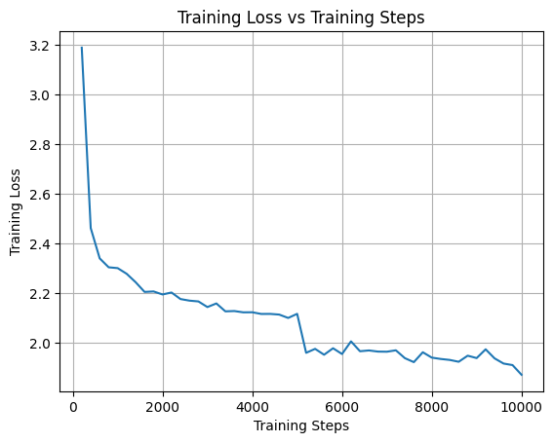
Training & Evaluation
Rouge Metric | Value
rouge1 | 0.3907
rouge2 | 0.1812
rougeL | 0.2748
rougeLsum | 0.3650
On standard news summarization benchmarks (e.g., CNN/DailyMail), BART-based models typically report ROUGE-1 ≈ 0.40–0.44 and ROUGE-2 ≈ 0.18–0.21 in research literature.
The obtained scores (ROUGE-1 ≈ 0.39, ROUGE-2 ≈ 0.18)
model’s performance is comparable to research and industry-level
Training loss decreases steadily
Early rapid loss reduction indicates quick capture of patterns.
Final low loss with minor fluctuations suggests stable convergence and good model performance.

Slide 17
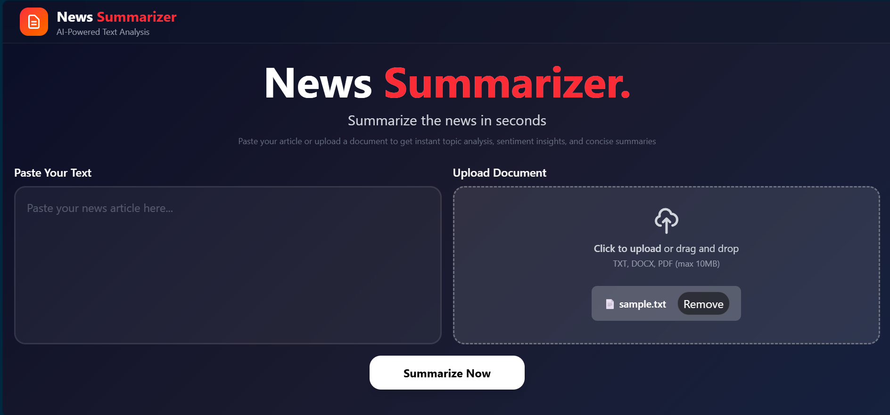
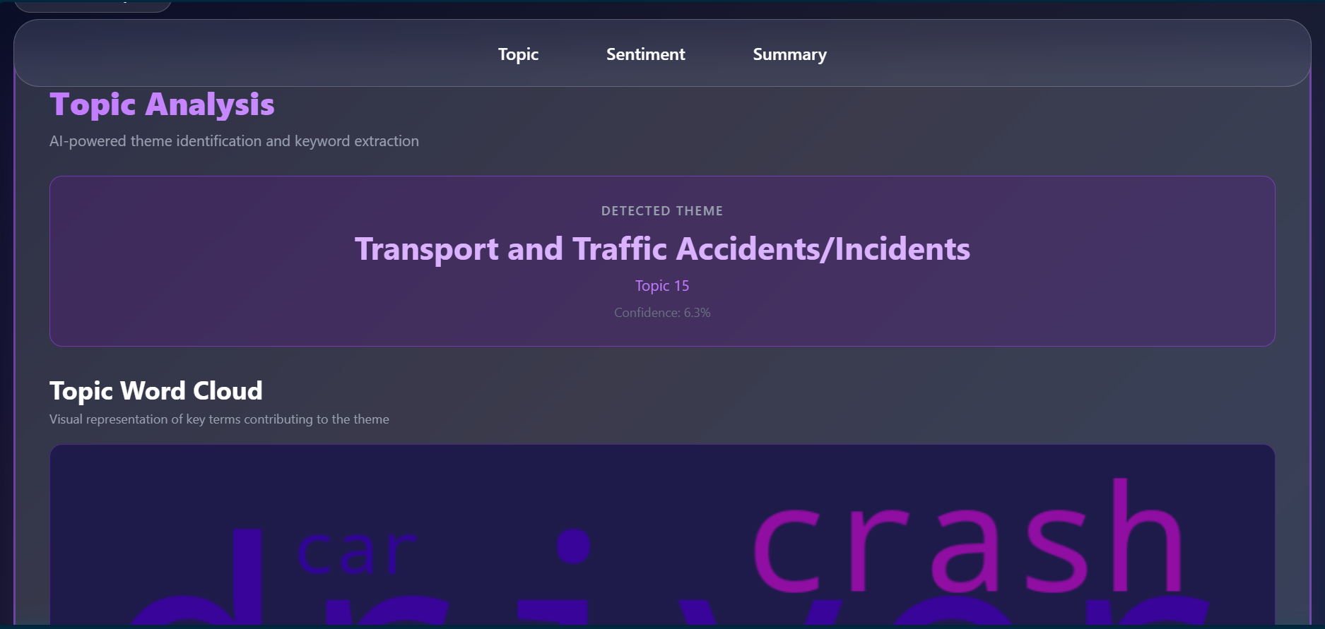
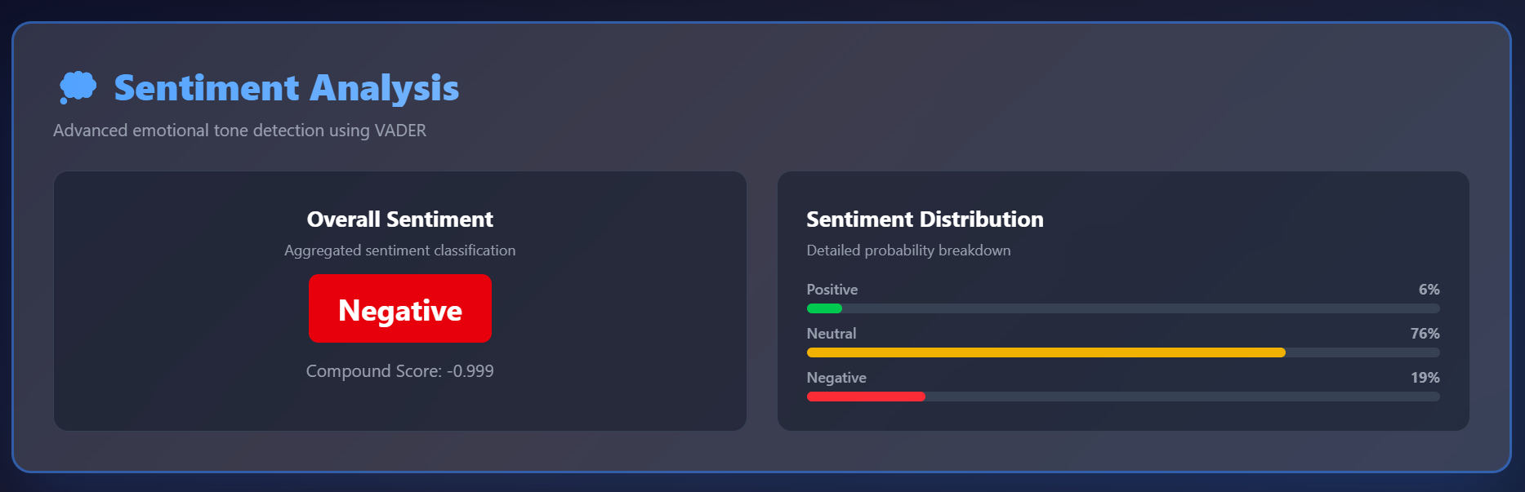
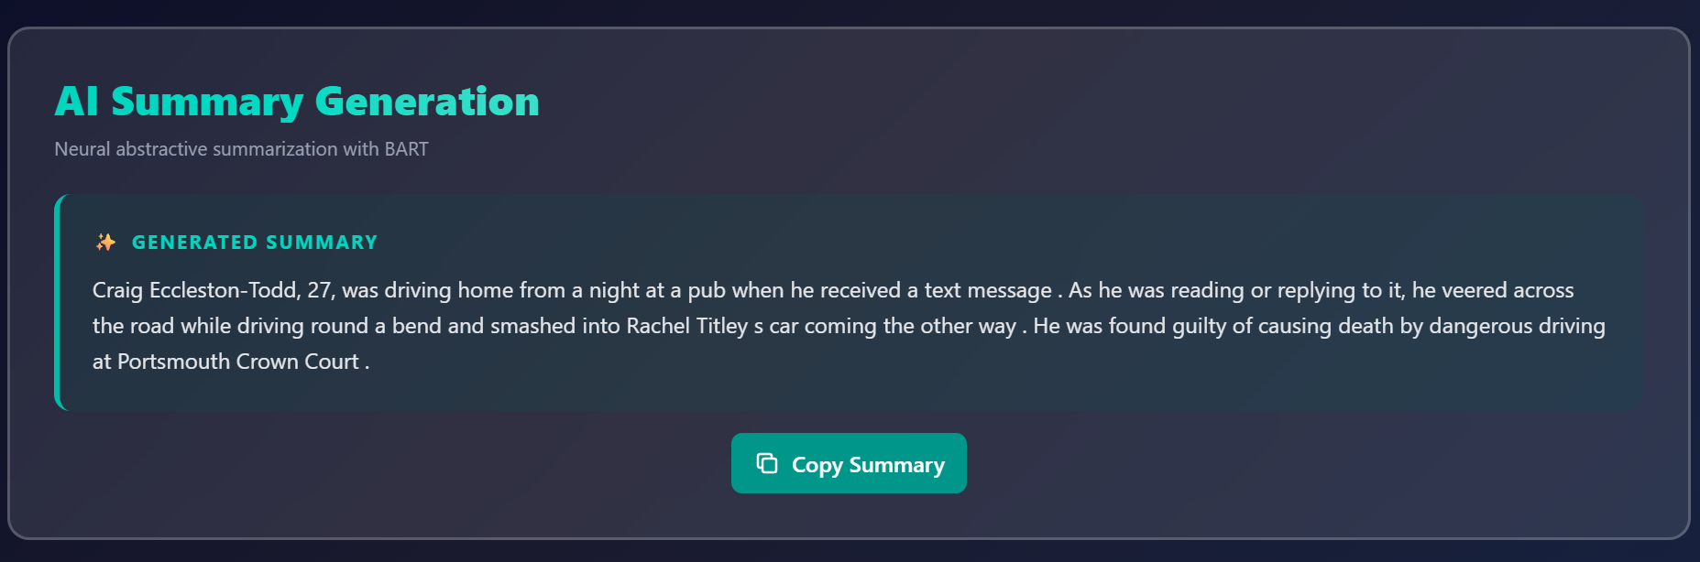
User Interface

Slide 18


