Slide 1
EnviroScan: Pollution Source Detection System
Amaldev K G
MCA (S2)
Vidya Academy of Science and Technology
APJ Abdul Kalam Technological University

Slide 2
Problem Statement
Increasing air pollution in Indian cities
Difficult to identify pollution sources
Need for data-driven analysis system

Slide 3
Project Objectives
Analyze air quality data
Identify pollution sources:
Vehicular
Industrial
Agricultural
Natural
Build interactive visualization system
Provide prediction using ML model

Slide 4
System Overview
User Input → Data Collection → Preprocessing → ML Model → Output + Visualization

Slide 5
Data Sources
OpenWeatherMap API (Air + Weather Data)
Parameters collected:
PM2.5, PM10
NO2, SO2, CO, O3
Temperature, Humidity, Wind

Slide 6
Data Preprocessing
Removed missing values
Cleaned inconsistent data
Feature engineering:
Distance from road
Distance from industry
Distance from farmland

Slide 7
Pollution Source Classification
Condition | Source
Near road + high NO2 | Vehicular
Near industry + high SO2 | Industrial
Near farmland + high PM2.5 | Agricultural
Else | Natural

Slide 8
Model Used
Algorithm: Decision Tree Classifier
Input features:
Pollution parameters
Weather data
Output:
Pollution source

Slide 9
Model Evaluation
Accuracy: 100% (training data)
Fast prediction
Easy interpretation

Slide 10
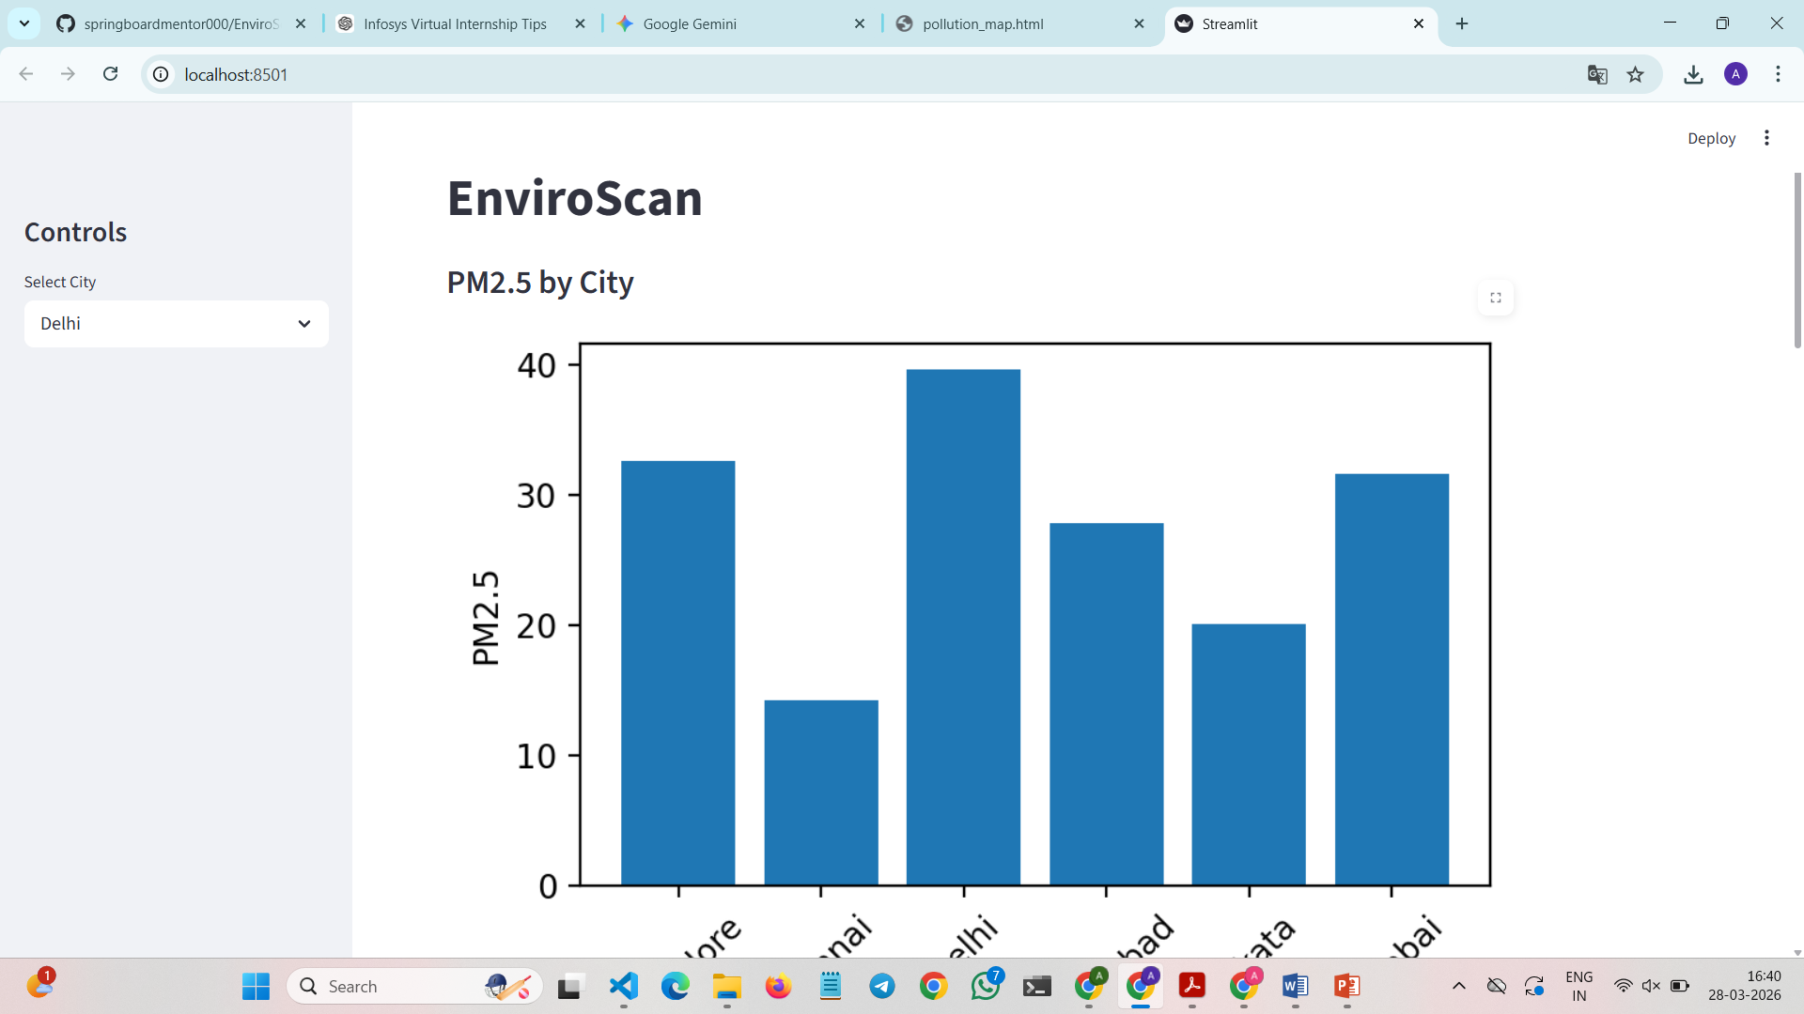
User Interface

Slide 11
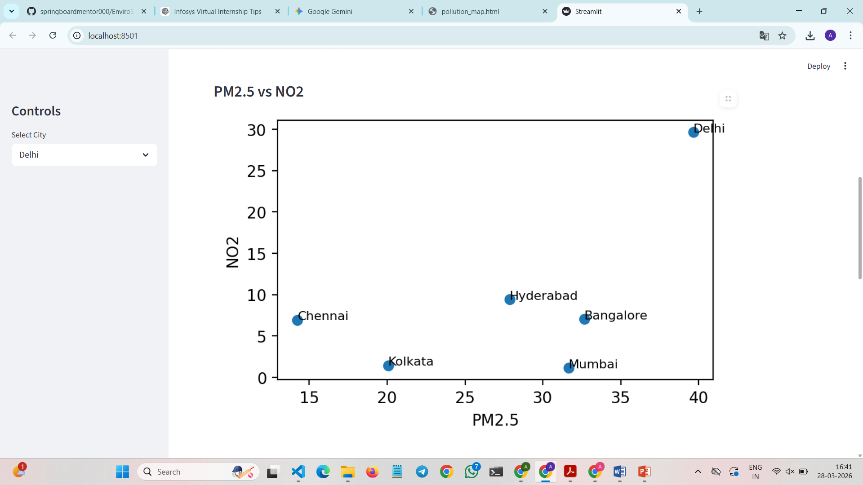

Slide 12
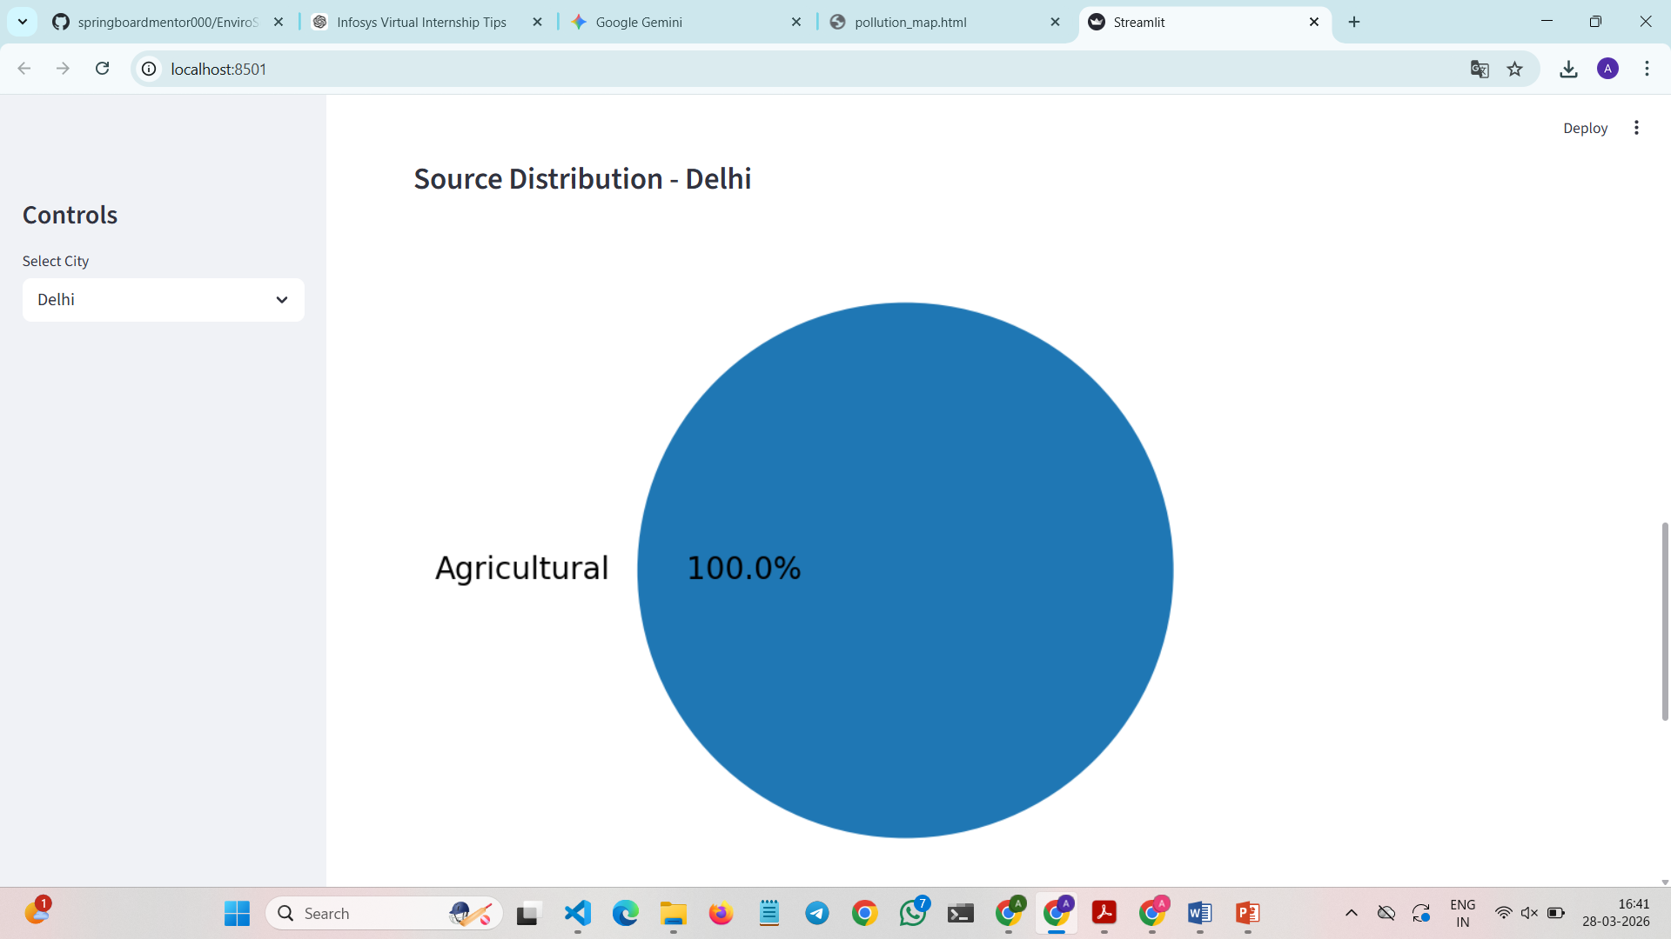

Slide 13
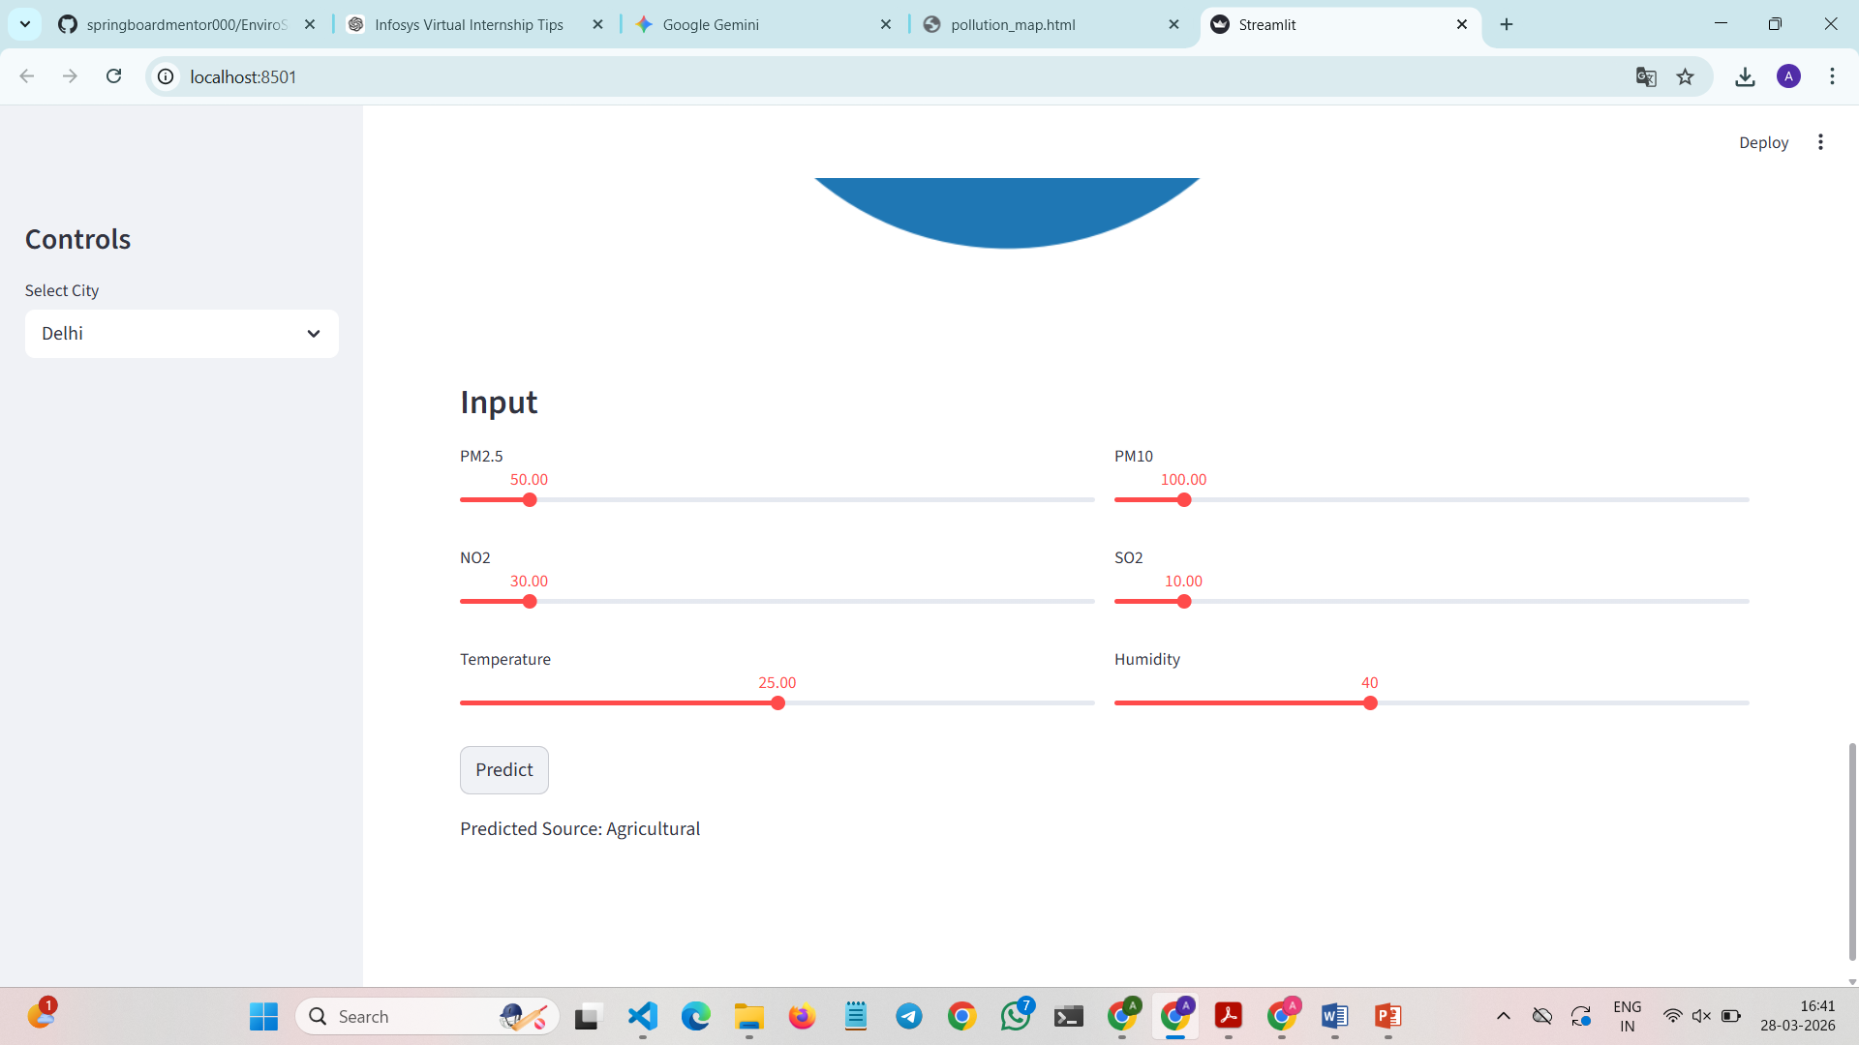

Slide 14
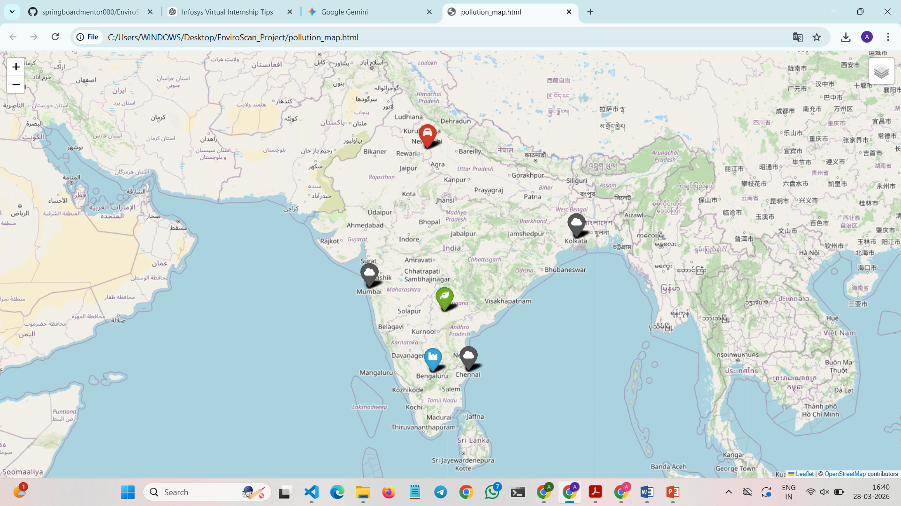
Geospatial Visualization

Slide 15
Prediction Feature
User inputs pollution values
Model predicts source instantly
Displays:
Source
Confidence score

Slide 16
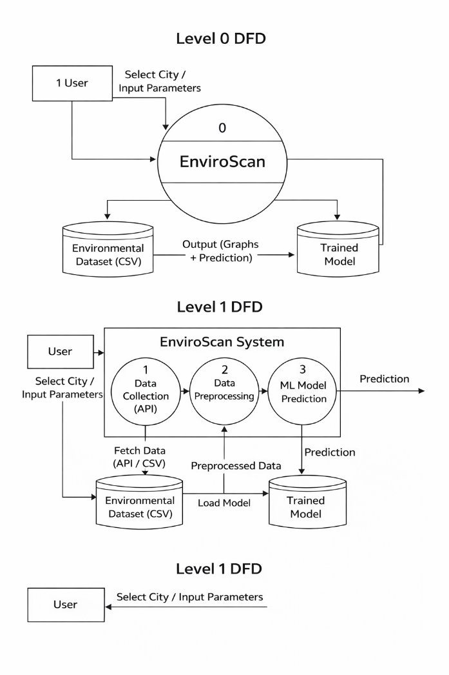
Data Flow Diagram

Slide 17
Conclusion
Successfully built pollution analysis system
Accurate source prediction
User-friendly interface

Slide 18
Future Scope
Real-time live data integration
More cities coverage
Advanced ML models
Mobile app version

Slide 19
Thank You

