Slide 1



Air Fly Smart Delay Prediction System
Name: M . Chandrika (Batch-13)
Project Name: Air Fly Insights Data Visualization and Analysis of Airline Operations

Slide 2



Technology Stack:
Front end
Middle Ware
Back end

Slide 3
Core Features
Interactive Dashboard:- User-friendly interface built with Streamlit , Real-time display of analytics and insights , Dynamic charts and visualizations using Matplotlib/Seaborn
Machine Learning Integration:- Predictive analytics with Random Forest and Logistic Regression ,Model training and evaluation for accurate results ,Ability to save/load models using Joblib / Pickle
Data Handling & Analysis:- Efficient data processing with Pandas / NumPy ,Clean, structured input for ML models ,Data filtering, aggregation, and transformation
Backend Functionality:- Business logic handled with Python, Smooth connection between frontend (dashboard) and ML models
Development & Collaboration Tools:- Version control and team collaboration via Git & GitHub ,Code editing and debugging with VS Code / PyCharm
Deployment Ready :- Easy deployment for users to access the dashboard online ,Potential to integrate with cloud platforms for real-time usage

Slide 4
Challenges Facing
1
2
Data Quality & Preprocessing
Real-world data may have missing values, outliers, or inconsistencies
Cleaning and preparing data for ML models can be time-consuming
Requires careful handling to avoid inaccurate predictions
Model Accuracy & Overfitting
ML models like Random Forest or Logistic Regression may overfit on training data
Ensuring generalization to new/unseen data is challenging
Requires hyperparameter tuning and validation techniques (like K-Fold Cross Validation)
3
4
Integration Between Components
Linking Streamlit frontend, Python backend, and ML models smoothly can be tricky
Middleware handling and model loading must be efficient to avoid delays in dashboard response
Deployment & Scalability
Deploying the dashboard for multiple users simultaneously may cause performance issues
Cloud deployment, resource management, and scaling the ML models need careful planning

Slide 5
System Architecture Overview
1. Frontend (User Interface)
Streamlit Dashboard: Interactive visual interface
Charts & Visuals: Real-time graphs using Matplotlib/Seaborn
User Input: Filters, selections, and data upload
2. Backend (Application Logic)
Python Core: Handles user requests and communication
Data Preprocessing: Cleans and formats data for ML models
API Endpoints (if any): For data or model access
3. Middleware / ML Layer
Scikit-learn Models: Random Forest, Logistic Regression
Data Manipulation: Pandas / NumPy
Model Persistence: Joblib / Pickle to save/load models
4. Development & Deployment Tools
IDE: VS Code / PyCharm
Version Control: Git & GitHub
Deployment: Streamlit Cloud, local server, or cloud hosting
Flow
User → Streamlit UI → Python Backend → ML Models → Results → Streamlit UI

Slide 6
Challenges and Solutions
1
2
Data Quality & Preprocessing
Challenge: Missing, inconsistent, or noisy data can reduce ML accuracy.
Solution: Use data cleaning techniques (handling missing values, outlier removal) and preprocessing pipelines in Pandas / NumPy.
Model Accuracy & Overfitting
Challenge: ML models may overfit training data, performing poorly on new data.
Solution: Apply cross-validation (K-Fold), tune hyperparameters, and consider ensemble methods like Random Forest for better generalization.
3
4
Integration Between Frontend & Backend
Challenge: Linking Streamlit frontend with Python backend and ML models can be slow or error-prone.
Solution: Use efficient data handling, cache ML model results with Joblib, and test API/data flows thoroughly.
Deployment & Scalability
Challenge: Supporting multiple users or large datasets may affect performance.
Solution: Deploy on scalable platforms like Streamlit Cloud or Heroku, optimize code, and use lightweight data transfers.

Slide 7
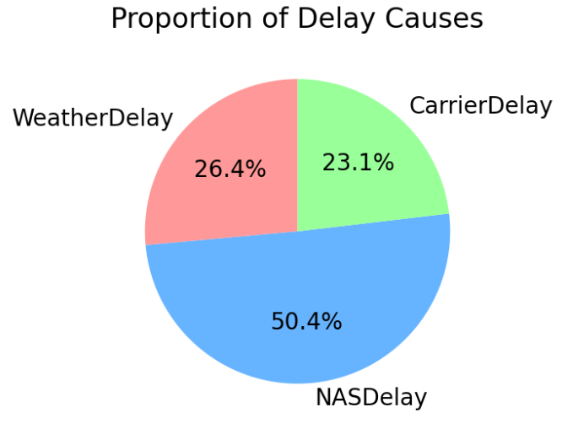
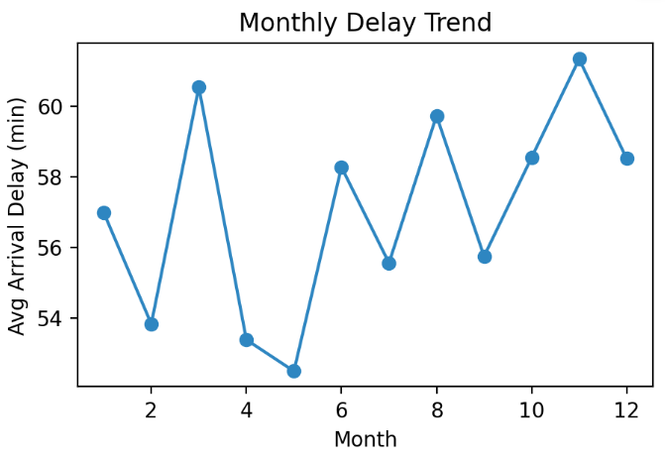

Measurable Outcomes and Positive Impact

Slide 8
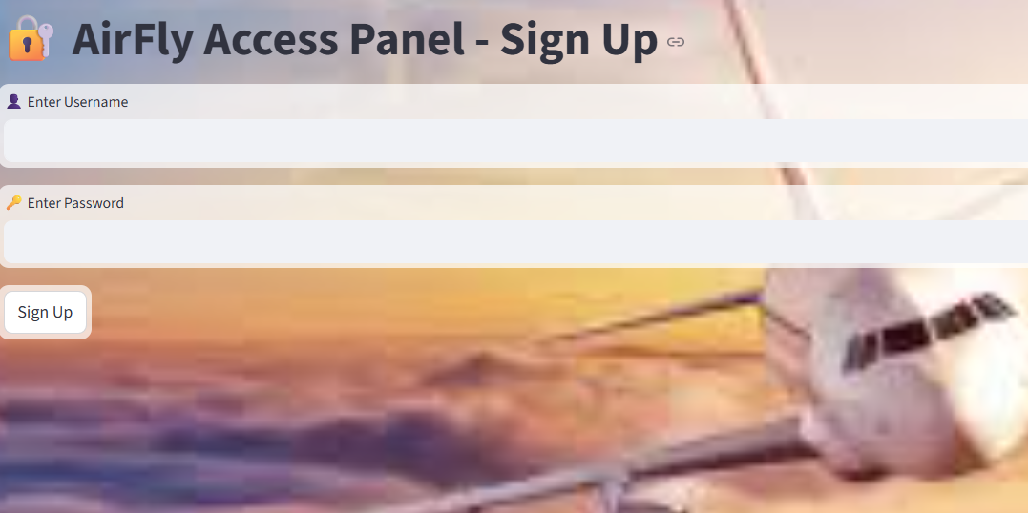
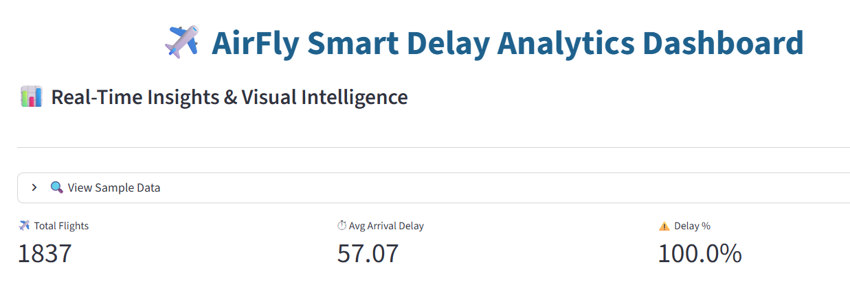
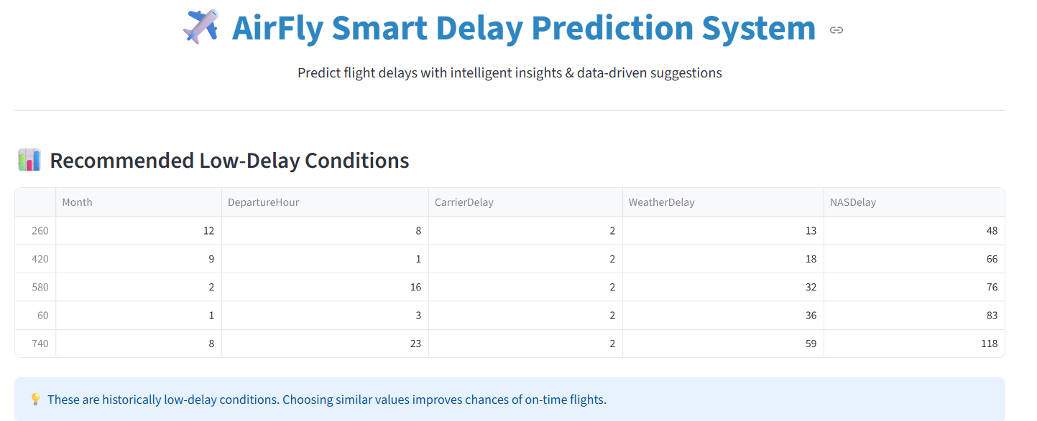
These mock-ups showcase a seamless experience for users, enhancing engagement through intuitive design and functionality.

Slide 9
Future Enhancements
Real-Time Data Integration – Connect the dashboard with live APIs to provide real-time flight delay predictions and insights.
Predictive Analytics Improvements – Use advanced ML models like XG Boost, LSTM, or deep learning to improve accuracy in predicting delays.
User Personalization – Allow users to customize dashboards, select preferred routes, airlines, and notification alerts.
Mobile-Friendly Version – Develop a responsive mobile interface for access on smartphones and tablets.
Interactive Visualizations – Add more interactive charts, heatmaps, and route analysis for better user engagement.
Automated Reporting – Generate scheduled reports with key insights for stakeholders via email or cloud storage.
Sentiment & Social Media Analysis – Integrate passenger reviews and social media feedback for a holistic view of airline performance.
Scalability & Cloud Deployment – Deploy the application on cloud platforms like AWS or Azure for better performance and scalability.

Slide 10

Thank You

