Slide 1
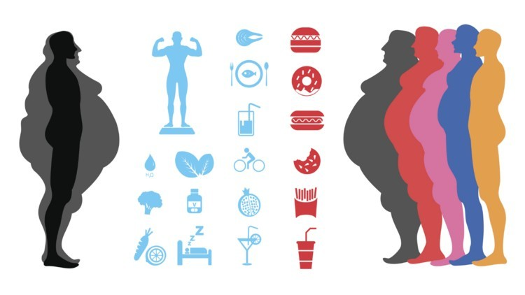
Predicting Obesity Levels Using ML
Under the Mentorship of Mr.
Narrendra Kumar
Infosys Springboard Internship

Slide 2
Introduction
Obesity levels are typically classified to measure the extent of excess body fat and its associated health risks. These levels are often determined using metrics like Body Mass Index (BMI), which is calculated as weight (kg) divided by height squared (m²)

Slide 3


Objective
Obesity can cause many physical Problems.
Obesity is becoming problematic
To develop a machine learning model for predicting obesity level based on persons eating habits, physical condition and other factors.

Slide 4
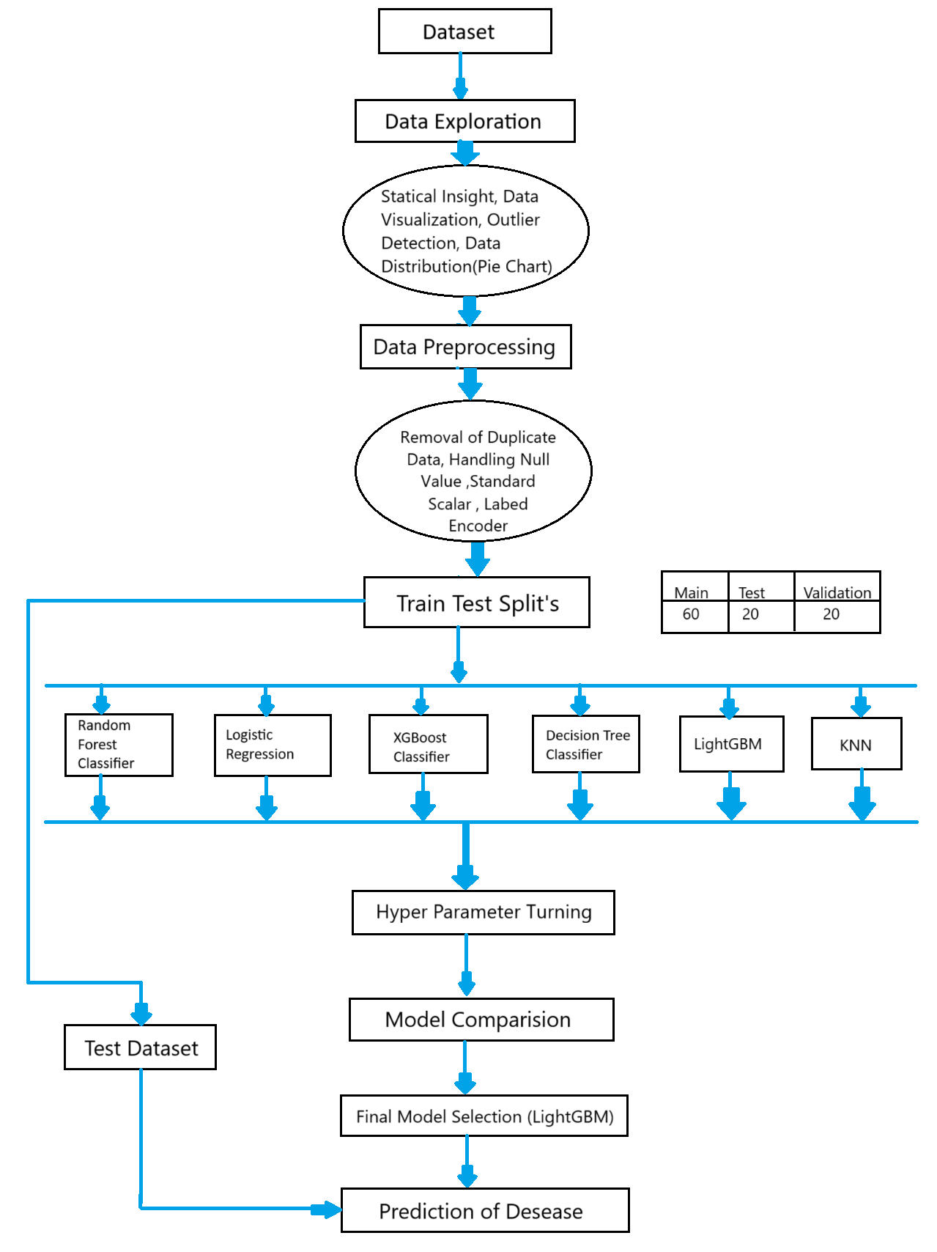
Flow Chart

Slide 5
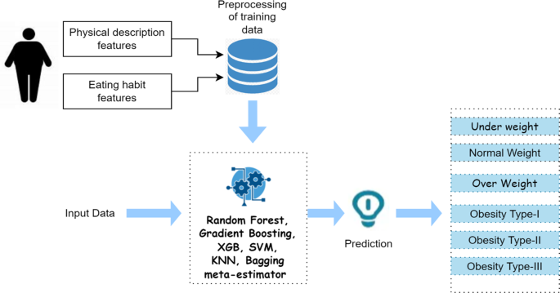
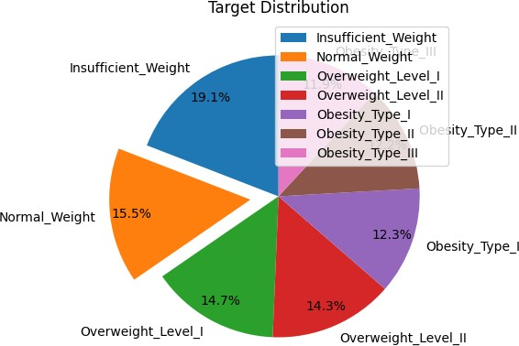
Methodology
Key Steps:
1. Data Exploration
2. Data Preprocessing
3. Splitting Data
4. Feature Selection
5. Model Implementation
6. Hyperparameter Tuning and Comparison
7. Final Model Selection

Slide 6
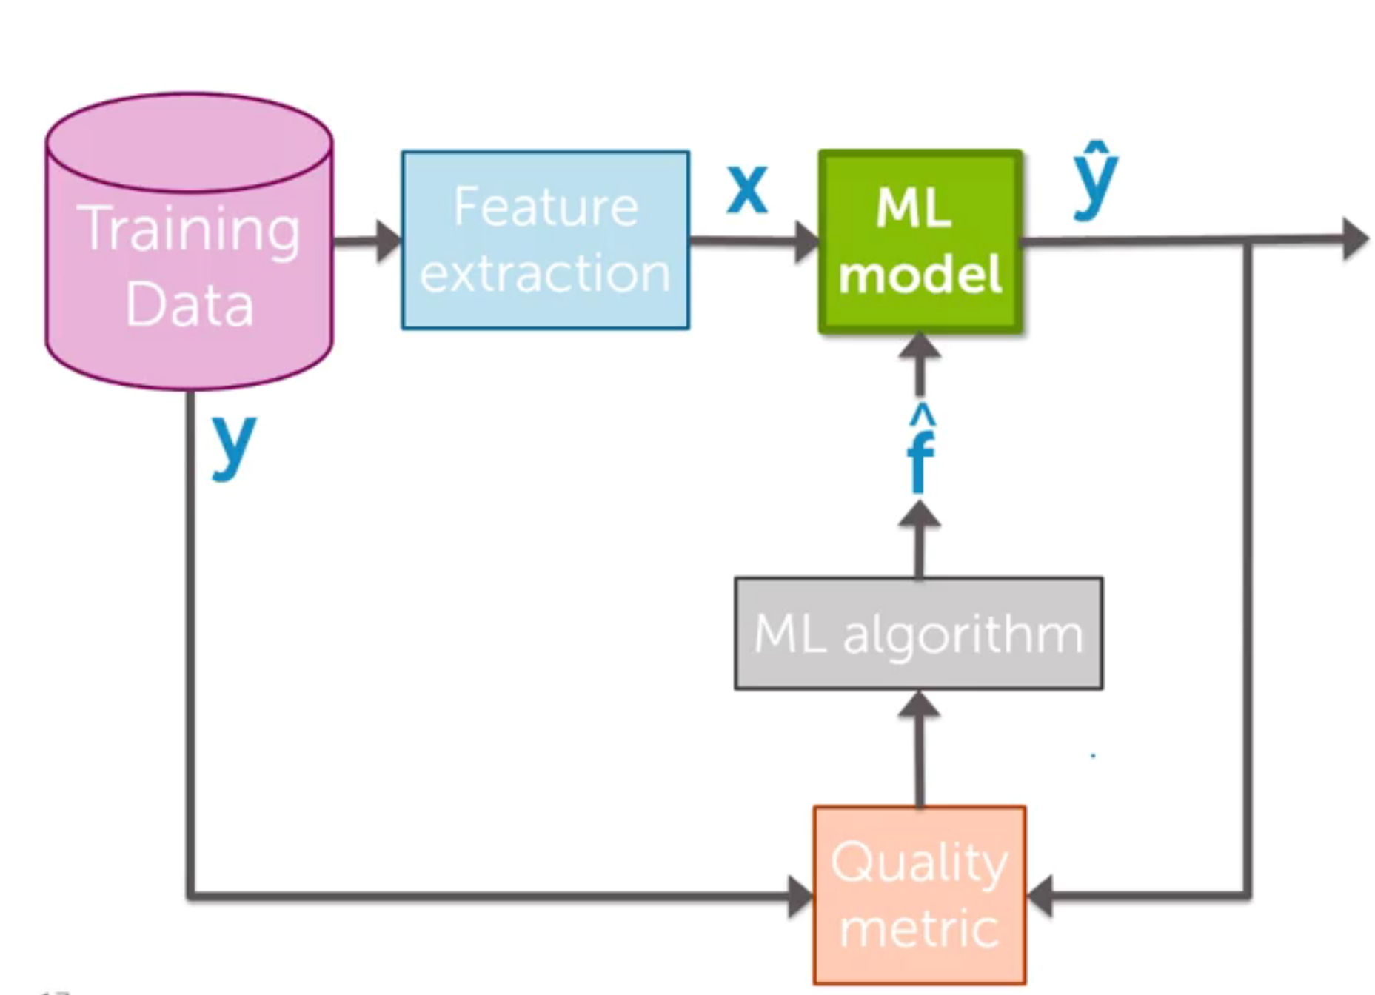
Model Implementation
Random Forest Classifier
Logistic Regression
XGBoost
Decision Tree
LightGBM

Slide 7

Final Model Selection
Chosen Model: LightGBM for its balanced performance
without over fitting.
Outcome: Almost accurate classification and identification of key obesity risk factors.

Slide 8

ML on WEB

Slide 9
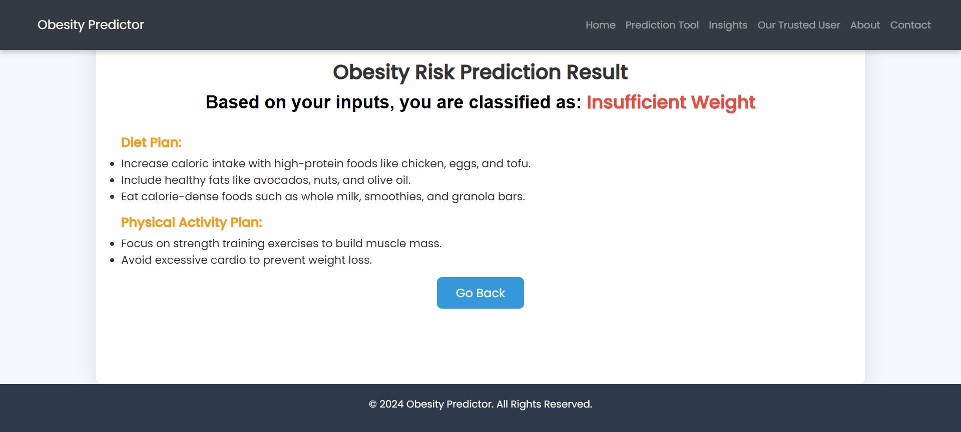
Results

Slide 10
Challenges
Outliers were there in Number of Meals, Height, weight and Age column.
Non-Linear relationship
Almost all the algorithms were overfitting the test set.

Slide 11
Advantages
In this project, a method based on ML algorithm is created, using supervised and unsupervised classification techniques.
We all have witnessed Covid19 pandemic and since the pandemic people are becoming more health conscious than before. And currently the trend of online fitness apps or health monitoring apps is increasing. So this model can be very useful for online platforms for reaching potential customers.
This model can be very useful for performing online surveys and find about population obesity status for minimizing cardiovascular risk.
Disadvantages
This model was created based on survey done in Mexico, Peru and Colombia. It focuses on particular population. So for different regions this model might suffer.

Slide 12
Thank You

