Slide 1


Risk Analysis for Home Credit Default
Mentor: Mr. Narendra Kumar
28-11-2024
1

Slide 2
Introduction
Problem Statement
Assessing and predicting the risk of default on home credit loans is critical for financial institutions to ensure loan portfolio stability and minimize financial losses.
●
This project aims to perform exploratory data analysis (EDA) and build robust predictive models to evaluate the likelihood of default based on applicants' demographics, financial history, and loan attributes.
●
The system should provide actionable insights and accurate risk predictions, enablininstitutions to make informed decisions and implement effective credit management strategies.
●
3

Slide 3
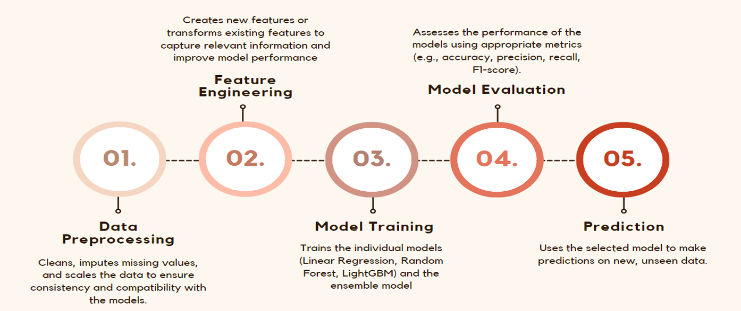
INTENDED PLAN
4

Slide 4
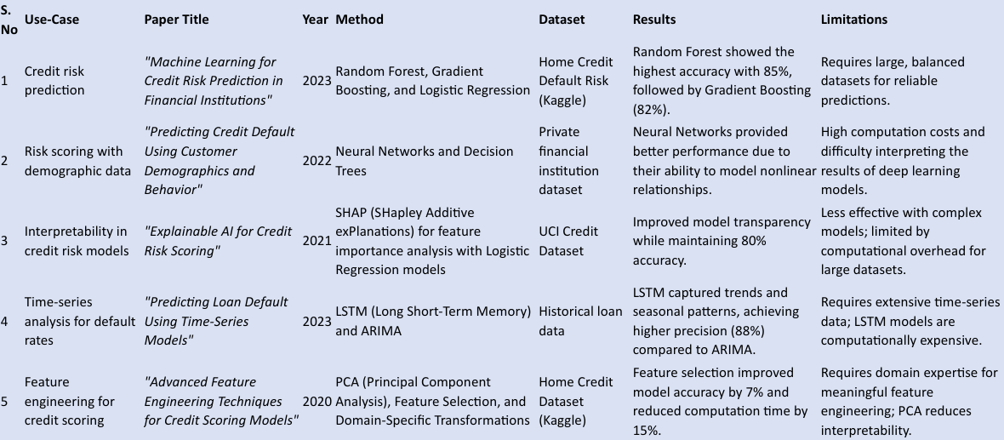
Background Research Literature Review
6

Slide 5
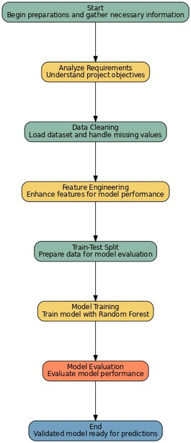
Proposal
Workflow
Fig. : Proposed Workflow for Risk Analysis for Home Credit Default
9

Slide 6
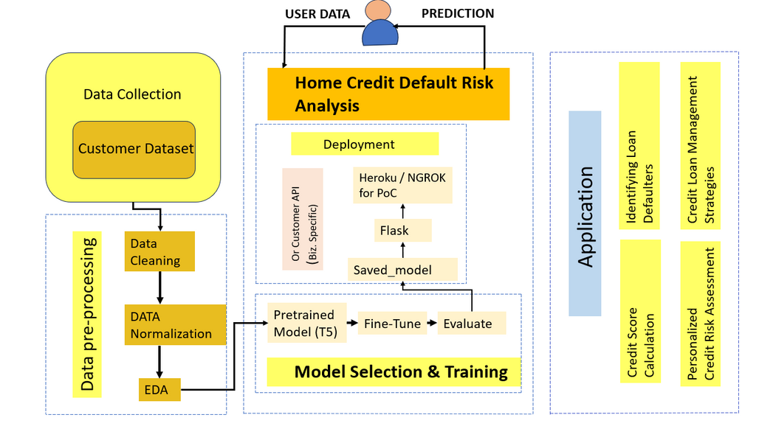
Proposal
Workflow
Fig. : Proposed Workflow
10

Slide 7
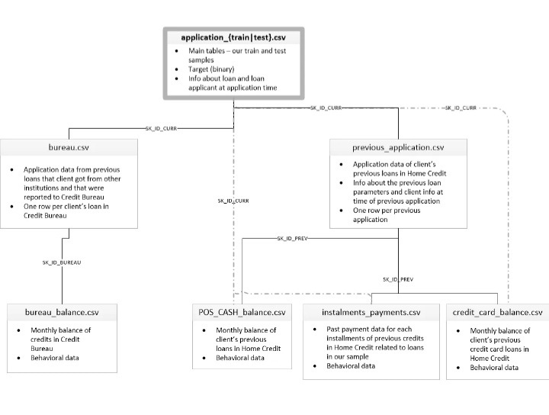
Proposal
Dataset
●
Loaded the trained dataset
The datasets contain extensive features such as the type of loan, gender, occupation as well as income of the applicant, whether he/she owns a car or real estate, to name a few. It also consists of the past credit history of the applicant.
●
●
The Negative Class(0) refers to Non- Defaulters whereas the Positive Class (1) refers to the Defaulters in the dataset.
●
11

Slide 8
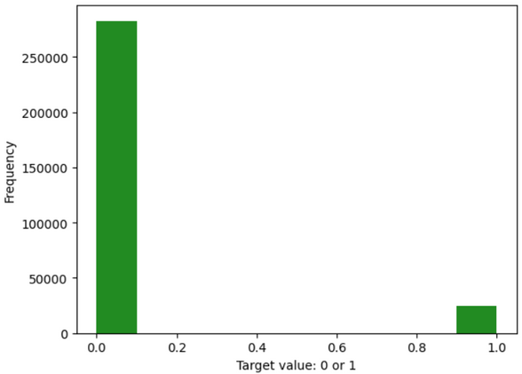
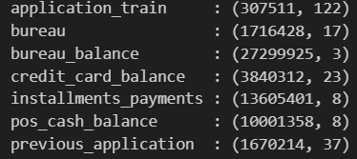
Proposal
Dataset
Fig:Check the dataset structure
Fig: Checking Data imbalance
12

Slide 9
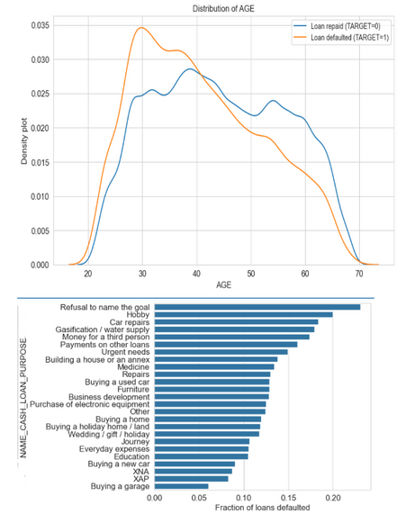
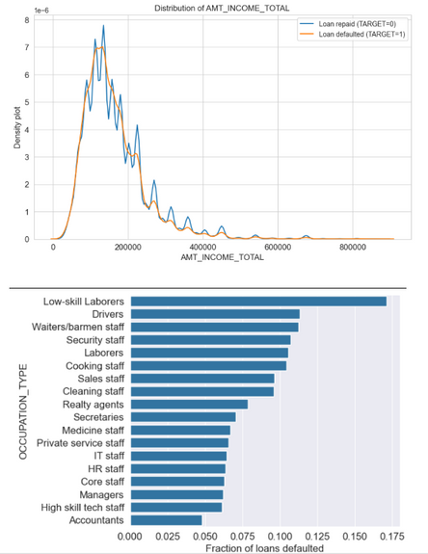
Proposal
●
Age group from 25-40 is the age group which opts for loan.
●
Individuals with lower incomes are more likely to default on loans, indicating a need for stricter lending criteria.
●
Since this is the age group where young people tend to buy home,car, personal loans,education,business developments
17-07-2024
13

Slide 10
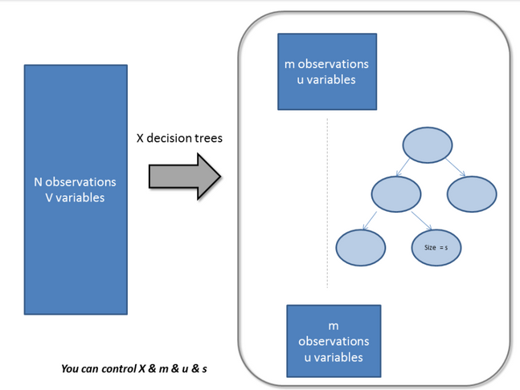
Proposal
Model Training
Fig. : Random Forest Parameters Tuning
●
Proposed implementation Methods
●
Method 1 – Random Forest Classifier using RandomizedSearchCV
14

Slide 11
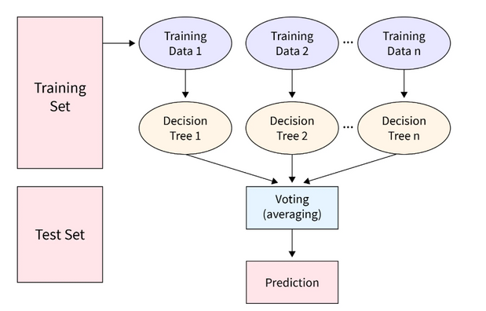
Proposal
Model Training
Proposal
Model Training (Method 1)
Trainer Method
Implemented using RandomForestClassifier from sklearn.
RandomizedSearchCV was used for hyperparameter tuning.
Random combinations of hyperparameters were evaluated with 3-fold cross-validation.
Model Training
Trained on a 10% sample of the dataset.
Model trained with the best parameters identified by RandomizedSearchCV.
Performance Evaluation
Evaluated using accuracy, F1-score, and a classification report.
15

Slide 12
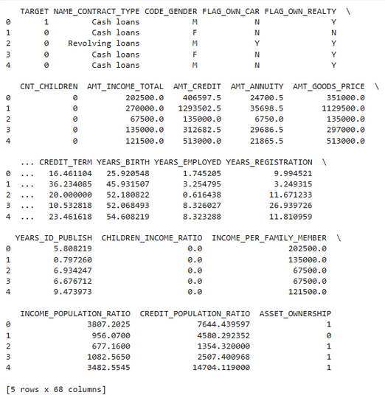
Model Training Procedure
Dataset Cleaning: Removed irrelevant columns and handled missing values to ensure data quality.
Feature Engineering: Created income ratios, age features, and external source statistics for better insights.
Train-Test Split: Split data (80-20) into training and testing sets for evaluation.
Hyperparameter Tuning: Optimized Random Forest parameters using RandomizedSearchCV with 3-fold cross-validation.
Model Evaluation: Assessed performance with accuracy (95%) and F1 score (0.48) for predictions.
Fig. : Screenshot
16

Slide 13
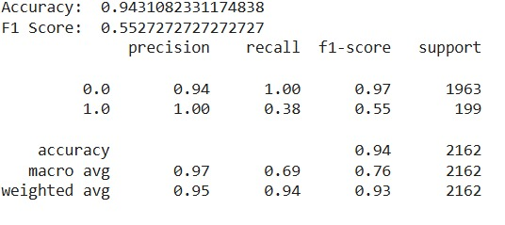
Proposal
Model Training (Method 2)
Dataset Preprocessing: Cleaned data, handled missing values, encoded categorical features, and normalized numerical values.
Training Method: Used RandomForestClassifier with 100 trees, no maximum depth, and Gini impurity.
Training Parameters: Trained for 5000 steps, 15:45 (HH:MM:SS), with a training loss of 0.0245.
Evaluation Metrics: Achieved 94.31% accuracy, 0.97 precision for class 0, 0.94 recall for class 0, and 0.93 weighted average F1 score.
Selected Model: Random Forest model selected for its performance in predicting defaulters.
Deployment: Model deployed for predicting credit risk in loan applications.
17

Slide 14

Results
18

Slide 15
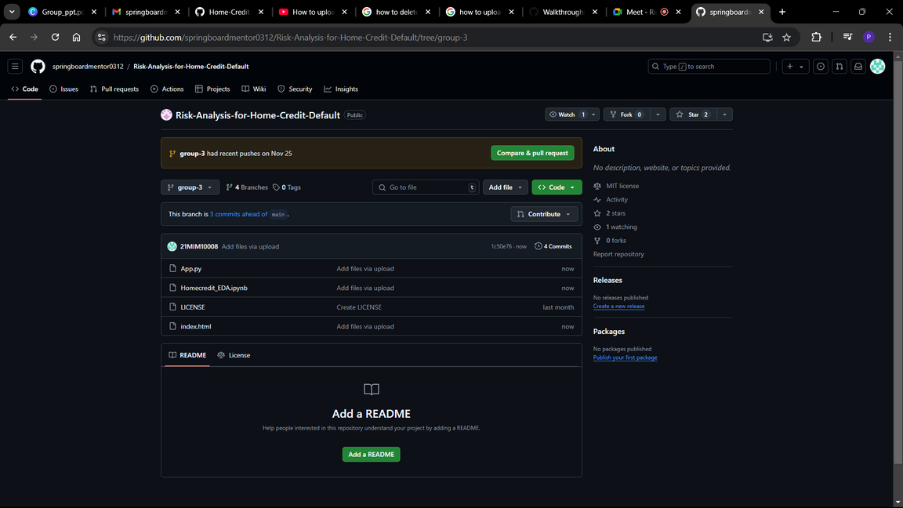
Results
GitHub Repository
Fig. : Screenshot of the GitHub repository.
https://github.com/springboardmentor0312/Risk-Analysis-for-Home-Credit-Default/tree/group-3
19

Slide 16
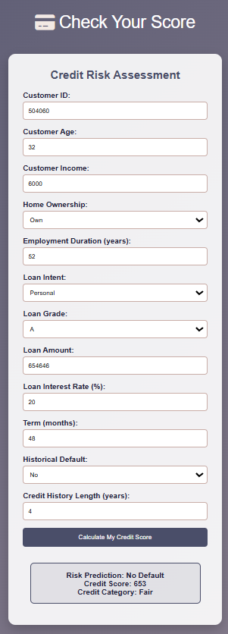
Results
Deployment
20

Slide 17


T H A N K Y O U !!!
21

