Slide 1
✈
PrognosAI
AI-Driven Predictive Maintenance
for Turbofan Engines
Python · XGBoost
FastAPI · PostgreSQL
Grafana · Docker
Springboard Internship Project · 2026

Slide 2
THE PROBLEM
Engines Fail Without Warning
Unplanned downtime is expensive, dangerous, and avoidable.
💸
⚠️
🔩
Reactive Maintenance
Safety Risk
Over-Maintenance
Teams wait for failure, then scramble. Downtime costs $10K–$50K/hour in aviation contexts.
An engine that fails mid-operation risks crew and cargo. Late detection = mission-critical failure.
Replacing parts on fixed schedules wastes resources — engines often have usable life remaining.
💡 The question isn't IF an engine will fail — it's WHEN. PrognosAI answers that.

Slide 3
What PrognosAI Does
Predict engine health before failure happens.
"Tell me how many operational cycles this engine has left before it needs maintenance."
🟢
🟡
🔴
HEALTHY
WARNING
CRITICAL
> 60 cycles remaining
30–60 cycles remaining
< 30 cycles remaining
✓ Real-Time Predictions
✓ Per-Engine Drill Down
✓ Fleet-Wide Monitoring
✓ Model Accuracy Tracking

Slide 4
DATASET
NASA C-MAPSS Dataset
Turbofan engine degradation simulation — industry-standard benchmark.
The Commercial Modular Aero-Propulsion System Simulation (C-MAPSS) is NASA's standard dataset for predictive maintenance research. It simulates turbofan engine run-to-failure under various operating conditions.
21
30
sensor channels
per engine
cycle rolling
window
Subset | Train Engines | Test Engines | Op. Conditions | Fault Modes
FD001 | 100 | 100 | 1 | 1
FD002 | 260 | 259 | 6 | 1
FD003 | 100 | 100 | 1 | 2
FD004 | 248 | 249 | 6 | 2
125
13–14
RUL cap applied
(cycles)
informative sensors
used per subset
⚙ Zero-variance sensors excluded per subset. Rolling mean & std added as features.

Slide 5
System Architecture
End-to-end pipeline — data in, insights out. Fully containerised.
📁
🤖
⚡
🗄️
📊
C-MAPSS
Dataset
→
XGBoost
ML Model
→
FastAPI
Service
→
PostgreSQL
DB
→
Grafana
Dashboards
NASA test data
Trained per subset
REST API / 3 endpoints
Predictions + sensors
3 live dashboards
🐳 Docker Compose — all services spin up with one command: docker compose up
🔄 GitHub Actions → Docker Hub CI/CD pipeline on every push to main

Slide 6
ML MODEL
XGBoost — Remaining Useful Life Prediction
Gradient-boosted trees trained on multi-cycle sensor sequences.
1
Load & Label
NASA Score
Piecewise-linear RUL cap at 125 cycles — removes noise from early stable operation.
Asymmetric Penalty
2
Feature Engineering
Late prediction
(over-estimate RUL)
÷ 10
penalty
30-cycle rolling mean & std per sensor. Adds temporal degradation signal.
3
Scale
Early prediction
(under-estimate RUL)
÷ 13
penalty
MinMaxScaler fitted on train only — no data leakage into test set.
4
Train XGBoost
Lower score = better model
1000 trees, depth 4, lr 0.02. Trained per subset for specialisation.
Key Hyperparameters
5
Evaluate
n_estimators: 1000
max_depth: 4
NASA Score primary metric — asymmetric: late predictions penalised harder than early ones.
learning_rate: 0.02
subsample: 0.9

Slide 7
Model Results — Per Subset Performance
XGBoost evaluated on held-out NASA C-MAPSS test set.
Dataset | RMSE (↓) | MAE (↓) | R² (↑) | NASA Score (↓)
FD001 | 12.84 | 8.91 | 0.9412 | 243.1
FD002 | 21.37 | 15.22 | 0.8730 | 1,847.6
FD003 | 14.12 | 9.83 | 0.9280 | 389.4
FD004 | 23.91 | 17.05 | 0.8540 | 2,341.2
< 15 cycles
0.93+
NASA Score
RMSE on FD001 & FD003
(single operating condition)
R² score on single-condition
subsets — strong variance explained
Primary metric — penalises
late predictions more than early
FD002 & FD004 (6 operating conditions + 2 fault modes) are inherently harder — RMSE is expected to be higher.

Slide 8
API
FastAPI — 3 Prediction Endpoints
The ML brain of the system. Auto-docs at /docs.
Sample Response
/predict
POST
{
"engine_id": 1,
"subset": "FD001",
"predicted_rul": 42.5,
"health_status": "WARNING",
"unit": "cycles",
"prediction_id": 1083
}
Single engine, latest sensor snapshot. Fast, single-cycle inference.
/predict/sequence
POST
Full engine history. Rolling features use real cycles — most accurate.
/ground-truth
POST
Submit actual RUL after engine retirement. Populates accuracy dashboard.
🗄 Every prediction auto-persisted to PostgreSQL → Grafana dashboards update in real-time.

Slide 9
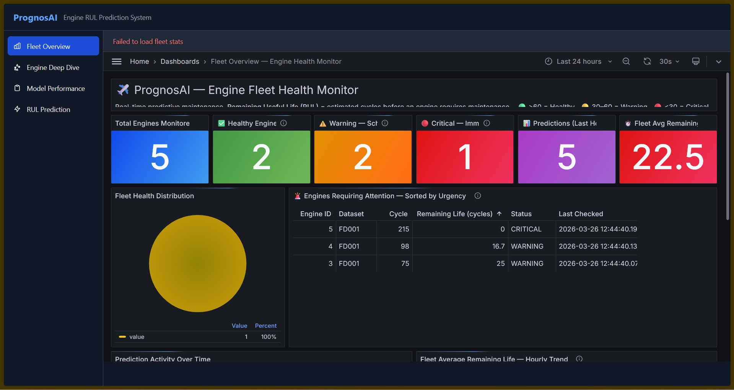
DASHBOARD 1
Fleet Overview — Engine Health Monitor
Real-time health status of every engine. Refreshes every 30s.
Stat cards · Fleet health pie · Urgency-sorted engine table · Prediction activity over time · Avg RUL trend

Slide 10
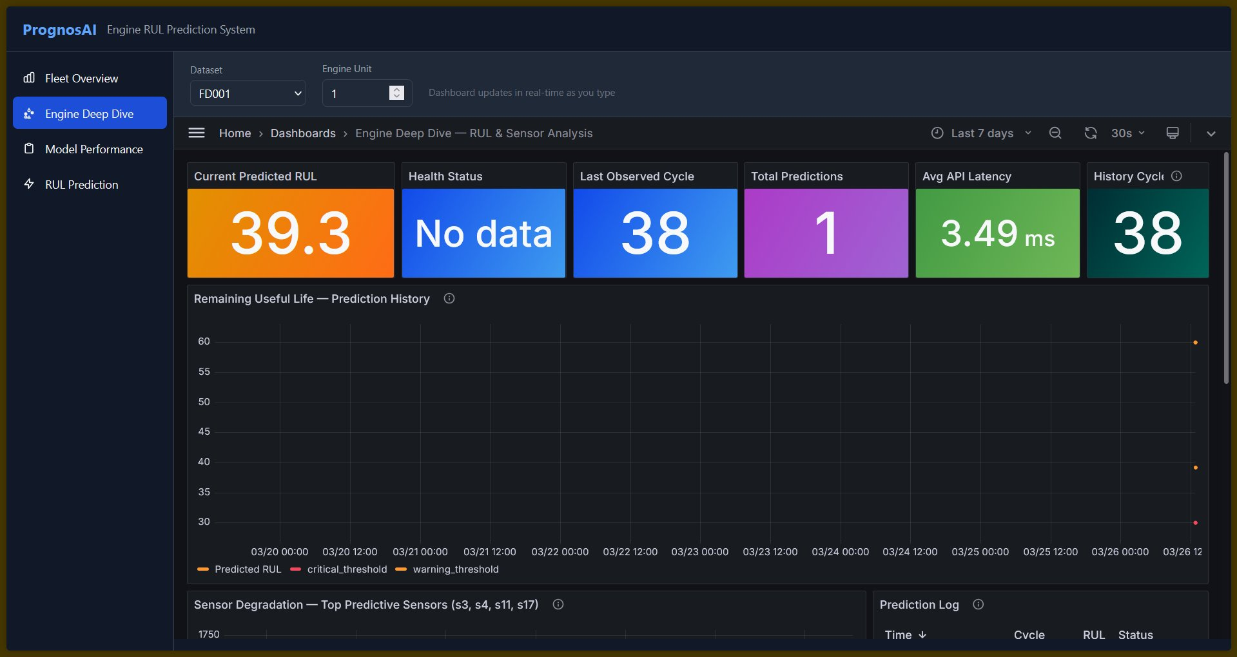
DASHBOARD 2
Engine Deep Dive — RUL & Sensor Analysis
Select any engine and dataset — dashboard updates instantly.
RUL prediction history · Sensor degradation trends (s3, s4, s11, s17) · Prediction log with latency

Slide 11
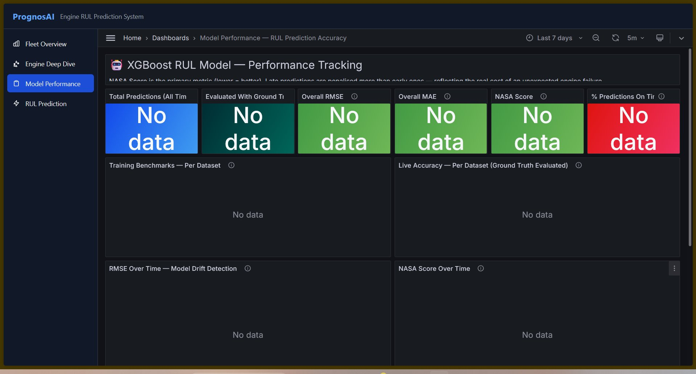
DASHBOARD 3
Model Performance — Accuracy Tracking
Monitors model drift. Rises in RMSE signal retraining time.
Training benchmarks · Live accuracy (ground truth) · RMSE/NASA over time · Error breakdown · Error distribution histogram

Slide 12
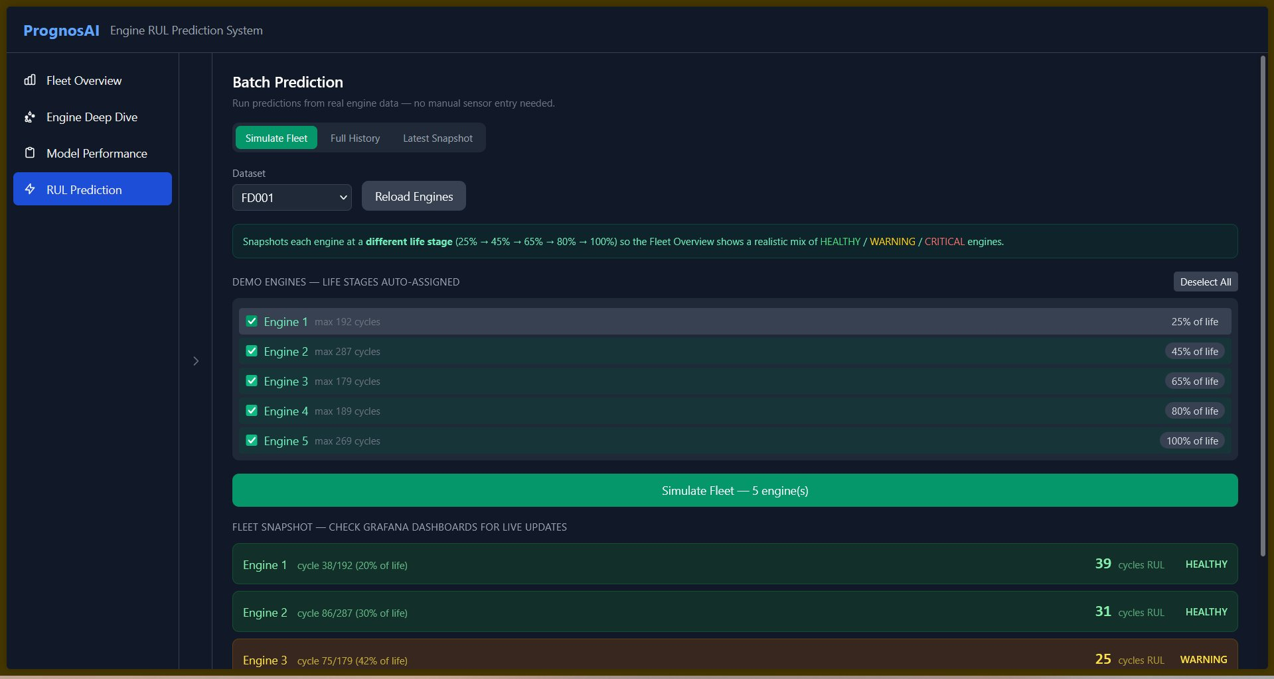
DASHBOARD 4
RUL Prediction UI — Batch Fleet Simulator
Built-in web UI. Simulate a full fleet with one click.
Simulate Fleet · Full History · Latest Snapshot modes — feeds predictions into PostgreSQL → Grafana auto-updates

Slide 13
Deployment — Docker + CI/CD
Zero-config setup. Any machine with Docker Desktop can run this.
1. Clone & configure
Docker Services
git clone <repo> && cp .env.example .env
rul-api
:8100
2. Launch entire stack
rul-postgres
:5432
docker compose up
rul-grafana
:3100
3. Populate dashboards
rul-grafana-init
one-shot
python bulk_predict.py --subset all --with-ground-truth
🔄 GitHub Actions CI/CD: on push to main → builds rul-api & grafana-init images → pushes to Docker Hub (amalsalilan/*)

Slide 14
LEARNINGS
Challenges & Key Learnings
What made this project hard — and what we learned from it.
🔄 Rolling Features at Inference Time
🎯 NASA Score vs RMSE Tradeoff
Rolling mean/std are computed on training history — but at inference, you may only have a single snapshot. Built a fallback using min_periods=1 and a dedicated /predict/sequence endpoint for full-history inputs.
RMSE penalises all errors equally. NASA Score penalises late predictions harder — matching real-world safety risk. This shaped model tuning decisions: we favoured slight early-bias over late-bias predictions.
📊 Grafana Provisioning Automation
🔢 Multi-Subset Model Design
Manually importing dashboards doesn't scale. Built grafana_init.py — a one-shot Docker container that registers the PostgreSQL datasource and imports all 3 dashboard JSONs automatically on first boot.
FD002/FD004 have 6 operating conditions vs FD001/FD003's 1 — a single model trained on all subsets would underfit. Separate models per subset gave significantly better RMSE and NASA scores.

Slide 15
✈
Thank You
Questions & Demo
Stack
▸ Python · XGBoost · scikit-learn
API Docs:
localhost:8100/docs
▸ FastAPI · Uvicorn · Pydantic
Grafana:
localhost:3100
▸ PostgreSQL · psycopg2
GitHub:
username / PrognosAI
▸ Grafana OSS 11
Docker Hub:
username/rul-api
▸ Docker Compose · GitHub Actions
PrognosAI — AI-Driven Predictive Maintenance · Springboard Internship 2026

