Slide 1
QUALITY INSPECTION SYSTEM
VisionInspect AI
Milestone 4 — Testing, Deployment & Documentation
Presented by Veeneshwari R
S.D.N.B.V.C

Slide 2
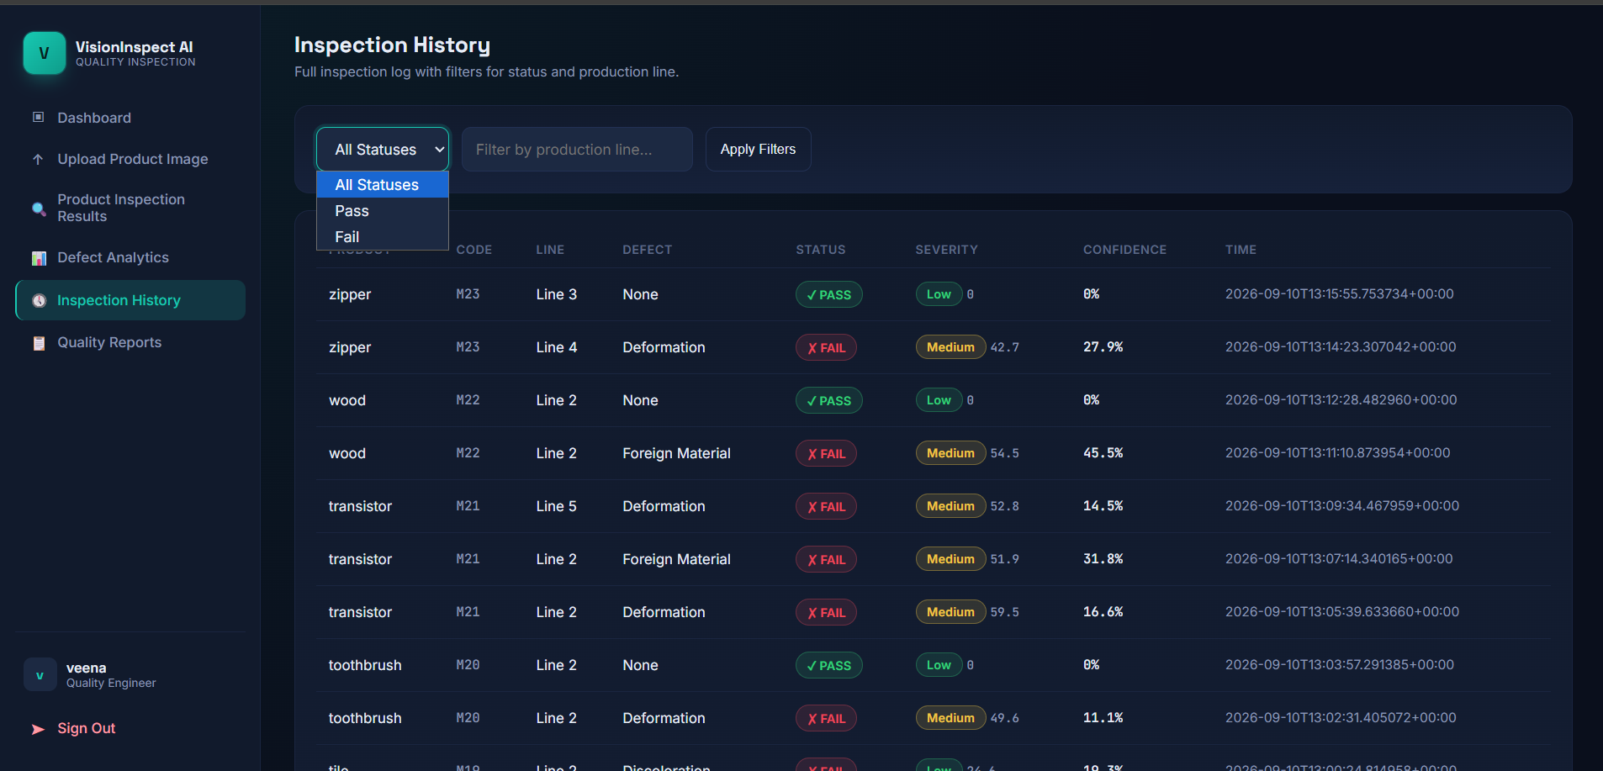
TESTING & VALIDATION
Trained Across Good & Defective Samples
Model trained and tested on 15+ distinct product categories
Every category validated with both PASS and FAIL samples
Defect types include Deformation, Discoloration, Contamination
Also detects Surface Scratch, Cut, and Foreign Material defects
Each result logged with a severity level: Low, Medium, or High
Confidence score captured per inspection for full traceability
2

Slide 3
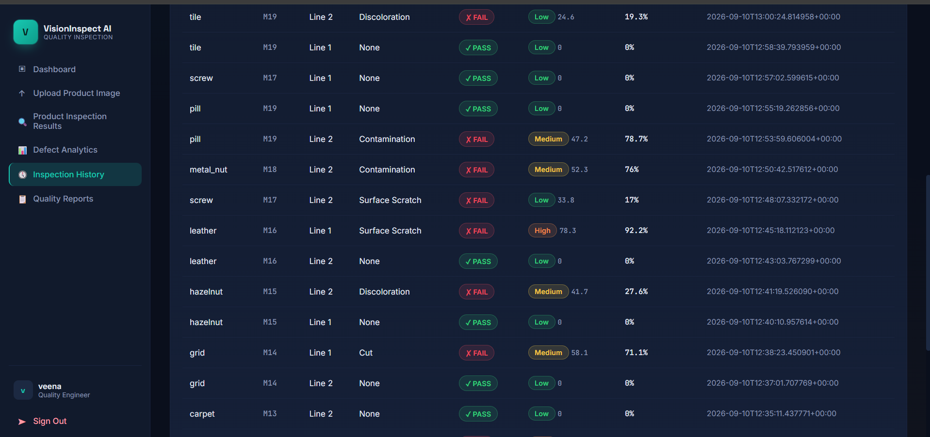
TESTING & VALIDATION
Full Inspection Log — Continued
Full audit trail stored in PostgreSQL for every inspection
Severity levels range from Low to High by defect impact
Confidence scores span 11%–92%, reflecting real variance
Multiple production lines tracked per product code
Every record timestamped to the millisecond for traceability
Log supports both Quality Engineer and Supervisor views
3

Slide 4
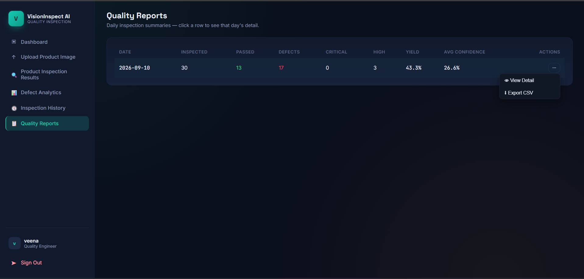
REPORTING
Daily Quality Reports with One-Click Export
Daily summary rolls up every inspection automatically
Tracks total inspected, passed, and defect counts per day
Breaks down defects by Critical and High severity levels
Calculates yield percentage and average AI confidence
Row dropdown offers View Detail or Export CSV instantly
Click any date to drill into that day's full inspection list
5

Slide 5
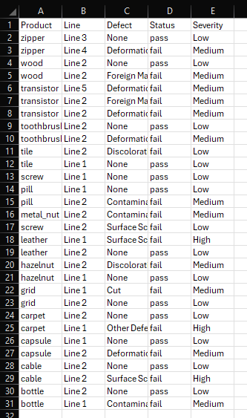
REPORTING
Exported CSV — Ready for Offline Analysis
One click from the Reports page dropdown menu
Includes every inspection row for the selected day
Captures Product, Line, Defect, Status, and Severity
Opens directly in Excel, Google Sheets, or any tool
Enables offline analysis without needing app access
Makes sharing with stakeholders and auditors simple
6

Slide 6
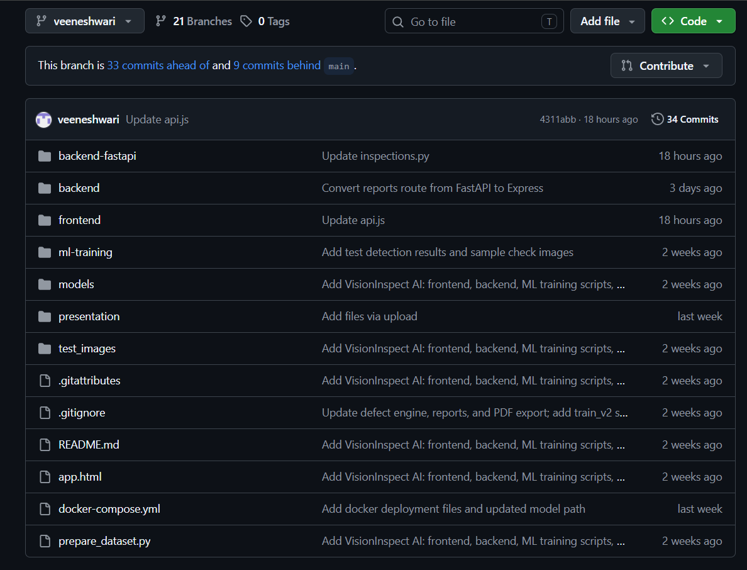
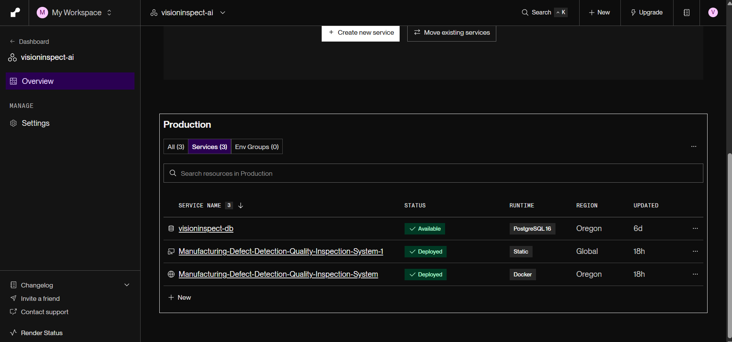
DEPLOYMENT & VERSION CONTROL
GITHUB REPOSITORY
From VS Code to Production
Source code developed and version-controlled
in VS Code
Pushed to GitHub across 30+ commits on the
working branch
Backend containerized using a custom Dockerfile
Frontend deployed separately as a Render static
site
LIVE DEPLOYMENT (DOCKER + RENDER)
Backend deployed as a Render Docker web service
PostgreSQL database hosted and connected via
Render
7

Slide 8
Thank You
VisionInspect AI — Quality Inspection System
Veena · Quality Engineer

