Slide 1
V
VisionInspect AI
Manufacturing Defect Detection & Quality Inspection Platform
MILESTONE 1
VEENESHWARI R S.D.N.B.V.C
Infosys Internship Project · August 2026

Slide 2
OVERVIEW
Project Objective
↓
Reduce Manual Inspection Effort
Build an AI-powered manufacturing quality inspection platform that automatically detects product defects from images, classifies defect types, and delivers real-time production analytics.
Automate visual QA with computer vision instead of manual checks
✓
Improve Product Quality
Consistent, repeatable defect detection across every unit
This platform replaces slow, error-prone manual inspection with a fast, consistent, camera-driven workflow — built for manufacturing plants, QA teams, and industrial automation providers.
⚠
Minimize Manufacturing Defects
Catch issues before they reach customers
↑
Increase Production Efficiency
Real-time analytics drive faster quality decisions
VisionInspect AI · Milestone 1
2

Slide 3
ENGINEERING
Technology Stack
▢
FRONTEND
⚙
BACKEND
◉
AI & TRAINING
● HTML5 · CSS3
● Python · FastAPI
● PyTorch · Anomalib
● Vanilla JavaScript (SPA router)
● JWT Authentication
● PatchCore anomaly detection
● Chart.js — analytics & trends
● SQLite Database
● MVTec AD benchmark dataset
● Dark, responsive UI
● RESTful API (Node/Express variant also available)
● Trained locally via VS Code
Developed and tested entirely within Visual Studio Code — separate Node/Express and FastAPI backends, interchangeable behind the same frontend.
VisionInspect AI · Milestone 1
3

Slide 4
ENGINEERING
System Architecture
Browser / Frontend
FastAPI Backend
SQLite Database
HTML · JS · Chart.js
Login, Dashboards, Upload UI
REST API
JWT Auth Middleware
Users · Products
Inspections
AI Inference Engine
PatchCore (Anomalib)
Severity Scoring Logic
Request / Response flow: Frontend calls REST endpoints → FastAPI validates JWT → reads/writes SQLite → AI engine scores uploaded images → JSON result returned to UI.
VisionInspect AI · Milestone 1
4

Slide 5
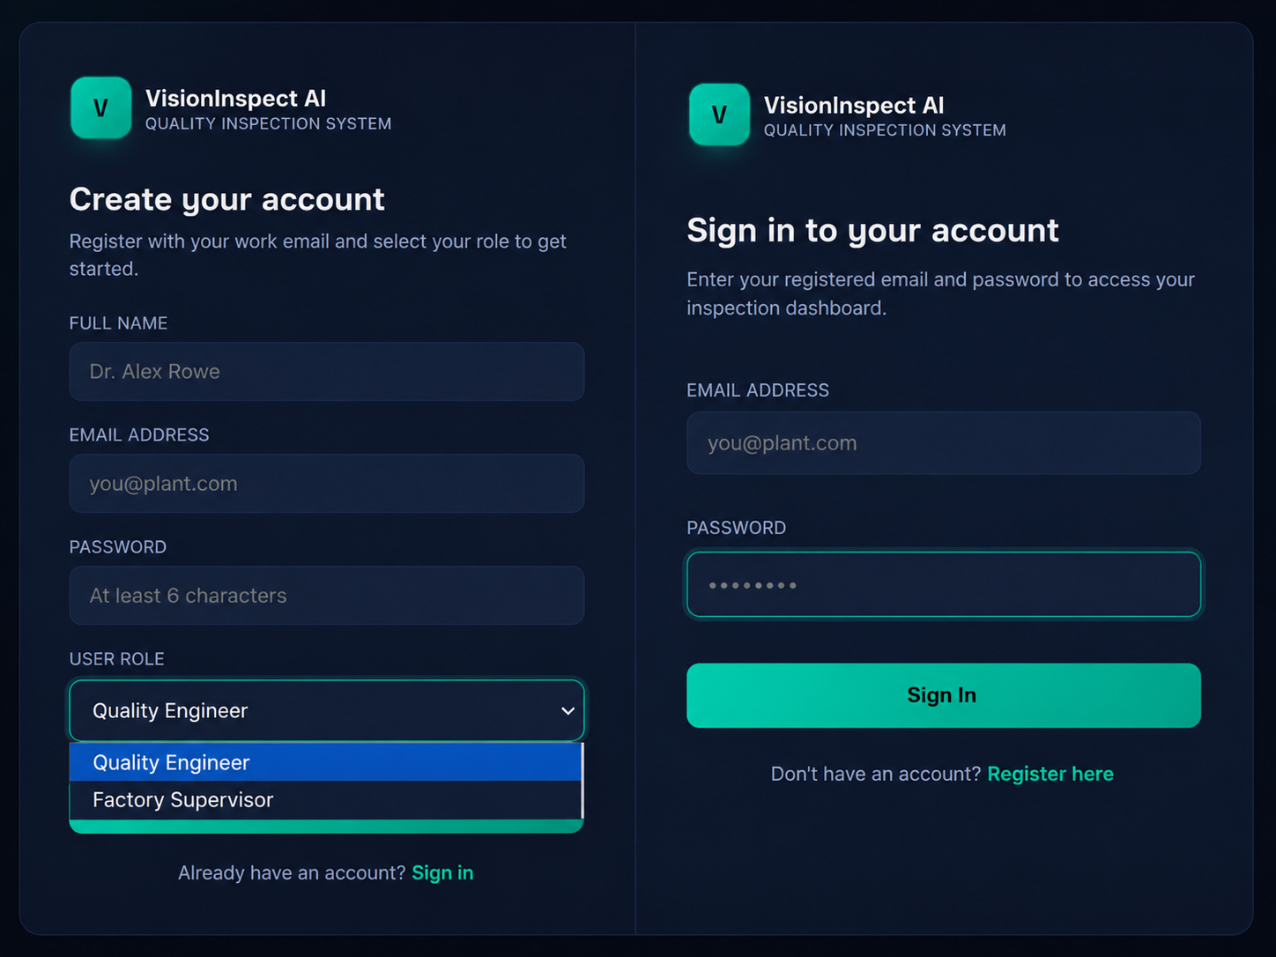
FRONTEND
Login & Registration
Secure sign-in and sign-up flow for every user
Role selection at registration — Quality Engineer or Factory Supervisor
Passwords hashed with bcrypt before they ever touch the database
VisionInspect AI · Milestone 1
5

Slide 6
BACKEND
Authentication & Security
Register / Login
JWT (JSON Web Tokens) power stateless sessions — no server-side session storage needed
bcrypt password hashing — plaintext passwords are never stored
Role-Based Access Control distinguishes Quality Engineer vs Supervisor permissions
Every API route except register/login requires a valid Bearer token
Tokens expire after 8 hours by default, configurable via environment variable
JWT Token Issued
Bearer Header on Requests
Protected Route Access
VisionInspect AI · Milestone 1
6

Slide 7
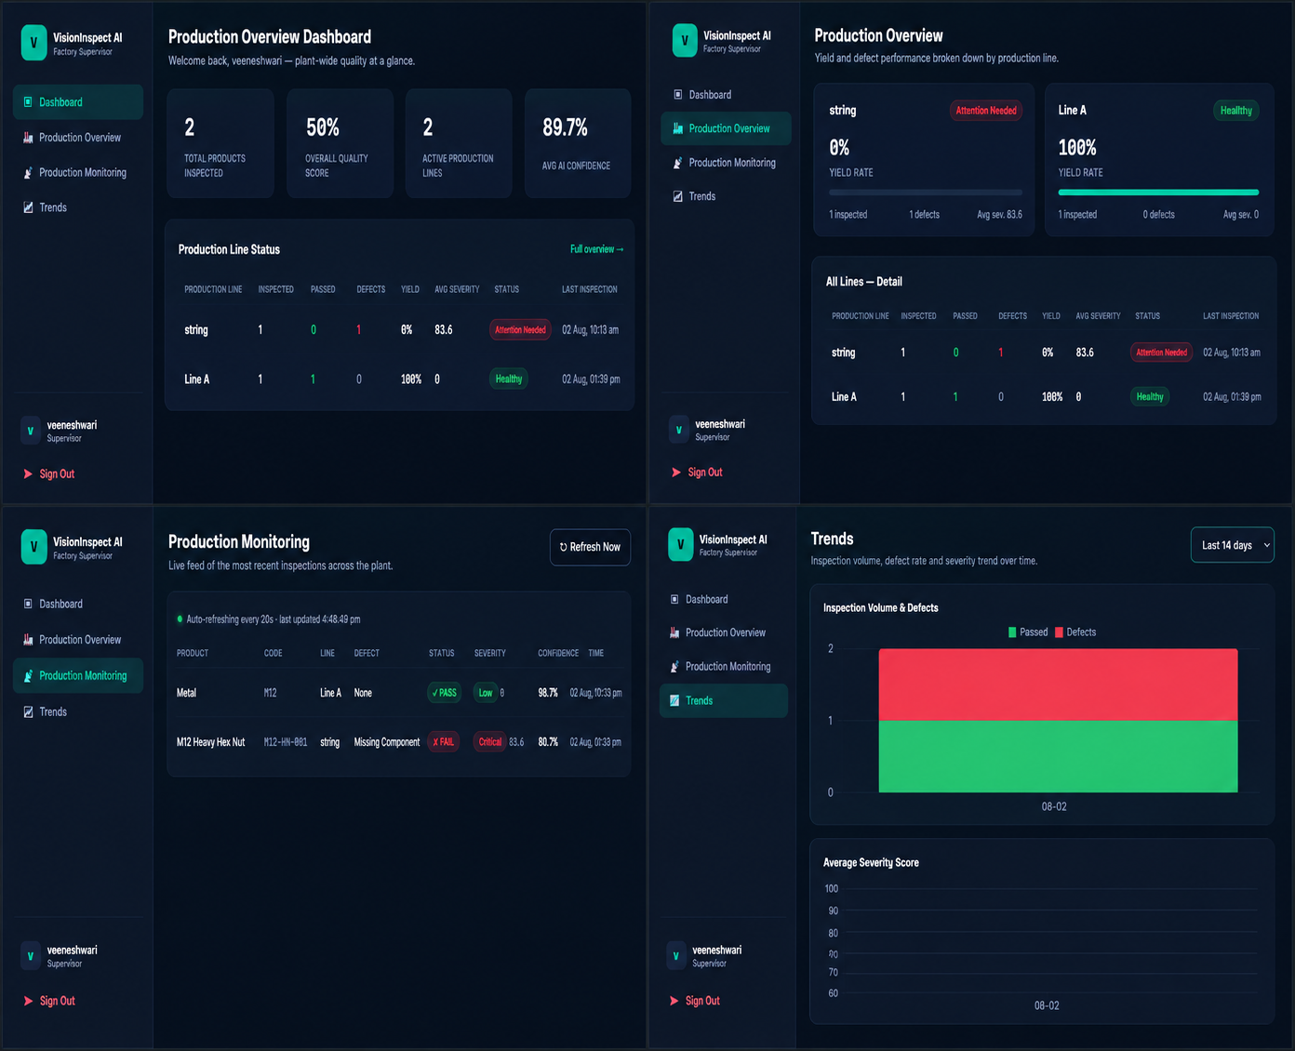
FRONTEND
Factory Supervisor — Dashboard Suite
Dashboard — plant-wide KPIs at a glance
Production Overview — per-line yield cards and detail table
Production Monitoring — live feed, auto-refreshes every 20 seconds
Trends — inspection volume, defect rate, and severity charts over time
VisionInspect AI · Milestone 1
7

Slide 8
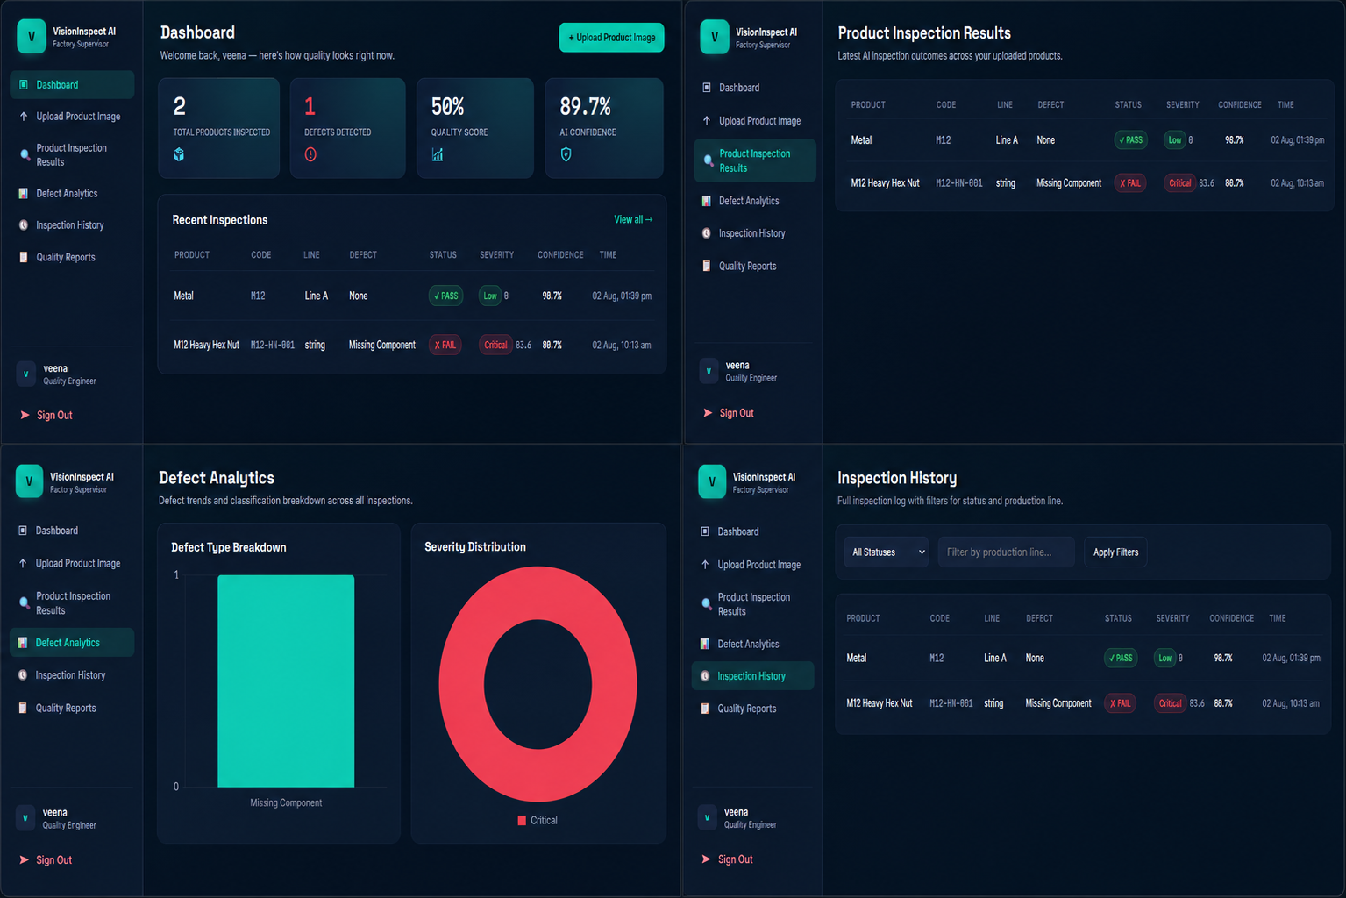
FRONTEND
Quality Engineer — Dashboard Suite
Dashboard — personal KPIs and recent inspection activity
Product Inspection Results — latest AI outcomes in one table
Defect Analytics — defect-type breakdown and severity distribution charts
Inspection History — full filterable log by status and production line
VisionInspect AI · Milestone 1
8

Slide 9
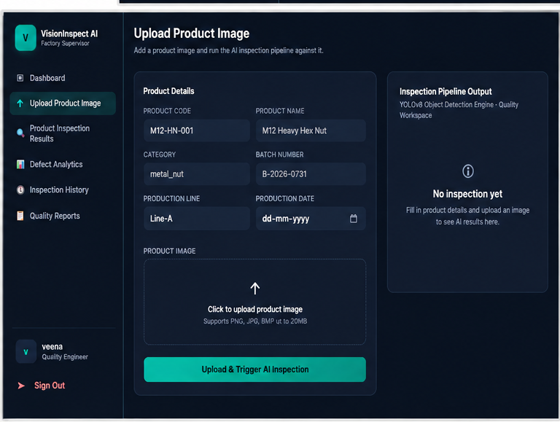
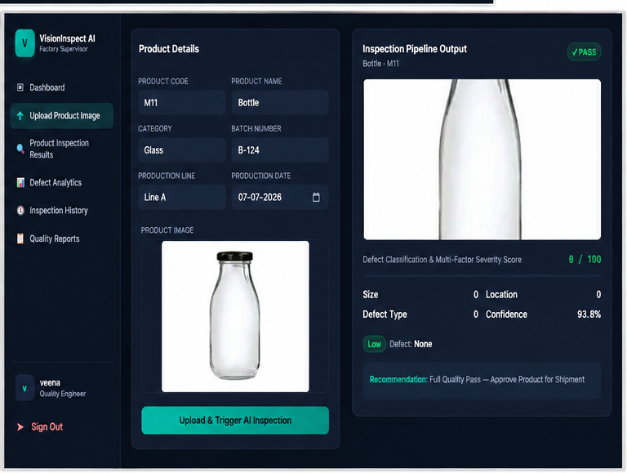
CORE WORKFLOW
Upload Image & Run AI Inspection
BEFORE
AFTER
Drag-and-drop image upload with product metadata (code, batch, production line)
One click triggers the AI inspection pipeline against the uploaded image
Result view shows bounding box overlay, multi-factor severity score, and a clear recommendation
VisionInspect AI · Milestone 1
9

Slide 10
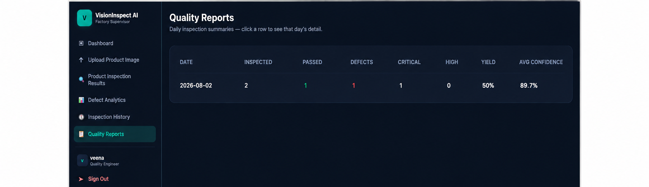
FRONTEND
Quality Reports
Daily inspection summaries — inspected, passed, defects, yield %
Critical and High severity defect counts surfaced per day
Click any row to expand that day's full inspection detail
VisionInspect AI · Milestone 1
10

Slide 11
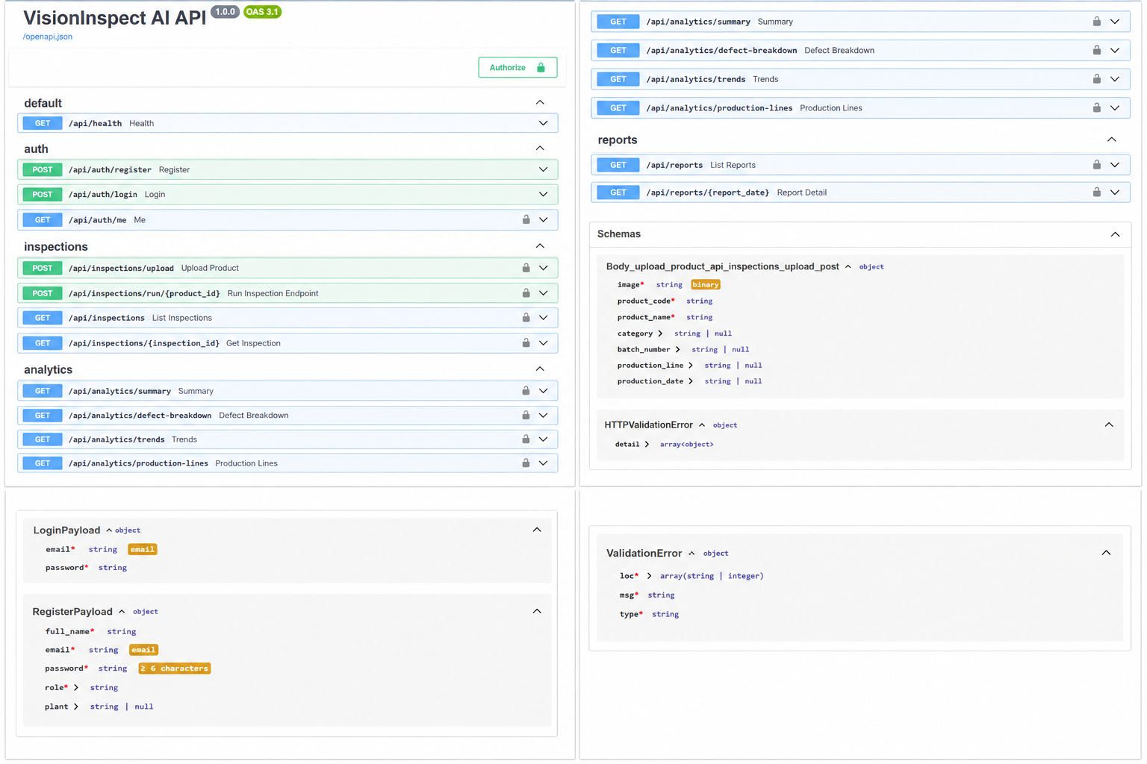
BACKEND
Backend API — FastAPI + Swagger
Auto-generated interactive API documentation at /docs
Endpoints organized by tag: auth, inspections, analytics, reports
OpenAPI 3.1 specification with built-in Pydantic request validation
VisionInspect AI · Milestone 1
11

Slide 12
MACHINE LEARNING
AI Model Training — MVTec AD Dataset
1
2
3
4
MVTec AD Dataset
Feature Extraction
PatchCore Memory Bank
Anomaly Scoring
metal_nut category
~220 defect-free training images
Pretrained WideResNet-50
backbone (via Anomalib)
Coreset subsampling of
normal feature patches
Nearest-neighbor distance
flags defective regions
Model: PatchCore, trained end-to-end using Anomalib (PyTorch) inside VS Code
Training pipeline verified locally on CPU — single-pass feature extraction, no backpropagation
Evaluated with Image AUROC and Pixel AUROC on held-out defective test images
Architecture designed to extend to additional product categories (screw, bottle, cable) for Milestone 2
VisionInspect AI · Milestone 1
12

Slide 13
AI LOGIC
Severity Scoring Framework
Severity = Size × 30% + Location × 25% + Defect Type × 25% + Confidence × 20%
Critical
80 – 100
Major structural defect — reject product, trigger workflow
High
60 – 79
Significant quality issue — repair or rework recommended
Medium
40 – 59
Moderate concern — flagged for manual inspection review
Low
0 – 39
Minor cosmetic defect — product generally acceptable
VisionInspect AI · Milestone 1
13

Slide 14
PROGRESS
Milestone 1 — Key Achievements
✓
Authentication & role-based access implemented (JWT + bcrypt)
✓
Quality Engineer & Factory Supervisor dashboards fully built
✓
Image upload + AI inspection pipeline working end-to-end
✓
Defect analytics & trend visualizations (Chart.js)
✓
Quality Reports with expandable daily summaries
✓
FastAPI backend with complete REST API + Swagger docs
✓
SQLite schema — users, products, inspections
✓
PatchCore anomaly detection model trained on MVTec AD
VisionInspect AI · Milestone 1
14

Slide 15
THANK YOU

