Slide 1





EcoPackAi
AI-Powered Sustainable Packaging Recommendation System
Internship Project Report | Infosys
Mentor Name : G Navinash
Intern Name : Jayanth G

Slide 2

Problem Statement: Packaging Sustainability Challenge
Modern businesses face increasing pressure to adopt sustainable packaging solutions while keeping costs under control. Traditional packaging selection relies heavily on manual analysis, supplier catalogs, and trial-and-error approaches
This leads to:
• Higher operational costs
• Environmentally harmful material choices
• Lack of standardized sustainability metrics
• Poor scalability for large product catalogs

Slide 3


Solution: EcopackAi
EcoPackAI is an AI-driven system that analyzes product and packaging parameters to recommend the most suitable packaging material.
The system predicts:
• Estimated packaging cost
• Sustainability score
• Optimal packaging material type
This enables organizations to make faster, data-driven, and eco-friendly packaging decisions.

Slide 4
Machine Learning model
The core intelligence of EcoPackAI is powered by supervised machine learning models.
Key steps include:
• Data preprocessing and normalization
• Feature selection based on packaging attributes
• Model training and evaluation
• Prediction of cost and sustainability score
The trained model ensures accurate, consistent, and explainable recommendations.

Slide 5



ARCHITECTURE DIAGRAM
Next Slide

Slide 6
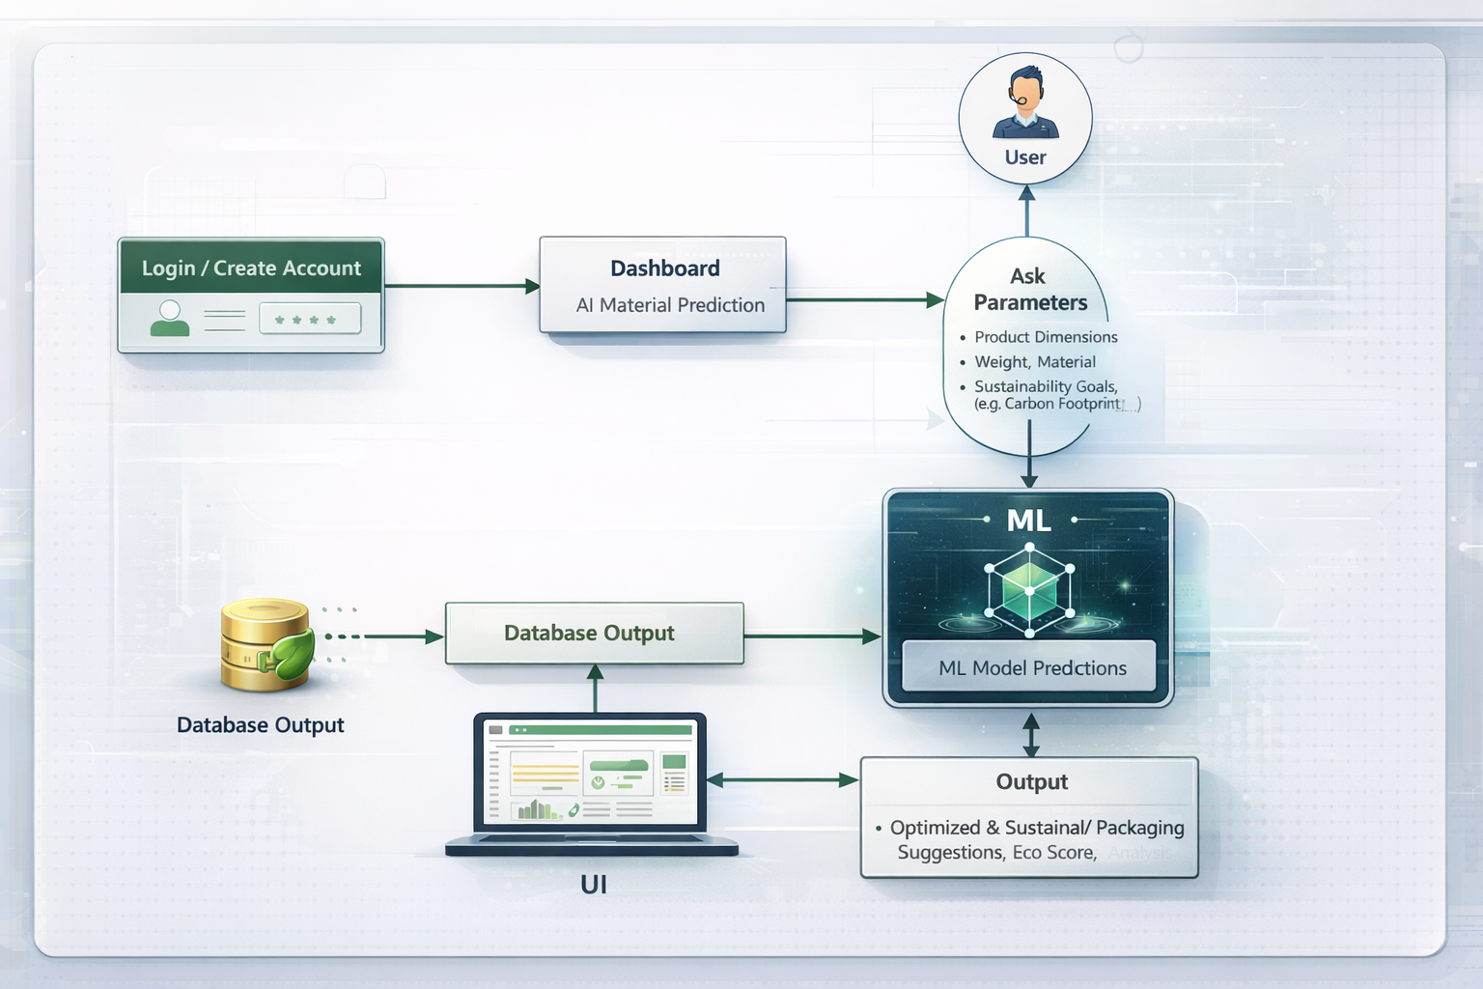

Slide 7

Tech Stack
Frontend:
• HTML, CSS, Bootstrap
• Flask templates for dynamic UI
Backend:
• Python (Flask framework)
• Machine Learning models (Random Forest / XGBoost)
Database:
• SQLite for user and prediction data
Deployment:
• Cloud-ready architecture (GCP / AWS compatible)

Slide 8

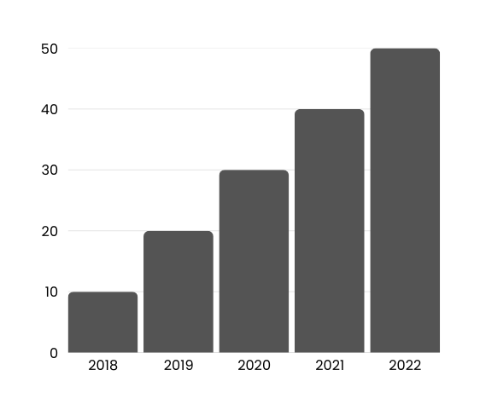

Impact & Analysis
Operational Efficiency:
• Reduces manual packaging analysis time significantly
Cost Optimization:
• Helps businesses minimize packaging expenses
Sustainability Impact:
• Encourages use of eco-friendly materials
• Supports ESG and sustainability goals
Scalability:
• Suitable for startups to large enterprises

Slide 9
Future Scope & Enhancements
EcoPackAI can be extended with advanced capabilities such as:
• Carbon footprint estimation for packaging materials
• Supplier and vendor integration
• Real-time pricing and availability updates
• Advanced dashboards and analytics
• Integration with e-commerce and ERP systems
These enhancements can transform EcoPackAI into a full-scale sustainable packaging platform.

Slide 10

Conclusion
EcoPackAI demonstrates how Artificial Intelligence can be leveraged to solve real-world sustainability challenges.
By combining machine learning with cost and sustainability analysis, the system empowers organizations to make smarter packaging decisions.
EcoPackAI contributes towards greener supply chains, reduced environmental impact, and improved operational efficiency.

Slide 11

Thank You
"Sustainability is no longer a choice, it is a responsibility."

