Slide 1

Submitted by : Thrinayani Reddy
Submitted to : G. Navinash sir

Slide 2
PCB ERROR DETECTION
Problem statement
The objective is to develop an automated defect detection and classification system for Printed
Circuit Boards (PCBs) using image processing and deep learning techniques. The system will
employ reference-based image subtraction, contour extraction, and CNN-based classification to
identify and label defects. A fully functional frontend web application will be developed to allow
users to upload PCB images and receive labeled outputs highlighting defects.

Slide 3
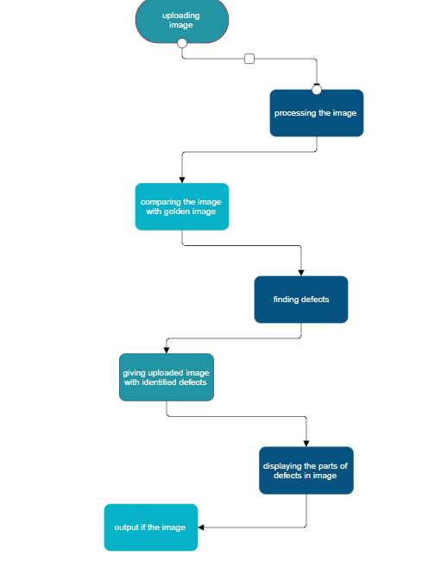
Working process

Slide 4
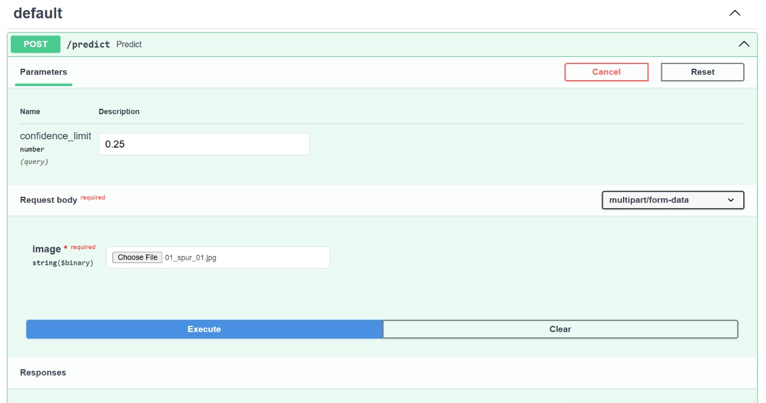
Interface image:
Above image is the interface of the uploading image. Here the golden image is already inbuilt and you just need to upload only the image of pcb which we have to find the defects and we have to give the confidence limit. Here the confidence limit refers to the minimum amount of accuracy we need in the output image.

Slide 5
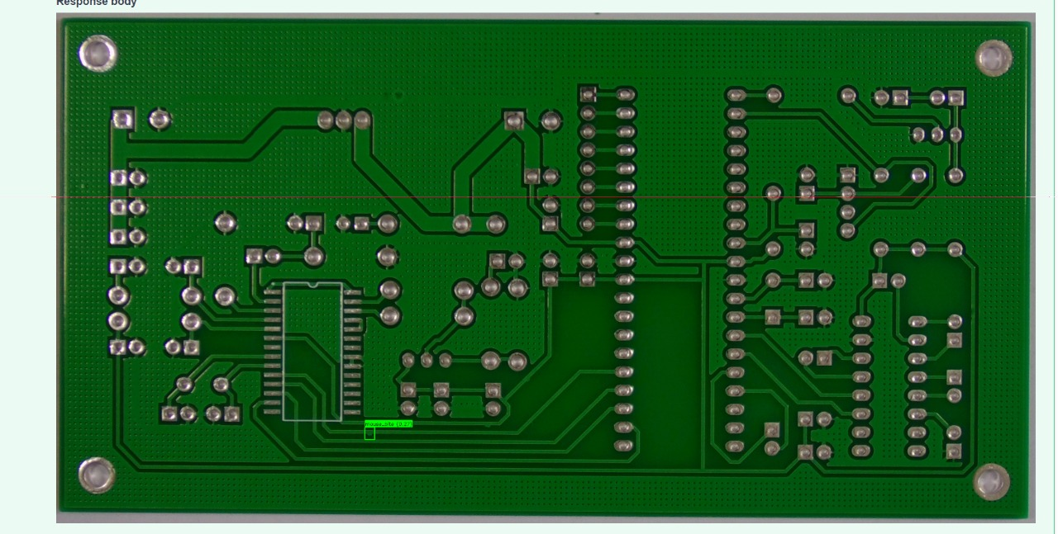
Image of defects :
This is the image after finding the defects in the image and it will highlight the part where the defects are arrived.

Slide 6
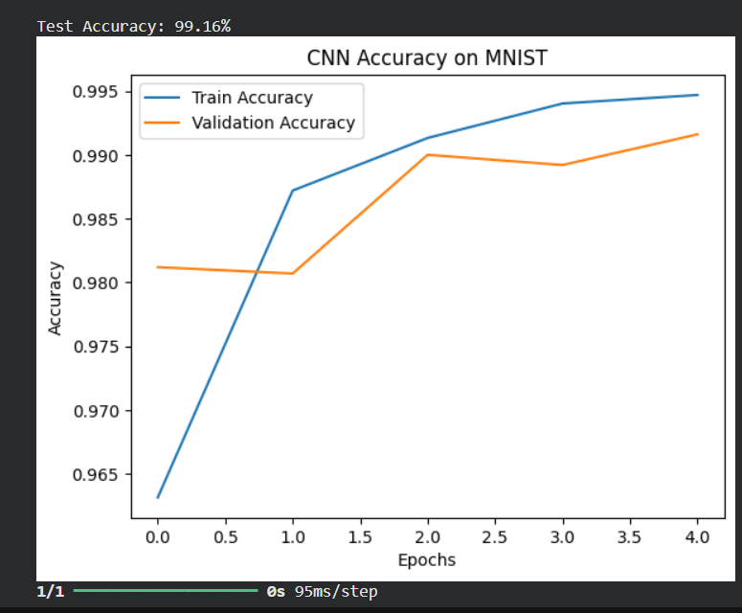
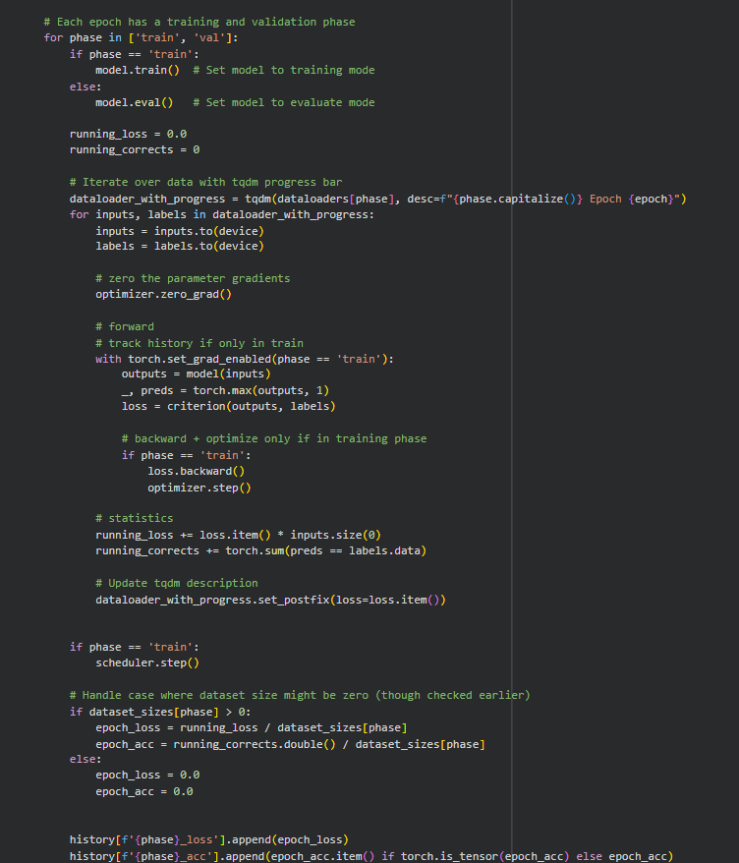
Accuracy graph :
Code for training part :
The accuracy we got is 99.16%.

Slide 7
Objectives :
To analyze PDB structures and identify common structural errors.
To detect missing residues and incomplete chain segments.
To evaluate steric clashes and geometric inconsistencies.
To document findings for improving downstream structure-related analyses
Methodology:
Get the data
Translate the data
Finding the flaws
Making the report
Result and findings :
Multiple structures contained missing loop regions and unresolved side chains.
Some proteins exhibited chain discontinuities likely caused by weak electron density.
Steric clashes were observed at crowded residue interfaces, indicating potential refinement issues.
Bond angle deviations were minimal but present in flexible regions.

Slide 8
Conclusion :
PDB error detection is essential for ensuring the accuracy and usability of protein structural data. The analysis performed in this project highlights the prevalence of missing residues, steric clashes, and chain discontinuities in protein structures. By identifying these issues early, researchers can refine models or select higher-quality alternatives, improving the reliability of downstream structural and computational analyses.

